Slide 1
TaskFlow: Employee Task Management System
T
TaskFlow
Work Better. Achieve More.
CODESPARK Hackathon 2026 | Team ID: 15
Kasireddy Srihitha
Cheeti Srihitha
Boddu Pemesh
2520030153
2520030400
2520030388
KLH Deemed to be University
Notes:
Team ID 15: Kasireddy Srihitha (2520030153), Cheeti Srihitha (2520030400), Boddu Pemesh (2520030388). KLH Deemed to be University.

Slide 2





Introduction
Centralized Task Management
Separate Leader and Employee Workspaces
What is TaskFlow?
TaskFlow is a web-based employee task management application.
Team leaders assign work, and employees track their responsibilities.
Task Progress Visibility
Simplified Work Coordination

Slide 3





Problem Statement
Unclear task ownership
No clear record of who is responsible
Difficulty tracking task progress
THE NEED
Status updates are scattered or missing
A centralized and easy-to-use task management solution
Poor visibility of deadlines and priorities
Important work is easy to overlook
Time-consuming task monitoring
Manual follow-ups take time away from work

Slide 4




Objectives
01
02
03
04
05
Simplify task assignment
Separate leader and employee workflows
Track task status
Manage task priorities and due dates
Improve task visibility and coordination

Slide 5


Proposed System
Frontend prototype
IMPLEMENTED
Full system
PROPOSED
Planned, not yet built
User registration and login interface
Shared database storage
Role-based workspaces
Secure authentication and authorization
Task creation and assignment by team leaders
Task status updates by employees
Deadline and update notifications
Dashboard with task counts
Team reports and analytics
Search and status-based filtering

Slide 6





Key Features
Role-Based Workspaces
Task Assignment
Priority Management
Task Status Tracking
Team Leader and Employee views
Leaders assign to employees
Low, Medium, High
To Do, In Progress, Completed
Search and Status Filters
Task Dashboard
Edit and Delete Tasks
Due-Date Management
Find tasks quickly
Total, To Do, In Progress, Completed
Available to Team Leaders
Set and view task due dates

Slide 7
System Workflow
1
2
3
4
User Registration / Login
Select User Role
Team Leader Creates and Assigns Task
Employee Views Assigned Task
7
6
5
Dashboard Reflects Updated Status
Employee Marks Task Completed
Employee Starts Task
Team leaders create and assign tasks. Employees move each task from To Do to In Progress to Completed, and the dashboard counts update automatically.

Slide 8
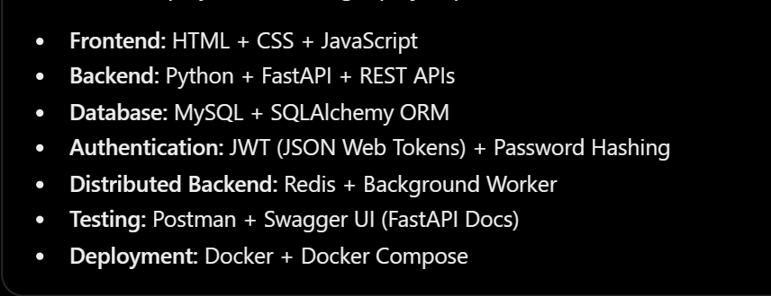
Common Tech Stack
This image shows the common stack prescribed for the hackathon. React.js, Spring Boot, REST APIs, MySQL, JPA/Hibernate, Postman and Python.

Slide 9
Expected Outcomes and Future Scope
Expected Outcomes
Future Scope
PLANNED, NOT COMPLETED
Easier task assignment and monitoring
Responsive mobile improvements
Secure authentication and authorization
Clear task ownership
Notifications for deadlines and task updates
Better visibility of task priorities and status
Reports and team performance analytics
Simplified task progress tracking

Slide 10
Conclusion
TaskFlow provides a simple interface for employee task management.
It supports task assignment, priority management, search, and progress tracking.
Its role-based design supports team leaders and employees.
Future improvements can add shared database storage, secure authentication, and notifications.
Thank You!

