Slide 1
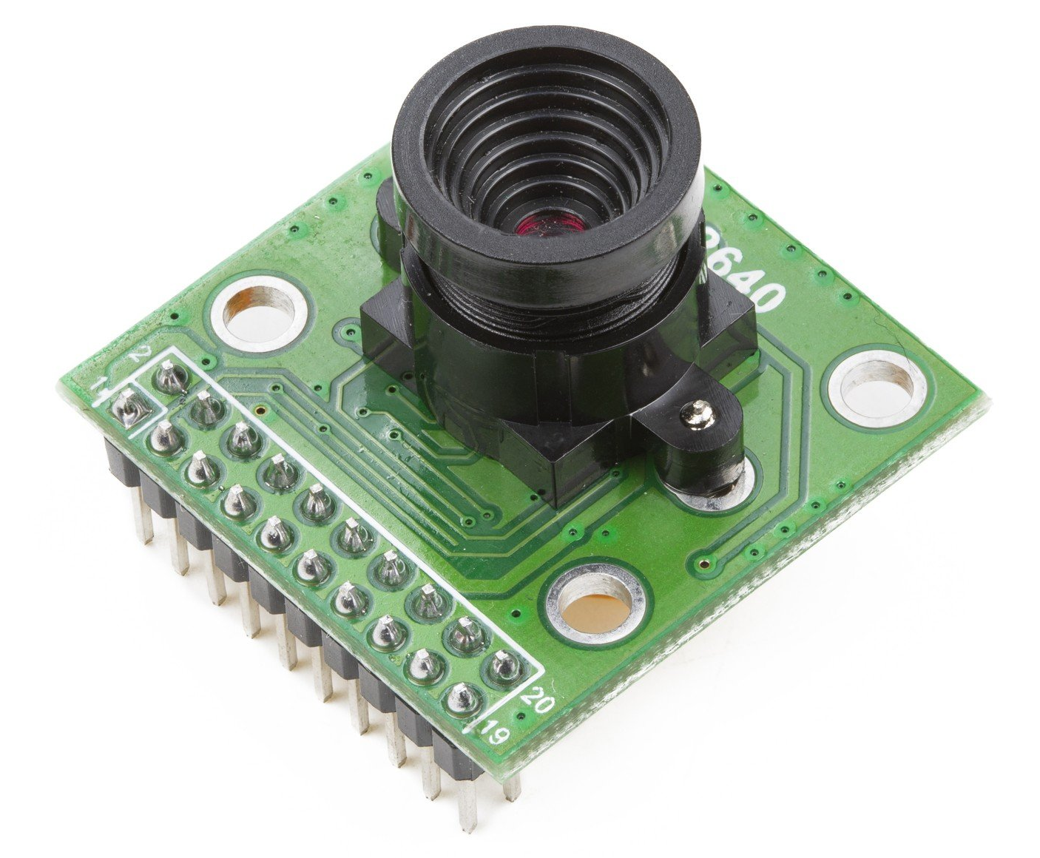
OV2640
CMOS OV2640 Cameral Module 2-Megapixel
Max image sizes and transfer rates:
UXGA/SXGA @ 15 fps
SVGA @ 20 fps
CIF @ 60 fps
Controlled through SCCB interface
Output formats:
RGB (RBG565/555)
GRB422
YUV (422/420)
YCbCr(4:2:2)
https://www.arducam.com/product/2mp-ov2640-camera-module/

Slide 2
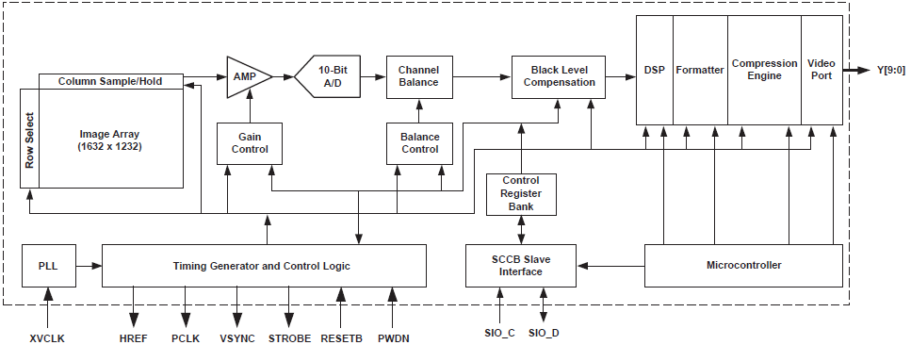
Functional Block Diagram
https://www.arducam.com/docs/camera-breakout-board/2mp-ov2640/

Slide 3
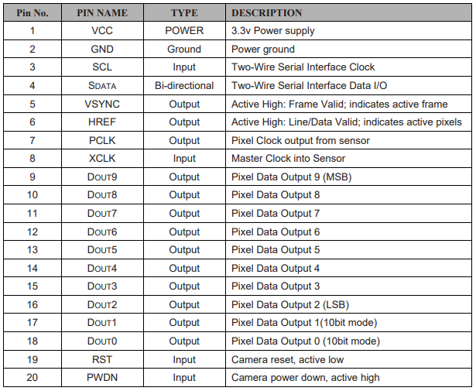
Pin Description
2
4
6
8
10
12
14
16
18
20
1
3
5
7
9
11
13
15
17
19
https://www.uctronics.com/download/cam_module/U3359-1Inch4_2_Megapixel_OV2640_CMOS_Camera_Module_REVA_DS.pdf

Slide 4
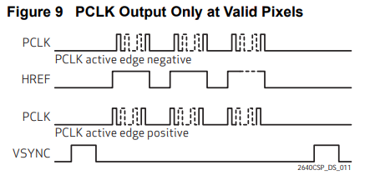
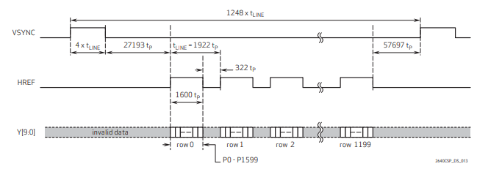
Pixel Timing
Table 1 Frame/Pixel Rates in UXGA Mode
Frame Rate (fps) | 15 | 7.5 | 2.5 | 1.25
PCLK (MHz) | 36 | 18 | 6 | 3
Figure 13 UXGA Frame Timing
https://www.uctronics.com/download/OV2640_DS.pdf

Slide 5
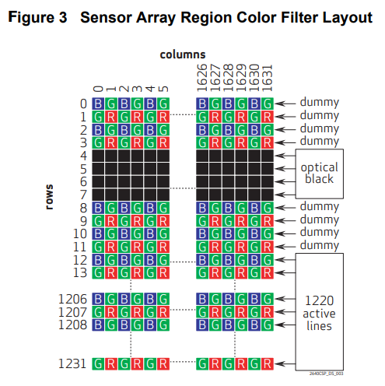
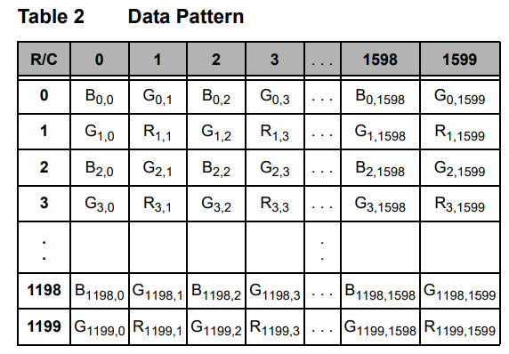
Pixel Output Pattern
Data output sequence following first HREF and after VSYNC
https://www.uctronics.com/download/OV2640_DS.pdf

