Slide 1
CoreI2C

Slide 2
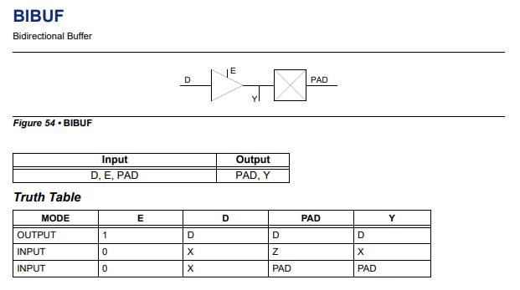
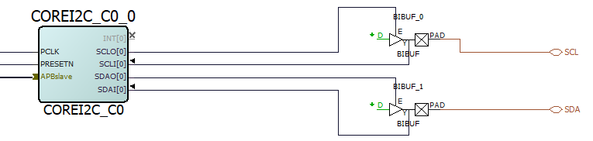
Connecting CoreI2C

Slide 3
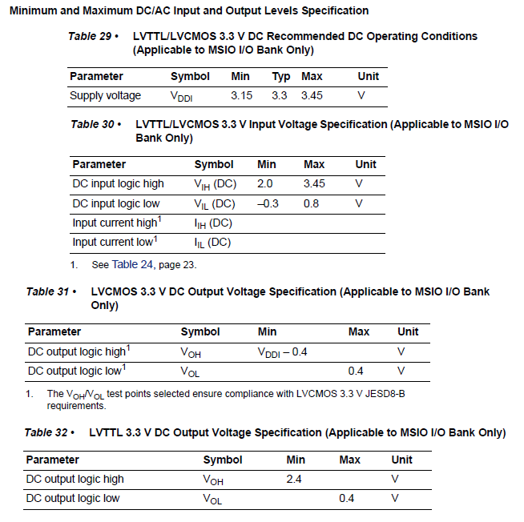
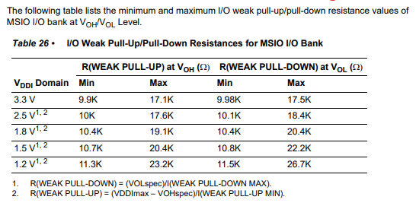
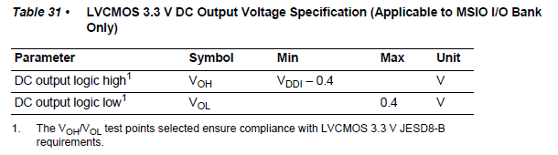

Pull-Up Resistor
OR Strong Pull-up Resistor
$$\frac{V_{DD}−V_{OH}}{3 mA}$$

