Slide 1

RISC-V FPGA for Computer Vision Applications
Tutorial 5: IO Testing
EE 297A/B
Wednesday, February 17, 2021
Project Members:
Anee Mineshkumar Dubhia^{[1]}
Chee Vang^{[2]}
Advisor:
Professor Harry Li, Ph. D.^{[3]}

Slide 2
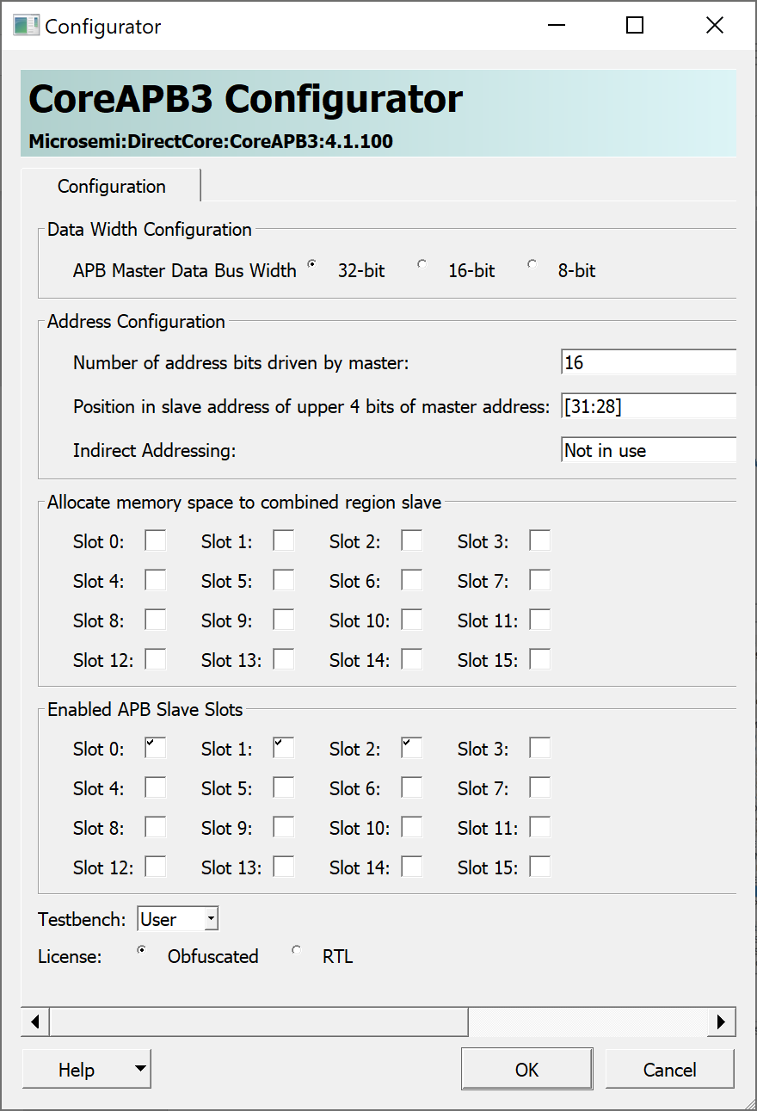
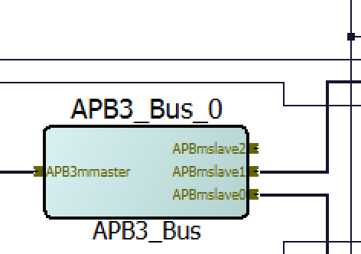
Step 1: Enable additional APB Slaves
Double click on APB3_Bus_0 Module in SmartDesign
Check Slot 2 to increase number of APB slaves
Click OK
Right-click APB3_Bus_0 and choose Update Component
There is now 3 APB slaves.
2
Fig. 3. Modified APB3_BUS_0
Why? Because some IP cores are interfaced through APB in Libero SoC IDE
3
Fig. 2. APB3_BUS_0 configuration to enable a new slave device

Slide 3
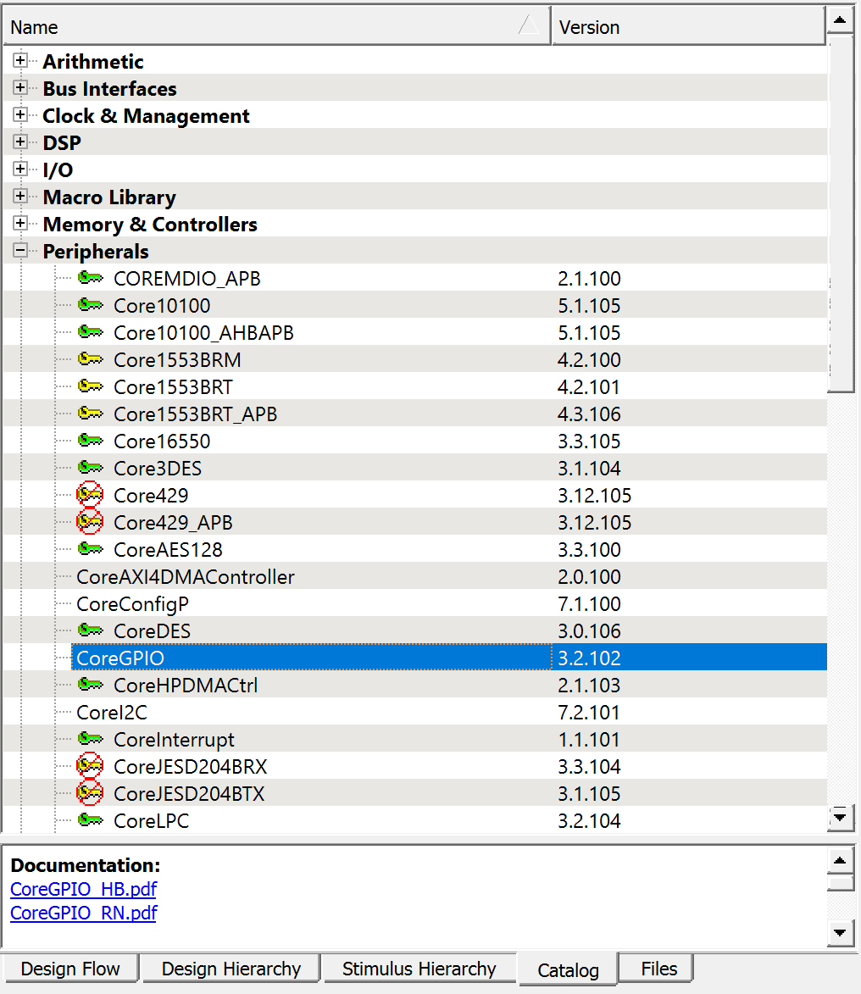
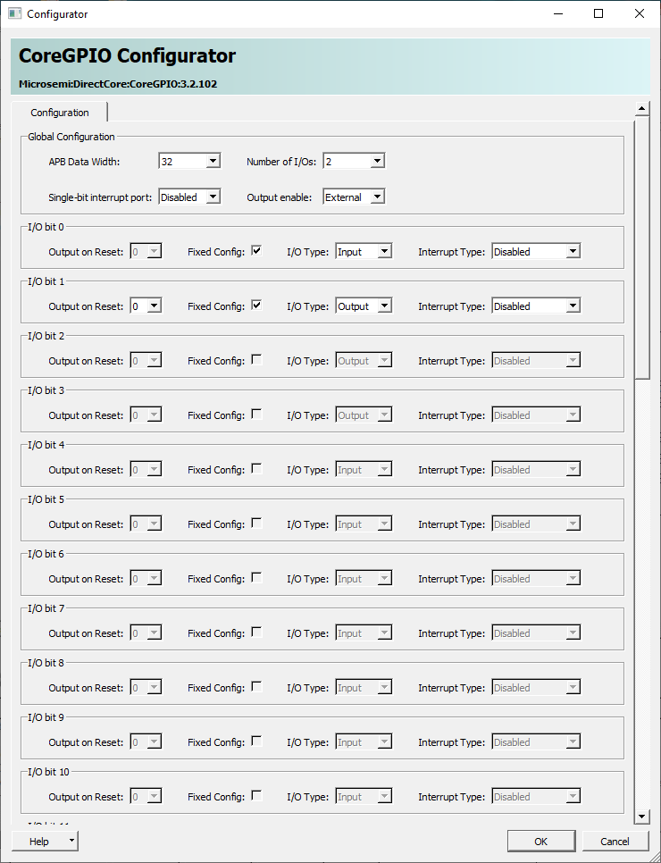
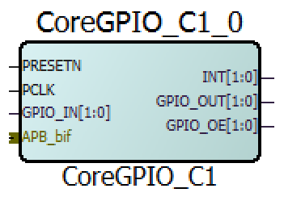
Step 2: Add and Configure CoreGPIO
To add a GPIO core, go to Catalog > Peripherals > CoreGPIO
Give it a name or leave as default
In CoreGPIO Configurator, change Number of I/Os to 2
Check the boxes Fixed Config for I/O bit 0 and bit 1
Set them as below and click OK
bit 0 – Input
bit 1 – Output
3
4
5
1
Fig. 4. CoreGPIO in Catalog
Fig. 5. CoreGPIO configured with two outputs
Fig. 6. Unconnected CoreGPIO in SmartDesign

Slide 4
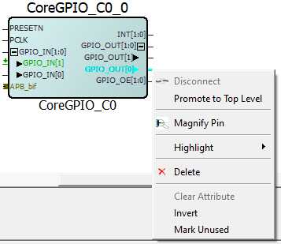
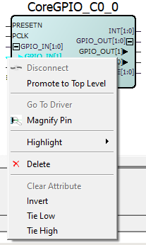
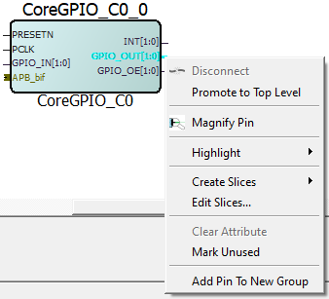
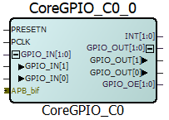
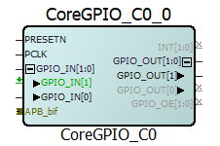
Step 3: Configure CoreGPIO Pins
In the SmartDesign, right-click on the pin of GPIO_OUT and GPIO_IN
Select Create Slices >> 2 slices of width 1 to reveal individual pins
Since bit 0 is an input and bit 1 is an output
Select Tie Low for GPIO_IN[1]
Select Mark Unused for GPIO_OUT[0]
Right-Click INT and choose Mark Unused
Repeat step 5 to GPIO_OE
3 (b)
Fig. 9. GPIO_IN[1] mark unused
2
3 (a)
Fig. 10. Completed configuration for CoreGPIO
Fig. 7. Edit GPIO_OUT to reveal individual pins for outputs
Fig. 8. Tie low GPIO_IN[1]

Slide 5
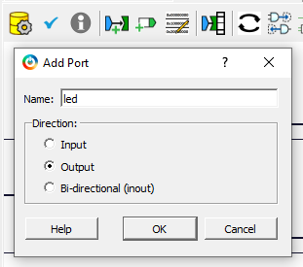
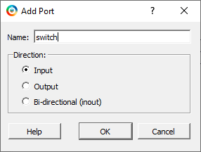


Step 3: Add 2 Output Ports
Click on Add Port button
Name the port
Set Direction as Output
Click OK
Repeat steps 1-4 but set it as an input port
1
2
5
3
4
Fig. 14. Output port named “led” and input port named “switch”
Fig. 13. Adding a new output port for the LED and input port for the switch
They are located on the top right/left corner of the design and can be moved.

Slide 6
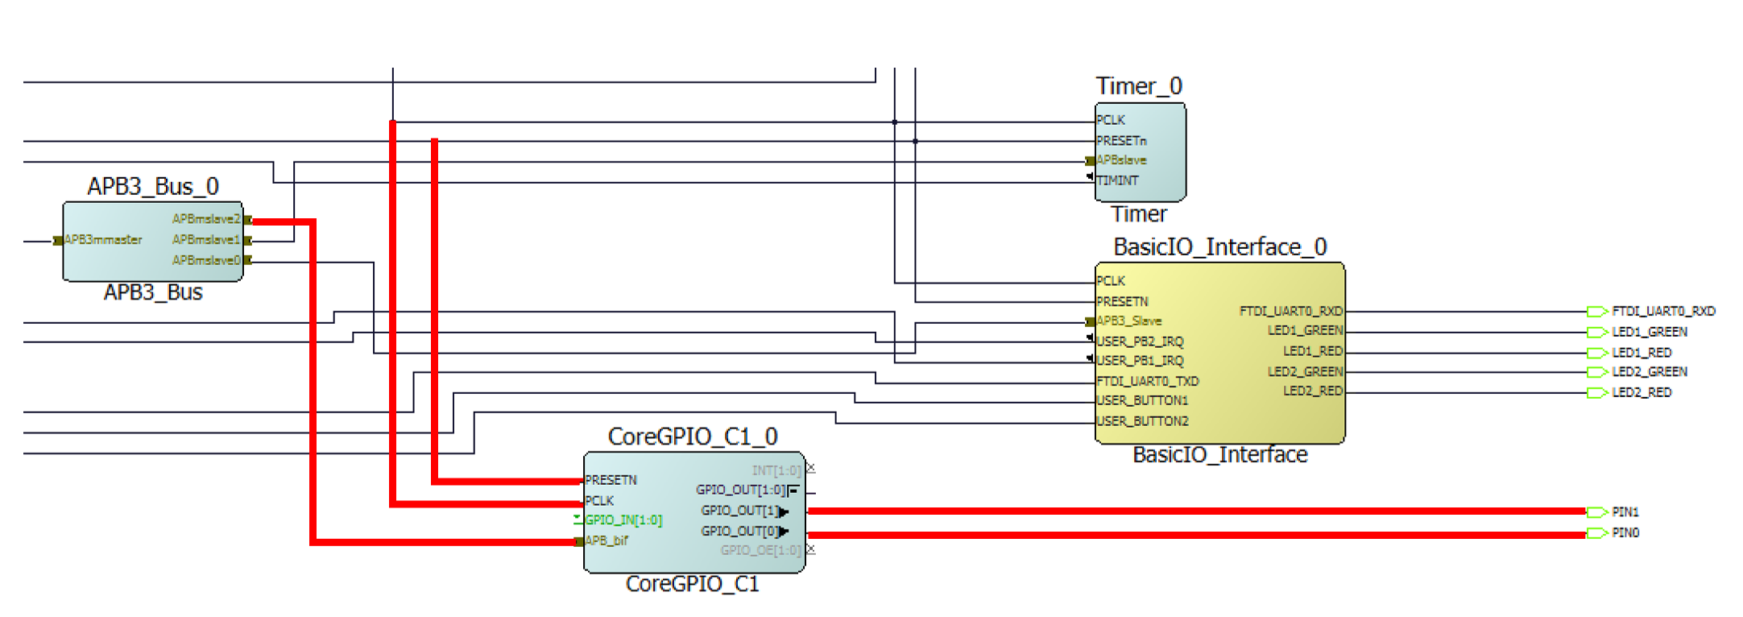
Step 4: Make Connections
Make the connections as shown using Connection Mode button (drag and drop to make connections)
Fig. 16. Connection mode button on toolbar
Fig. 15. New connections highlighted in red that connects APB3_BUS_0 to CoreGPIO and output ports

Slide 7
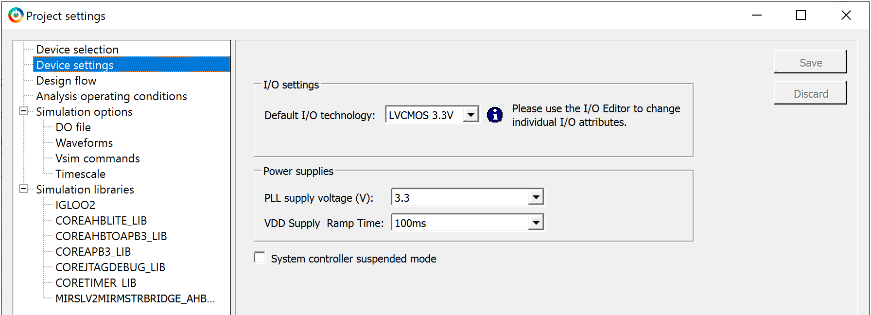
Project Settings (Optional)
3
2
Fig. 17. I/O settings in Project settings
To change the I/O settings to 3.3V, go to Project > Project Settings
In Device Settings, change Default I/O technology to LVCMOS 3.3V
Click on Save and close it
Why? This sets the I/O pins to 3.3 V which is used to drive the LED and switch. Compute the resistor value based on the voltage setting you selected.

Slide 8
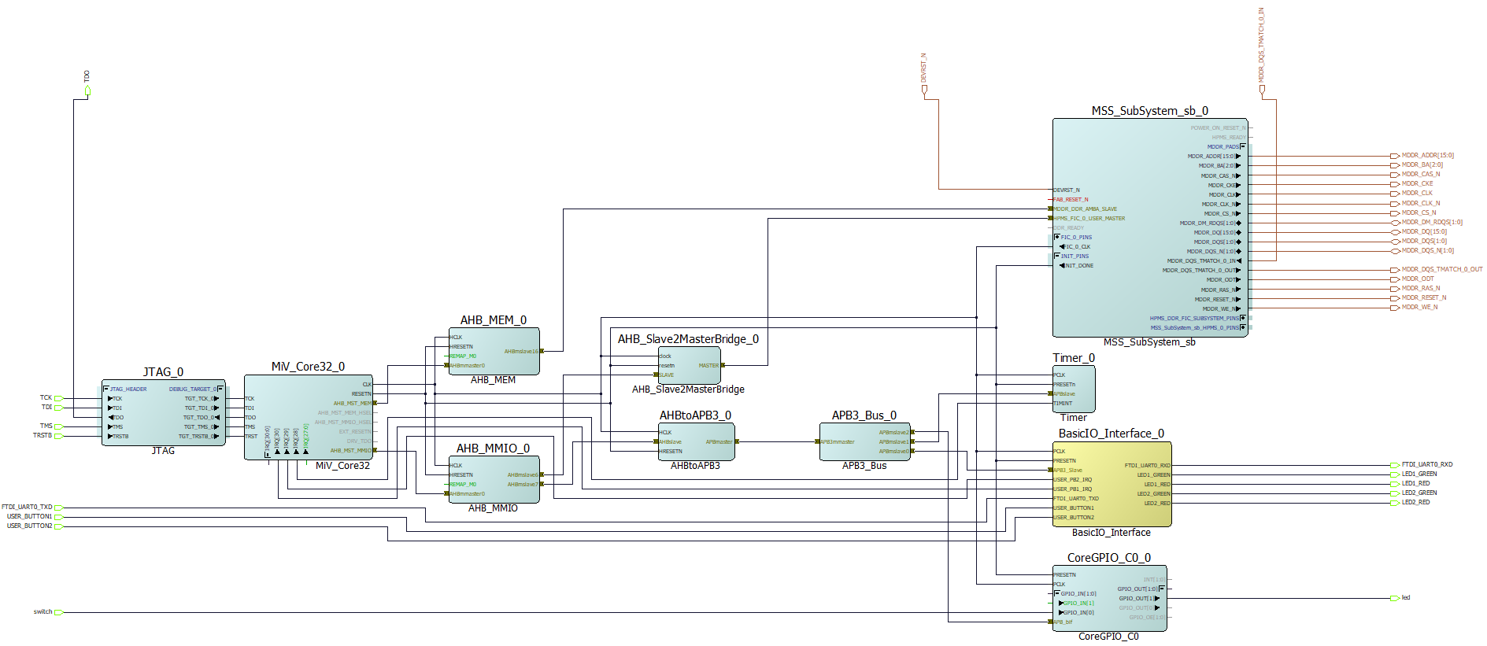
Hardware Design
Fig. 1. SmartDesign layout modified with CoreGPIO and output ports

Slide 9
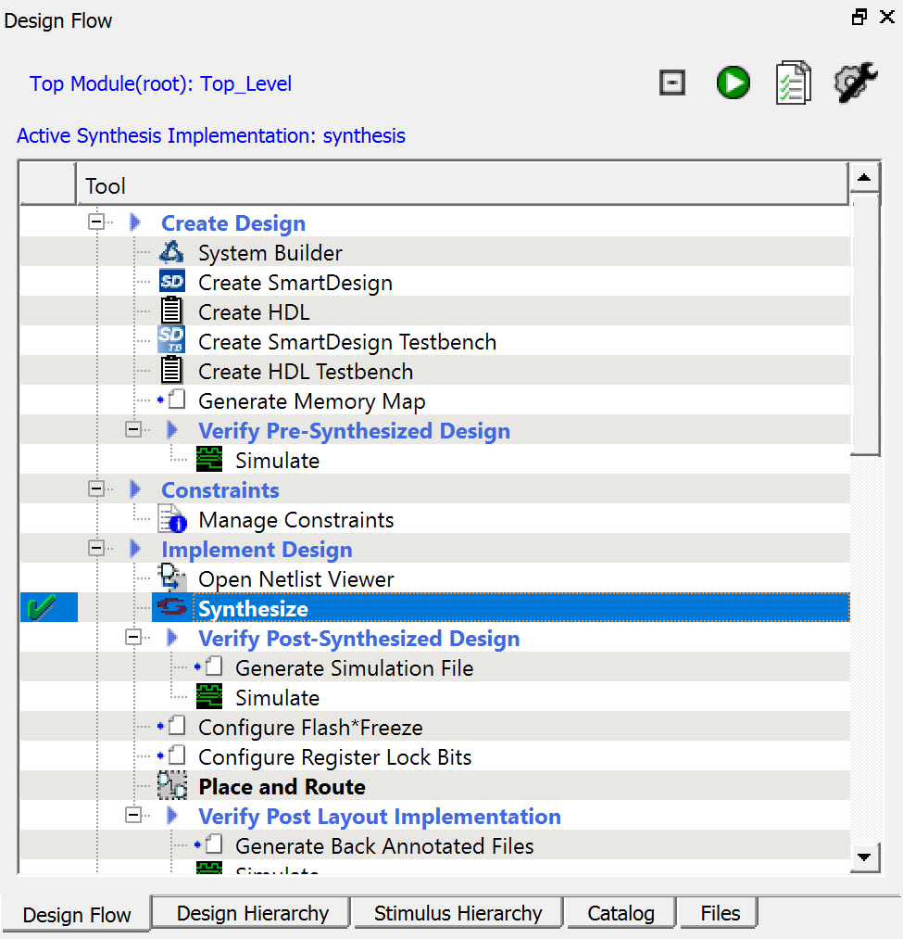
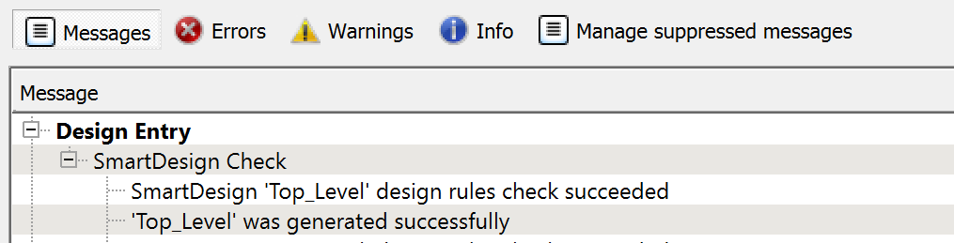
Step 5: Verify and Synthesize
2
1
Fig. 18. Design Rules Check and Generate Component buttons
Fig. 19. Error free design after Design Rules Check and Generate Component
3
In the SmartDesign, click on Design Rules Check
Then click on Generate Component
Next, in Design Flow double-click Synthesize
A green check mark will appear if there are no errors
Fig. 20. Synthesize in Design Flow

Slide 10
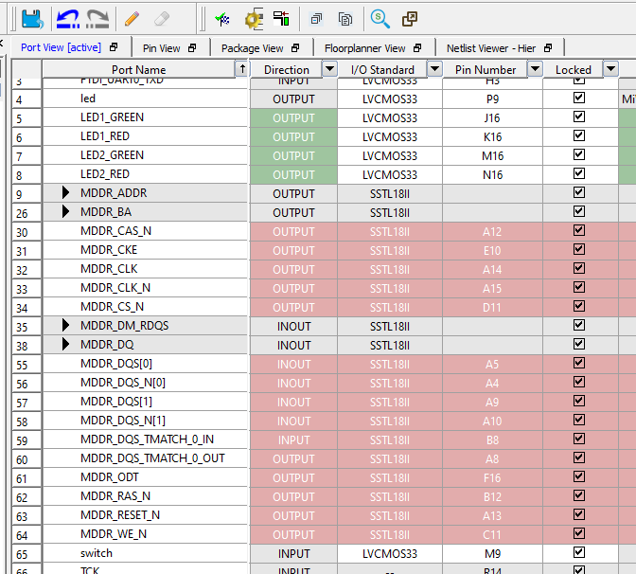
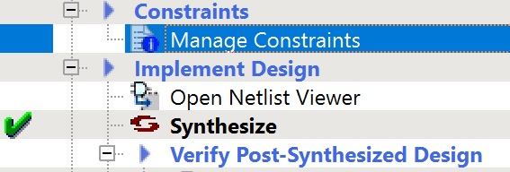
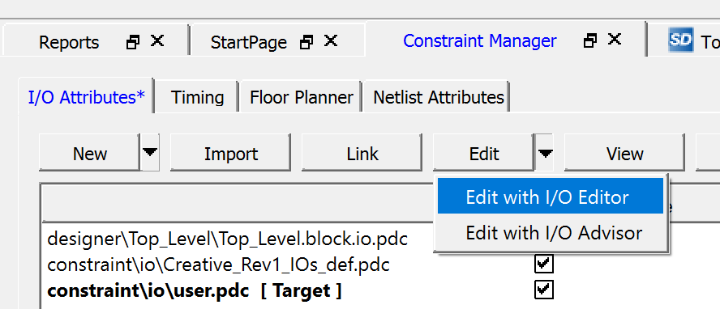
Step 6: Pin Assignments
5
4
1
Fig. 21. Manage Constraints in Design Flow
2
3
Fig. 22. Opening I/O Editor in Constraint Manager
4
Double-click on Manage Constraints in Design Flow
Click on Edit on Constraint Manager
Choose Edit with I/O Editor
Assign the pins described in Table 1 in the I/O Editor
Click on Commit and close the window
Fig. 23. List of ports in the design, including the two new output ports created
Table 1. Output ports with corresponding FPGA pin number and pin name
Port | FPGA Pin | Pin Name
led | P9 | D7
switch | M9 | D8

Slide 11
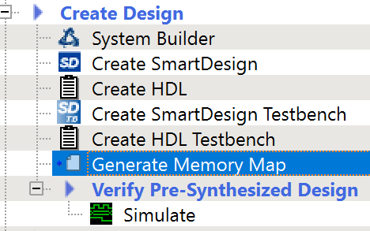
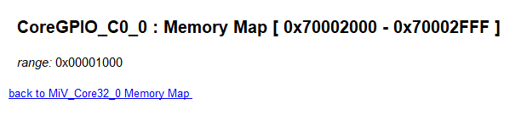
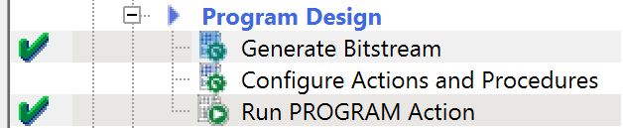
Step 7: Generate and Run the Design
Click on Generate Memory Map in Design Flow
Address of the CoreGPIO will be at the bottom of the generated datasheet
Double click Generate Bitstream
Connect to FPGA board
Double click Run PROGRAM Action
If the program is running on SoftConsole, terminate it before clicking on Run PROGRAM Action
1
Fig. 24. Generate Memory Map in Design Flow
3
5
Fig. 25. Memory address for GPIO core
Fig. 26. Generate Bistream and Run PROGRAM Action in Design Flow

Slide 12
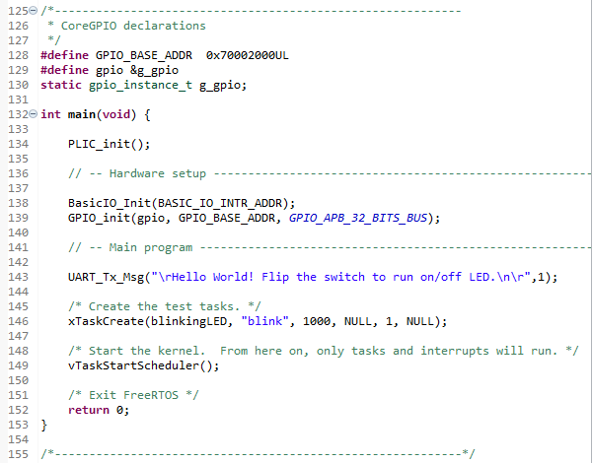
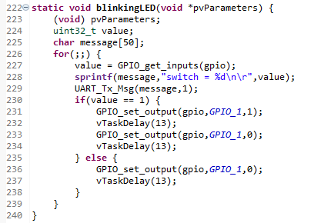
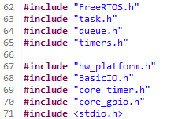
Step 8: Modify the Code on SoftConsole
Modify/Add the code in the red boxes in main

Slide 13
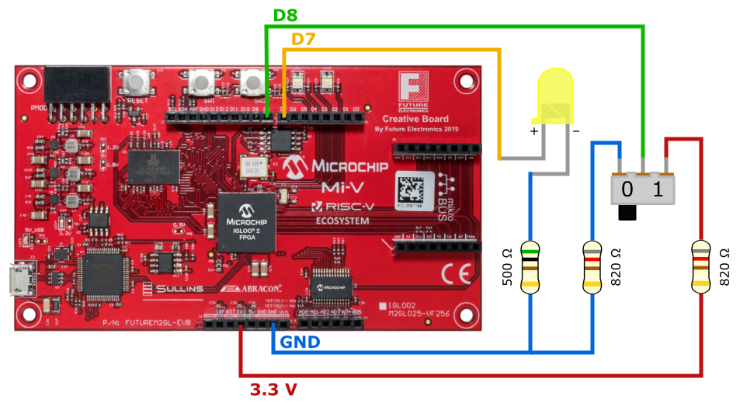
Step 10: Build and Debug the Project
2
3
Fig. 29. SoftConsole tool bar
Connect the testing circuit to the FPGA specified pins
Select the project in Project Explorer and click on Build button
If there are no errors, click on Debug button
Switch to debug perspective and Resume the program
Fig. 28. Circuit to test the two GPIO added to demo project

