Slide 1
Rooting out the Rumor Culprit in Online Social Networks
Chee Wei Tan
City University of Hong Kong
16 August, 2013
2013 Fall Workshop on Information Theory and Communications, Tainan, Taiwan

Slide 2


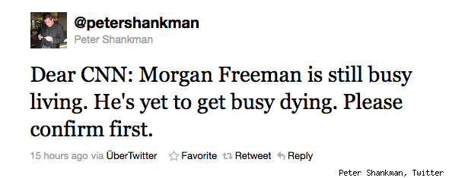
Motivation
Rumors
Source: Google

Slide 3
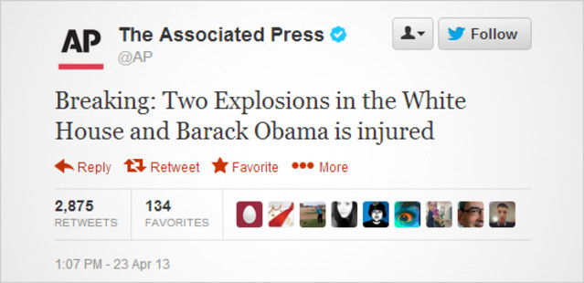
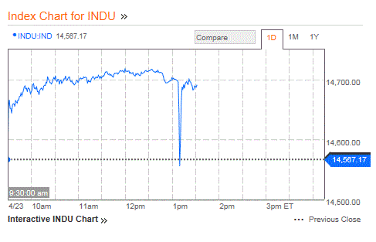
Motivation
Rumors
Source: Bloomberg

Slide 4
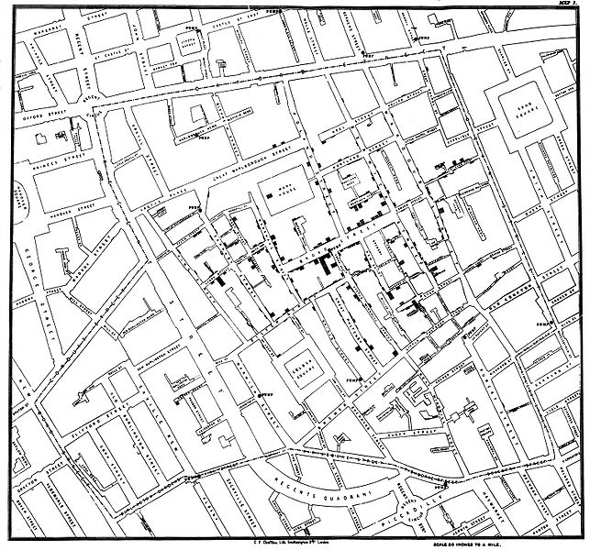
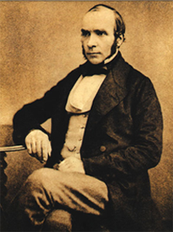

Motivation
1854 London Cholera Epidemic
Outbreak source
Dr. John Snow
Source: Wikipedia

Slide 5
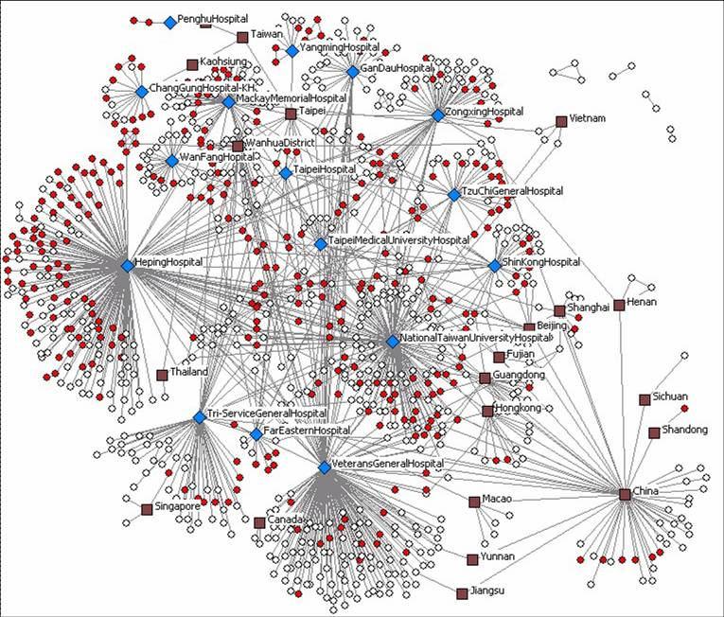
Motivation
2003 SARS (severe acute respiratory syndrome)
Source: The University of Arizona Artificial Intelligence Lab

Slide 6


Motivation
2003 SARS Rumor
Rumor: “Entire City was poised to be quarantined”
14 year-old boy arrested for creating fake news page
Epicenter of
Hong Kong SARS
329 Infected
42 killed
Source: http://edition.cnn.com/2013/02/21/world/asia/hong-kong-sars-anniversary
Rumor and panic spread faster than virus. Nothing spreads like fear!

Slide 7
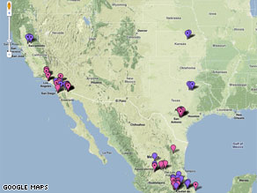
Motivation
2009 Online Flu Map Goes Viral
Created by Pittsburgh biochemist Harry Niman on April 21, 2009
Surpassing 290,000 web views and 3000 comments within 9 days
Source: http://edition.cnn.com/2009/TECH/04/30/online.flumaps/index.html

Slide 8
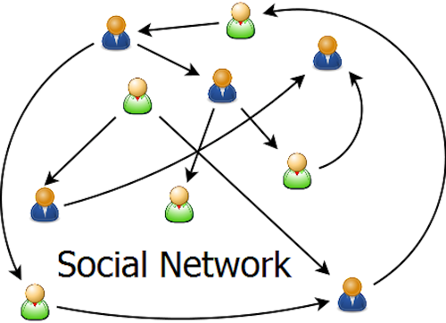


Motivation
Growth and Expansion of Online
Social Networks
Smartphone revolution 2007
Twitter 2006
Tencent Weixin 2012

Slide 9
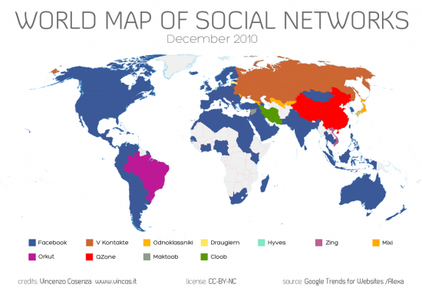
Motivation
Reach of Online Social Networks

Slide 10

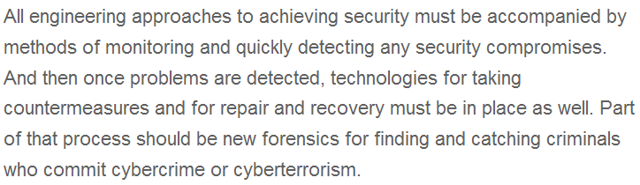
Motivation
National Grand Challenges
US National Academy of Engineering Grand Challenges 2008
Challenge No. 11: Secure Cyberspace

Slide 11

Motivation
DARPA Mathematical Challenges
23 Mathematical Challenges issued by US Defense Advanced Research Projects Agency (DARPA) in 2008
Challenge No. 2: The Dynamics of Networks
Challenge No. 14: An Information Theory for Virus Evolution - can Shannon’s theory shed light on this fundamental area?
Source: https://www.fbo.gov/download/9bc/9bce380aafb19f9ad3bda188bfc1ab20/DARPA-BAA-08-65.doc

Slide 12
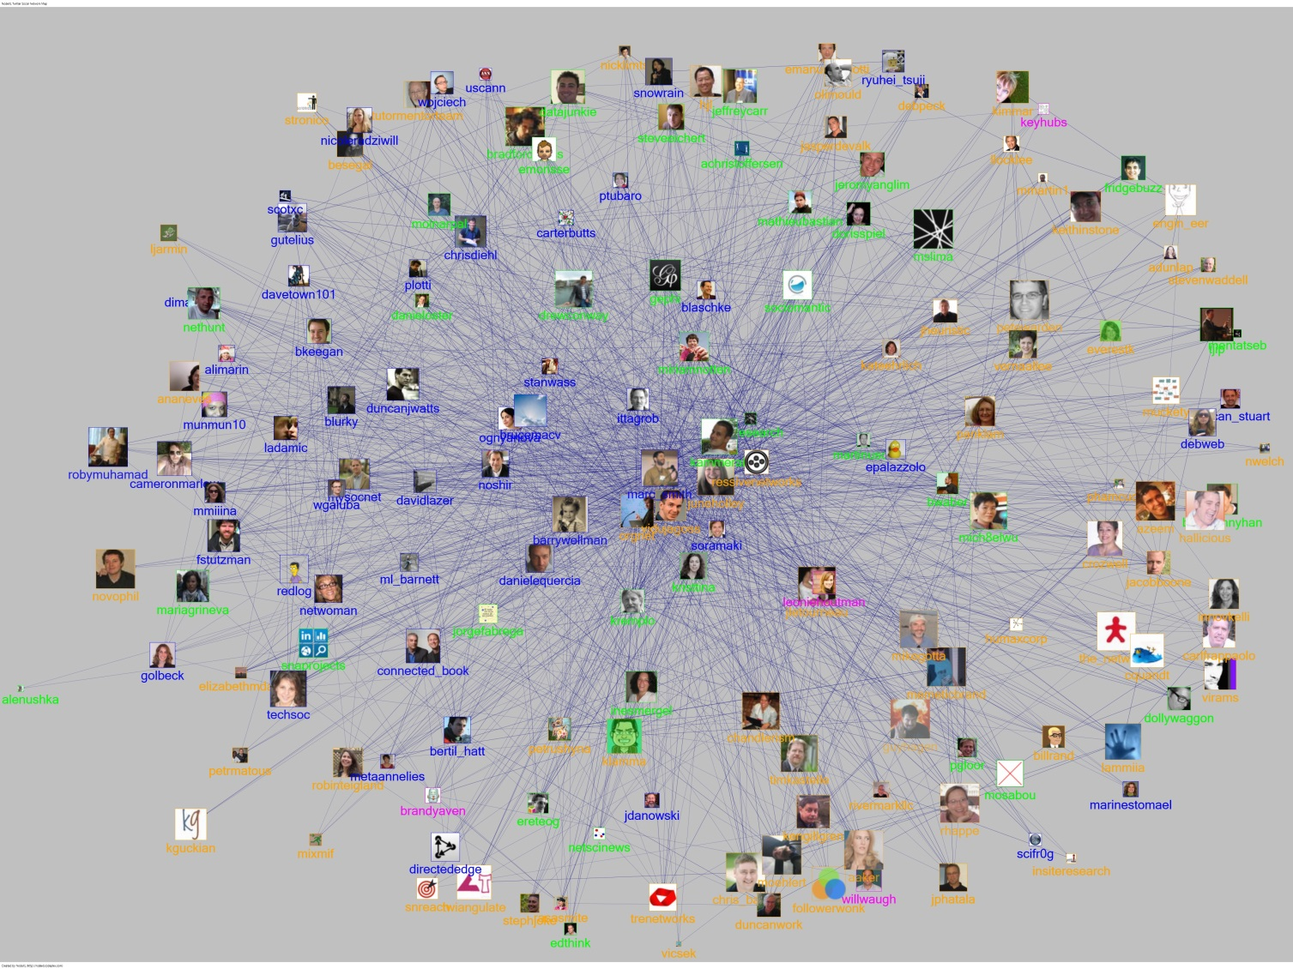
Rumor Spreading in Online Social Network
Outbreak of infectious virus
Diffusion of viral Information in Network
Cause of outbreak
Epidemic-like information flow = rumor spreading in a network.

Slide 13
Who is the culprit?
Spread of computer virus
Tweeting and Retweeting in Twitter Network
A rumor, originating from a suspect set, spreads on a network.
We only know the prior suspect set and infected nodes.
Can we find the single rumor source?

Slide 14
Outline
Related Work and Spreading Model
Rumor Centrality
Detection in Tree Network
Extensions
Conclusion
Notes:
14

Slide 15
Literature ----Research on epidemic outbreak/rumor spreading
understand impacts of network structure and infection/cure rates
learn network parameters and predict propagation characteristics
extract influential source nodes
[Moore—PRE’00, Pastor-Satorras—PRL’01, Newman—PRE’02]
[Streftaris—IWSM’02, Okamura—ISSRE’07, Gomez-Rodriguez—SIGKDD’10]
[Kempe—SIGKDD’03, Chen—SIGKDD’09, Dong—Allerton’12]
Rumor source estimation problem has only been recently studied.

Slide 16
Literature ----estimation of rumor source
identification of single rumor source using SI model
geometric trees, random graphs
identification of multiple rumor sources (SI model), identification of single rumor source (SIR model)
noisy estimation of a single rumor source
[Shah—TIT’11, Shah—SIGMETRICS’12]
[Shah—arXiv’11, Shah—TIT’11]
[Luo—TSP’13, Zhu—ITA’13]
[Pinto—PRL’12]
Important features such as suspects, no. of observations, topology has not been considered.

Slide 17
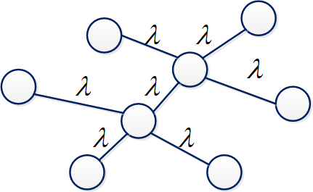
SI Model for Rumor Spreading
SI (susceptible-infectious) model
An infected node keeps the rumor forever
Uniform probability of any node in a prior suspect set being source
consists of suspect nodes
Time to infect neighbor is independent and exponentially distributed with rate λ

Slide 18
Outline
Related Work and Spreading Model
Rumor Centrality
Detection in Tree Network
Extensions
Conclusion
Notes:
18

Slide 19
Rumor Centrality
Shah and Zuman
IEEE Transactions on Information Theory 2011
Rumor centrality counts the number of permitted permutation to spread a rumor
Notes:
19

Slide 20
Rumor Centrality
Suppose Source 1
Two permutations: {1,2,3,4}, {1,2,4,3}
Suppose Source 2
Six permutations: {2,1,3,4}, {2,1,4,3},{2,3,1,4}, …
[Shah—TIT’11]
Notes:
20

Slide 21
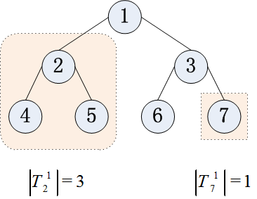
Rumor Centrality
Shah and Zuman
IEEE Transactions on Information Theory 2011
Rumor centrality counts the number of permitted permutation to spread a rumor
Notes:
21

Slide 22
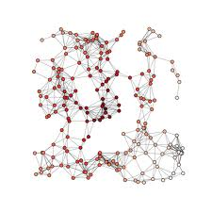
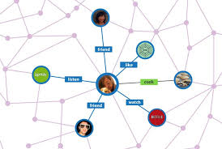
Rumor Center
[Shah—TIT’11]
ML (maximum likelihood) estimator
Most likely source is at the “center” of the network!
Notes:
22

Slide 23
Outline
Related Work and Spreading Model
Rumor Centrality
Detection in Tree Network
Extensions
Conclusion
Notes:
23

Slide 24

Detection with Suspects
Why consider suspects?
Not all infected are suspects
spread of infectious disease from cities to cities
(frequent travellers)
infection of rumors or computer viruses in cyberspace
(vulnerable hosts)
Suspect characteristics significantly affect detectability and add an interesting dimension to identifying the source reliably.

Slide 25

Detection with Suspects
What’s new with suspects?
Finite regime:
at most vs. at least 0.5 detection probability
Asymptotic regime:
0.307 vs. 1 best detection probability
Insightful monotonicity and averaging results
Wenxiang Dong, Wenyi Zhang and C. W. Tan
Proc. of IEEE Symposium on Information Theory 2013
Notes:
25

Slide 26



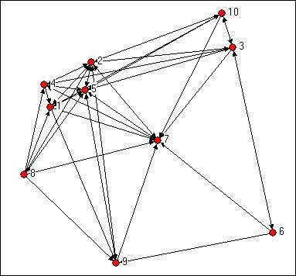
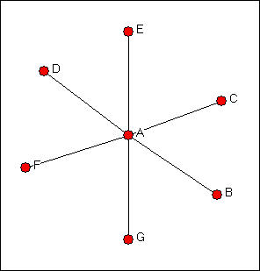
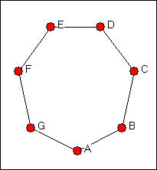
Detectability
Detectability is graph constrained. Network connectivity matters!
Notes:
26

Slide 27
MAP Rumor Source Estimator
MAP (maximum a posteriori) estimator
A prior suspect set
An observation of infected nodes

Slide 28
MAP Rumor Source Estimator
For regular tree-type networks
For general tree-type networks
For general networks
optimal MAP estimator
focus on regular trees
Analyze the correct detection probability upon observing n infected nodes

Slide 29
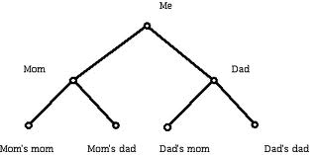
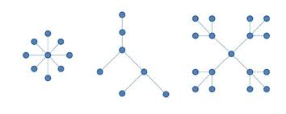
Detectability on Tree
How to detect on a tree?
Can fewer number of infected nodes help detectability?
Can a higher degree help detectability?
Notes:
29

Slide 30
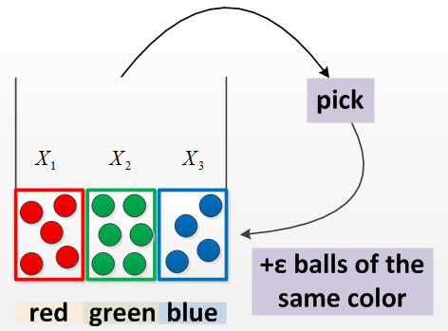
Pólya’s Urn Model
Joint distribution
Marginal distribution
Limit distributions
[Johnson—JWS’97]

Slide 31

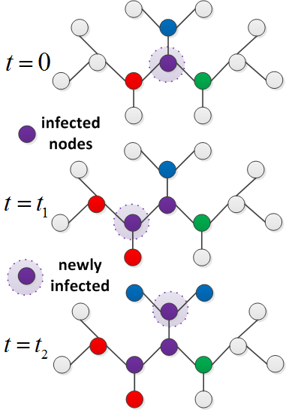
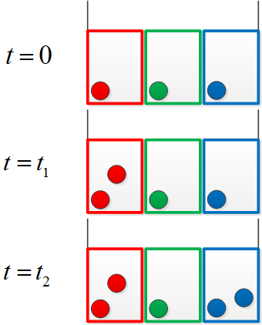
Equivalence to Pólya’s Urn Model
Rumor spreading process
Ball drawing process

Slide 32
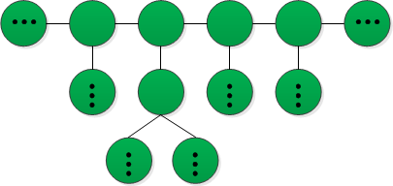
Suspecting all Nodes ----main results
Case 1
Main results
Any infected node might be the rumor source.
node degree
node degree
node degree
Monotonicity: Detection probability increases with degree and decreases with n
[Shah—TIT’11, Shah—SIGMETRICS’12]
The detection probability is asymptotically upper bounded by 0.307.

Slide 33



Minimum Detectability
Line Network is undetectable!
Can multiple observations help?
Notes:
33

Slide 34
Suspecting all Nodes ----validation experiment

Slide 35
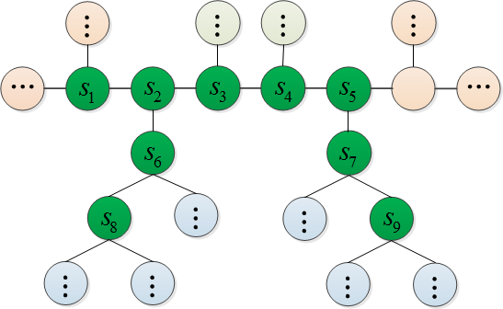
Connected Suspects ----main results
Case 2
Main results
All suspect nodes form a connected subgraph.
node degree
node degree
node degree
Monotonicity: Detection probability increases with degree and decreases with n
The performance is significantly improved and reliable detection can be achieved.

Slide 36
Connected Suspects ----validation experiment

Slide 37
Connected Suspects ----with vs. without prior knowledge
Closer-up look at case 2
Comparison with case 1
node degree
exceed prior probability
at least 0.5-detection
achieve reliable detection
node degree
non-trivial positive value
at most 0.5-detection
upper-bounded by 0.307
Suspect characteristics (connectivity) bring about new ingredients.

Slide 38
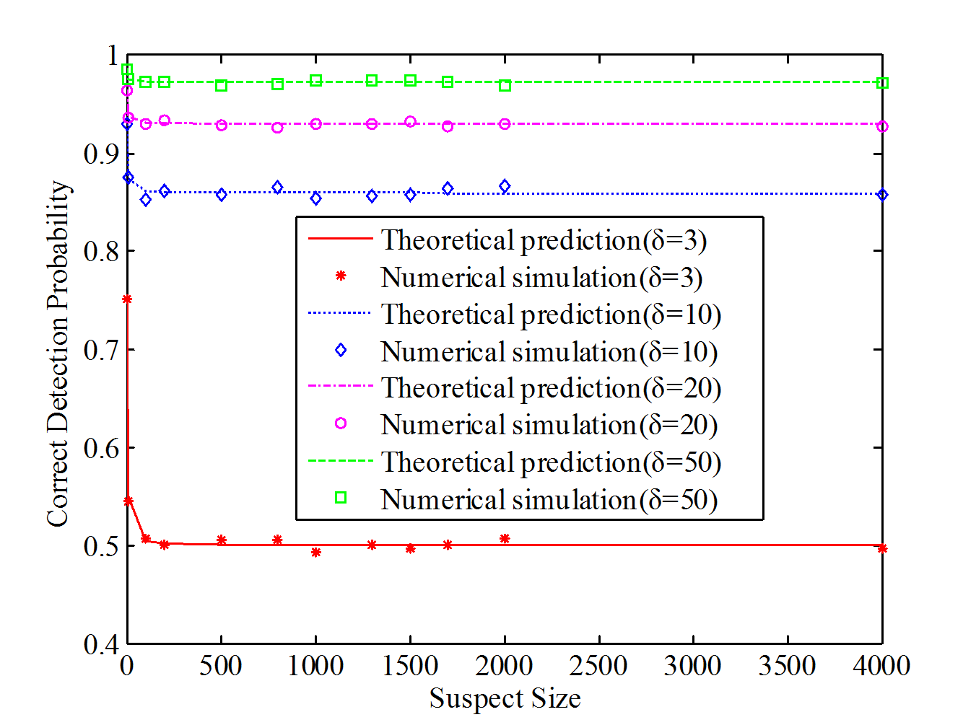
Connected Suspects ----validation experiment

Slide 39
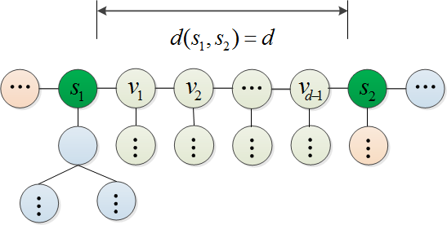
Two Suspects ----main results
Case 3
Main results
Two suspect nodes is separated by d.
node degree
node degree
Monotonicity: Detection probability increases with d
Identifying the rumor source is more difficult if the two suspects are closer.

Slide 40
Two Suspects ----validation experiment

Slide 41
Outline
Related Work and Spreading Model
Rumor Centrality
Detection in Tree Network
Extensions
Conclusion
Notes:
41

Slide 42
Extensions
Zhao, Dong, Zhang and Tan
Submitted to IEEE INFOCOM 2014
Zhou, Zheng and Tan
Submitted to ACM SIGMETRICS 2014
Detection with Multiple Observations
How many observations to take?
Detection in General Graphs
Unifying result for rumor centrality
How good or how bad is the Breath-first Search Heuristic?
Notes:
42

Slide 43
Conclusion
Rumor Centrality
Center of a Network
Network features: Suspects, Connectivity, Observations
Detectability and Detection
Statistical inference, probability theory, graph theory, Information theory
Scalable algorithms
Numerous Open Issues:
Heterogeneous connectivity and spreading models
Real-world data traces
Practical network forensics protocol in online social networks

Slide 44
Thank You
cheewtan@cityu.edu.hk
www.cs.cityu.edu.hk/~cheewtan

