Slide 1
Rooting out the Rumor Culprit in Online Social Networks
Chee Wei Tan
City University of Hong Kong
Nanyang Technological University
24 April, 2014

Slide 2


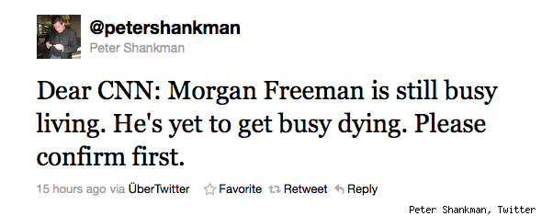
Motivation
Rumors
Source: Google

Slide 3
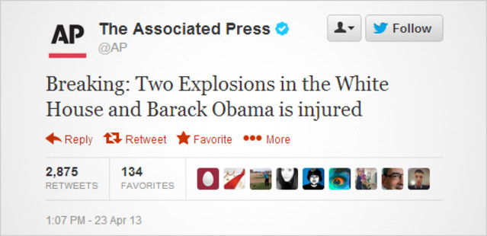
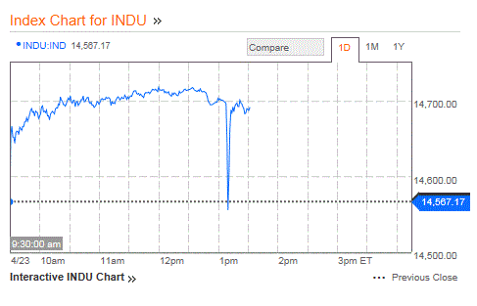
Motivation
Rumors
Source: Bloomberg

Slide 4
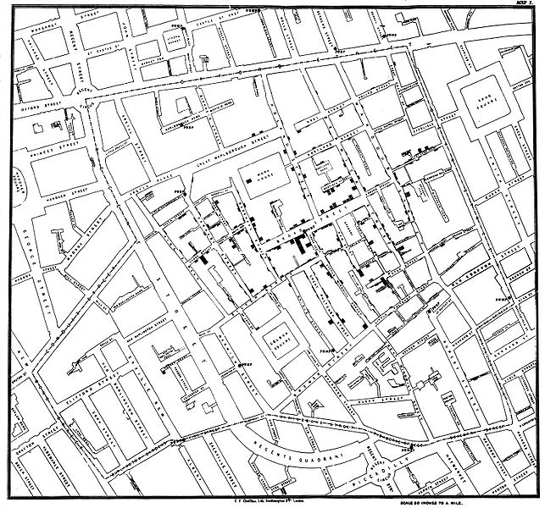
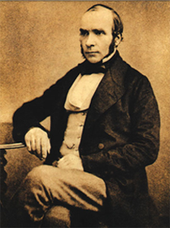

Motivation
1854 London Cholera Epidemic
Outbreak source
Dr. John Snow
Source: Wikipedia

Slide 5
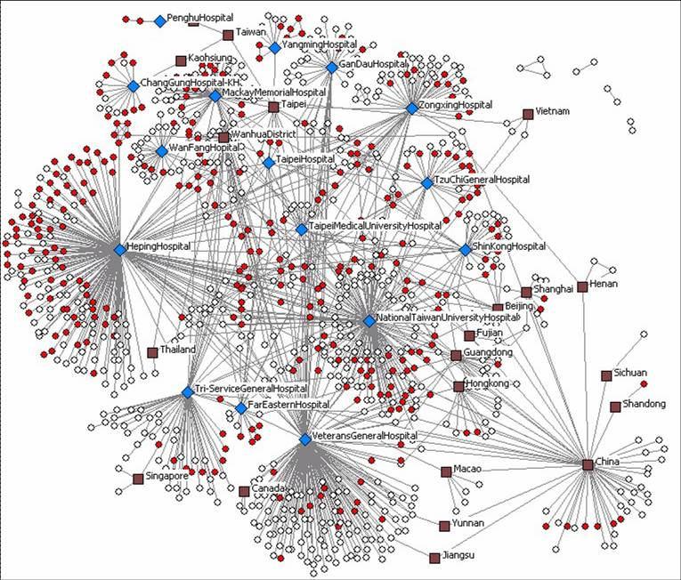
Motivation
2003 SARS (severe acute respiratory syndrome)
Source: The University of Arizona Artificial Intelligence Lab

Slide 6


Motivation
2003 SARS Rumor
Rumor: “Entire City was poised to be quarantined”
14 year-old boy arrested for creating fake news page
Epicenter of
Hong Kong SARS
329 Infected
42 killed
Source: http://edition.cnn.com/2013/02/21/world/asia/hong-kong-sars-anniversary
Rumor and panic spread faster than virus. Nothing spreads like fear!

Slide 7
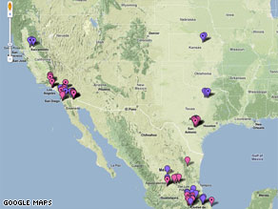
Motivation
2009 Online Flu Map Goes Viral
Created by Pittsburgh biochemist Harry Niman on April 21, 2009
Surpassing 290,000 web views and 3000 comments within 9 days
Source: http://edition.cnn.com/2009/TECH/04/30/online.flumaps/index.html

Slide 8
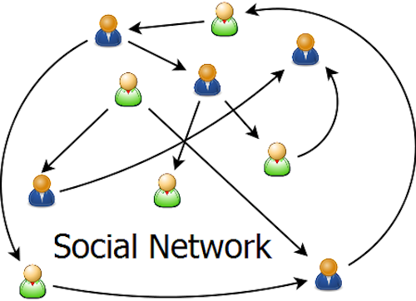


Motivation
Growth and Expansion of Online
Social Networks
Smartphone revolution 2007
Twitter 2006
Tencent Weixin 2012

Slide 9
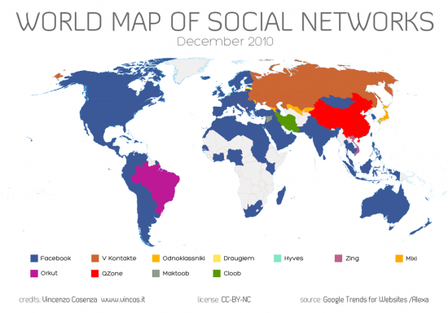
Motivation
Reach of Online Social Networks

Slide 10

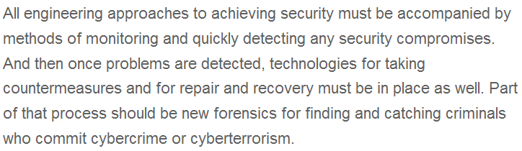
Motivation
National Grand Challenges
US National Academy of Engineering Grand Challenges 2008
Challenge No. 11: Secure Cyberspace

Slide 11
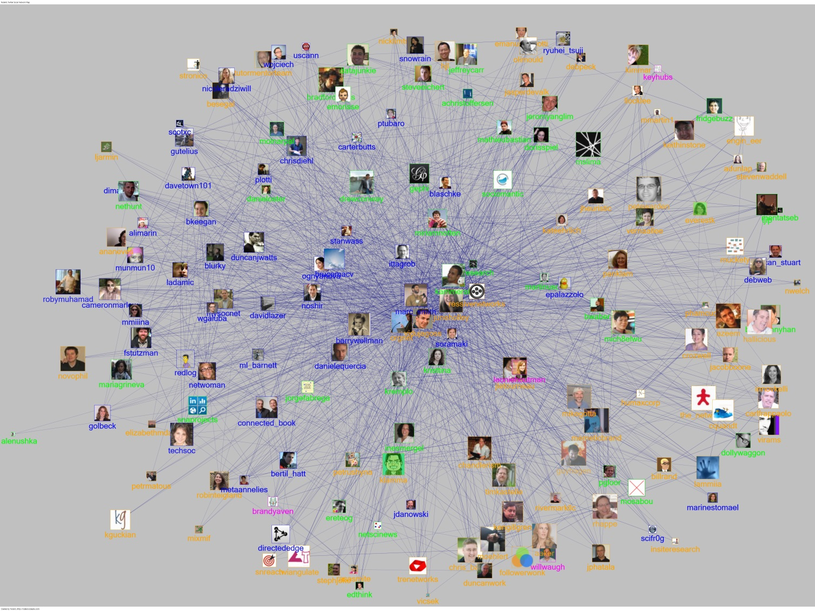
Rumor Spreading in Online Social Network
Outbreak of infectious virus
Diffusion of viral Information in Network
Cause of outbreak
Epidemic-like information flow = rumor spreading in a network.

Slide 12
Who is the culprit?
Spread of computer virus
Tweeting and Retweeting in Twitter Network
A rumor, originating from a suspect set, spreads on a network.
We only know the prior suspect set and infected nodes.
Can we find the single rumor source?

Slide 13
Outline
Related Work and Spreading Model
Rumor Centrality
Detection in Tree Network
Detection in General Network
Cybersecurity Forensics
Conclusion
Notes:
13

Slide 14
Literature ----Research on epidemic outbreak/rumor spreading
understand impacts of network structure and infection/cure rates
learn network parameters and predict propagation characteristics
extract influential source nodes
[Moore—PRE’00, Pastor-Satorras—PRL’01, Newman—PRE’02]
[Streftaris—IWSM’02, Okamura—ISSRE’07, Gomez-Rodriguez—SIGKDD’10]
[Kempe—SIGKDD’03, Chen—SIGKDD’09, Dong—Allerton’12]
Rumor source estimation problem has only been recently studied.

Slide 15
Literature ----estimation of rumor source
identification of single rumor source using SI model
geometric trees, random graphs
identification of multiple rumor sources (SI model), identification of single rumor source (SIR model)
noisy estimation of a single rumor source
[Shah—TIT’11, Shah—SIGMETRICS’12]
[Shah—arXiv’11, Shah—TIT’11]
[Luo—TSP’13, Zhu—ITA’13]
[Pinto—PRL’12]
Important features such as suspects, no. of observations, topology has not been considered.

Slide 16
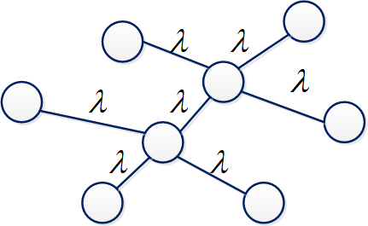
SI Spreading Model (Kermack & McKendrick 1927)
SI (susceptible-infectious) model
An infected node keeps the rumor forever
Uniform probability of any node in a prior suspect set being source
consists of suspect nodes
Time to infect neighbor is independent and exponentially distributed with rate λ

Slide 17


SI Spreading Model
Vertex of a graph to model the susceptible and the infected node (person)
An edge in models the relationship between two nodes
Two persons connected as Facebook Friends or Twitter Follower
Notes:
17

Slide 18
Outline
Related Work and Spreading Model
Rumor Centrality
Detection in Tree Network
Detection in General Network
Cybersecurity Forensics
Conclusion
Notes:
18

Slide 19
Toy Example
Counts the number of permitted permutation to spread a rumor
Notes:
19

Slide 20
Toy Example
Suppose Source 1
Two permutations: {1,2,3,4}, {1,2,4,3}
Suppose Source 2
Six permutations: {2,1,3,4}, {2,1,4,3},{2,3,1,4}, …
Notes:
20

Slide 21



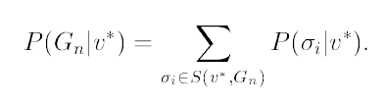
Inference in Tree
S
C
d
d
S
Notes:
21

Slide 22
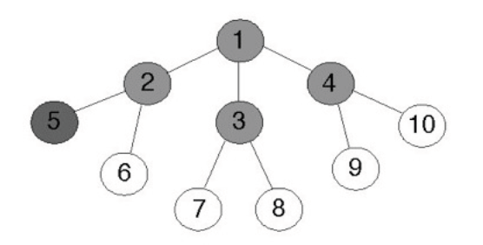
Toy Example
Notes:
22

Slide 23
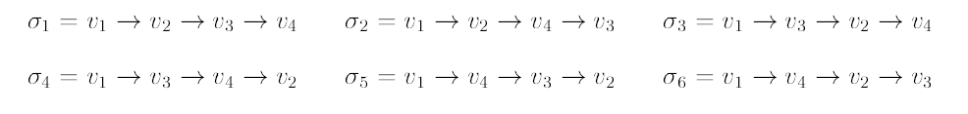
Toy Example
Suppose Node 1 is Rumor
Notes:
23

Slide 24


Toy Example
Suppose Node 1 is Rumor
Notes:
24

Slide 25


Toy Example
Suppose Node 1 is Rumor
Notes:
25

Slide 26
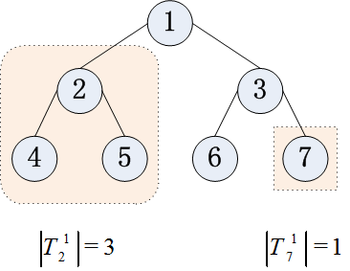
Rumor Centrality
Shah and Zuman
IEEE Transactions on Information Theory 2011
Rumor centrality counts the number of permitted permutation to spread a rumor
Notes:
26

Slide 27
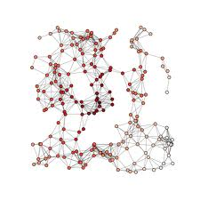
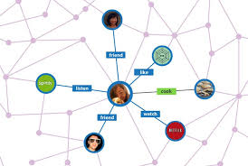
Rumor Center
[Shah—TIT’11]
ML (maximum likelihood) estimator
Most likely source is at the “center” of the network!
Notes:
27

Slide 28
Outline
Related Work and Spreading Model
Rumor Centrality
Detection in Tree Network
Detection in General Network
Cybersecurity Forensics
Conclusion
Notes:
28

Slide 29

Detection with Suspects
Why consider suspects?
Not all infected are suspects
spread of infectious disease from cities to cities
(frequent travellers)
infection of rumors or computer viruses in cyberspace
(vulnerable hosts)
Suspect characteristics significantly affect detectability and add an interesting dimension to identifying the source reliably.

Slide 30

Detection with Suspects
What’s new with suspects?
Finite regime:
at most vs. at least 0.5 detection probability
Asymptotic regime:
0.307 vs. 1 best detection probability
Insightful monotonicity and averaging results
Dong, Zhang and Tan
Proc. of IEEE Symp. on Information Theory 2013
Zhao, Dong, Zhang and Tan
ACM SIGMETRICS 2014
Notes:
30

Slide 31



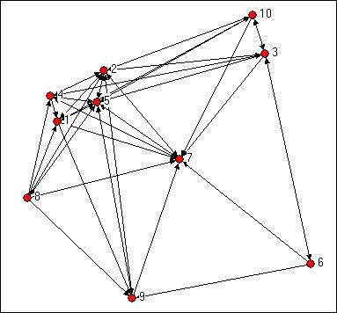
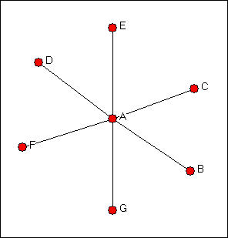
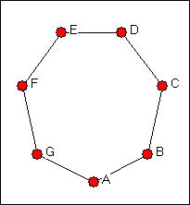
Detectability
Detectability is graph constrained. Network connectivity matters!
Notes:
31

Slide 32
MAP Rumor Source Estimator
MAP (maximum a posteriori) estimator
A prior suspect set
An observation of infected nodes

Slide 33
MAP Rumor Source Estimator
For regular tree-type networks
For general tree-type networks
For general networks
optimal MAP estimator
focus on regular trees
Analyze the correct detection probability upon observing n infected nodes

Slide 34
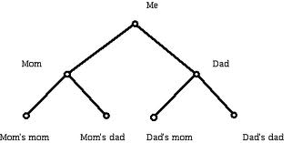
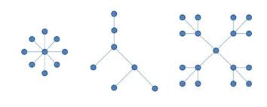
Detectability on Tree
How to detect on a tree?
Can fewer number of infected nodes help detectability?
Can a higher degree help detectability?
Notes:
34

Slide 35
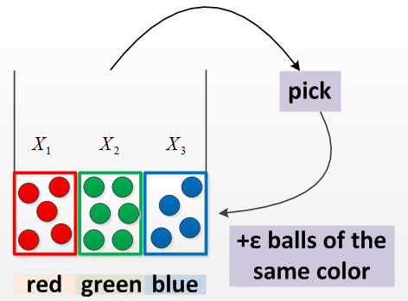
Pólya’s Urn Model
Joint distribution
Marginal distribution
Limit distributions
[Johnson—JWS’97]

Slide 36

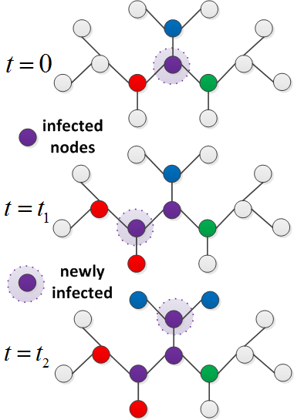
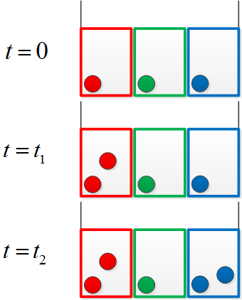
Equivalence to Pólya’s Urn Model
Rumor spreading process
Ball drawing process

Slide 37
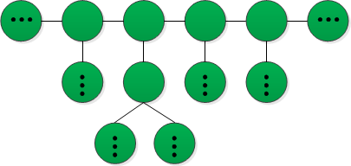
Suspecting all Nodes ----main results
Case 1
Main results
Any infected node might be the rumor source.
node degree
node degree
node degree
Monotonicity: Detection probability increases with degree and decreases with n
[Shah—TIT’11, Shah—SIGMETRICS’12]
The detection probability is asymptotically upper bounded by 0.307.

Slide 38



Minimum Detectability
Line Network is undetectable!
Can multiple observations help?
Notes:
38

Slide 39
Suspecting all Nodes ----validation experiment

Slide 40
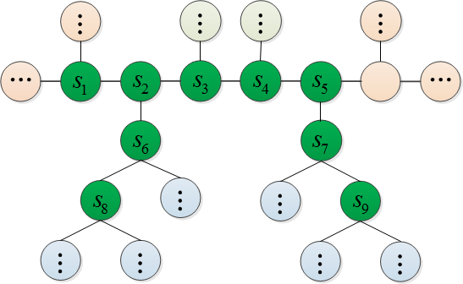
Connected Suspects ----main results
Case 2
Main results
All suspect nodes form a connected subgraph.
node degree
node degree
node degree
Monotonicity: Detection probability increases with degree and decreases with n
The performance is significantly improved and reliable detection can be achieved.

Slide 41
Connected Suspects ----validation experiment

Slide 42
Connected Suspects ----with vs. without prior knowledge
Closer-up look at case 2
Comparison with case 1
node degree
exceed prior probability
at least 0.5-detection
achieve reliable detection
node degree
non-trivial positive value
at most 0.5-detection
upper-bounded by 0.307
Suspect characteristics (connectivity) bring about new ingredients.

Slide 43
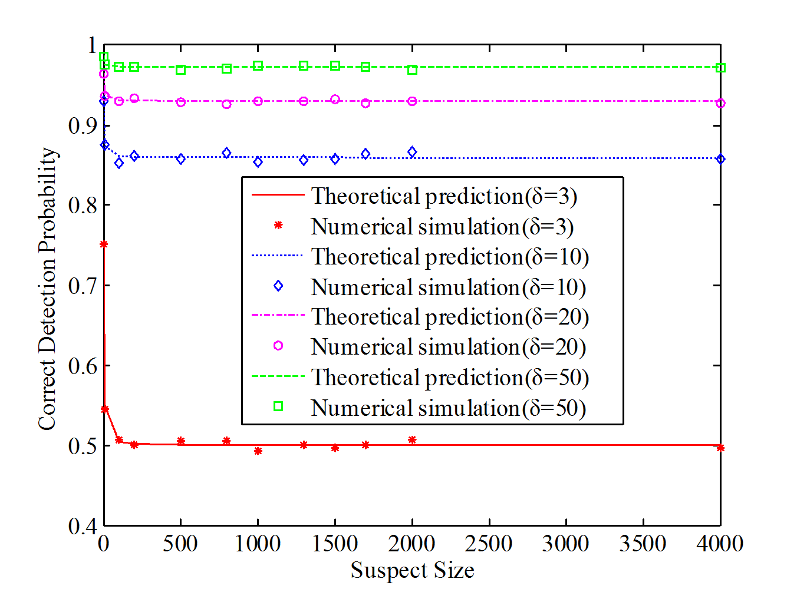
Connected Suspects ----validation experiment

Slide 44
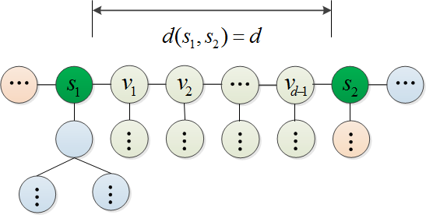
Two Suspects ----main results
Case 3
Main results
Two suspect nodes is separated by d.
node degree
node degree
Monotonicity: Detection probability increases with d
Identifying the rumor source is more difficult if the two suspects are closer.

Slide 45
Two Suspects ----validation experiment

Slide 46
Outline
Related Work and Spreading Model
Rumor Centrality
Detection in Tree Network
Detection in General Network
Cybersecurity Forensics
Conclusion
Notes:
46

Slide 47
Detection in General Network
Still an open problem
How to deal with loops?
Breadth-First-Search (BFS) Heuristic Algorithm
BFS tree approximates diffusion tree
Rumor centrality algorithm on BFS tree
Notes:
47

Slide 48
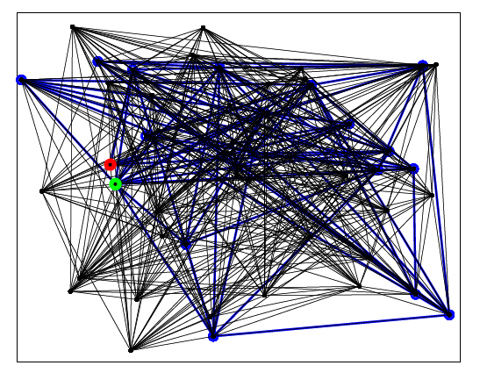

Detection in General Network
Erdos-Renyi random graph (N=50, K=20, p=0.4)
Actual Rumor Source
Rumor Center
Notes:
48

Slide 49
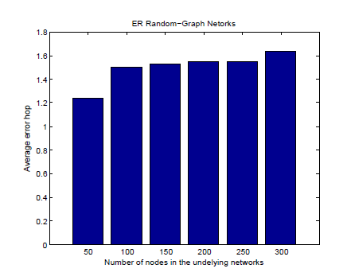
Detection in General Network
Erdos-Renyi random graph
Actual Rumor Source
Rumor Center
Notes:
49

Slide 50
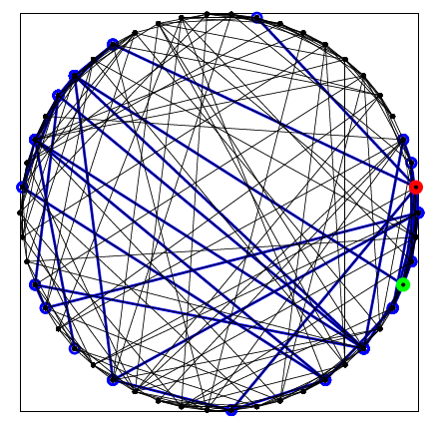
Detection in General Network
Newman-Watts small world (N=50, K=20, m0=4, p=0.4)
Actual Rumor Source
Rumor Center
Notes:
50

Slide 51
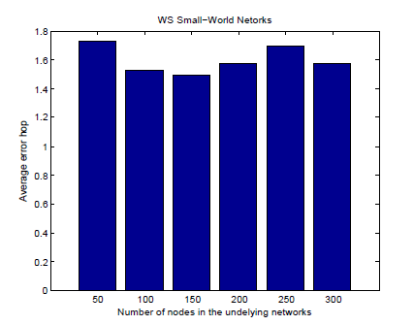
Detection in General Network
Newman-Watts small world graph
Actual Rumor Source
Rumor Center
Notes:
51

Slide 52
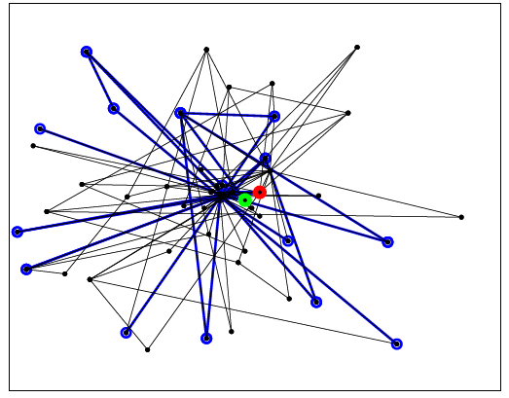
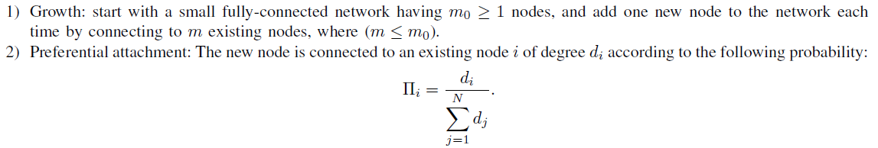
Detection in General Network
Barabasi-Albert scale-free graph (N=50, K=20, m0=4,m=2)
Actual Rumor Source
Rumor Center
Notes:
52

Slide 53
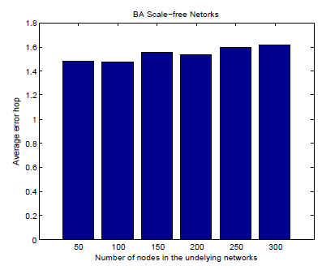
Detection in General Network
Barabasi-Albert scale free graph
Actual Rumor Source
Rumor Center
Notes:
53

Slide 54
Extensions
Zhao, Dong, Zhang and Tan
ACM SIGMETRICS 2014
Detection with Multiple Observations
How many observations to take?
2 Observations more than double the detectability performance of a single observation
Open Questions
General graph detection
How good or how bad is the Breadth-first Search Heuristic?
Notes:
54

Slide 55
Outline
Related Work and Spreading Model
Rumor Centrality
Detection in Tree Network
Detection in General Network
Cybersecurity Forensics
Conclusion
Notes:
55

Slide 56





Forensics in Online Social Networks

Slide 57
Network Cyber Security Forensics
Many interactions over online social networks that are recorded and available from API service to glimpse social relationship of users
Provide clues for rumor source detection and other cyber-security forensics algorithms
How to even obtain a single snapshot observation of the graph?
Bridge deep gulf between theory and practice
There is nothing more practical than a good theory!

Slide 58
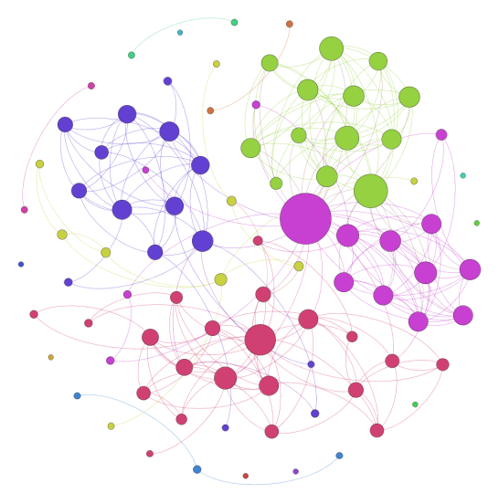
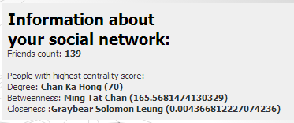
Forensics using Facebook Graph
Rate-constrained data scraping
Access control for privacy and security
How to use semantics to infer the possession of a rumor?
How to link social graph with technological graph?
58

Slide 59
Conclusion
Rumor Centrality
Center of a Network
Network features: Suspects, Connectivity, Observations
Detectability and Detection
Statistical inference, probability theory, graph theory, Information theory
Scalable algorithms
Numerous Open Issues:
Heterogeneous connectivity and spreading models
Real-world data traces
Practical network forensics protocol in online social networks

Slide 60
Thank You
cheewtan@cityu.edu.hk
www.cs.cityu.edu.hk/~cheewtan

