Slide 1
REAL-TIME SALES PERFORMANCE
ANALYTICS DASHBOARD
for Retail Businesses
Final Project Presentation • MCA Major Project • Subject Code: 23ONMCR-753
STUDENT
Gurram Mahadev Kishan
UID
CUOL725165
SUPERVISOR
Mr. Anurag Goel
UNIVERSITY
Chandigarh University | 2024–26
github.com/chefmaahi/retail_sales_project
Real-time sales performance analytics dashboard for retai business

Slide 2
OVERVIEW
Presentation Agenda
Project Overview & Objectives
Sales Forecasting Models
01
05
Dataset & System Architecture
Tableau Dashboard Walkthrough
02
06
ETL Pipeline & Database Design
Region-wise Analysis
03
07
KPI Analytics & Statistical Findings
Testing, Tech Stack & Conclusion
04
08
Real-Time Sales Performance Analytics Dashboard | Chandigarh University
2

Slide 3
01 · PROJECT OVERVIEW
Project at a Glance
An end-to-end retail sales analytics solution — from raw transactional data to a published, interactive Tableau dashboard. Built as an MCA Major Project demonstrating data engineering, analytics, forecasting, and business intelligence at an industry standard.
$456K
$136.8K
30%
1,000+
TOTAL REVENUE
TOTAL PROFIT
PROFIT MARGIN
TRANSACTIONS
3
25
9
10+
REGIONS COVERED
TESTS PASSING
TABLEAU DATA SOURCES
DASHBOARD VISUALS
Real-Time Sales Performance Analytics Dashboard | Chandigarh University
3

Slide 4
01 · PROJECT OVERVIEW
Project Objectives
1
2
3
Database Design
ETL Pipeline
KPI Analytics
Star-schema relational database for sales transactions and product details
Automated Extract–Transform–Load to clean and validate raw CSV data
Python/SQL modules computing revenue, profit margin & conversion rate
4
5
6
Forecasting
Tableau Dashboard
Testing & Docs
4 statistical models predicting 6-month sales performance
Interactive dashboards with Region, Category & Time filters
25 automated tests + full documentation published to GitHub
Real-Time Sales Performance Analytics Dashboard | Chandigarh University
4

Slide 5
02 · DATASET & ARCHITECTURE
Dataset Description
Retail transactions sourced from Kaggle, enriched with a Region dimension (Andhra Pradesh, Karnataka, Goa)
Field | Type | Range / Values
Transaction ID | Integer | 1 to 1000
Date | Date | 2023-01-01 to 2024-01-01
Customer ID | String | CUST0001 to CUST1000
Gender | String | Male / Female
Age | Integer | 18 to 64 years
Product Category | String | Beauty / Clothing / Electronics
Region | String | Andhra Pradesh / Karnataka / Goa
Quantity | Integer | 1 to 4 units
Total Amount | Float | $25 to $2,000
1,000
TOTAL ROWS
10
COLUMNS
3
REGIONS
3
CATEGORIES
0
MISSING VALUES
Real-Time Sales Performance Analytics Dashboard | Chandigarh University
5

Slide 6
02 · DATASET & ARCHITECTURE
System Architecture — Star Schema
dim_date
dim_customers
year, quarter, month,
week, is_weekend
gender, age,
age_group
fact_sales
1,000 transactions
dim_products
dim_region
category,
price_per_unit
Andhra Pradesh,
Karnataka, Goa
Real-Time Sales Performance Analytics Dashboard | Chandigarh University
Real-Time Sales Performance Analytics Dashboard | Chandigarh University
6
6

Slide 7
03 · ETL PIPELINE
ETL Pipeline — 4 Stage Workflow
1
2
3
4
EXTRACT
CLEAN
TRANSFORM
LOAD
Loads raw CSV via pandas. Logs row count and column structure.
Parses dates, removes duplicates, filters invalid values, standardises fields.
Derives date features, age groups, region mapping, profit at 30% margin.
Loads dimensions + fact table into SQLite; builds 3 aggregate tables + indexes.
Raw rows loaded
1,000
Rows after cleaning
1,000 (0 dropped)
dim_date rows
345 unique dates
dim_customers rows
1,000 unique
fact_sales rows
1,000 transactions
Pipeline runtime
< 1 second
Real-Time Sales Performance Analytics Dashboard | Chandigarh University
7

Slide 8
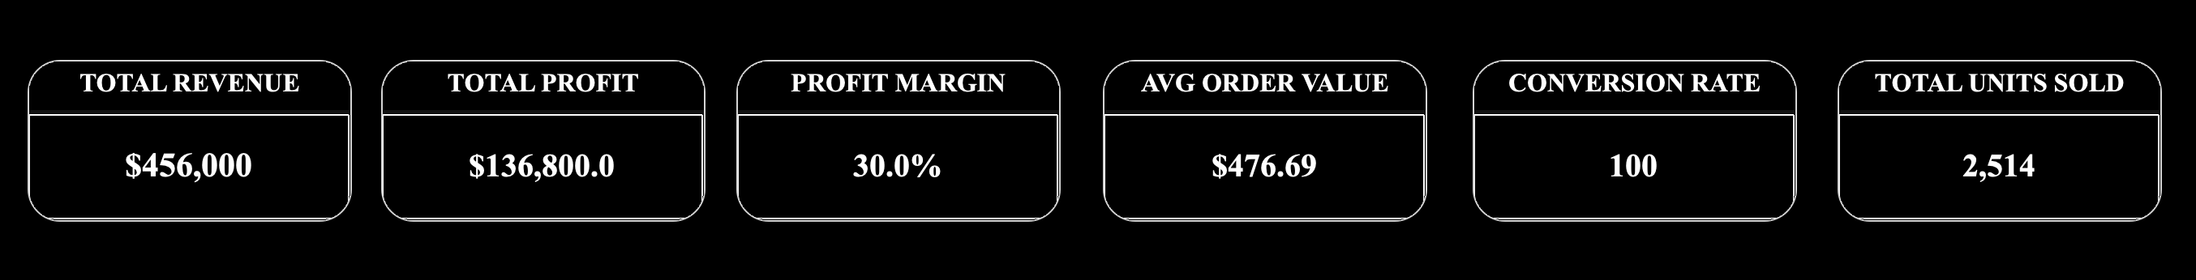
04 · KPI ANALYTICS
Core Revenue KPIs
KPI | Value | Formula
Total Revenue | $456,000 | SUM(total_amount)
Total Profit | $136,800 | SUM(total_amount) × 0.30
Profit Margin | 30.0% | SUM(profit) / SUM(revenue) × 100
Avg Order Value | $476.69 | SUM(total_amount) / COUNT(orders)
Conversion Rate | 100 | Orders / Unique Customers
Total Units Sold | 2,514 | SUM(quantity)
Live Tableau KPI Scorecards
KEY INSIGHT
A consistent 30% profit margin across all categories indicates a well-controlled, predictable cost structure — providing a strong foundation for scaling revenue without compressing profitability.
Real-Time Sales Performance Analytics Dashboard | Chandigarh University
8

Slide 9
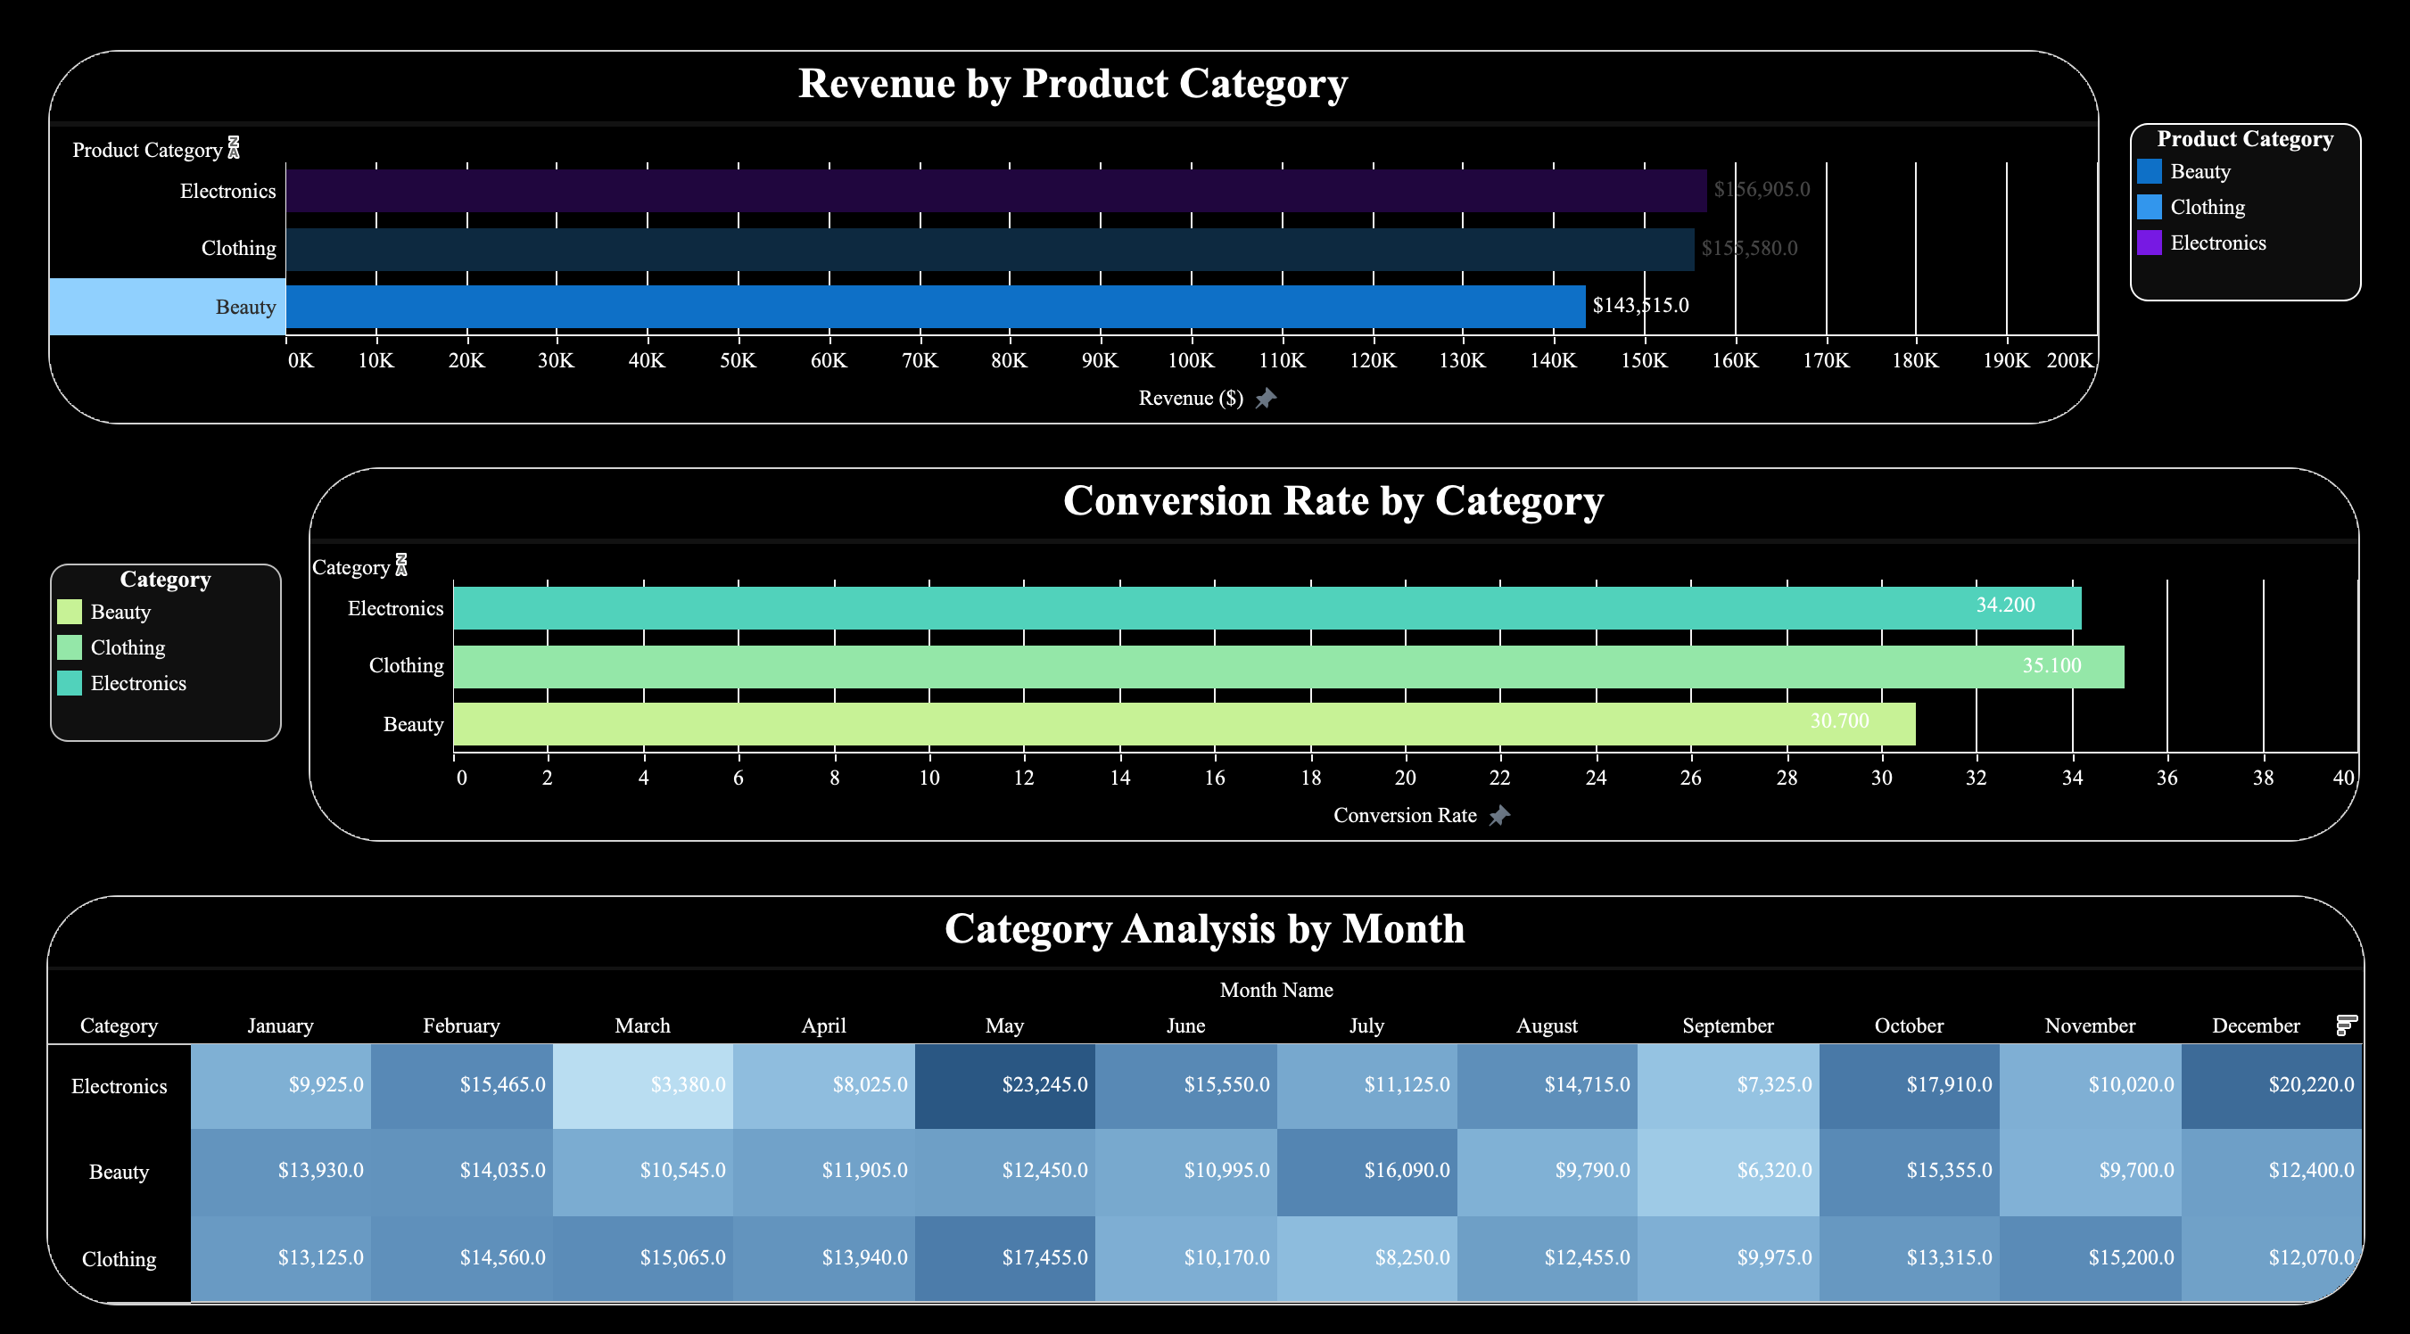
04 · KPI ANALYTICS
Revenue & Conversion by Category
Category Breakdown
Electronics
Share 34.4%
Conv. 34.2%
$156,905
Clothing
Share 34.1%
Conv. 35.1%
$155,580
Beauty
Share 31.5%
Conv. 30.7%
$143,515
Revenue is evenly split across all 3 categories — reducing single-category dependency risk.
Real-Time Sales Performance Analytics Dashboard | Chandigarh University
9

Slide 10
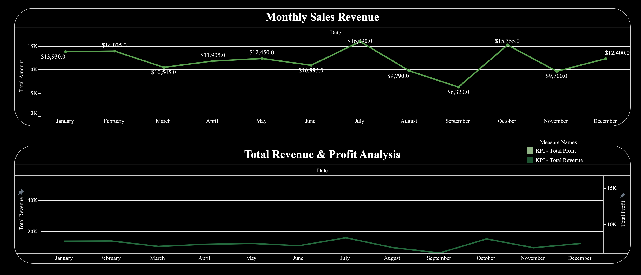
04 · KPI ANALYTICS
Monthly Seasonality & Trend
May
September
+$144.90
20.4%
Peak Month — $53,150
Trough Month — $23,620
Avg Monthly Growth Slope
Coefficient of Variation
Real-Time Sales Performance Analytics Dashboard | Chandigarh University
10

Slide 11
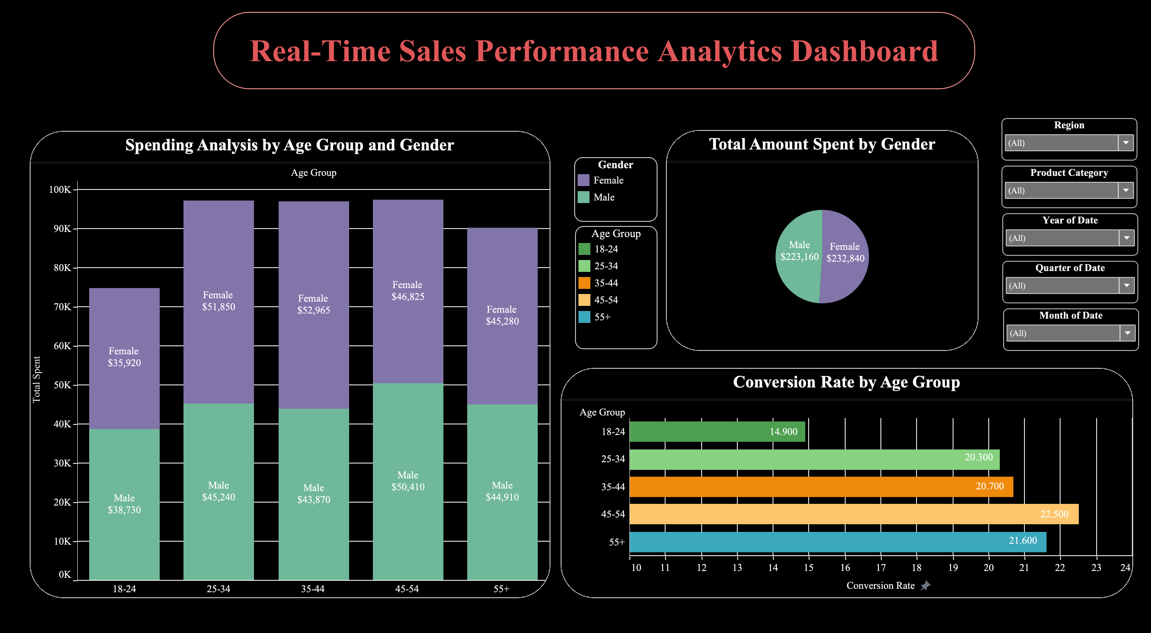
04 · KPI ANALYTICS
Customer Demographics: Age & Gender
Real-Time Sales Performance Analytics Dashboard | Chandigarh University
11

Slide 12
05 · SALES FORECASTING
Forecasting Models — Methodology
Moving Average
Linear Regression
Seasonal Naive
Ensemble (Final)
3-month rolling window average
OLS trend line: y = a + bx
Same month, prior year
Average of all 3 ± 10% CI
Smooths short-term noise
Captures long-term trend
Captures seasonal patterns
Reduces individual model error
Trend Analysis Summary
Upward
$38,000
$7,745
20.38%
Trend Direction
Mean Monthly Revenue
Std Deviation
Coeff. of Variation
Real-Time Sales Performance Analytics Dashboard | Chandigarh University
12

Slide 13
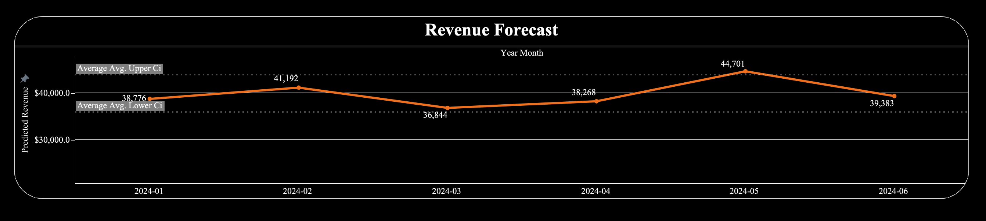
05 · SALES FORECASTING
6-Month Ensemble Forecast (Jan–Jun 2024)
Month | Predicted | Lower CI | Upper CI | Month | Predicted | Lower CI | Upper CI
Jan 2024 | $38,776 | $34,898 | $42,653 | Apr 2024 | $38,268 | $34,442 | $42,095
Feb 2024 | $41,192 | $37,073 | $45,312 | May 2024 | $44,701 | $40,231 | $49,172
Mar 2024 | $36,844 | $33,159 | $40,528 | Jun 2024 | $39,383 | $35,444 | $43,321
Total H1 2024 Projected Revenue: $239,164 (Range: $215,247 – $262,081)
Real-Time Sales Performance Analytics Dashboard | Chandigarh University
13

Slide 14
06 · TABLEAU DASHBOARD
Tableau Dashboard — 10 Interactive Sheets
# | Sheet Name | Data Source | Chart Type
1 | Spending Analysis by Age & Gender | 01_sales_transactions | Stacked Bar
2 | Total Amount Spent by Gender | 01_sales_transactions | Pie Chart
3 | Conversion Rate by Age Group | 04_customer_demographics | Horizontal Bar
4 | KPI Scorecards (6 cards) | 01_sales_transactions | BAN / Text
5 | Conversion Rate by Category | 03_category_performance | Horizontal Bar
6 | Revenue by Product Category | 01_sales_transactions | Horizontal Bar
7 | Total Revenue & Profit Analysis | 01_sales_transactions | Dual-Axis Line/Area
8 | Monthly Sales Revenue | 01_sales_transactions | Line with Labels
9 | Revenue Forecast | 05_forecasts | Line + CI Band
10 | Region & Seasonality Analysis | 07/08/09 region files | Bar / Heatmap
Live URL: public.tableau.com/app/profile/mahadev.kishan.gurram/viz/Realtimesalesperformanceanalyticsdashboardforretailbusiness
Real-Time Sales Performance Analytics Dashboard | Chandigarh University
14

Slide 15
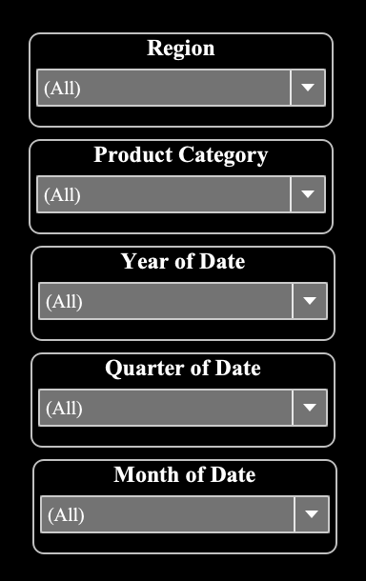
06 · TABLEAU DASHBOARD
Interactive Filters for Every View
Every sheet in the dashboard responds in real time to five global filters, letting stakeholders drill into exactly the slice of business they care about.
Region
Andhra Pradesh, Karnataka, Goa
Product Category
Beauty, Clothing, Electronics
Year of Date
2023 / 2024
Quarter of Date
Q1 – Q4
Month of Date
January – December
Real-Time Sales Performance Analytics Dashboard | Chandigarh University
Real-Time Sales Performance Analytics Dashboard | Chandigarh University
15
15

Slide 16
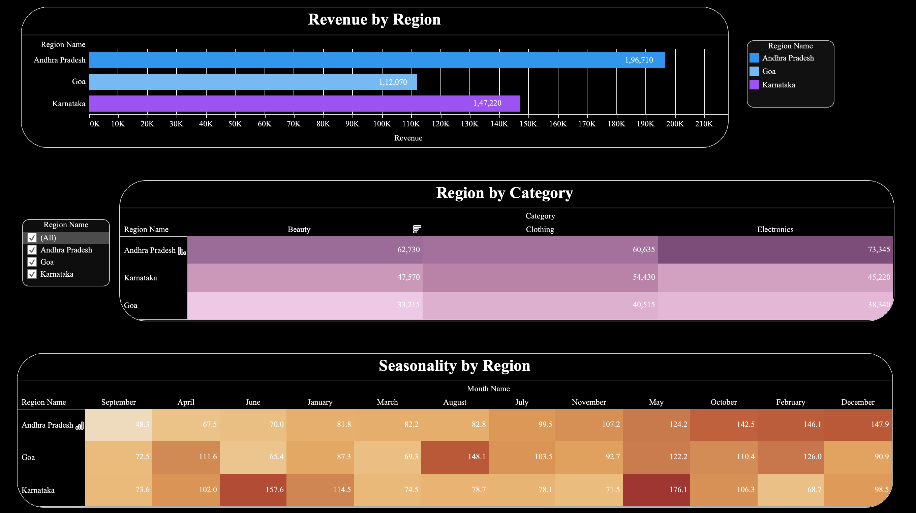
07 · REGION-WISE ANALYSIS
Revenue, Category & Seasonality by Region
Region Leaderboard
Andhra Pradesh
43.1%
₹1,96,710
Karnataka
32.3%
₹1,47,220
Goa
24.6%
₹1,12,070
Andhra Pradesh leads with 43.1% revenue share and the strongest growth trend — a clear priority market for expanded marketing investment.
Real-Time Sales Performance Analytics Dashboard | Chandigarh University
16

Slide 17
08 · FINDINGS & CONCLUSION
Key Findings & Recommendations
KEY FINDINGS
TOP RECOMMENDATIONS
Revenue grows steadily at +$144.90/month
May is peak ($53,150); September is trough ($23,620)
Andhra Pradesh leads regions with 43.1% revenue share
Category mix is balanced — no single-category risk
Zero repeat buyers — major retention opportunity
Launch a loyalty programme (+15–20% revenue potential)
Pre-May inventory build-up to prevent stockouts
September promotional campaign to offset the trough
Expand marketing focus in Andhra Pradesh
Migrate to PostgreSQL for production-scale growth
CONCLUSION
This project delivers a complete, production-quality retail analytics solution — from raw CSV to a published, filterable Tableau dashboard — covering 1,000+ transactions across 3 regions, with 25 automated tests validating every stage of the pipeline.
Real-Time Sales Performance Analytics Dashboard | Chandigarh University
17

Slide 18
TECH STACK
Python 3.12
pandas / numpy
SQLite (Star Schema)
Tableau Public
Git & GitHub
25 Unit Tests
THANK YOU
Questions & Discussion
Gurram Mahadev Kishan
UID: CUOL725165 | Chandigarh University
github.com/chefmaahi/retail_sales_project
https://public.tableau.com/app/profile/mahadev.kishan.gurram/viz/Realtimesalesperformanceanalyticsdashboardforretailbusiness/Real-TimeSalesPerformanceAnalyticsDashboard?publish=yes

