Slide 1
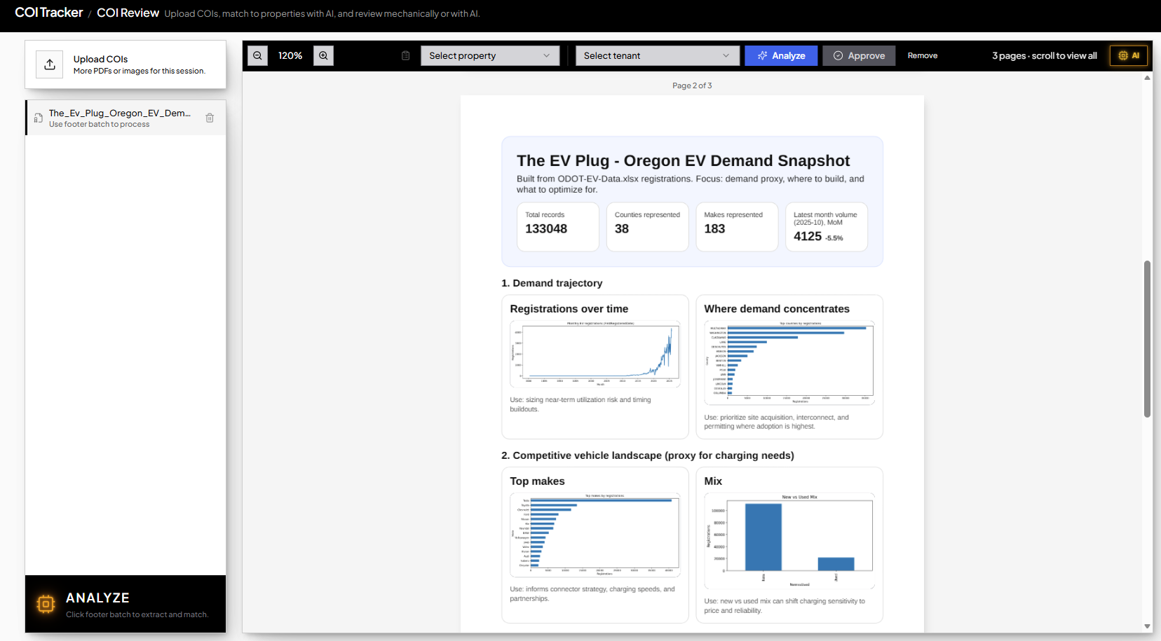
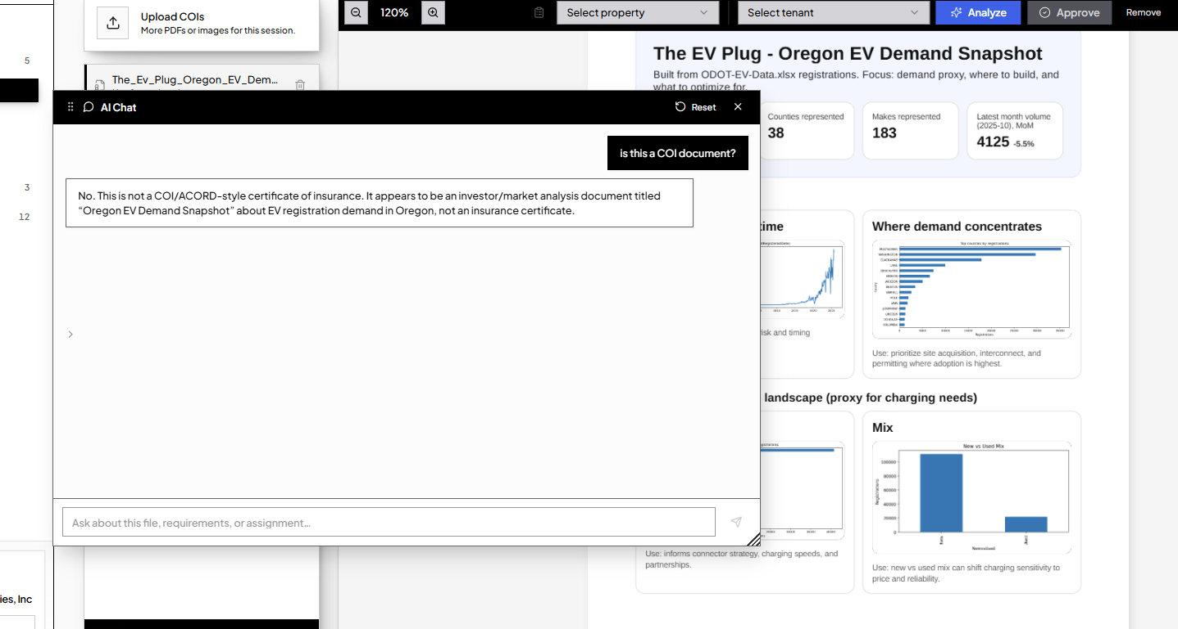
Autonomous AI Certificate Tracker
Performs analysis for selected file
Context Aware Chatbot Embedded
Batch analysis (2 or more files)

Slide 2
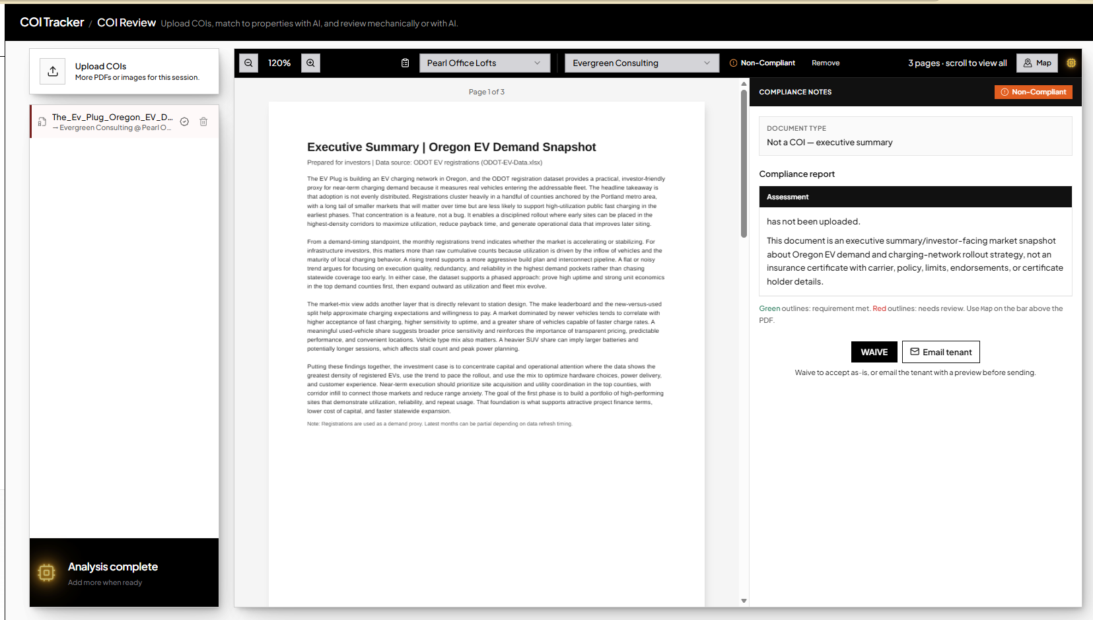
Autonomous AI Certificate Tracker
Analysis Output

Slide 3
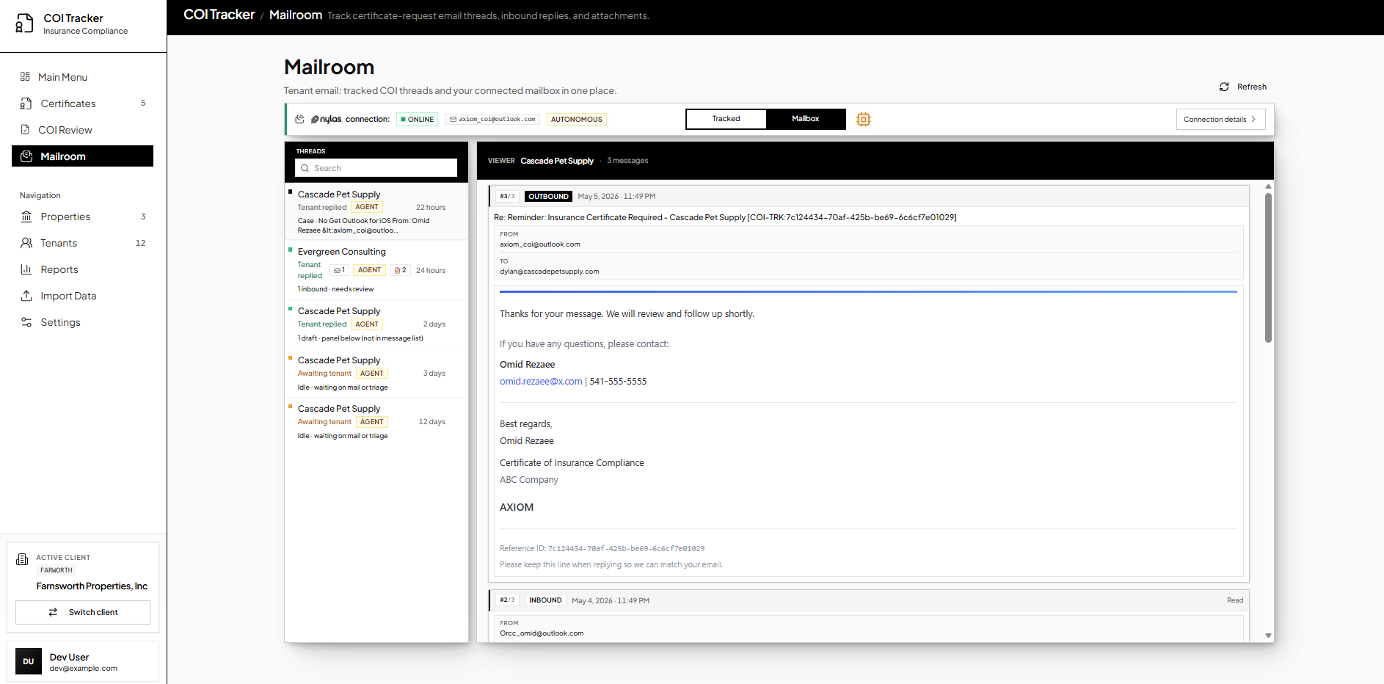
Autonomous AI Certificate Tracker
Autonomous Mode
General Inbox
Tracked Emails

Slide 4
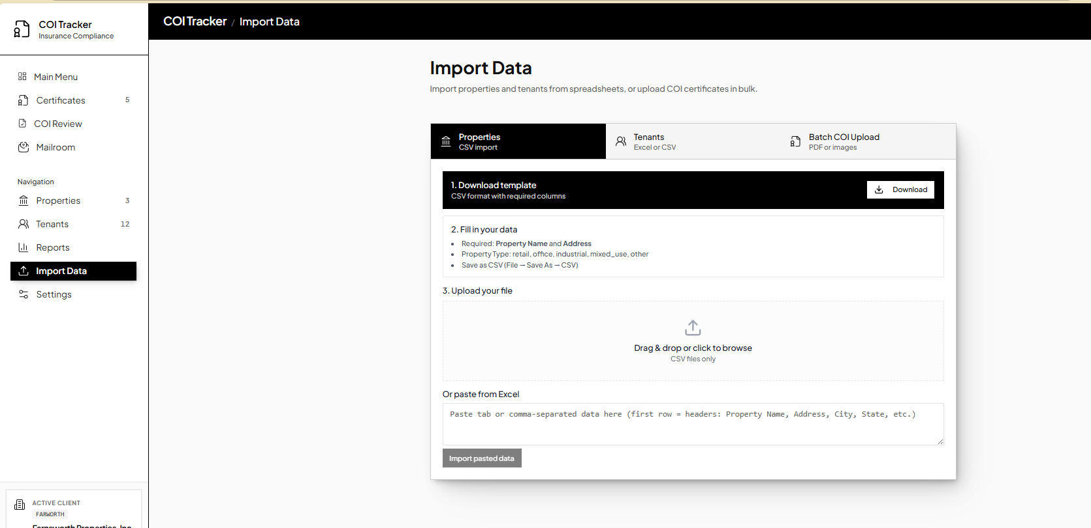
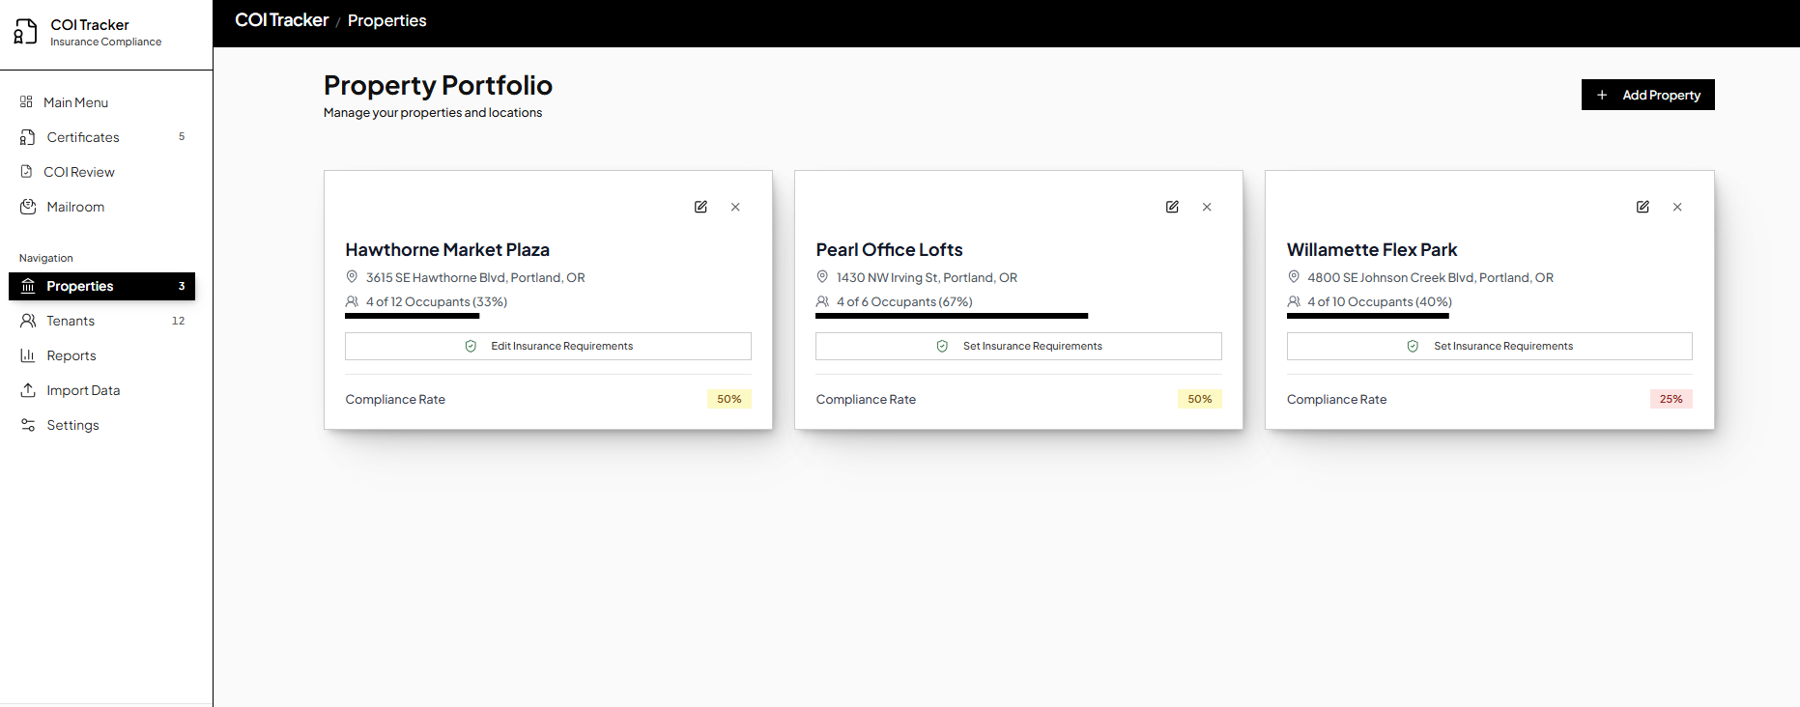
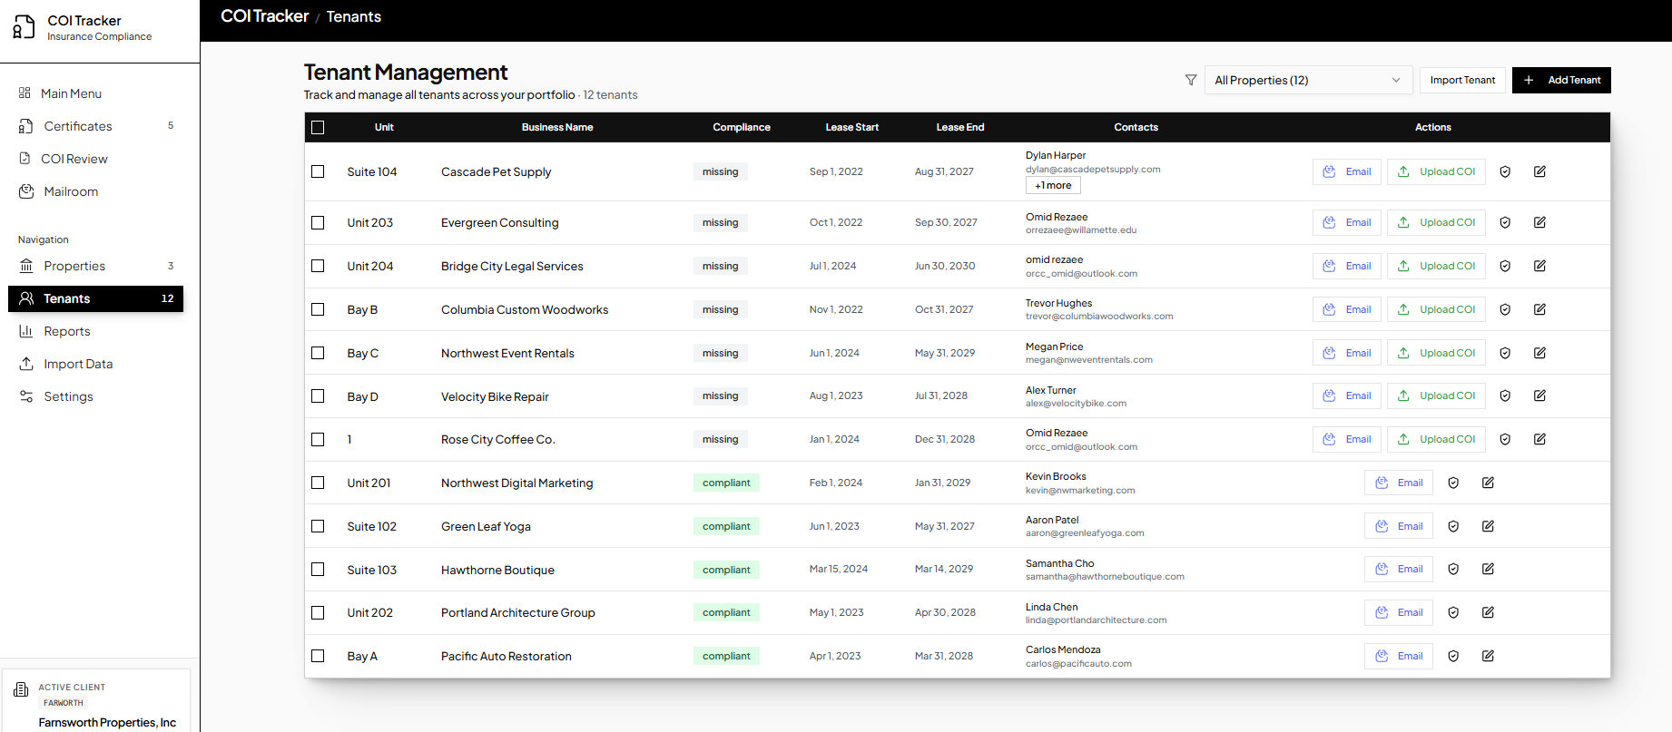
Other disclosed features:
Batch COI upload
rent-roll updates/imports
Property & Tenant Management Interface
Reporting

Slide 5
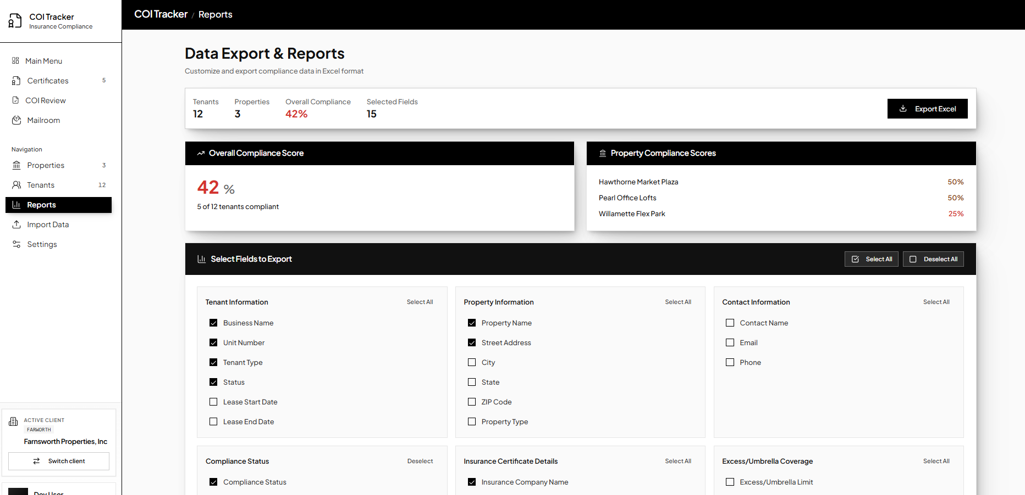
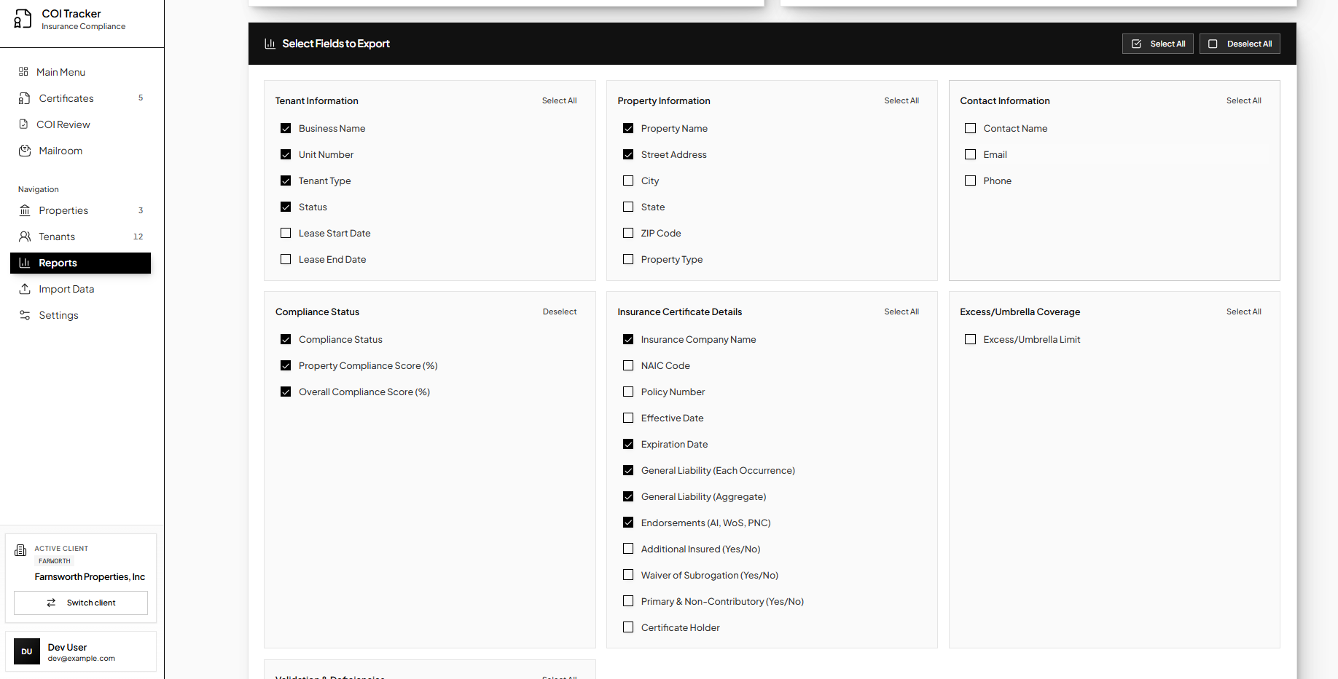
Other disclosed features:
Batch COI upload
rent-roll updates/imports
Property & Tenant Management Interface
Reporting
Flexible

