Slide 1


Machine Learning
With python
cls1: clustering
unsupervised learning types,
k-means algorithm
Notes:
Layout objects pulled from: https://slidesgo.com/
All icons are from: https://thenounproject.com/

Slide 2
Colab workbook
Link: click for access

Slide 3
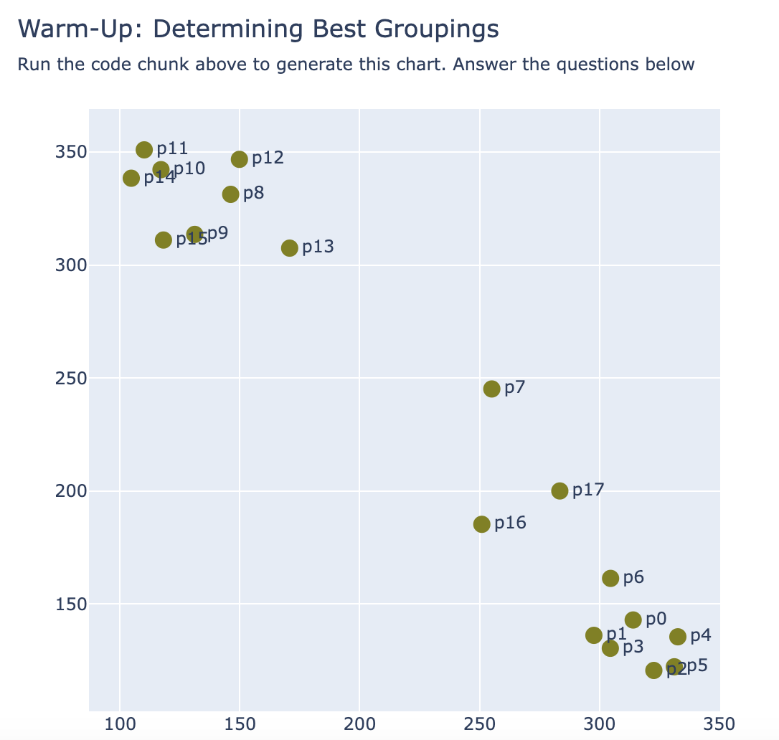

warmup
Questions to consider
How would you split the points below into 2 groups? 3 groups?
What makes points within each group similar? How do points between groups differ?
Are there any points that are hard to assign to a group?
Given we have no ground truth for the points here, how would you summarize information from the clusters?

Slide 4


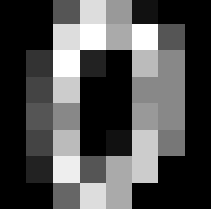
Datasets This Week
Datasets This Week
Lecture
Lab
Wisconsin
Breast Cancer
link: kaggle
Handwritten Digits
link: scikit-learn

Slide 5
Comparing learning approaches
We have seen some examples of complete ML workflow where we have explored a response variable y (target/ground truth) using a set of explanatory variables X (feature set)
example of
let’s look at some options for this approach
response variable y provides a goal for the model like predicting future observations of y, as well as a guide for the model since y contains the ground truth.
only have a set of observations X (feature set) and want to understand relationships among them, which help us find patterns and groups.
Supervised
response variable y is our target
Unsupervised
contains no response variable/target

Slide 6
Unsupervised
contains no response variable/target, only have a set of observations X (feature set) and want to understand relationships among them.
algorithms
apriori: frequent item pairs
FP-Growth: compressed pattern tree
use cases market basket analysis, product recs, health care diagnoses, drug interactions
algorithms
k-means: average-based group centers
hierarchical: nested groups
DBSCAN: point density groups
use cases customer segmentation, similar documents, social network connections, DNA
Association rule
finding frequent patterns or rules
clustering
grouping similar data by characteristics
algorithms
PCA: most important features
t-SNE: visualizes high dimensions
autoencoders: compresses + reconstructs
use cases visualizing high dimensional data, reducing noise, deep learning, RNA sequencing
algorithms
isolated forests: isolates outliers recursively
SVM: finds boundaries
LOF: compare local point densities
use cases financial fraud, system health monitoring, quality control, bacterial growth
Dimension reduction
reduce features while preserving information
Anomaly detection
finds unusual behaviors that deviate from expectations

Slide 7
Principal Component Analysis
when to use and not to use
Good when you
Have redundant or correlated (we call this multicollinearity) features as this reduces them down into principal components
Need to reduce complexity or noise
Remember to scale and find outliers beforehand
Not so good when you
Need interpretability. Principal components are combinations of all features, so hard to translate insights directly back to specific features.
Have non-linear features (use tSNE instead) or categorical features (use autoencoders +OHE instead)
algorithms
PCA: most important features
t-SNE: visualizes high dimensions
autoencoders: compresses + reconstructs
use cases visualizing high dimensional data, reducing noise, deep learning, RNA sequencing
Dimension reduction
reduce features while preserving information
A principal component is a linear combination of all features in a dataset.
The first one created is the most important, as it contains information about the most variability (dimension that has the biggest differences) in our data. Akin to finding what makes the data unique.

Slide 8
The goal of this unsupervised approach is to group similar observations together
clustering
grouping similar data by characteristics
algorithms
k-means: average-based group centers
hierarchical: nested groups
DBSCAN: point density groups
use cases customer segmentation, similar documents, social network connections, DNA
There are different ways to measure similarity and compare groups.
Why clustering?
Discover new patterns and/or groups in data
Use group labels as feature in supervised learning
Where is it useful?
Anywhere you can compute similarity!

Slide 9
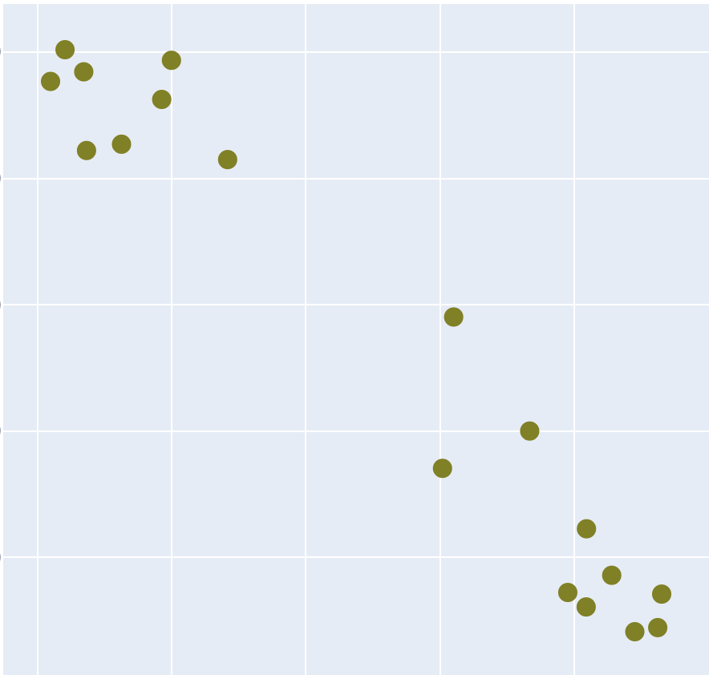

Features can be on different scales and in different units.
You may need to do transformations on your data before measuring distance (more on this next week)
There are different ways to measure similarity and compare groups.
use distance to group points into similar and dissimilar groups
From our warm-up example, we would measure how far apart any two data points are from each other.
Distance measures
Euclidean: point to point
Manhattan: city blocks (L1 norm)
Mahalanobis: point to distribution
correlation distance: used in gene expressions

Slide 10
exercise
Create a function euclidean that takes in two points (dict) and calculates the euclidean distance between the points.
The function should display the information calculated in a nice format.
Example:
pt1 ={'x': 255, 'y': 245, 'id': 'p7'}
pt2 = {'x': 275, 'y': 275, 'id': 'C1'}
euclidean(p1, p2)
Distance between p7 and C1 = sqrt(-20^2 + -30^2) = sqrt(1300) = 36.1
C1

Slide 11
k-means with k=3
needs numerical data!
k-means algorithm
Set k initial centroids randomly
Compute euclidean distance between each point and each centroid
Assign point to nearest centroid
For each cluster, average the coordinates of all of the points, finding new centroid
Repeat 2-4 until clusters are stable (no change in last iteration)
Things to keep in mind:
Depending on initial centroid, you can get different clusters!
Sensitive to outliers and scale
repeat until centroids are stable

Slide 12
first iteration step 2
first iteration steps 3-4
second iteration step 2
second iteration steps 3-4
third iteration step 2
third iteration steps 3-4
stable
check out this tool for visualization

Slide 13
k-means scikit-learn doc (link)
Set k random initial centroids
Compute euclidean distance between each point and each centroid
Assign point to nearest centroid
For each cluster, average the coordinates of all of the points, finding new centroid
Repeat 2-4 until clusters are stable (no change in last iteration)
hyperparameters
n_clusters: arguably most important parameter is finding optimal k (we’ll see how to pick later this week)
init: defaults to k-means++ (randomly spaced out), can also be random
max_iter: can set upper threshold on max number of iterations
random_state: makes random init reproducible
Example of using this algorithm
from sklearn.cluster import KMeans
KMeans(n_clusters=2, random_state=42, max_iter = 1000)

Slide 14
Other clustering algorithms
k-medoids: alternative to k-means when Euclidean distance isn’t useful. Good with outliers as the medoid is an actual data point rather than a centroid (average point in cluster).
k-modes: categorical version of k-means by deciding clusters by the number of matching categories.
hierarchical: recursively merges pairs of data points using pairwise distance and visualizes uses dendrogram. No need to specify k, but rigid and sensitive to noise.
DBSCAN: labels certain points as core if in a dense neighborhood (nearest points), else points are non-core. Flexible cluster shapes and robust to outliers, but hard to tune.
Gaussian mixture models (GMMs): matches data points to fit into normal distributions using Mahalanobis distance. Also called Expectation-Maximization (EM). More robust version of k-means since probabilistic and flexible cluster shape, though not great on big data.

Slide 15
Work Time
HW3 Q#1
Let’s get a start on some more homework questions. Grab a partner to get started.
View on our website

Slide 16
Machine Learning
With python
cls2: clustering
evaluation, silhouette score
Notes:
Layout objects pulled from: https://slidesgo.com/
All icons are from: https://thenounproject.com/

Slide 17
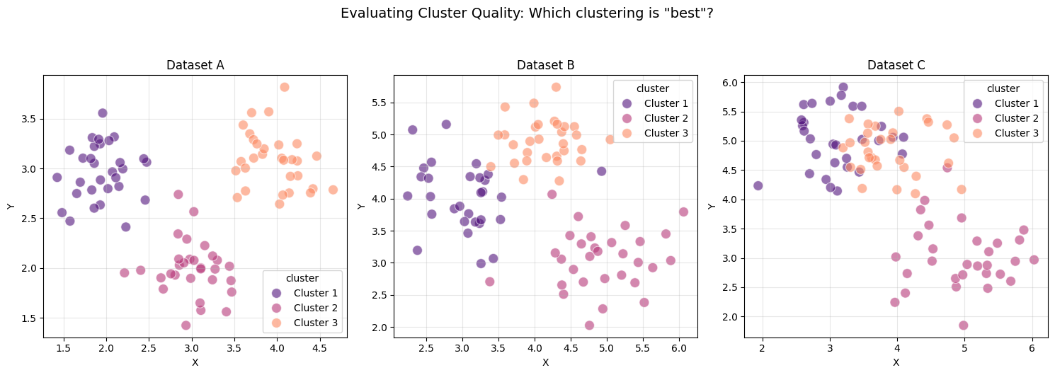
warmup
Which clustering result do you think is "best"? Why?
What criteria are you using to judge the quality of these clusters?

Slide 18
Cluster evaluation
How can we evaluate the results of clustering?
plotting but only if low dimensional
compare with ground truth labels, but only if available
various measures, one being the silhouette coefficient

Slide 19
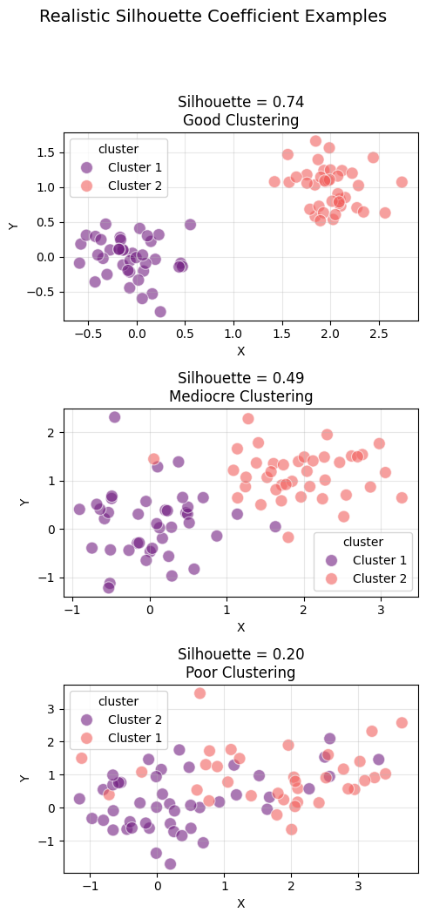
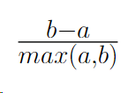
close to 1 clustering is awesome
The silhouette coefficient is a measure for how good a cluster is:
where a is the average intra-cluster distance, or average distance between pairs of points within a cluster; and b is the average inter-cluster distance, or average distance between pairs of points in different clusters
close to 0 clustering is random
close to -1 clustering is opposite

Slide 20
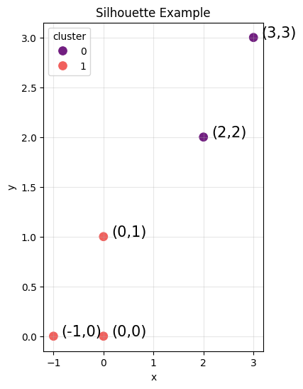
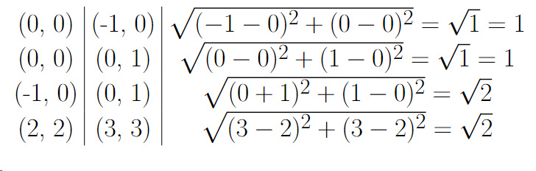
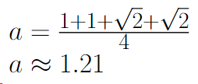
To compute a, find average intra-cluster distance by computing Euclidean distance for each pair of points in the same cluster and then average.

Slide 21
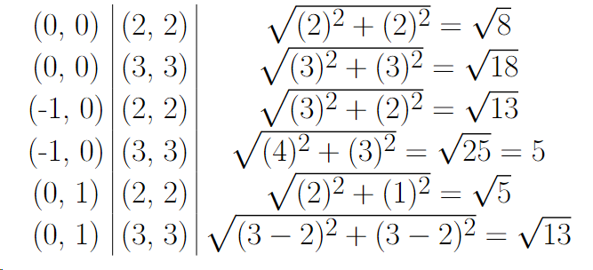
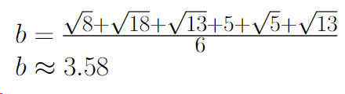
To compute b, find average inter-cluster distance by computing Euclidean distance for each pair of points in a different cluster and then average.

Slide 22
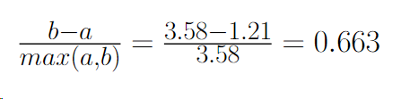
Now what? Well, let’s interpret it!
It’s closer to 1 than 0, so it’s pretty good.
If the clusters were spaced further apart, then this would go up.

Slide 23
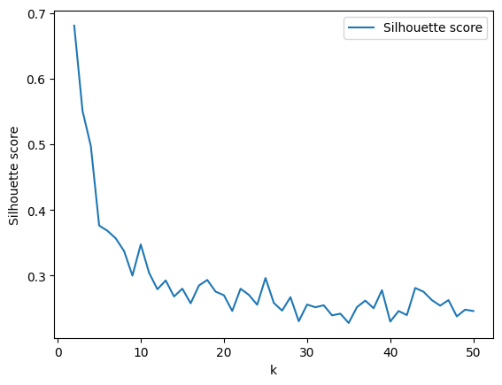
Sooo how to choose k??
optimal when k=2
Well, you either have to:
have domain knowledge, or
try and evaluate different values for k picking best silhouette coefficient
try hierarchical (agglomerate) clustering

Slide 24
Colab workbook
Link: click for access
this workbook contains the code to generate the examples, and can be referenced if you choose to do clustering in your final project.

Slide 25
Work Time
HW3 Q#2
Let’s get a start on some more homework questions. Grab a partner to get started.
View on our website

Slide 26
Quiz EVL
We’ll continue content at 1:50. Spend ~5 minutes on each page, adding explanation where needed.

Slide 27
Machine Learning
With python
cls3: clustering
example workflow
Notes:
Layout objects pulled from: https://slidesgo.com/
All icons are from: https://thenounproject.com/

Slide 28
Model Selection Flowchart
Unsupervised: Dimensionality Reduction
Need to reduce dimensionality?
Y
Unsupervised: Clustering
N
N
Has a Target Variable?
Y
Supervised: Classification
Supervised: Regression
N
Y
Predicting a Numeric Value?

Slide 29
Model Selection Flowchart
Unsupervised: Clustering
k-means
k-modes
N
Y
Prefer probabilities?
Categorical variables?
N
Hierarchical
Y
Y
Y
GMMs
Need to reduce dimensionality?
Y
Unsupervised: Dimensionality Reduction
Specify k?
Hierarchical?
N
N
N
DBSCAN
N
Has a target variable?
Y
Supervised: Classification
N
Y
Supervised: Regression
Predicting a numeric value?

Slide 30
Colab workbook
Link: click for access
Time to see clustering in practice.
Code example using breast cancer data.
While walking through this example, take note of the various steps of the 5-step ML workflow and the various tasks we do within each step.

Slide 31
Example of ML workflow
To better understand how we can organize our workflows, we’ll be filling out the diagram layout using the linked colab workbook.

Slide 32
Exploring Data
Data cleaning
Model selection
Model training
Model evaluation
data insights
cleaned data
selected algorithms
fitted models
model insights
EDA: data is not missing values. correlation plot. high dim -->visualize with PCA. pairplot visualization --> some groupings, try k=2.
DATA: no data cleaning occured.
SEL: unsupervised clustering. using k-means with n_clusters (2,20). baseline random cluster assignment with k=2.
TRAIN: no train/test split since unsupervised.
EVL: clustering metric--> silhouette coefficient. best fit model = 0.69 --> good clustering.
Have target variable --> investigate cluster quality. k=2 Cluster 0 -->130M,1B; 99%M. k=2 Cluster 1 -->82M,356B; 18%M 82%B.

Slide 33
What kinds of exploratory data analysis will you do?
Exploring Data
Data cleaning
Model selection
Model training
Model evaluation
data insights
cleaned data
selected algorithms
fitted models
model insights
Breast cancer dataset from scikit
→
look at data
→
statistical measure
→
visualizations
→
statistical tests
→
data insights
no missing values
target feature: 1 is benign 0 is malignant
PCA pairplot shows some potential groupings
lots of features
nothing
65% benign
try k=2
skip
high dimensional
correlation plot
PCA
not that helpful

Slide 34
What data cleaning, conversion, or preparation will you need to do to prepare your data set?
Exploring Data
Data cleaning
Model selection
Model training
Model evaluation
data insights
cleaned data
selected algorithms
fitted models
model insights
data insights
→
skip
→
cleaned data

Slide 35
Which machine learning algorithms will you use to train models?
Why are you choosing these algorithms?
Exploring Data
Data cleaning
Model selection
Model training
Model evaluation
data insights
cleaned data
selected algorithms
fitted models
model insights
cleaned data
→
learning approach
→
null model
→
simple model
→
complex model
→
selected algorithms
unsupervised
randomly assigning records to k clusters
Kmeans
n_clusters (2,20)
random_state (42)
none
clustering
use k from best-fit
skip
have target variable
investigate clusters

Slide 36
How will you attempt to optimize your models?
Exploring Data
Data cleaning
Model selection
Model training
Model evaluation
data insights
cleaned data
selected algorithms
fitted models
model insights
change complexity by feature OR algo selection
cleaned data
+
selected algorithms
→
tune hyperparameters
→
select test set
→
train models
→
best fit model
Kmeans
n_clusters (2,20)
random_state (42)
unsupervised
Find best fit model
none
silhouette score

Slide 37
How will you analyze the performance of your models?
Exploring Data
Data cleaning
Model selection
Model training
Model evaluation
data insights
cleaned data
selected algorithms
fitted models
model insights
fitted models
→
clustering metric
→
cluster quality
→
cluster investigation
→
results
→
model insights
silhouette score to find best fit model
sil score 0.69
Cluster 0:
#0: 130, #1:1
99% malignant
further look at summary metrics of each cluster
k = 2
good clustering
contains 60% of actual malignant
What identifies Cluster 0?
performs significantly better than random baseline
Cluster 1 mix
Cluster 1:
#0: 82, #1:356
12% malignant, 82% benign
clusters are present
further investigate
contains 40% of all malignant

