Slide 1
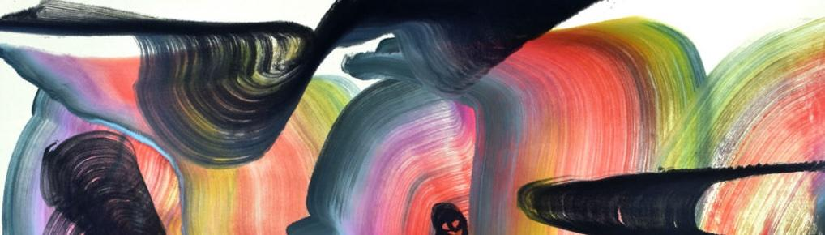

Machine Learning
With python
storytelling
Notes:
Layout objects pulled from: https://slidesgo.com/
All icons are from: https://thenounproject.com/

Slide 2
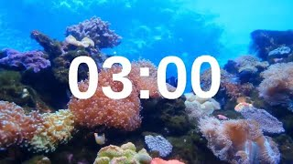
warmup
How do we craft good stories? What are the ingredients?
What comes to mind when you see the term data journalism?

Slide 3
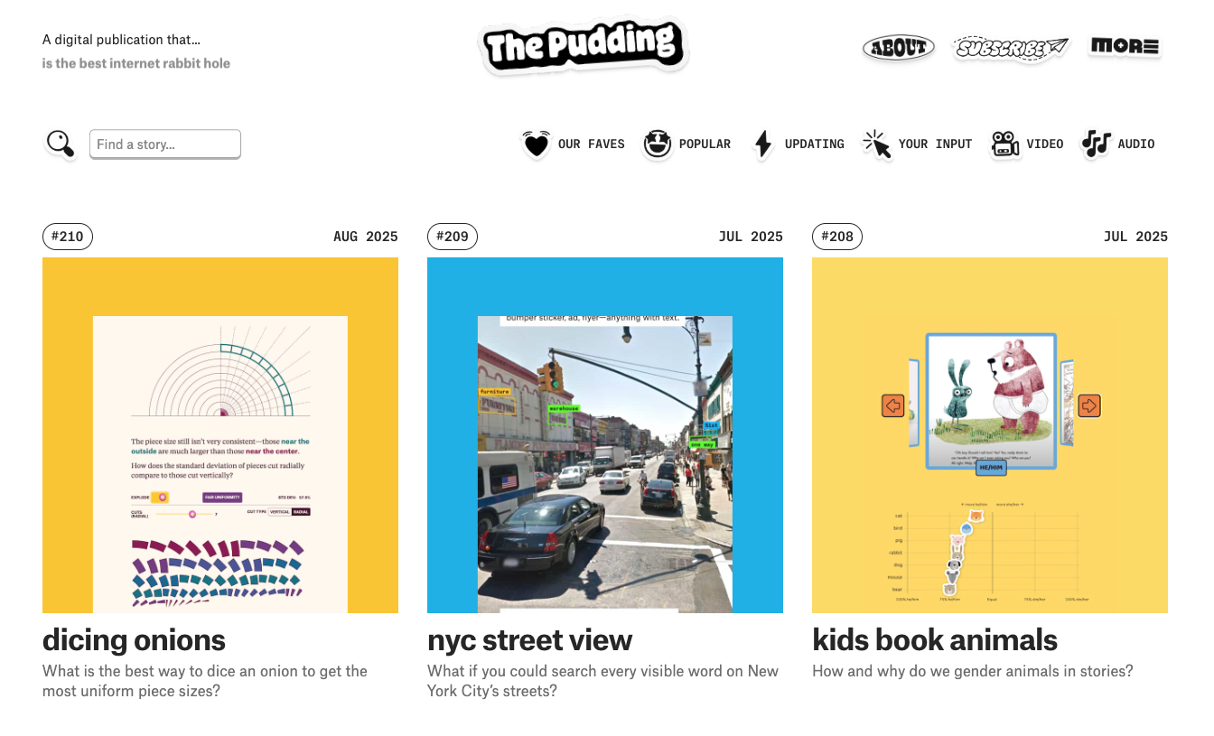
what is data journalism?
involves a blending of journalism with other fields such as data visualization, computer science, and statistics, "an overlapping set of competencies drawn from disparate fields" https://en.wikipedia.org/wiki/Data_journalism
uses technology to access, analyse and find stories in data and then tell the stories of the people the data represents https://www.thebureauinvestigates.com/explainers/what-is-data-journalism
https://pudding.cool/
let’s take a peak at this one

Slide 4
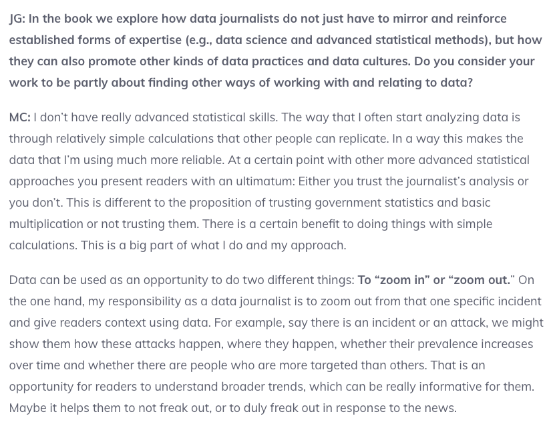
when you have: simple fact
https://datajournalism.com/read/handbook/two/working-with-data/experiencing-data/the-web-as-a-medium-for-data-visualisation

Slide 5
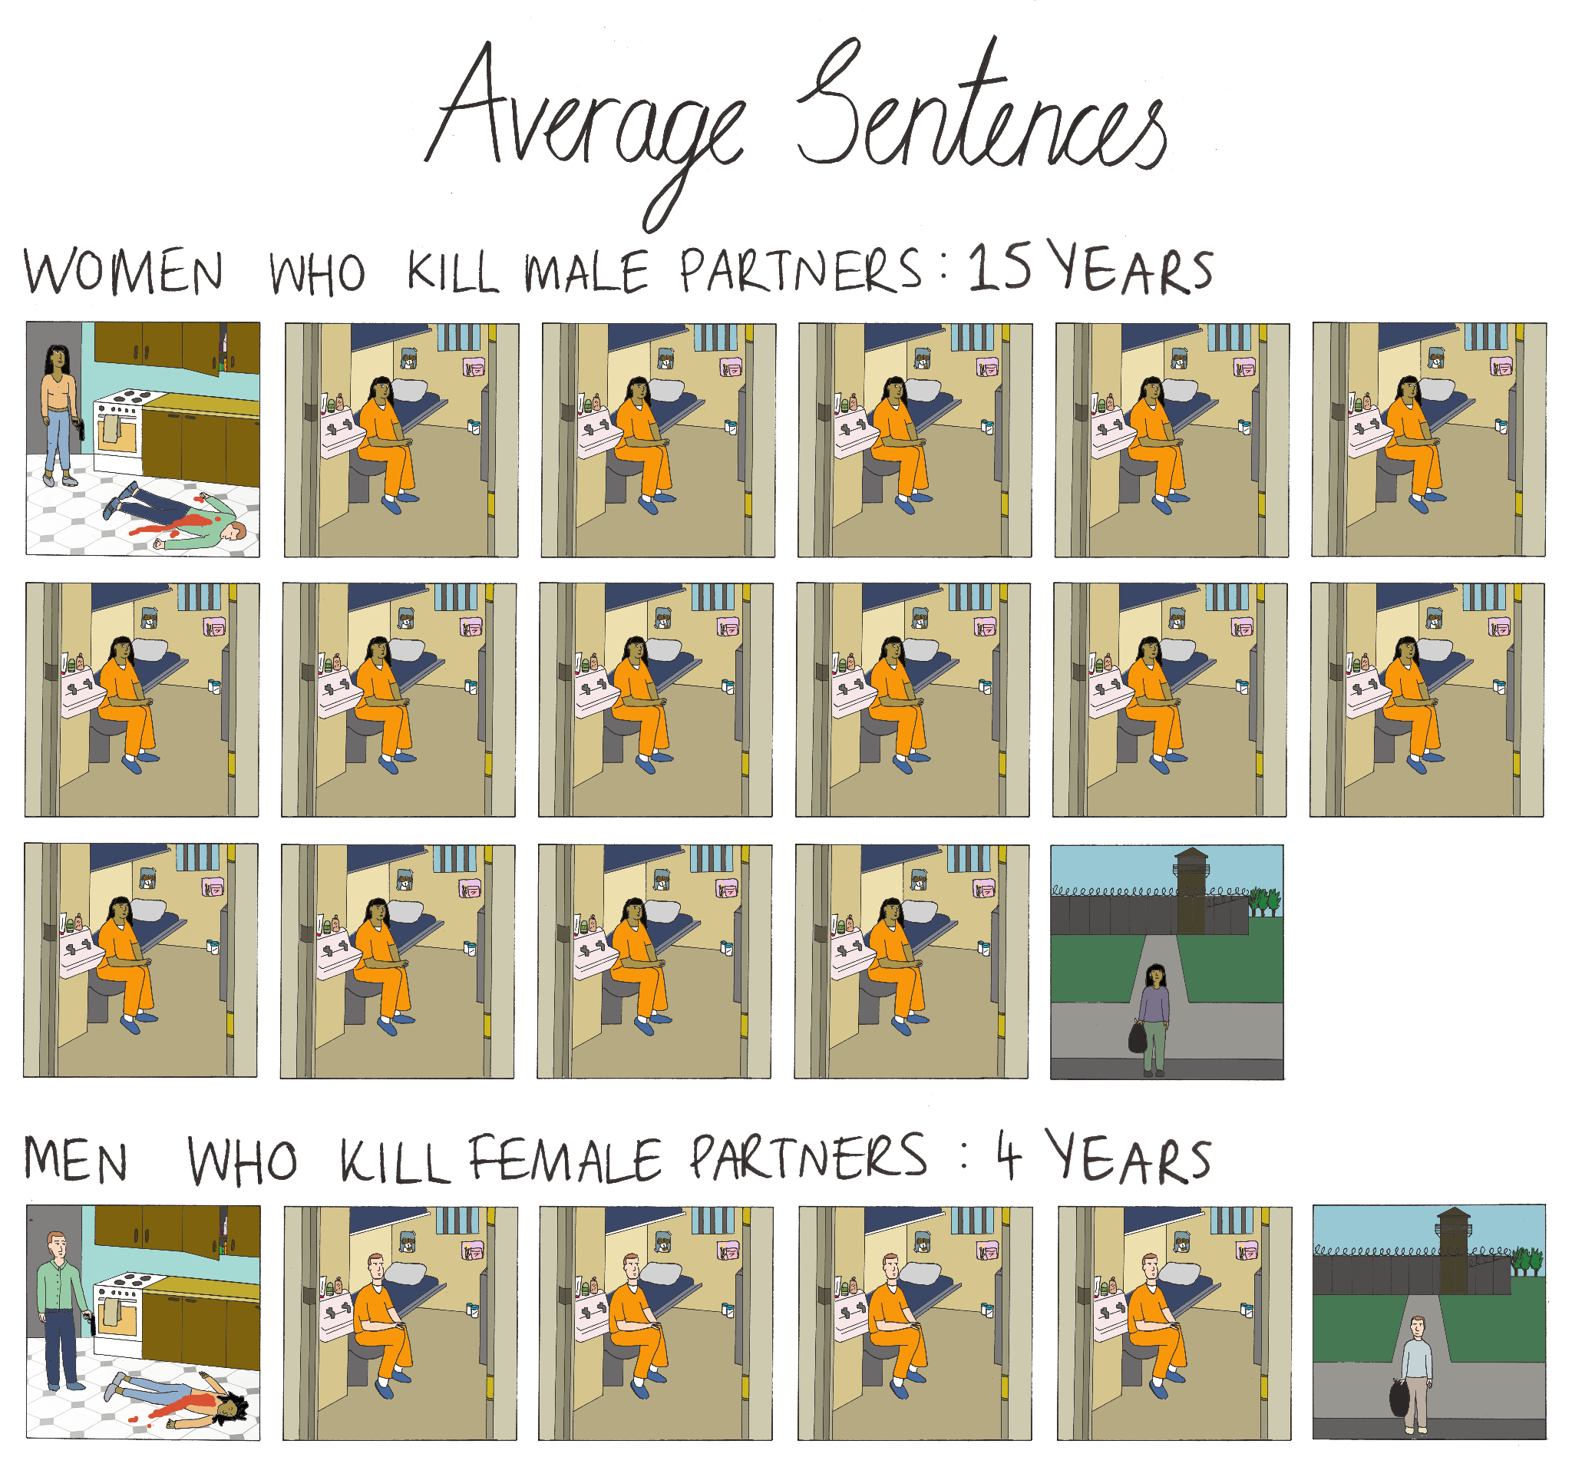
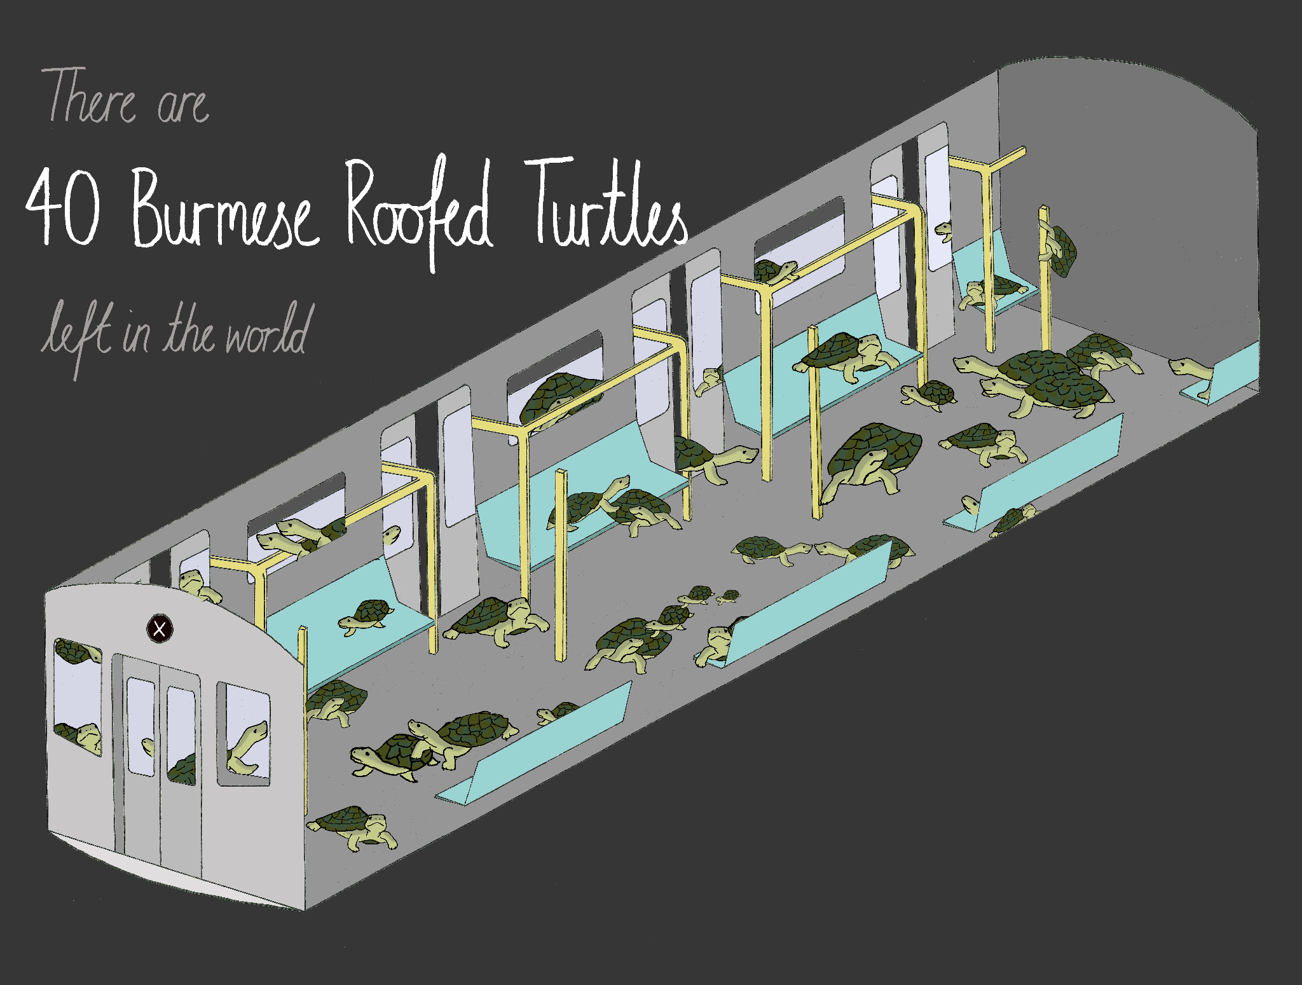
when you have: simple fact
https://datajournalism.com/read/handbook/two/working-with-data/experiencing-data/the-web-as-a-medium-for-data-visualisation

Slide 6
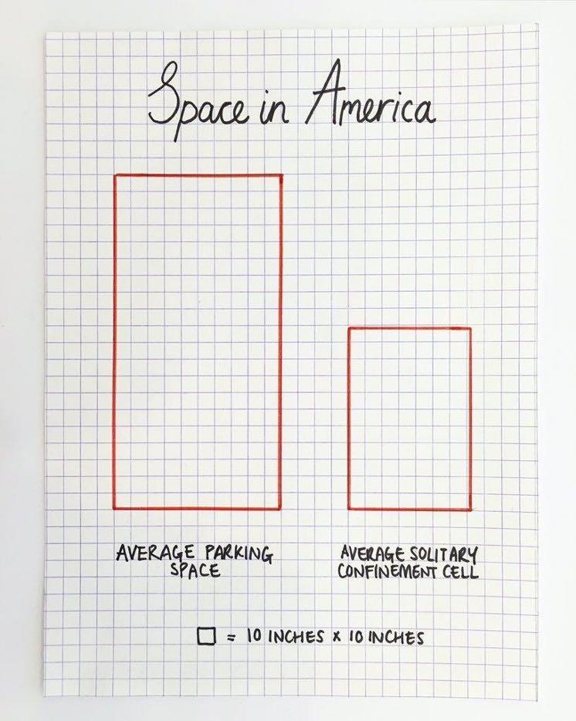
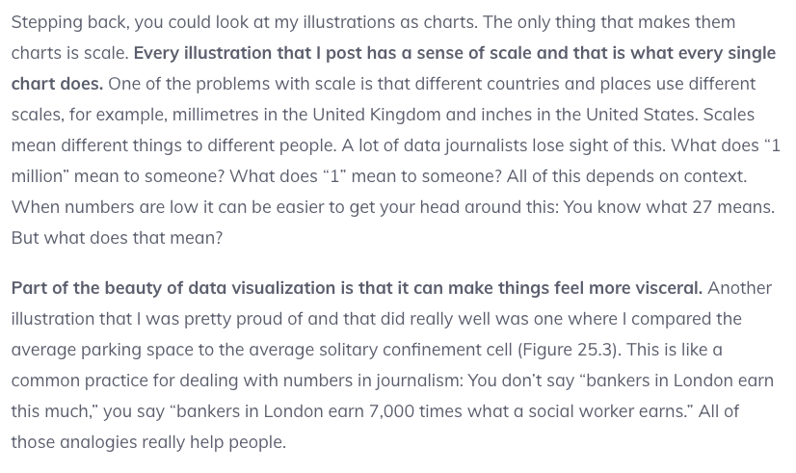
when you have: simple fact
https://datajournalism.com/read/handbook/two/working-with-data/experiencing-data/the-web-as-a-medium-for-data-visualisation

Slide 7
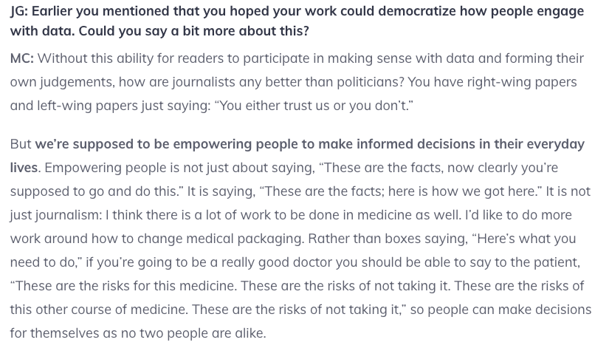
when you have: simple fact
https://datajournalism.com/read/handbook/two/working-with-data/experiencing-data/the-web-as-a-medium-for-data-visualisation

Slide 8
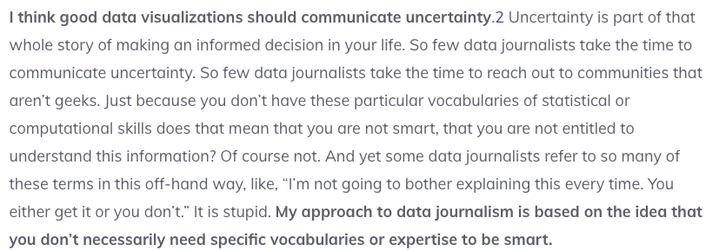
when you have: simple fact
https://datajournalism.com/read/handbook/two/working-with-data/experiencing-data/the-web-as-a-medium-for-data-visualisation

Slide 9
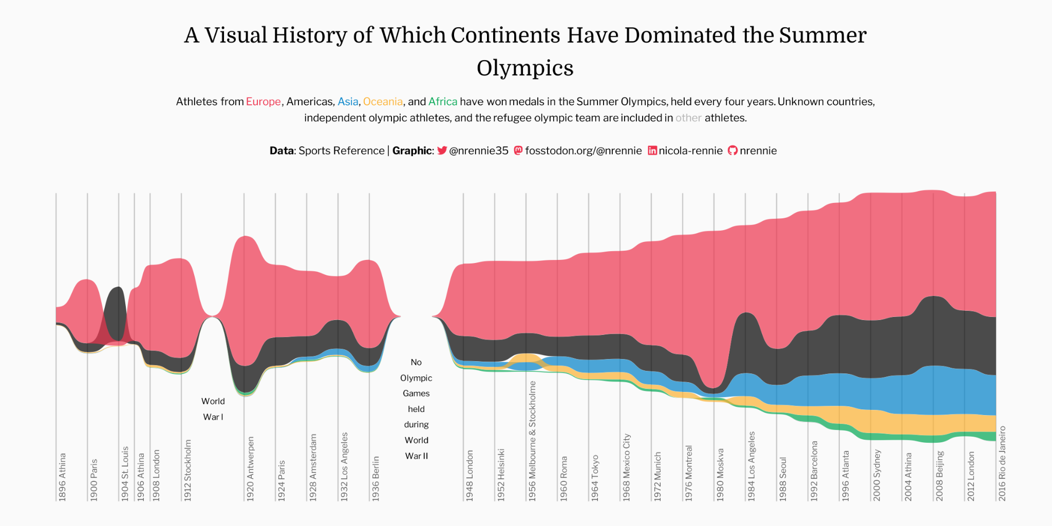
when you have: lots of data
https://nrennie.rbind.io/projects/data-visualisation/#data-visualisation-challenges

Slide 10
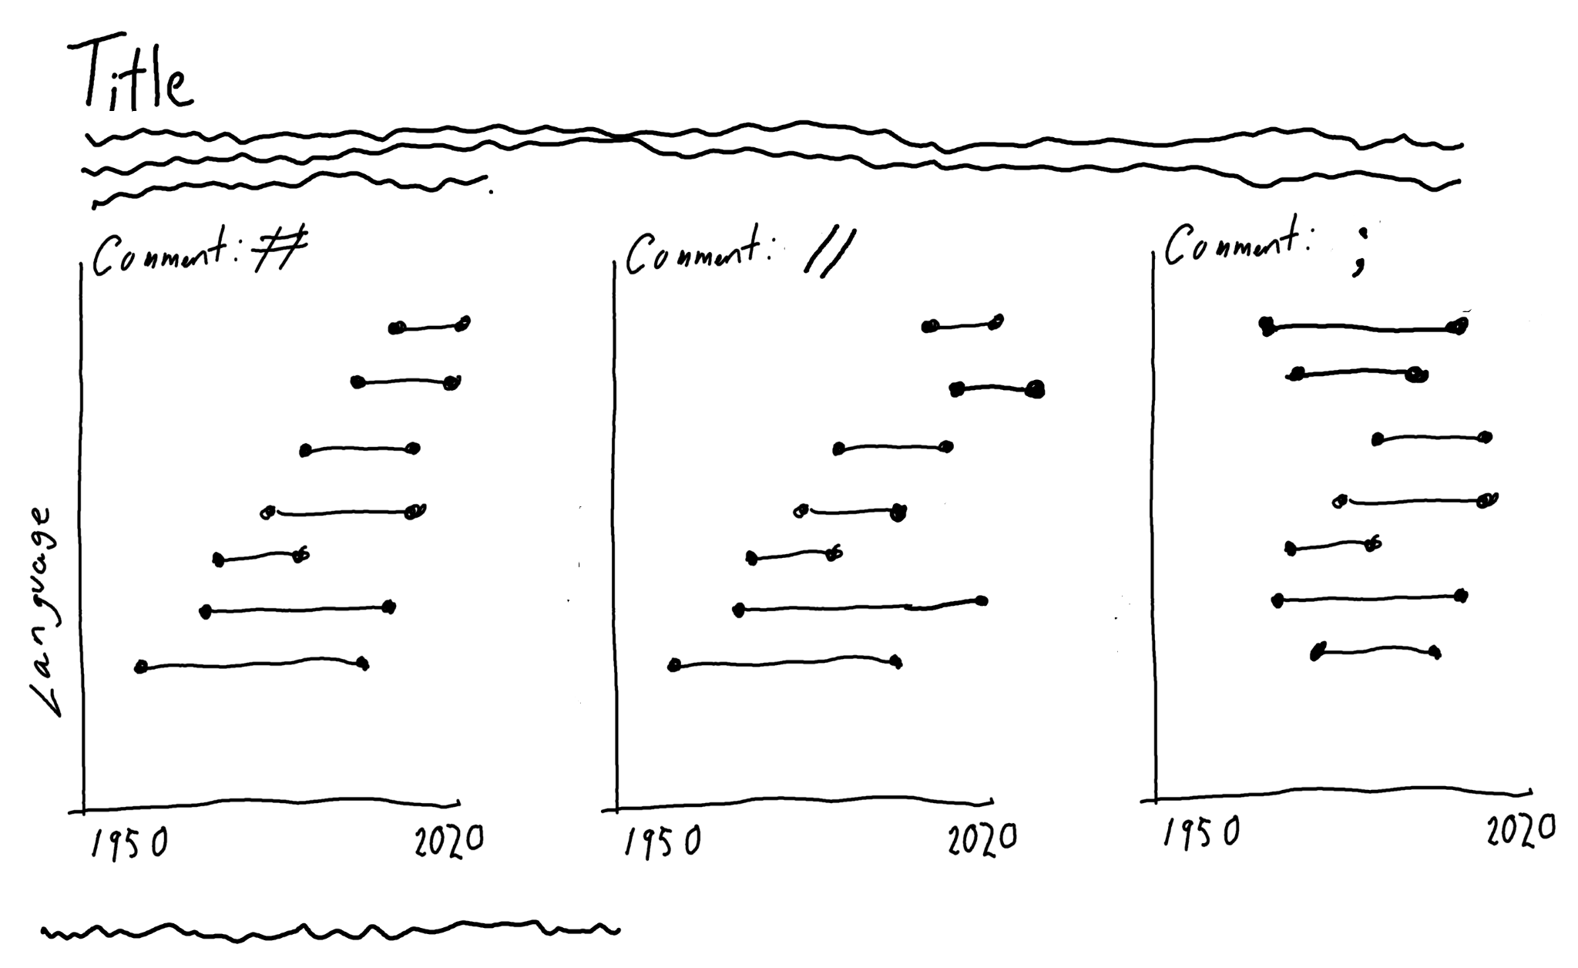
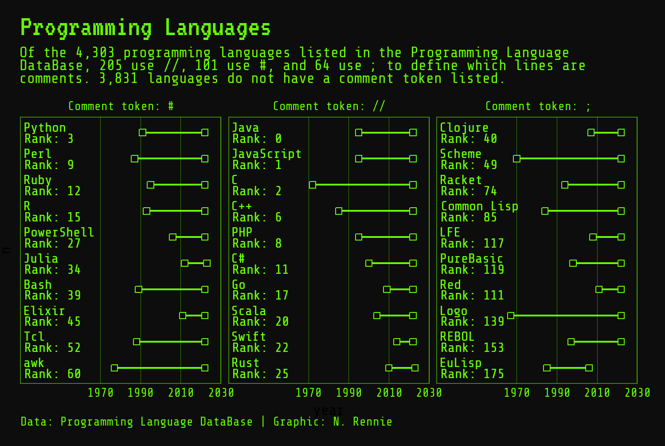
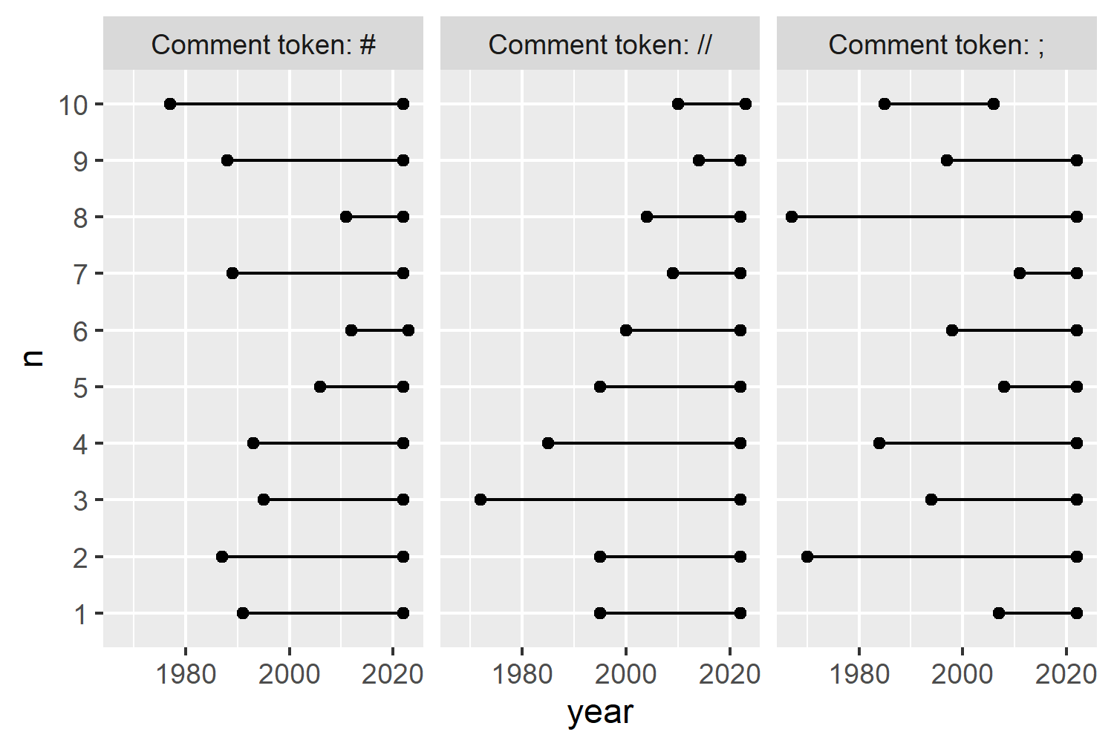
when you have: lots of data
Start small with a sketch of what you’d like to show.
Build up from the sketch, using inspiration from others.
https://nrennie.rbind.io/art-of-viz/programming-languages.html#exploratory-sketches

Slide 11
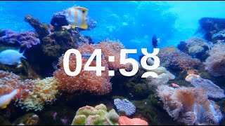
Exercise
What is a story, and what different formats can a story take (think beyond essays)?
Is there a structure or formula for what makes a good story? What makes things memorable? Can stories be addictive?
What aspects about our semester projects could help to build a good story? What would the audience need to know to understand the “so what”

Slide 12
What is a story?
A set of observations, facts, or events (true or invented) that are presented in a specific order such that they create an emotional reaction in the audience.
The emotional reaction is created through tension at the beginning of the story followed by some type of resolution towards the end.
The flow from tension to resolution is called the story arc.
Every good story has a clear, identifiable arc.
what’s the recipe for a good story?
Similar to how you answer job questions, actually!
In interviews we use the SHARE method: situation, hindrance, action, results, and evaluate.
In stories we can use the Opening-Challenge-Action-Resolution format.

Slide 13
How can data add to a story?
You can aim to have a visualization for each section: opening, challenge, action, and resolution. These can take various forms, so try a few out and see what makes sense.
Rarely can a static visualization tell an entire story. It may illustrate the opening, challenge, action, or resolution, but unlikely to convey all or multiple parts of the story all at once.
how to make good visualizations
Put your insight in the title, and pick an appropriate chart. This helps to make your visual memorable and useful when telling the story
Limit colors to highlight the key insight. Make sure to be consistent with color
Add legends and labels that are customized. Any additional context can be added as a caption.

Slide 14
how to build a compelling story
Hook: capture the reader's attention
Context: provides background information
Tension: what conflicts or challenges are present
Opinions: what makes this a human story, share insights or opinions from real people
Implications: for whom and in what circumstances would this lead to a less than ideal outcome
Closing: bringing it all together

Slide 15
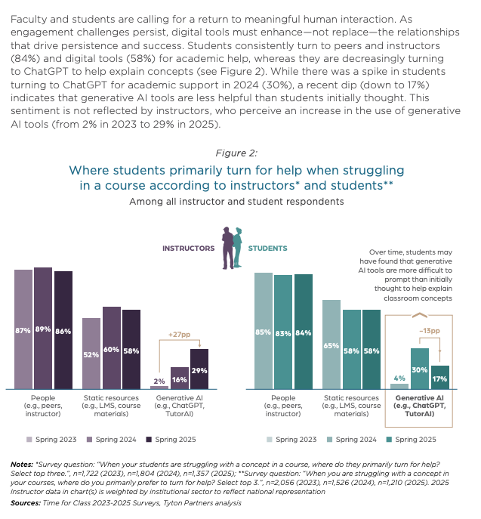
Hook: “Despite uptake of genAI usage in recent years, students still prefer humans for help 84% of the time compared to 17%.”
Hook : “In the past year, 13% less students are using genAI, although their instructors think 13% more are using it”
https://tytonpartners.com/time-for-class-2025/

Slide 16
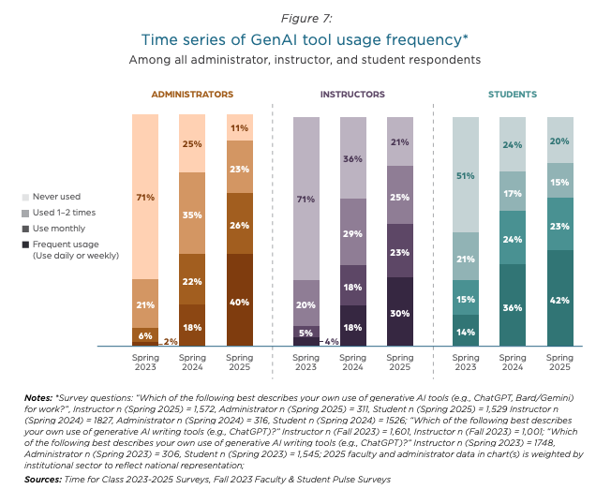
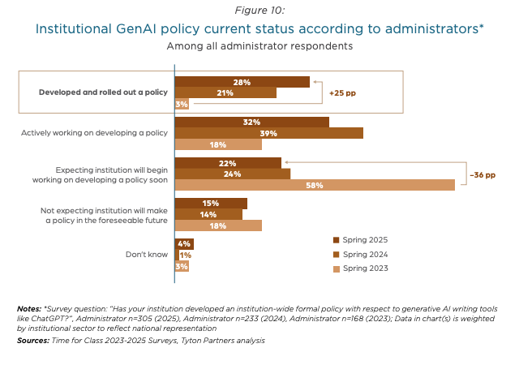
42% of students frequently use genAI
While only 28% of institutions have rolled out a genAI policy
https://tytonpartners.com/time-for-class-2025/

Slide 17
Let’s practice making some interesting graphics for the stats we have.
Get into groups of 2-3, grab a whiteboard marker and come up with as many examples of how we could visualize these stats.
Go beyond a basic barchart.. how could you make these like the turtles on a train, or space in america graphics?
Hook
Despite significant uptake of usage, students still prefer humans for help 84% vs 17%.” (Fig 2).
Does this indicate a gap in trust? Is it related to accuracy, reliability, or privacy concerns?
Context
AI is widely used by students (42% weekly, Fig 7).
Clear adoption in recent years. Ask for whom? Who benefits most, and who risks misuse or overreliance?
Tension
Institutions lag on policy (28% formalized, Fig 10).
Students may be unsure about rules? Instructors may be uncomfortable with usage? Policy gaps can create the potential for unintentional misconduct, inequities, or inconsistent AI use.
voices
Add quotes or anecdotes from students & instructors.
This is the human touch.
Implications
Colleges may need to invest more in in-person tutoring and AI literacy.
Ensures equitable support, explores how to verify, and clarifies what responsible AI usage looks like. This protects both students and instructors.
closing “Call to action”
Students still turn to humans over generative AI for help in college settings.
Institutions must align AI tools, policies, and support structures to build trust, equity, and effective learning outcomes.
https://tytonpartners.com/time-for-class-2025/

Slide 18
Exercise
We will be spending the rest of class today building our slide decks. We’re now going to outline the following in a slide deck. Make sure to communicate insights, not just results.
Opening
Background information about dataset and type of information included (be general! We don’t need to know every last detail). Use a hook if you’d like to capture audience attention
Challenge
What question do you want to answer? Why is this important?
Action
How have you dealt with data issues? What type of modeling approach did you use? Pros and cons of various algorithms used.
Resolution
How did you model perform? Where did it go wrong? Any adjustments you would make? How has your solution answered the question and how could it be used?

Slide 19
Machine Learning
With python
presentations
Notes:
Layout objects pulled from: https://slidesgo.com/
All icons are from: https://thenounproject.com/

Slide 20
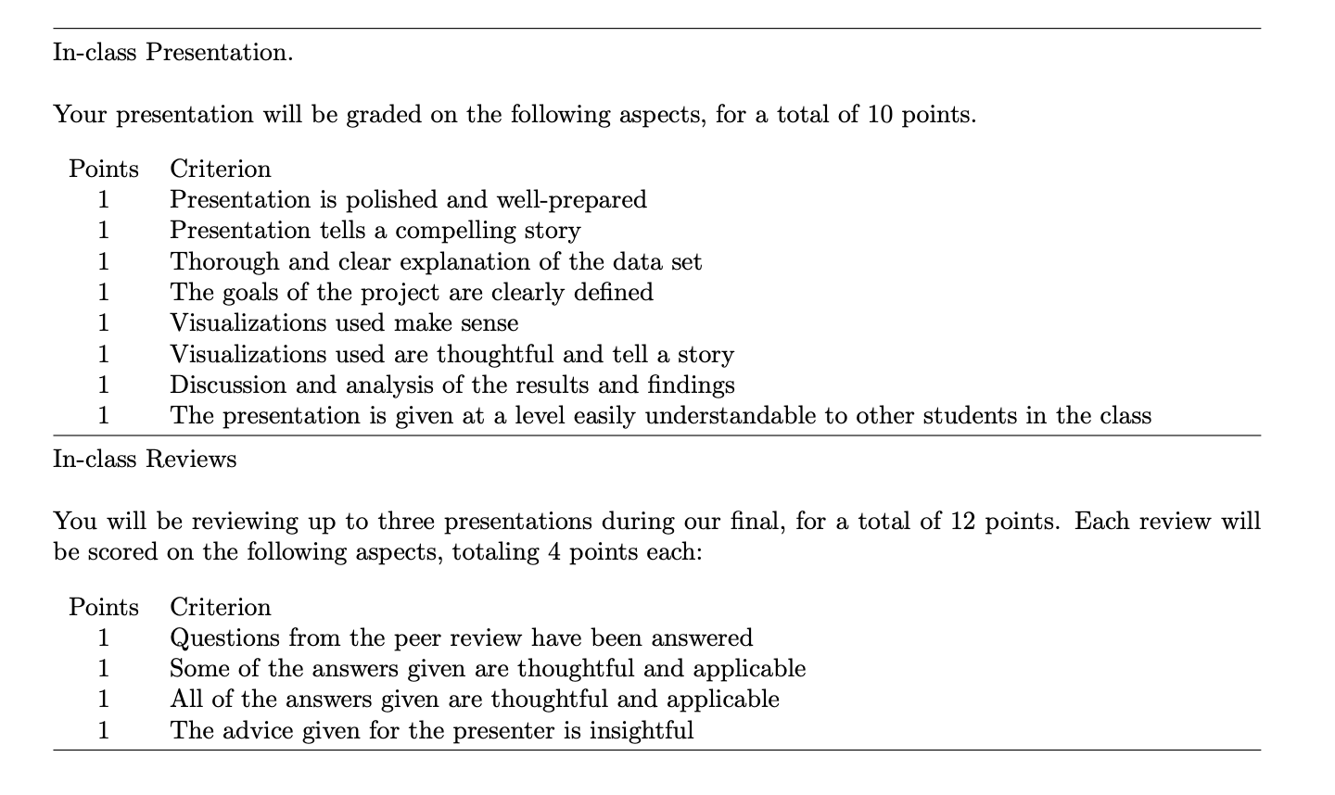
rubric found on course site

Slide 21
What to do as a peer viewer
1. What’s the main question or problem this group is addressing? Write this in your own words. Be specific!
2. What’s their main insight or takeaway? What did you learn? What is the key “so what?” of the data story?
3. Write a 1–2 sentence “elevator pitch” for this project. Imagine you’re explaining this project to a non-technical person in a hallway. Keep it clear and compelling.
4. Who do you think is the intended audience or stakeholder?
5. What’s one thoughtful question or piece of feedback you’d ask as a stakeholder or data reviewer? Try to go beyond “what tool did you use?”
6. What was strong about this presentation or their approach? This can be related to clarity, design, insight, relevance, etc.

Slide 22
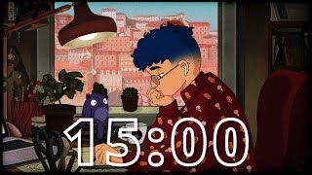
Peer Evaluations
You will spend 10-15 minutes at each table. As a presenter, try to get through slides in ~8 minutes so the reviewer can have 5 minutes to ask questions and fill out the peer review. If you have downtime, feel free to edit your presentation.
Round 1
presentation
Round 2
presentation
Round 3
presentation

