Slide 1


Machine Learning
With python
data1: working with data
EDA and data cleaning
Notes:
Layout objects pulled from: https://slidesgo.com/
All icons are from: https://thenounproject.com/

Slide 2



Datasets This Week
Datasets This Week
Lecture
HW + Lab
1994 Census
link: openml
AirBnB
link: openml

Slide 3
Colab workbook
Link: click for access

Slide 4
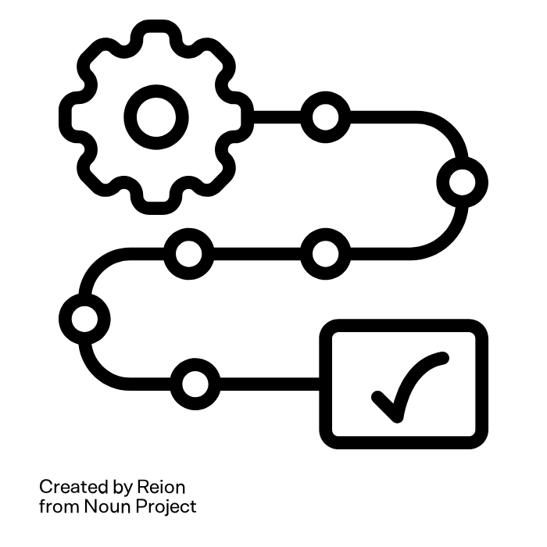

Review
What are the five steps of the ML workflow? Can you name some things we do during the first step?

Slide 5
EDA refresher
research dataset: features types and descriptions
summary statistics
value counts
pairplots
correlations and statistical tests
bar charts or histograms

Slide 6
Why do EDA in the first place?
distributions unbalanced? skewed? Otherwise weird?
missing values keep? drop? fill in?
outliers weird, but reasonable? unreasonable?
relationships between columns linear? nonlinear?
feature selection features that are not useful (e.g. only one value) vs features that are too useful (e.g. ID number)
duplicate examples same entity vs different entities

Slide 7
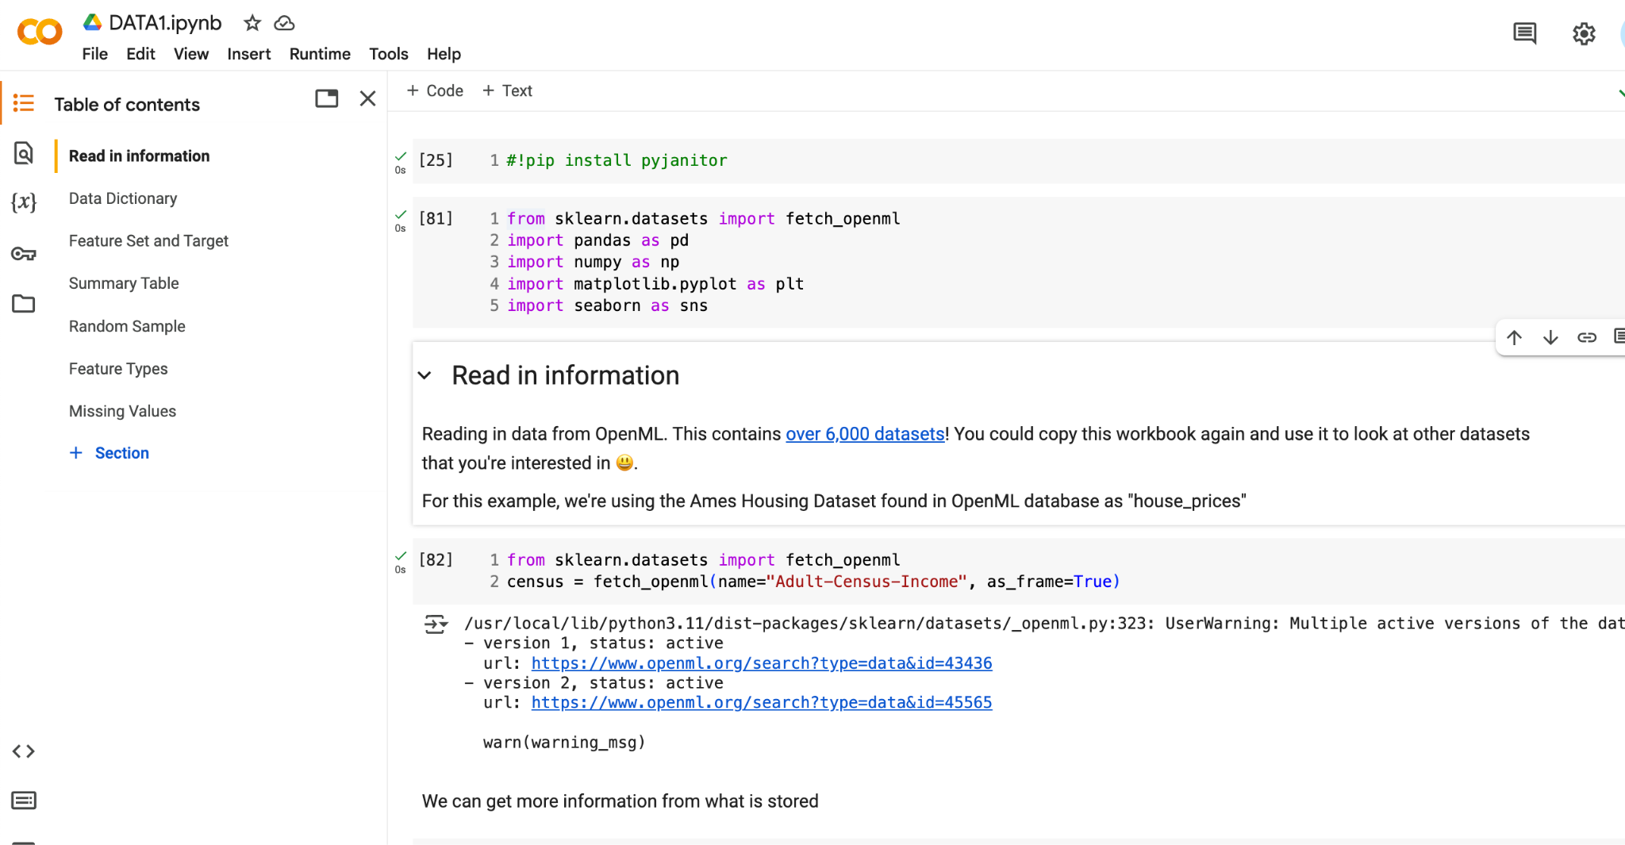

Slide 8
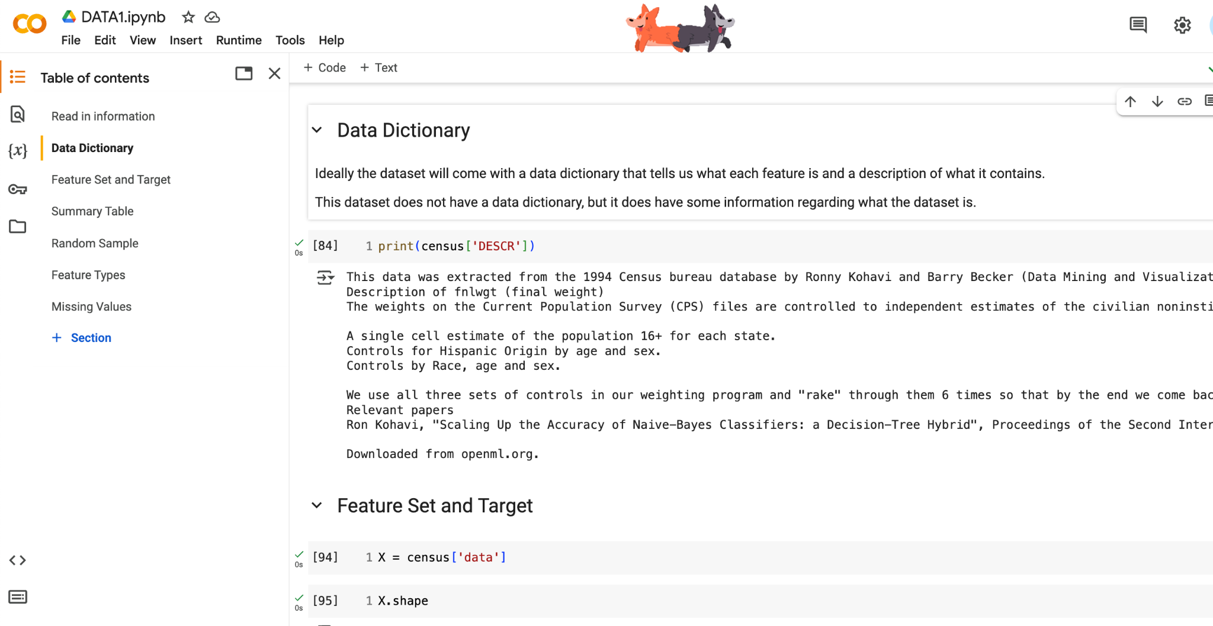

Slide 9
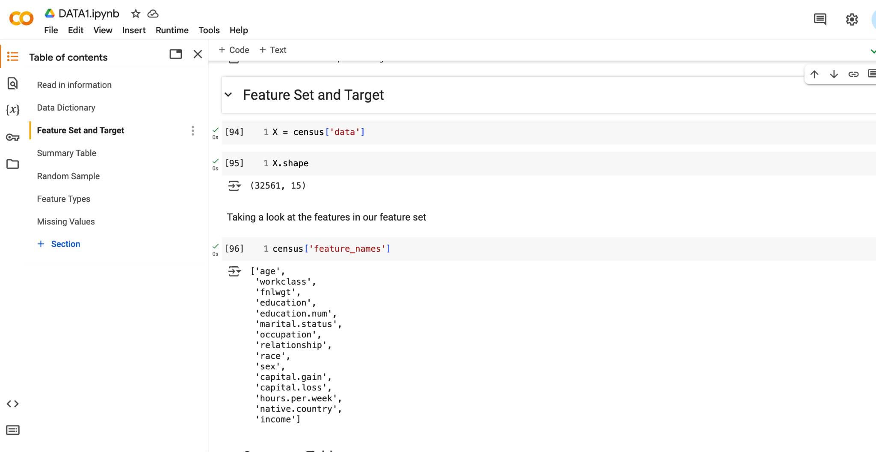
When considering data preprocessing, we’ll need to have a goal in mind.
This dataset is usually used to predict the feature income based off the other features present. We will use this framework as we decide how to clean our data.

Slide 10
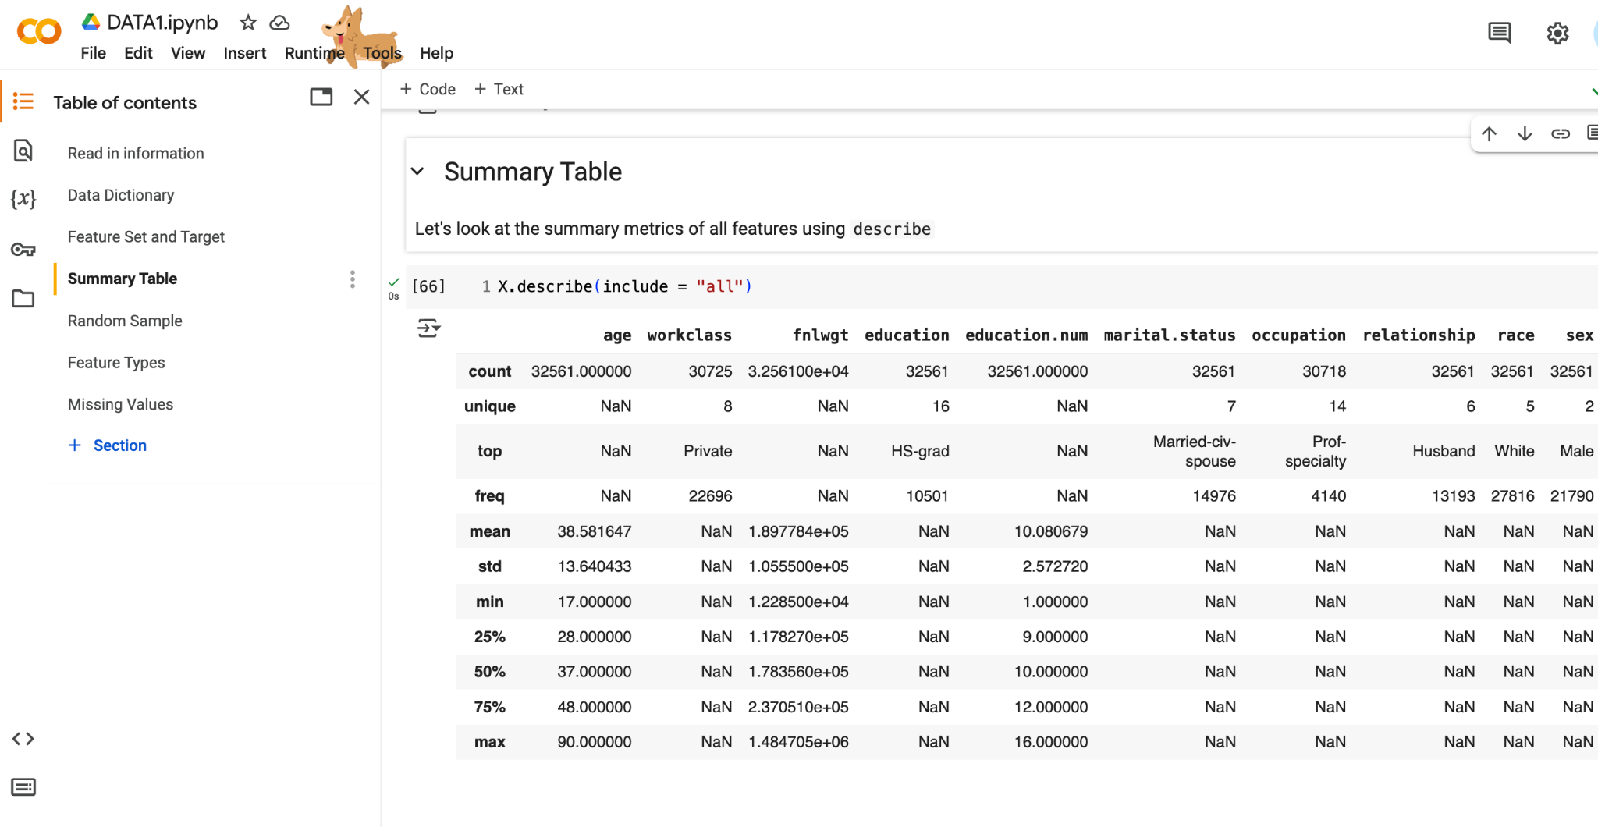

Slide 11
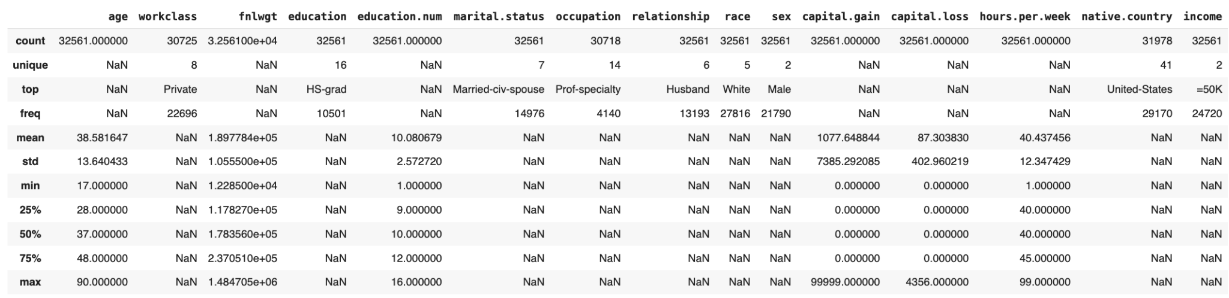
exercise
Look at the summary metrics. What do you notice about the features?
Are any numerical features skewed? Are any categorical features unbalanced?

Slide 12


Data cleaning and preprocessing
Apply changes to dataset, so that it will work better for machine learning.
Application specific.
Exploratory data analysis enhances domain knowledge, arguably the most important.
Research your data, where it came from, talk to experts or stakeholders.

Slide 13
Look for missing values in records
Could be strings like "?" or "NA"
Could be really negative values like -99
Caution: missing values might not be missing
How to deal with missingness in features
drop records with missing values
Categorical
fill in with "Missing" or create indicator variable
Numeric
impute with mean or median or mode, or using ML approach

Slide 14
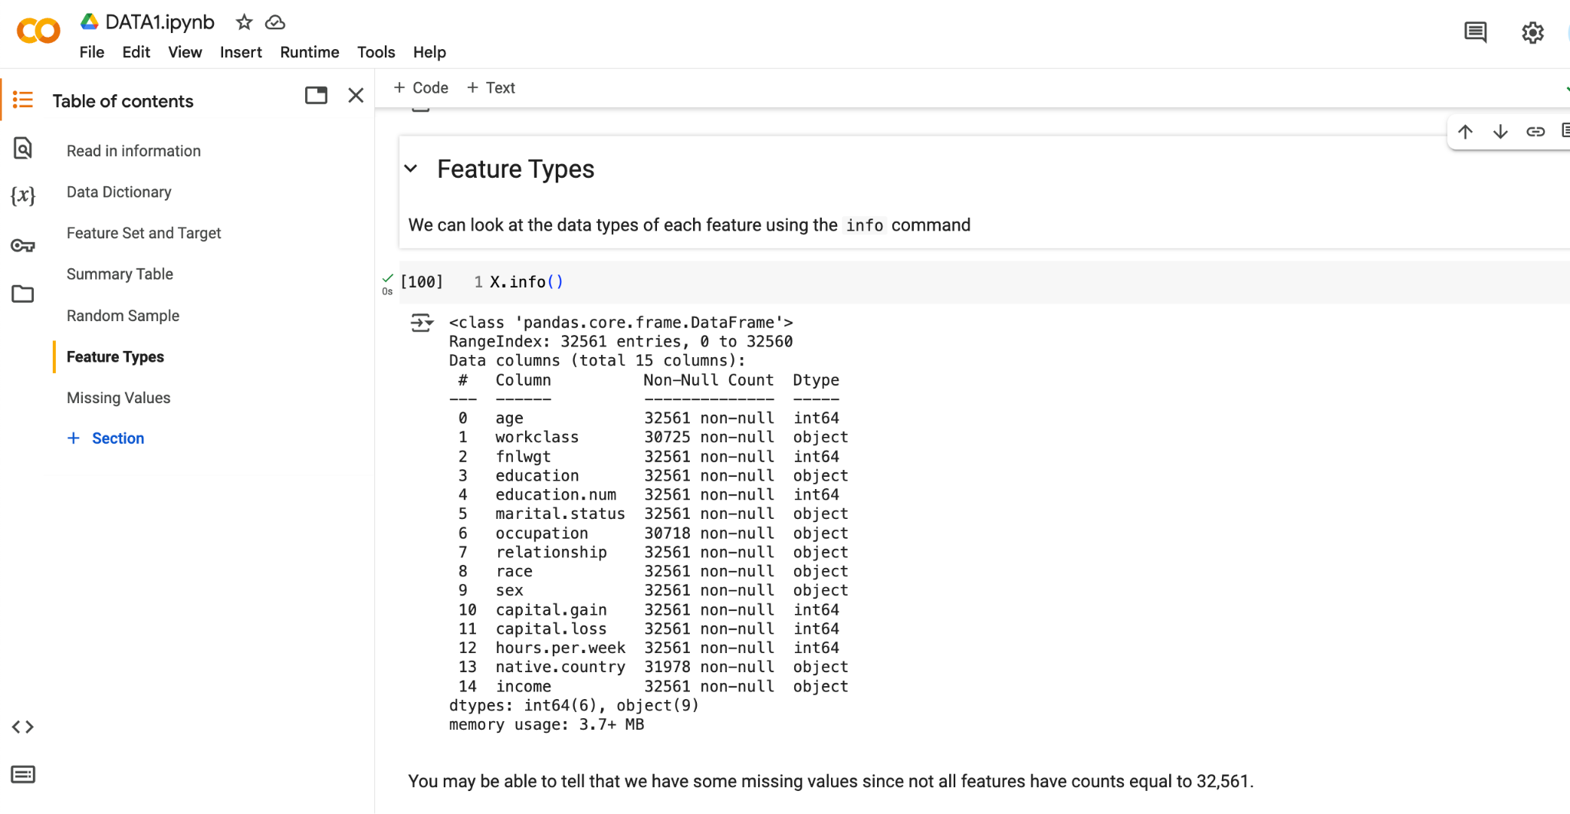

Slide 15
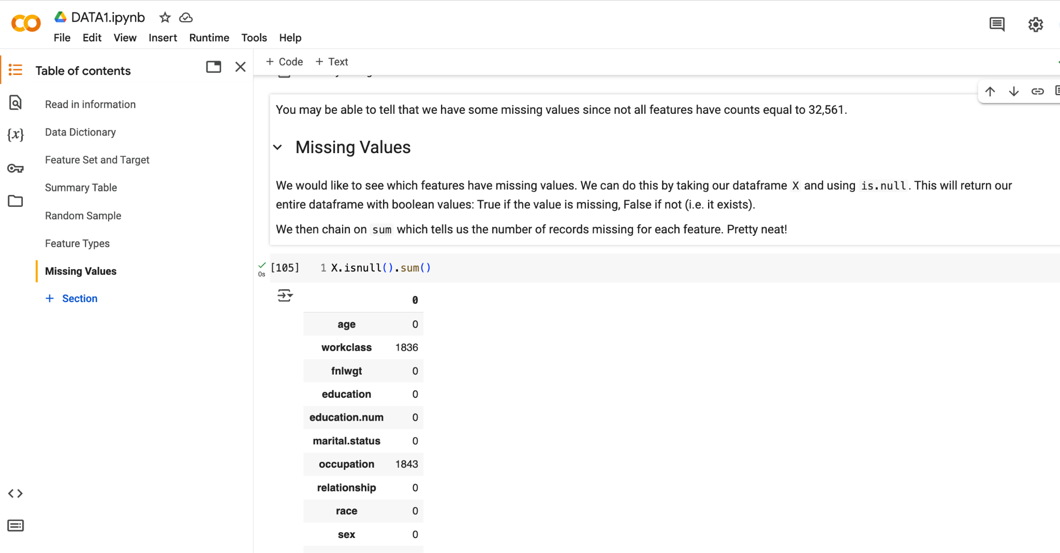

Slide 16
How to deal with missingness in features
drop records with missing values
Categorical
fill in with "Missing" or create indicator variable
Numeric
impute with mean or median or mode, or using ML approach
How to KNOW WHEN TO DROP records
column missing <1% entries
record missing target variable
record missing many entries
column missing many entries
drop column
Caution: be careful about dropping records- might make dataset unrepresentative of real-world

Slide 17
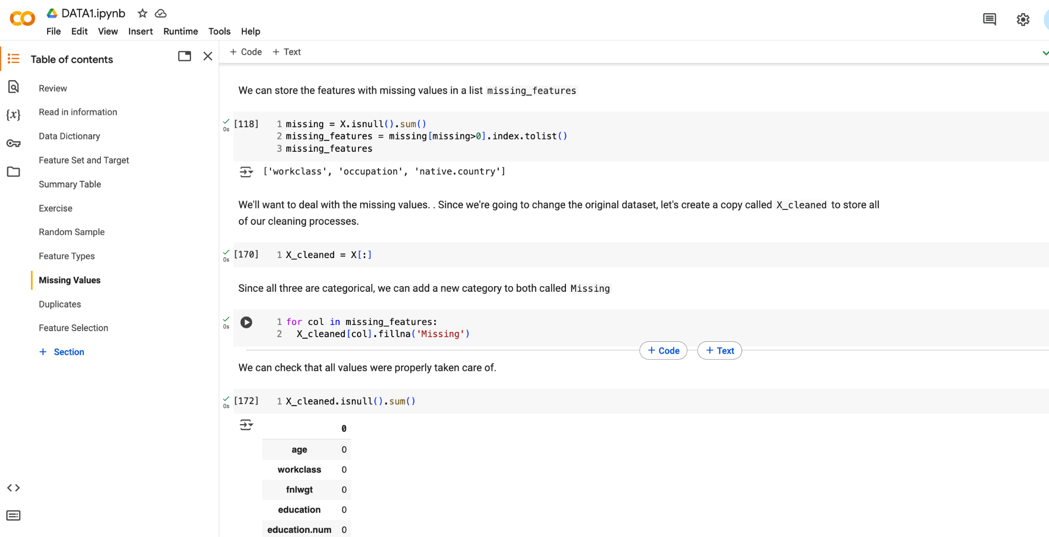

Slide 18
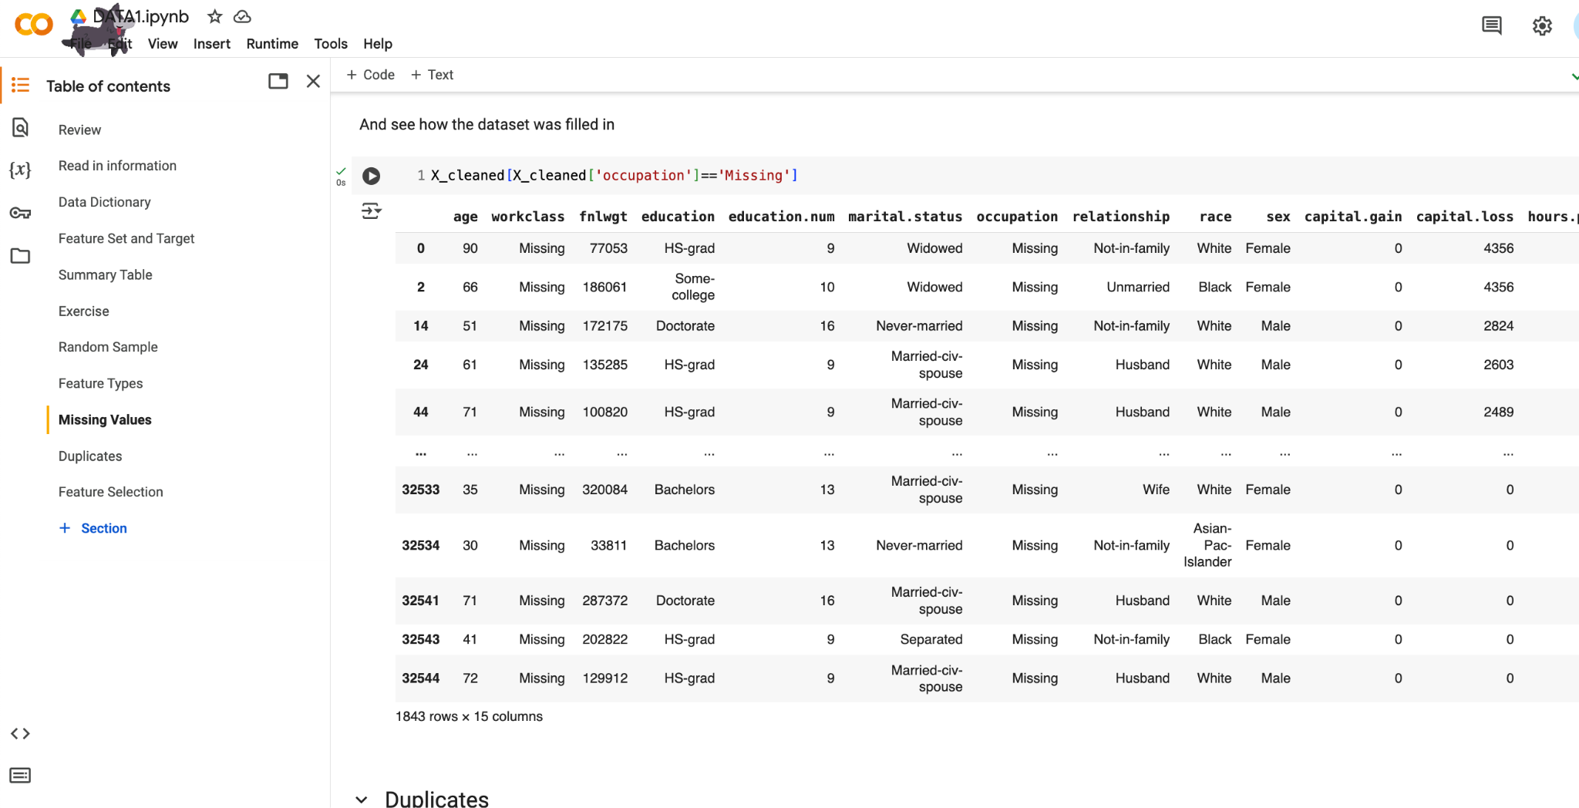

Slide 19
Look for duplicate records
Caution: are these representing one entity (e.g. same person), or two entities with same values (eg. two people with same answers)
if same entity: probably drop one
if different entities: probably keep both
all entries typically the same

Slide 20
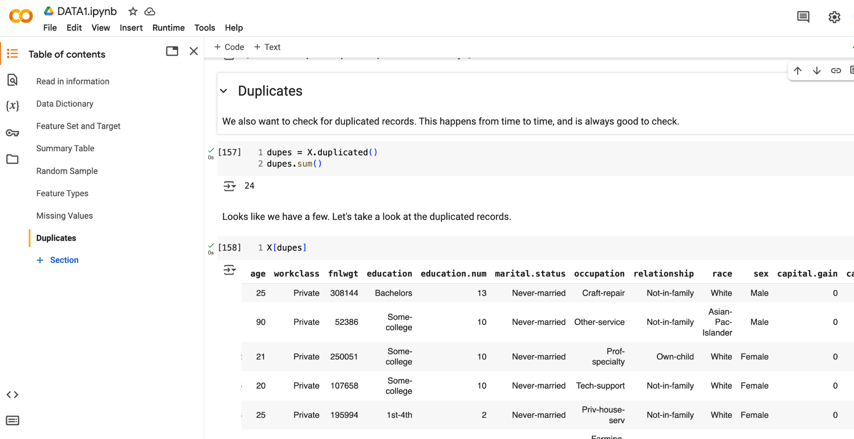

Slide 21
How to KNOW WHEN TO DROP features
not useful
only one value which doesn't help distinguish between examples or EDA
domain knowledge → not useful, would just add noise
too useful
ID number or key as this uniquely identifies example and can lead to overfitting
column missing many entries
> 10% definitely
more than 5%, consider
We often experiment with including and/or excluding features and see how it affects performance
This means multiple recipes to pair with each model

Slide 22
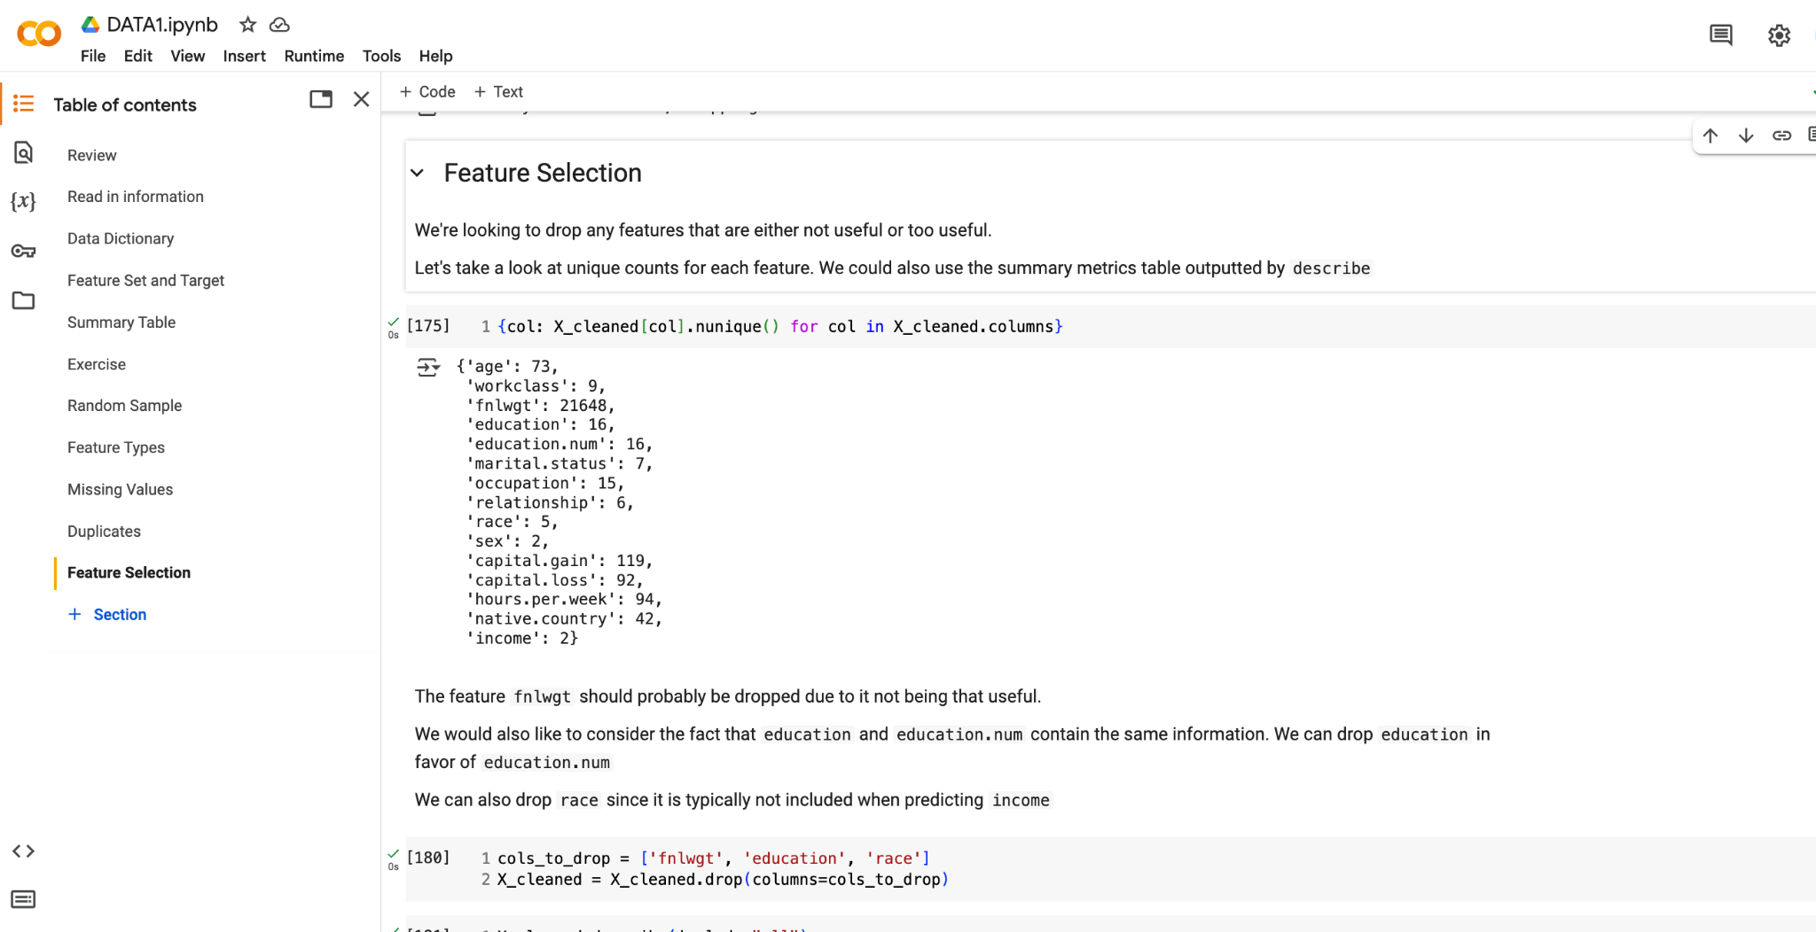
not useful (for now)
keep one
marital.status and native.country may not be useful, so consider these as well
consideration needed

Slide 23
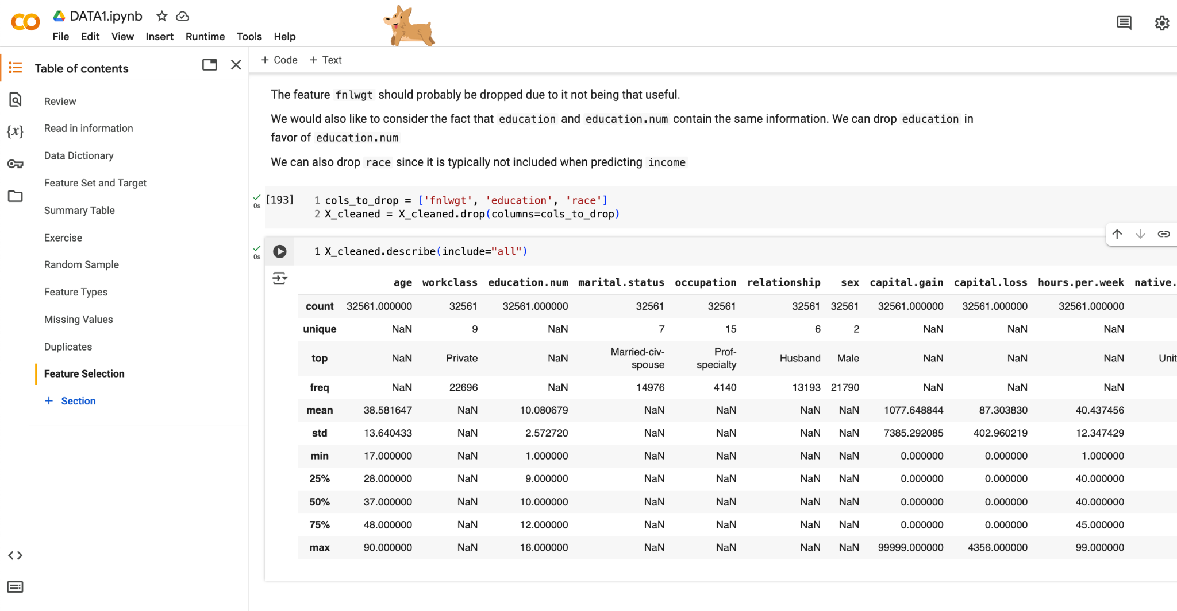

Slide 24
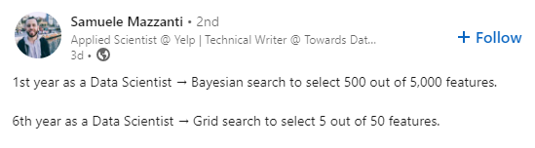
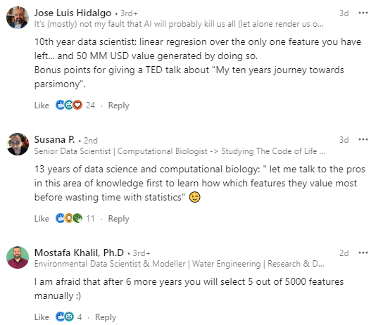
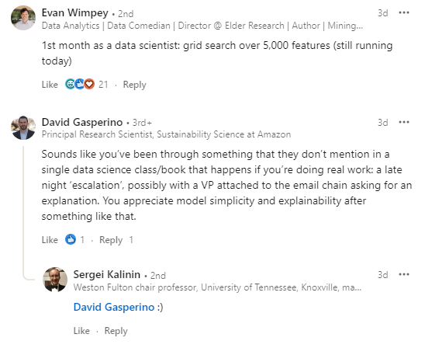
Feature selection takes time and knowledge
Everyone is in the same boat

Slide 25
Data cleaning and preprocessing
Good data cleaning and preprocessing takes a lot of time and effort, and is the most impactful thing you can do to improve performance of your models
"Models are only as good as the data they’re trained on."
- Cathy O’Neil author of Weapons of Math Destruction
Think carefully about any changes you make
Does it make sense? What is an argument for making this change? What is an argument against it?
What will be the impact? Both on your model, and when your model is used?
Doing nothing is a choice - can be good or bad
Consult others!

Slide 26
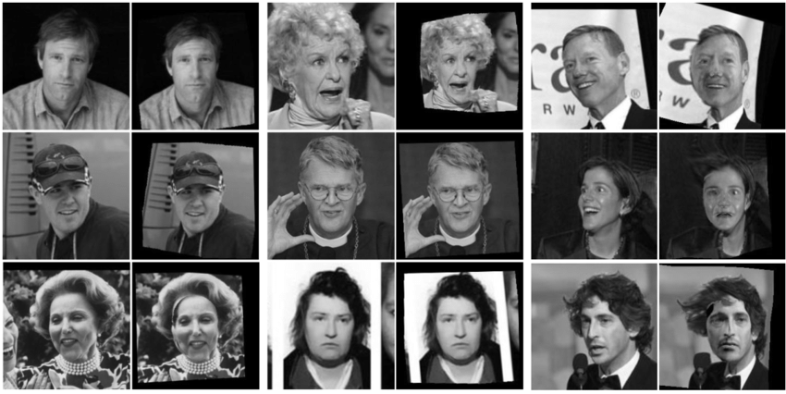
Even the best data cleaning can't always fix flawed data
"Models are only as good as the data they’re trained on."
- Cathy O’Neil author of Weapons of Math Destruction
Facial recognition dataset (Labeled Faces in the Wild or LFW) is more than 75% male and more than 80% white

Slide 27
Work Time
HW4 Q#1-2
Let’s get a start on some more homework questions. Grab a partner to get started.
View on our website

Slide 28
Machine Learning
With python
data2: working with data
feature engineering + transformations
Notes:
Layout objects pulled from: https://slidesgo.com/
All icons are from: https://thenounproject.com/

Slide 29
Colab workbook
Link: click for access

Slide 30
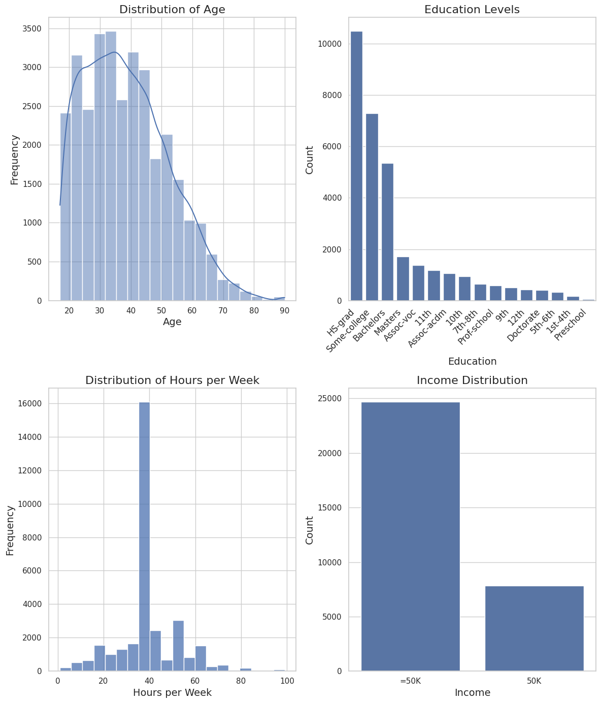

warm-up
Here are some exploratory plots for a few of the features in our dataset. Each of the features present have some reason they likely need to be transformed prior to being feed into an ML algorithm.
For each plot, describe why it may need to be transformed.
If you have time, think of one solution you could do to fix one of these features.

Slide 31
What should you be looking for?
unbalanced Data categorical
if impacting performance, can oversample from under represented class or undersample from over represented class; or try bucketing
skewed distribution continuous
apply transform to make it less skewed; then consider scaling
otherwise weird case-by-case
convert numerical to bucketed categorical; or create indicator variable

Slide 32
Help the algorithm with the data by transformation the data in some way
Improve model performance by feature engineering
Add layers of interactions to fully understand relationships in the data
Key Ideas
Numeric feature may need to be scaled
Reduce dimension by grouping (encoding) categories

Slide 33
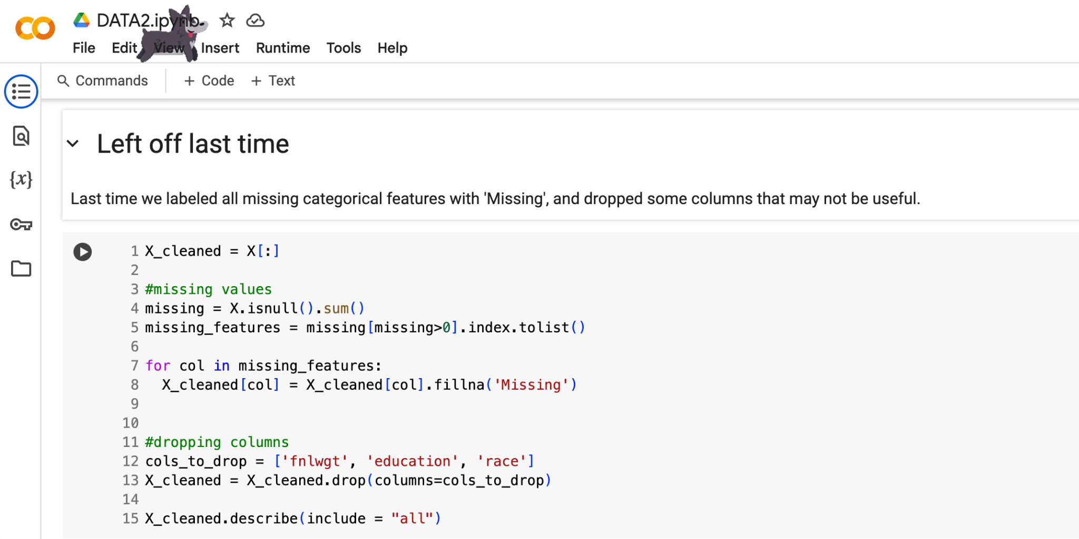
DATA1 Recap: fill in missing
Why: Complete data is essential for most ML algorithms

Slide 34
DATA1 Recap: drop irrelevant features
Why: fnlwgt: sampling weight (irrelevant) and race: demographic (reduce potential bias)

Slide 35
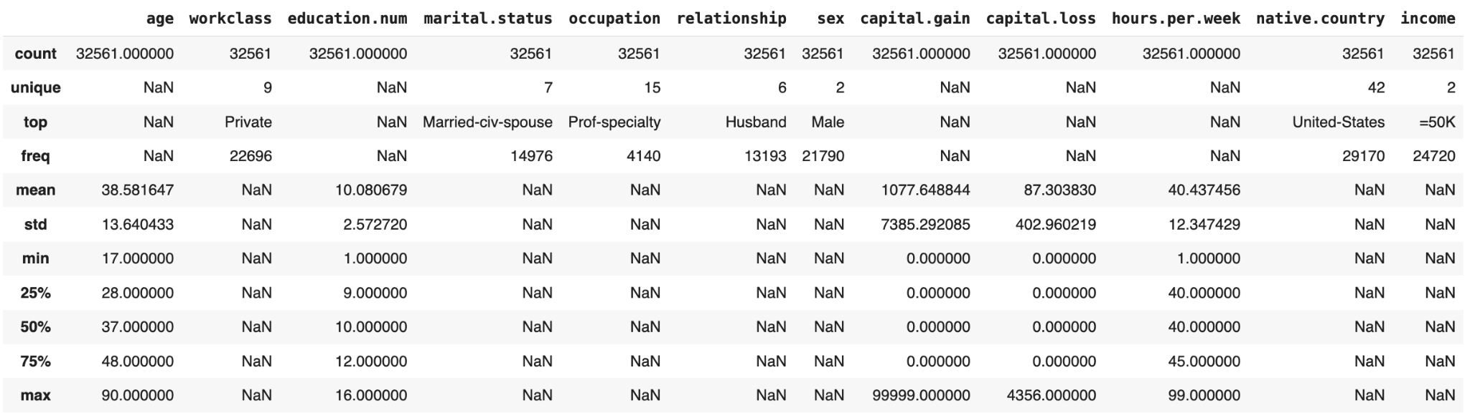
Feature types
look at your data to see which features are categorical and which are numeric
keep an eye on categorical features with many categories (5+), any numerical features with heavy skew, interesting/weird occurrences, among others.

Slide 36
Feature Engineering
create a new set of features from existing features
drop a feature
irrelevant
bias
use features to construct new ones
group and bin categories
convert categorical to binary with one-hot encoding (OHE)
ordinal features
create interactions (advanced)
transform a single feature
change distribution
scaling to appropriate range
Why? Many ML algorithms are sensitive to scale, work best with data that is continuous and normally distributed

Slide 37
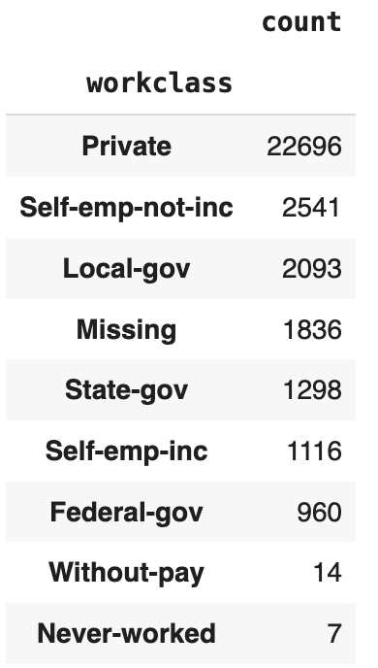
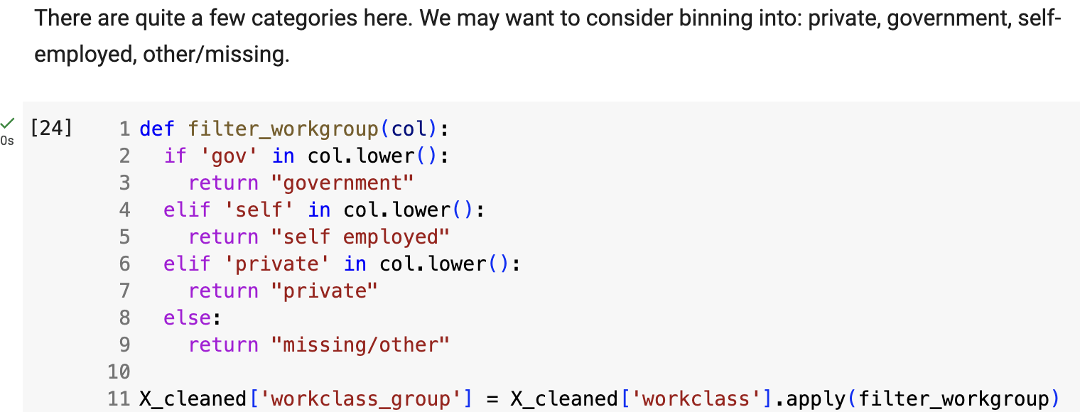
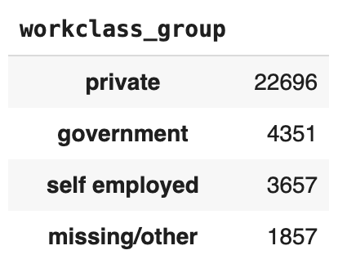
use features to construct new ones
group and bin categories
convert categorical to binary with one-hot encoding (OHE)
create interactions (advanced)
ordinal features
based off related categories
Why: reduce complexity by binning workclass into related categories to construct new feature workclass_group

Slide 38
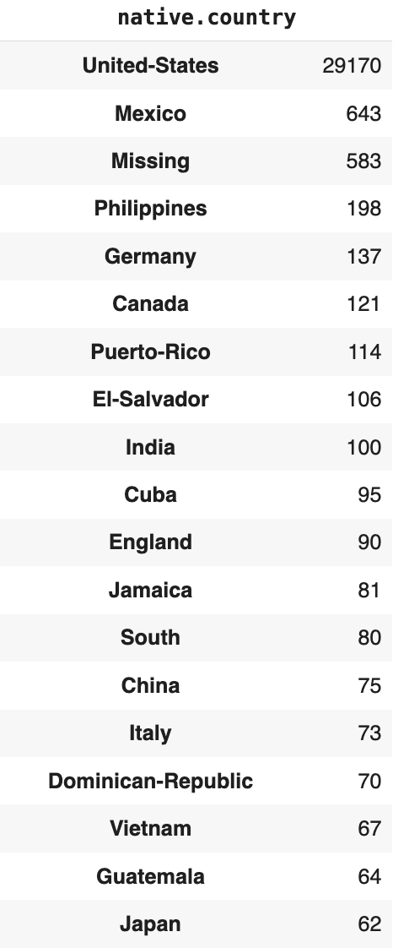
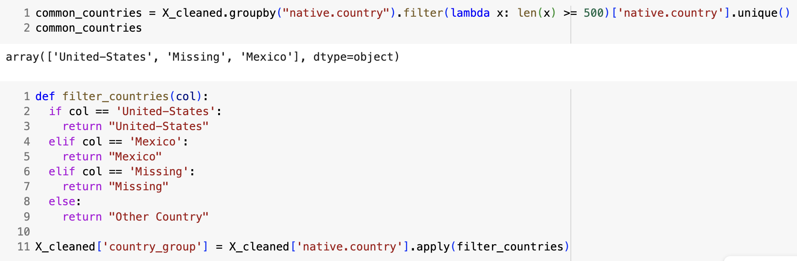
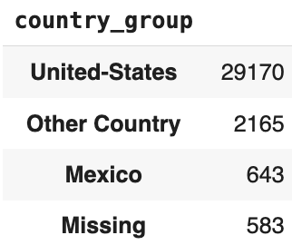
use features to construct new ones
group and bin categories
convert categorical to binary with one-hot encoding (OHE)
create interactions (advanced)
ordinal features
based off counts
Why: reduce complexity by binning native.country by most frequently occuring to construct new feature country_group

Slide 39
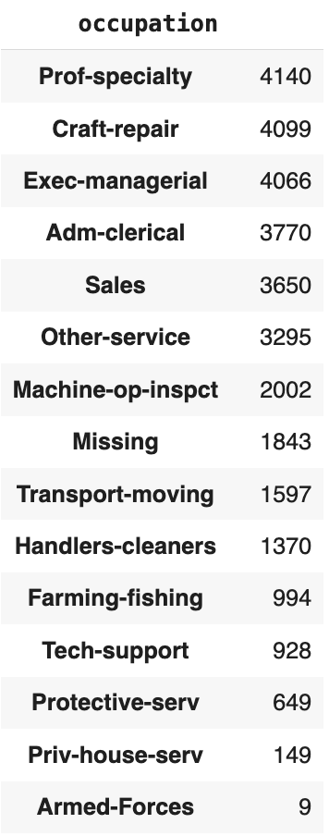
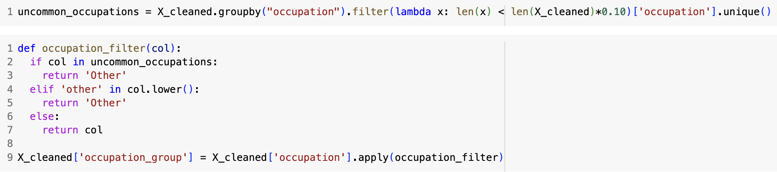
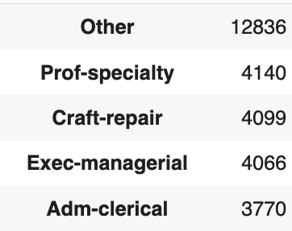
use features to construct new ones
group and bin categories
convert categorical to binary with one-hot encoding (OHE)
create interactions (advanced)
ordinal features
based off % of total
Why: reduce complexity by binning uncommon categories from occupation into ‘Other’ and constructing new feature occupation_group
Note: the percentage cutoff is subjective (like with most things in data cleaning), so may need to try a few out to see what the best choice is.

Slide 40

use features to construct new ones
group and bin categories
convert categorical to binary with one-hot encoding (OHE)
create interactions (advanced)
ordinal features
Try this yourself! Figure out how to construct new features from the following existing ones: marriage or relationship
Pick an approach above to filter by: type, count, %total.
Create a filtering function and apply the changes. Make sure to create a new feature when you do so.
Output the value counts of the newly created feature

Slide 41
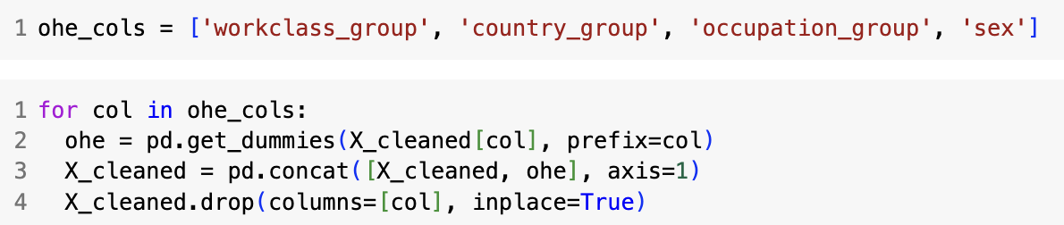
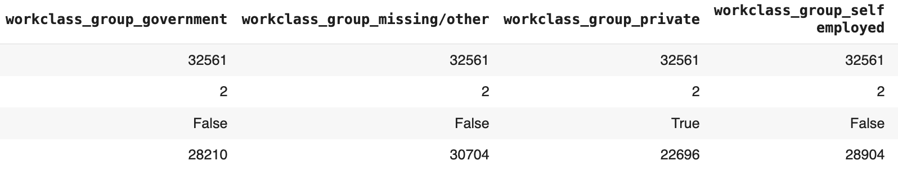
use features to construct new ones
group and bin categories
convert categorical to binary with one-hot encoding (OHE)
create interactions (advanced)
ordinal features
Why: ML algorithms love numbers, not so much categories

Slide 42
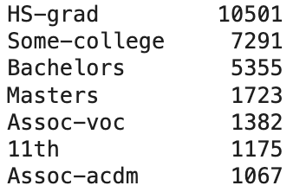
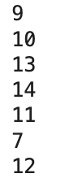
use features to construct new ones
group and bin categories
convert categorical to binary with one-hot encoding (OHE)
create interactions (advanced)
ordinal features
other types of construction
drink_size
small
medium
large
date
03/07/2025
width
height
length
month
day
year
1
2
3
volume
ordinal
dates
interactions
Ideally we keep ordinal (ordered numbers) and drop the categorical

Slide 43
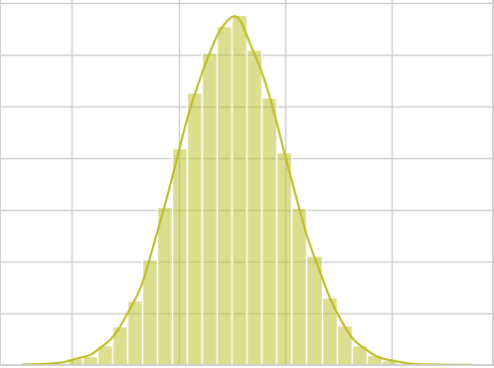
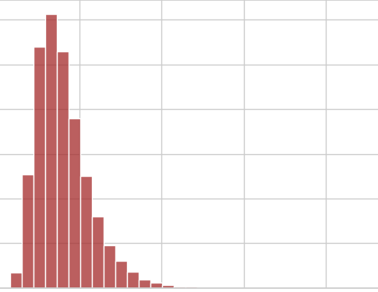
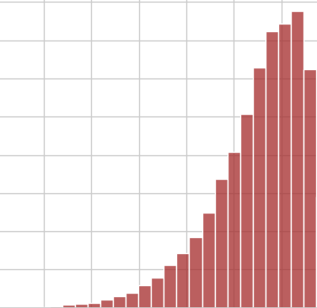
transform a single feature
change distribution
scaling to appropriate range
Goal: more balanced, more normal
Transformations: log, square root, 1/x
Transformations: polynomials (powers)
normal
right skewed
left skewed
Other Transformations: sometimes you also care about the variance of your data. Enter in Box-Cox (positive, right-skewed data) and Yeo-Johnson (more flexible version).

Slide 44
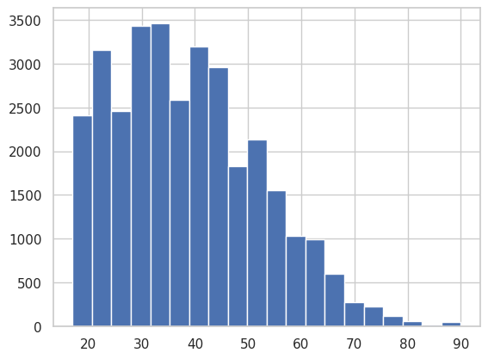
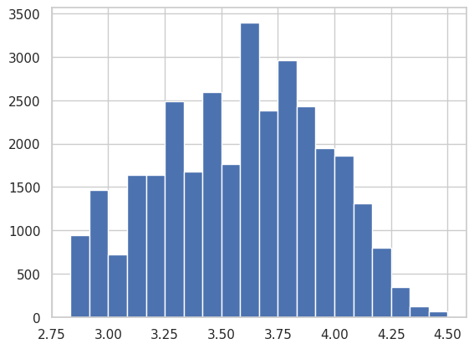
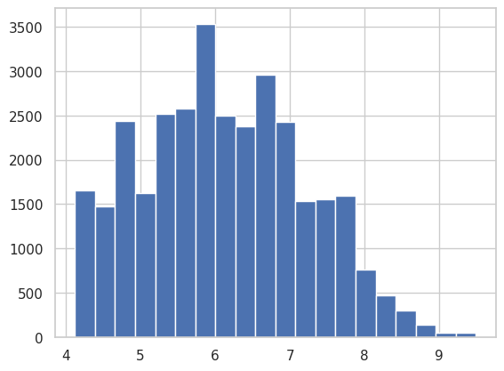
transform a single feature
change distribution
scaling to appropriate range
age
log(age)
sqrt(age)
right skewed
Note: we could also construct a new feature called age_buckets that may be more promising.

Slide 45
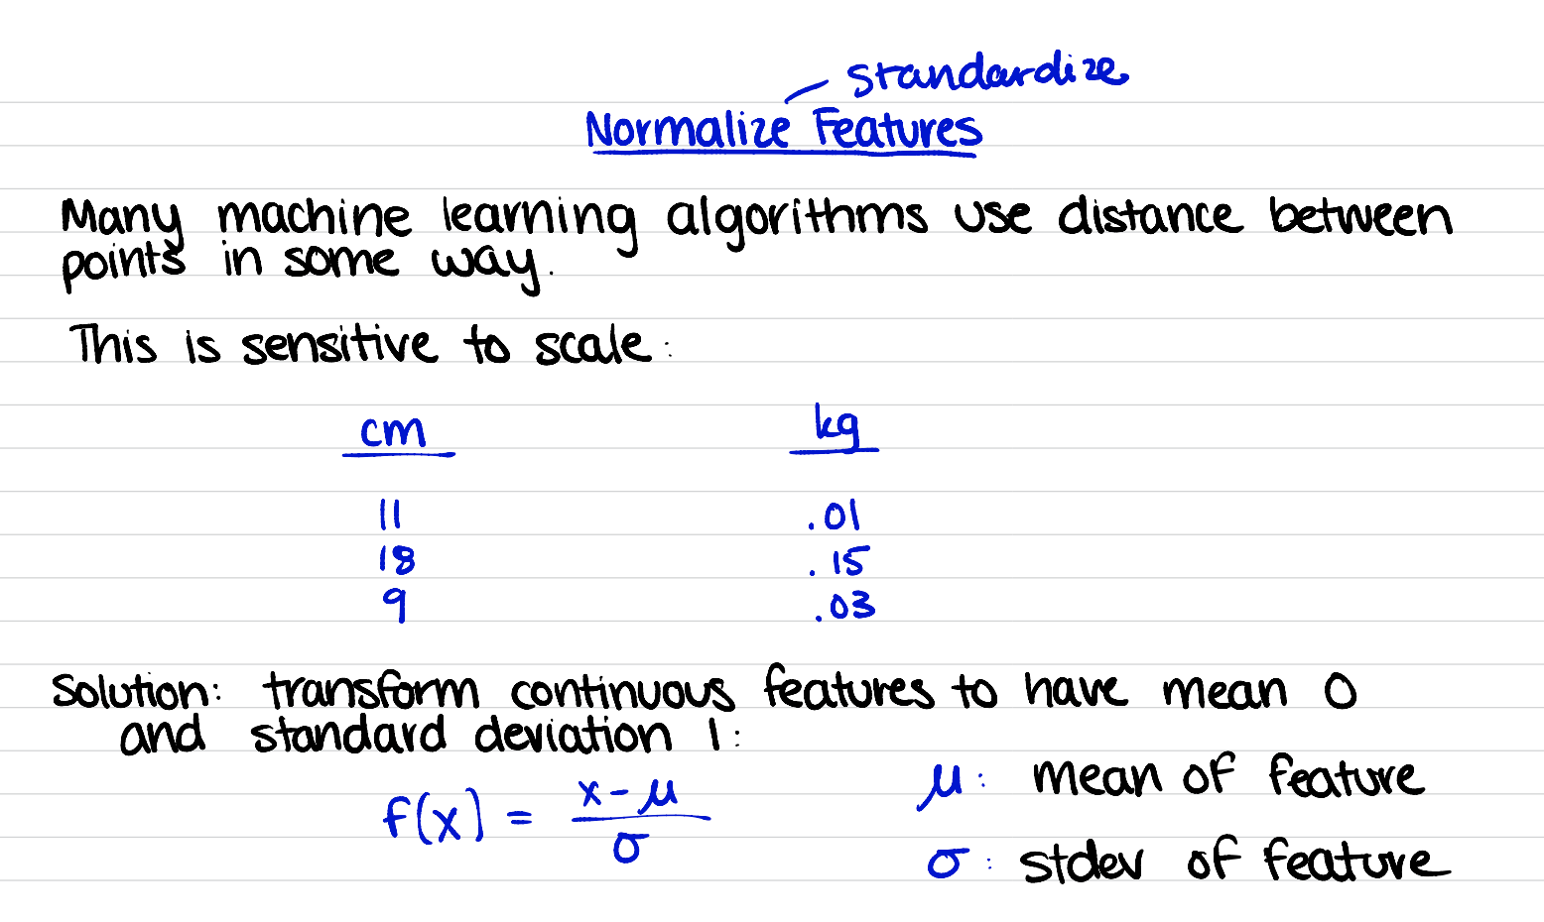
transform a single feature
change distribution
scaling to appropriate range
Most ML algorithms use distance between points in some way.
This is sensitive to scale!
Also helpful for gradient-boosted methods
cm
11
15
26
mg
225
100
600
cup
.25
.75
1.5
Solution: transform continuous feature have certain distribution or features
robustScaler uses quantiles
good with outliers
minmaxScaler range [0,1]
preserves original distribution
StandardScaler normalization or standardization
mean 0, s.d. 1
good for normally distributed things

Slide 46
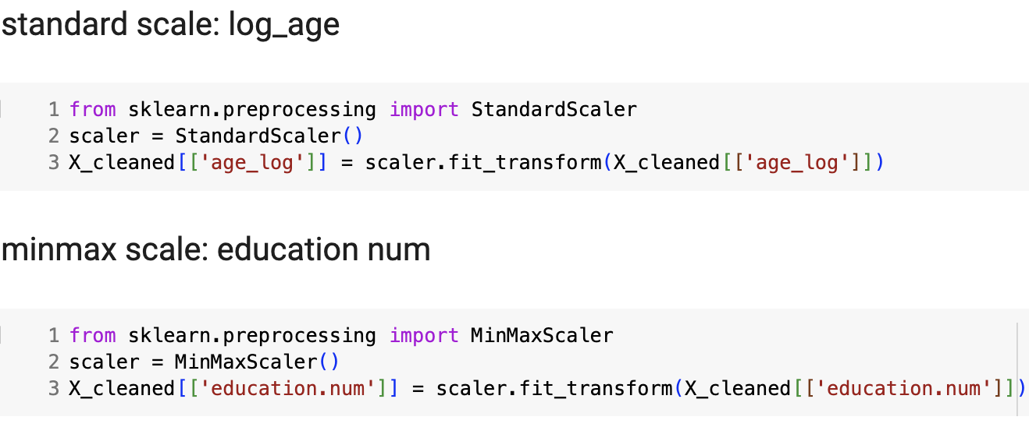
transform a single feature
change distribution
scaling to appropriate range

Slide 47
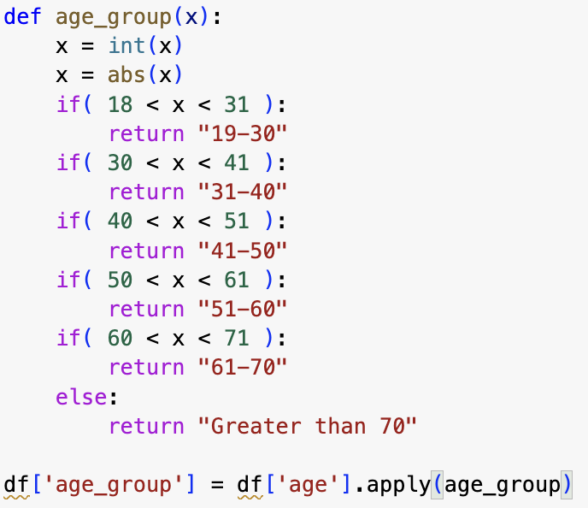
You can add more features as you see fit. Maybe you want to create education groups, or age buckets.
The reason we typically spend 80% of our time in EDA and data processing is exactly because it’s iterative improvements.
You try something, and it either succeeds or it doesn’t. If it works, awesome. If it doesn’t, that's great too. Knowing what doesn’t work is just as valuable as knowing what does.

Slide 48
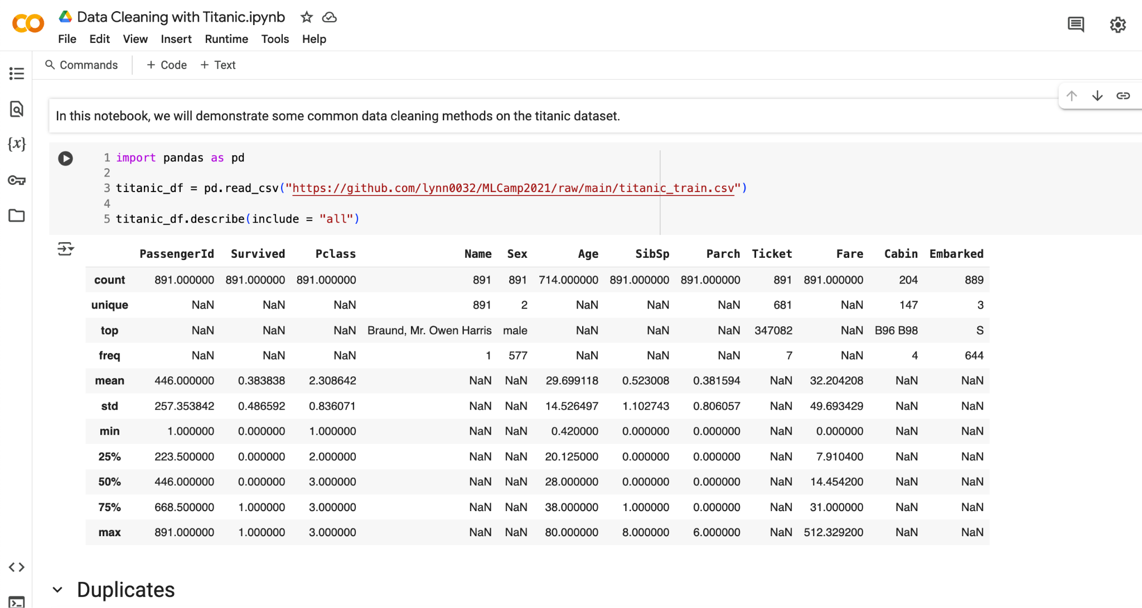
Extra example using the Titanic dataset in this workbook (click here)

Slide 49
Work Time
HW4 Q#3-4
Let’s get a start on some more homework questions. Grab a partner to get started.
View on our website

Slide 50
Dealers Choice
Project work time
PC3 or PC4
View on our website
lab work time
Lab CLS or DATA
View on our website

