Slide 1


Machine Learning
With python
EVL1: Evaluation
over/underfitting, cross-validation
Notes:
Layout objects pulled from: https://slidesgo.com/
All icons are from: https://thenounproject.com/

Slide 2
Colab workbook
Link: click for access
These are class notes. They’re never due, but helpful to have when completing homework and studying for standards.

Slide 3



Datasets This Week
Datasets This Week
Lecture
Lecture
HW1 + Lab1
Lab
Wisconsin
Breast Cancer
link: kaggle
Titanic
link: github
Palmer Penguins
link: github
Titanic
link: github

Slide 4
Bias refers to the error introduced by the model's simplifying assumptions. High bias often results in underfitting, where the model is too simple to capture the underlying patterns of the data. This means it makes systematic errors.
high variance
Variance refers to the model's sensitivity to small fluctuations in the training data. High variance leads to overfitting, where the model fits the training data very closely (even noise) and fails to generalize well to new, unseen data.
complex
bad
Bias-variance tradeoff
Bias is associated with underfitting (model too simple). Variance is associated with overfitting (model too complex). It’s the tradeoff between these two that we try to balance in machine learning.
low variance
ideal
simple
low bias
high bias

Slide 5



How to know what the target variable is?
Once we have a list of ideas, we will then use our knowledge of specific models to understand which questions can be answered, and which questions we need either more data or entirely different modeling approaches for.
It depends on which questions you want to ask, or in practice, which questions your stakeholders want answered.
In this class, we will be working on conceptualizing the types of questions that could be asked given a particular dataset.

Slide 6



How to know which model is best?
Let’s see some examples!
We will start to cover this today, but simply put we want models that performs well on unseen data.
Usually you want to always create a null model and then compare each of your models to the null model.
null
simple
complex
There are other factors that come into play like predictive power, reproducibility, and interpretability of models.
Generally simple models work well and are quite interpretable so always good to start with simple regression or decision tree models depending on what type of question you want to answer. You can add in more complex models and then compare to null and simple models.

Slide 7



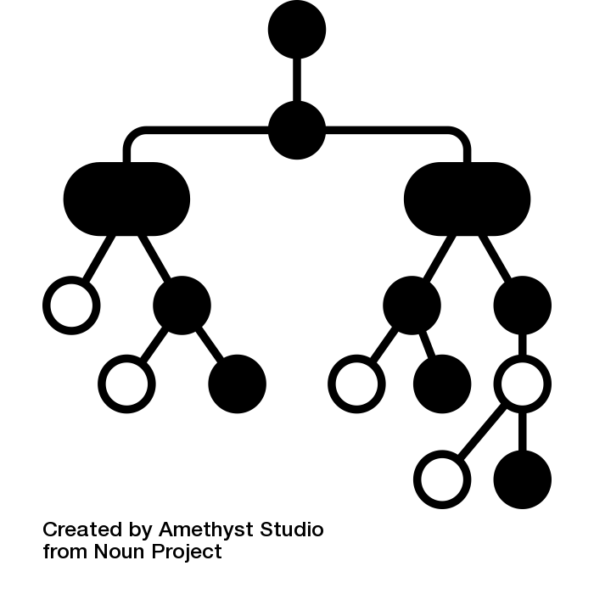
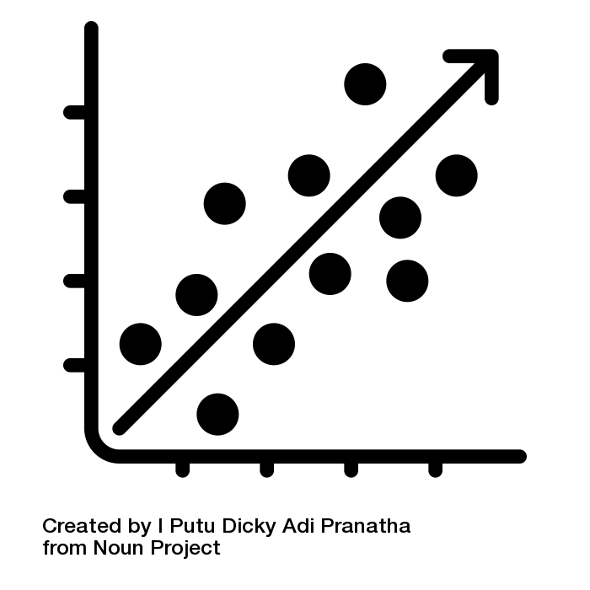
XGBoost
Random Forest
Decision
Tree
Linear Regression
high variance
Scenario 1: Predicting Equipment Failure in a Manufacturing Plant A manufacturing plant has a fleet of machines, and you are tasked with predicting when a machine is likely to fail based on sensor data such as temperature, vibration, and pressure readings over time. Your goal is to minimize downtime by identifying which machines need maintenance before they break down.
low variance
Supervised Regression
low bias
high bias

Slide 8

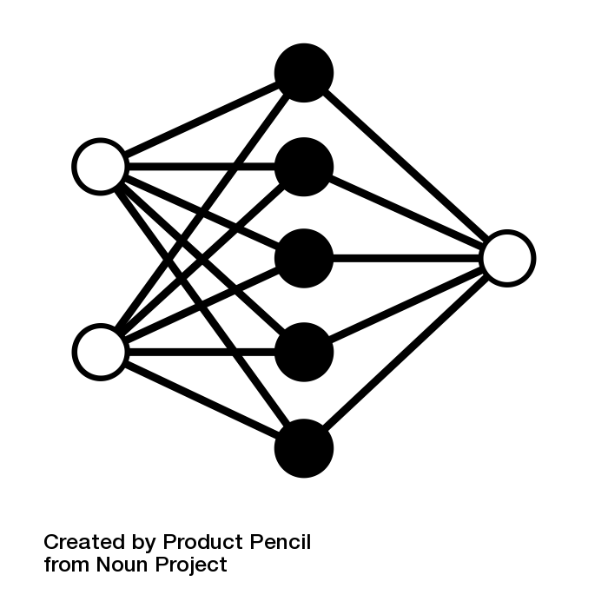
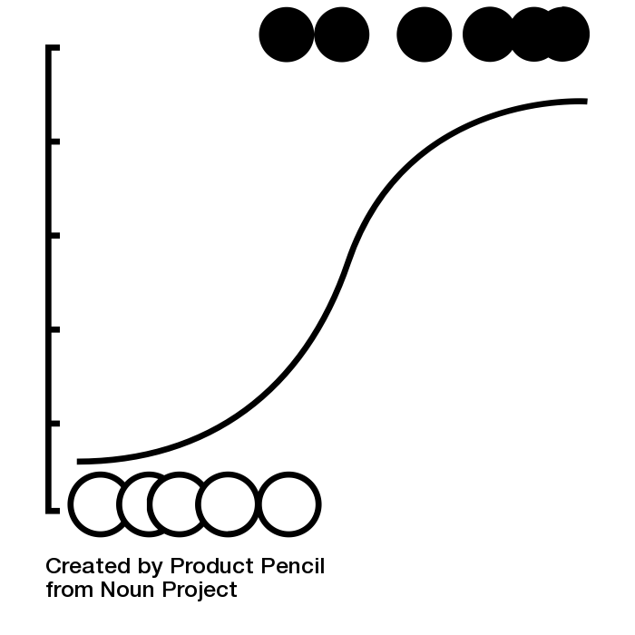
Neural Network
Random Forest
Decision
Tree
Logistic Regression
high variance
Scenario 2: Identifying Fraudulent Transactions in a Banking System A bank wants to reduce financial fraud. They have transaction data from millions of credit card purchases, including the transaction amount, merchant, customer location, and time of purchase. The goal is to classify transactions as either "fraudulent" or "legitimate" based on this data.
low variance
Supervised classification
low bias
high bias

Slide 9

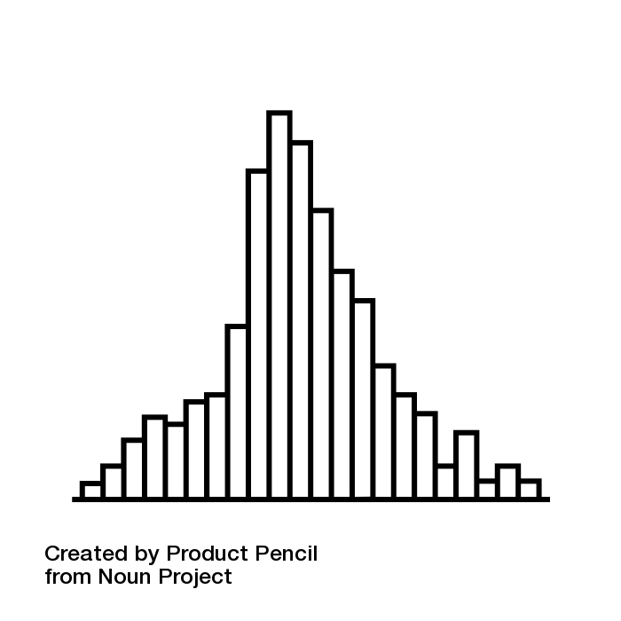
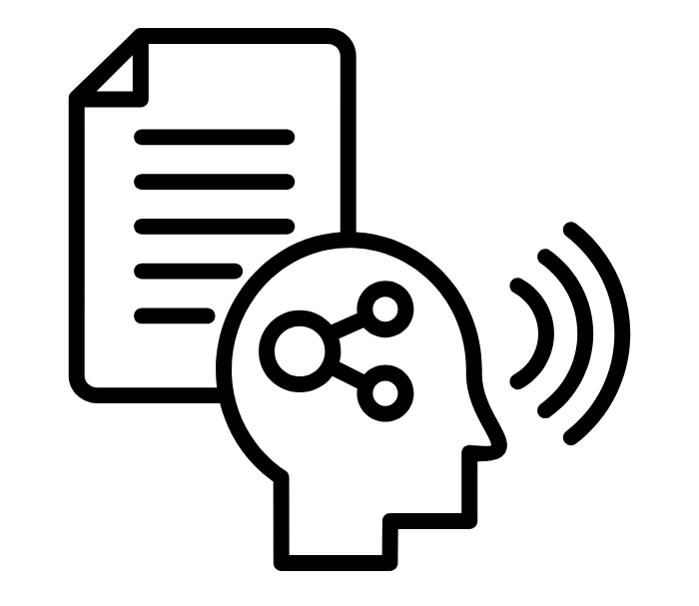

Neural Network
SVM
Naive
Bayes
Logistic Regression
NLP
high variance
Scenario 3: Analyzing Customer Sentiment for a Brand on Social Media A retail company wants to understand how customers feel about their brand. They have a dataset of social media posts, including customer reviews, tweets, and comments. You need to classify these posts as either "positive," "neutral," or "negative" to gain insights into the company’s public perception.
low variance
Supervised classification
low bias
high bias

Slide 10

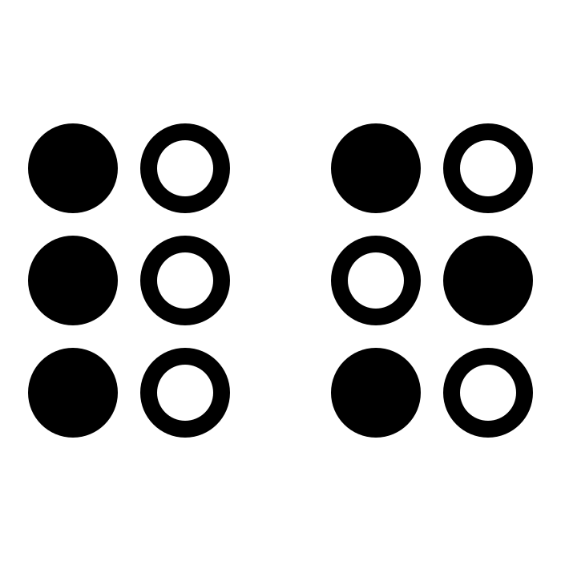
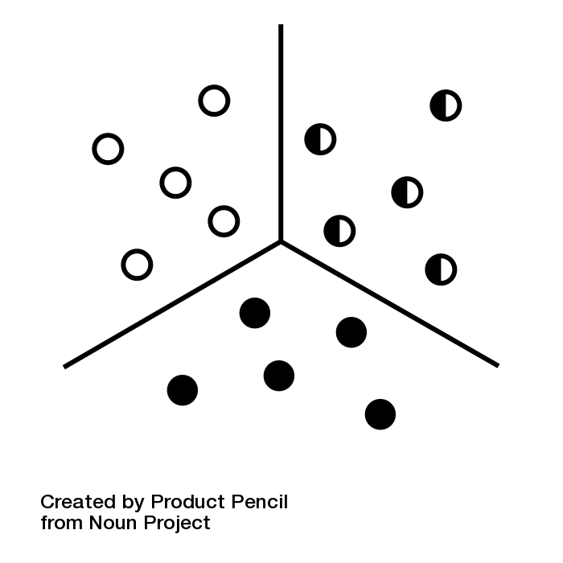

Deep Reinforcement
Genetic algorithm
Decision
Tree
k-means clustering
high variance
Scenario 4: Optimizing Delivery Routes for a Logistics Company A logistics company delivers goods to various locations. They want to optimize their delivery routes based on variables such as traffic patterns, weather conditions, and delivery deadlines to minimize fuel consumption and improve delivery time.
low variance
unSupervised Clustering
low bias
high bias

Slide 11

Exercise
You’ve been tasked with explaining what we’ve been going over in class to your grandma (or my grandma if you need one).
Use simple ideas, and feel free to use analogies to make it easier for her to understand!
How would you explain what the difference between a simple and complex model is?
How would you describe bias and variance?
Example: variance is the inability to make a decision, sort of like how some people change their minds on which ice cream flavor is their favorite. In models, variance happens when the model is influenced by the data, causing it to give different answers each time.
Example: bias is always choosing the same thing, sort of like how some people say vanilla is the best flavor without ever trying a different one. In models, bias is making decisions based off incomplete information, often leading to mistakes.

Slide 12
Evaluating a model
The model is trained on data and so is optimized to perform well on the data it's seen
Problem: How do we know that a model is making decisions based on real-world patterns rather than just "memorizing" the data?
Solution: Don't let the model see all the data for training - hold some out. Then, after the model is done training, evaluate its performance on the unseen data.

Slide 13
Data splitting for model development
Training set: data used with selected learning algorithms (models). Bigger usually better.
Testing set: data used on model to estimate real-world performance. Small ok, as long as representative of real-world data on deployment.
train
~80%
Keeping training set separate from test set to ensure we are not leaking information and thus not biasing models.
test
~20%

Slide 14
Overfitting
Every model we build will be fit to a particular set of data (i.e. training set)
Problem: Model performs well on data it has seen (training set), but really poorly on data it has not (test/dev set). This is called overfitting, and occurs because our model is more focused on fine details rather than big picture.
Solution: (1) Use enough data in training set so model can see wide variety of options; (2) ensure test set is representative of real-world data; (3) perform some sort of crossfold validation.

Slide 15
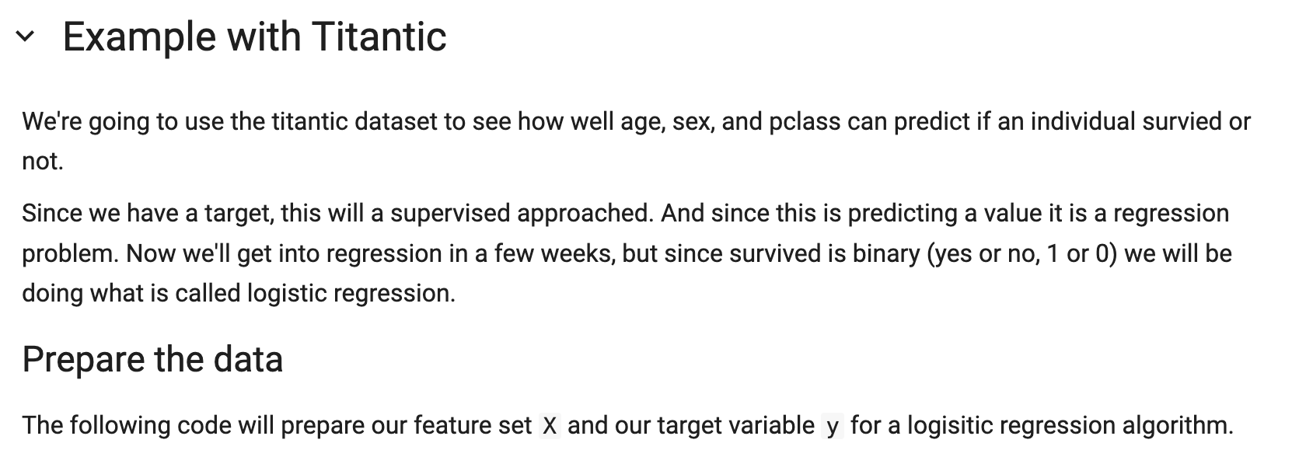
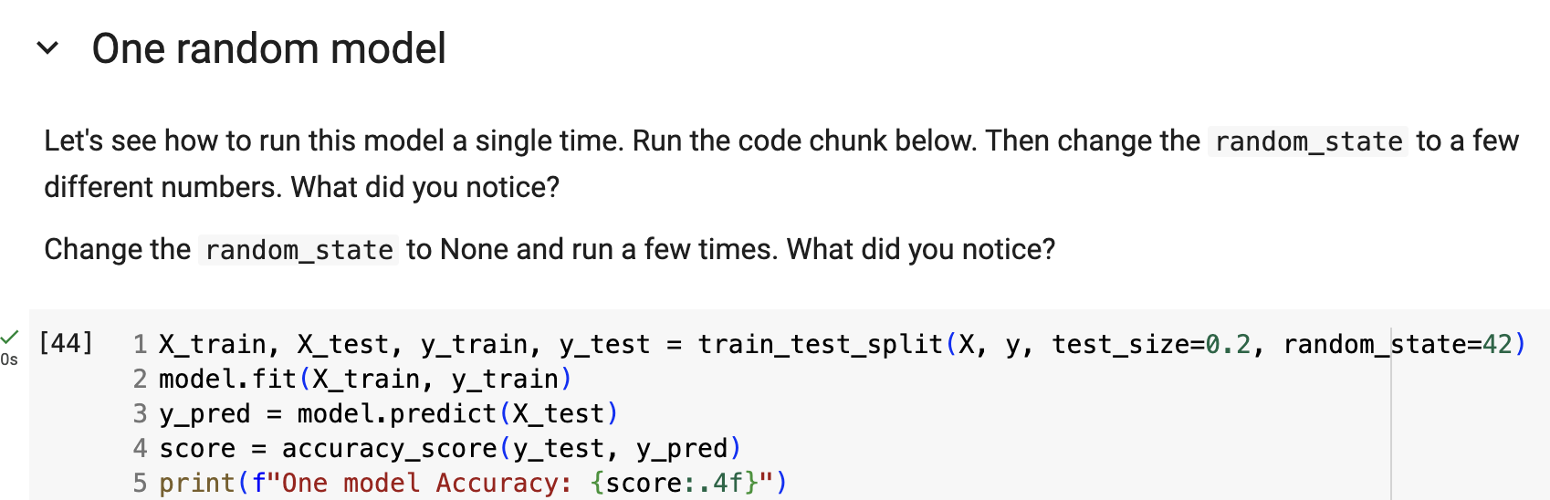

Overfitting Example
Let’s see what this looks like in practice! We’re going to take a look at how to build a simple model using the titanic dataset.
Our goal is to figure out why different values for random_seed change our model accuracy.

Slide 16
. . . but what if we get really lucky or unlucky with our choice of test set ?
Solution 1:
Repeat n times:
randomly split data into testing and training sets
initialize new model , train on training set
evaluate performance on test set
Average performance across all iterations (also look at each performance score)

Slide 17
. . . but what if we get really lucky or unlucky with our choice of test set ?
Dataset
Solution 2: k-fold cross-validation
Randomly shuffle data
Divide data into k equal size chunks (often k = 5)
Initialize and train model on chunks 2,3,4,5. Evaluate performance on chunk 1
Initialize and train model on chunks 1,3,4,5. Evaluate performance on chunk 2
..(etc)..
Average performance across iterations
1
2
3
4
5

Slide 18
. . . but what if we get really lucky or unlucky with our choice of test set ?
Solution 3: stratified k-fold cross-validation:
same as k-fold cross-validation, except also ensures that representation of target classes in each fold matches their distribution in the dataset.
We use this option when we have an unbalanced target variable
Dataset
1
2
3
4
5
Example: would want to use stratified validation on Survived target in Titanic data set since training contains ~40% survived and ~60% did not survive.

Slide 19
. . . but what if we get really lucky or unlucky with our choice of test set ?
If data is huge, then ~85% ok
train
~70%
Solution 4: use dev set (common in neural nets or if model is operationalized)
Training set: data used with selected learning algorithms (models). Bigger usually better.
Development set: data used to estimate which model + hyperparameter combo is ideal. Ensure dev and test sets are iid.
Testing set: data used on final selected model to estimate real-world performance. Small ok, as long as representative of real-world data on deployment.
dev
~15%
test
~15%

Slide 20
Work Time
HW2 Q#1
Let’s get a start on some more homework questions. Grab a partner to get started.
View on our website

Slide 21
Machine Learning
With python
Evl2: Evaluation
bootstrapping, evaluation metrics
Notes:
Layout objects pulled from: https://slidesgo.com/
All icons are from: https://thenounproject.com/

Slide 22
Colab workbook
Link: click for access

Slide 23
Cross-Validation
Sampling Method: No replacement (disjoint training/test splits)
Test Set: Different test fold for each iteration
Bias/Variance: Less variance (due to different test sets)
Computational Cost: High (K models need to be trained
Bootstrapping
Sampling Method: With replacement (some points may appear multiple times)
Test Set: Out-of-bag data not used in resampling
Bias/Variance: Higher variance (due to resampling with replacement)
Computational Cost: Moderate (less expensive than K-fold with more resamples)
small/medium data OR need more generalizability
cross-validation
large data OR ensemble model
bootstrapping

Slide 24
Exploring Data
Data cleaning
Model selection
Model training
Model evaluation
data insights
cleaned data
selected algorithms
fitted models
model insights
change complexity by feature OR algo selection
cleaned data
+
selected algorithms
→
tune hyperparameters
→
select test set
→
train models
→
best fit model
simple or pre-trained algo OR small data
small/medium data OR need more generalizability
overfitting
Workflow
Goals
skip
cross-validation
decrease complexity
Steps
complex algo OR complex workflow
large data OR ensemble model
underfitting
Decisions
imbalance
data
do this step
bootstrapping
increase complexity
down/up sample

Slide 25
Exercise
Repeat the workflow example, but for EDA (Exploring Data).
Identify the steps you take in the process. and
What decision you make along the way.
A general outline is on the next slide.
Grab a partner, and a whiteboard marker, and a spot at a whiteboard. Bring a chair if you want to sit.
Draw the following outline, then take time adding guesses. It may be helpful for one partner to have the slide decks from EDA open, and the other takes notes on the board.

Slide 26
Exploring Data
Data cleaning
Model selection
Model training
Model evaluation
data insights
cleaned data
selected algorithms
fitted models
model insights
data set
→
look at data
→
statistical measures
→
visualizations
→
statistical tests
→
data insights
look at count of missingness
Workflow
Goals
how to handle
Steps
types of features: lots of categorical?
Decisions (mainly for next step)
feature encoding
add a 3x3 grid to the whiteboard, fill in your answers

Slide 27
Exploring Data
Data cleaning
Model selection
Model training
Model evaluation
data insights
cleaned data
selected algorithms
fitted models
model insights
data set
→
look at data
→
statistical measures
→
visualizations
→
statistical tests
→
data insights
look at count of missingness
skewed data
skewed data
significant relationships or correlations
Workflow
Goals
how to handle
visualize
transformation
feature selection
Steps
types of features: lots of categorical?
imbalanced feature
relationships or correlations
Decisions (mainly for next step)
feature encoding
down/up sample
statistical testing
identify any outliers
how to handle

Slide 28


Evaluation Metrics
When we predict a binary feature, we can do either classification or regression.
Let’s build a survival model for Titanic passengers, and evaluate how good our model is at predicting if folks actually survived.
There are various metrics for evaluation performance of machine learning models.
We’re going to be looking at some of these metrics for both classification and regression.
did not survive
survived

Slide 29
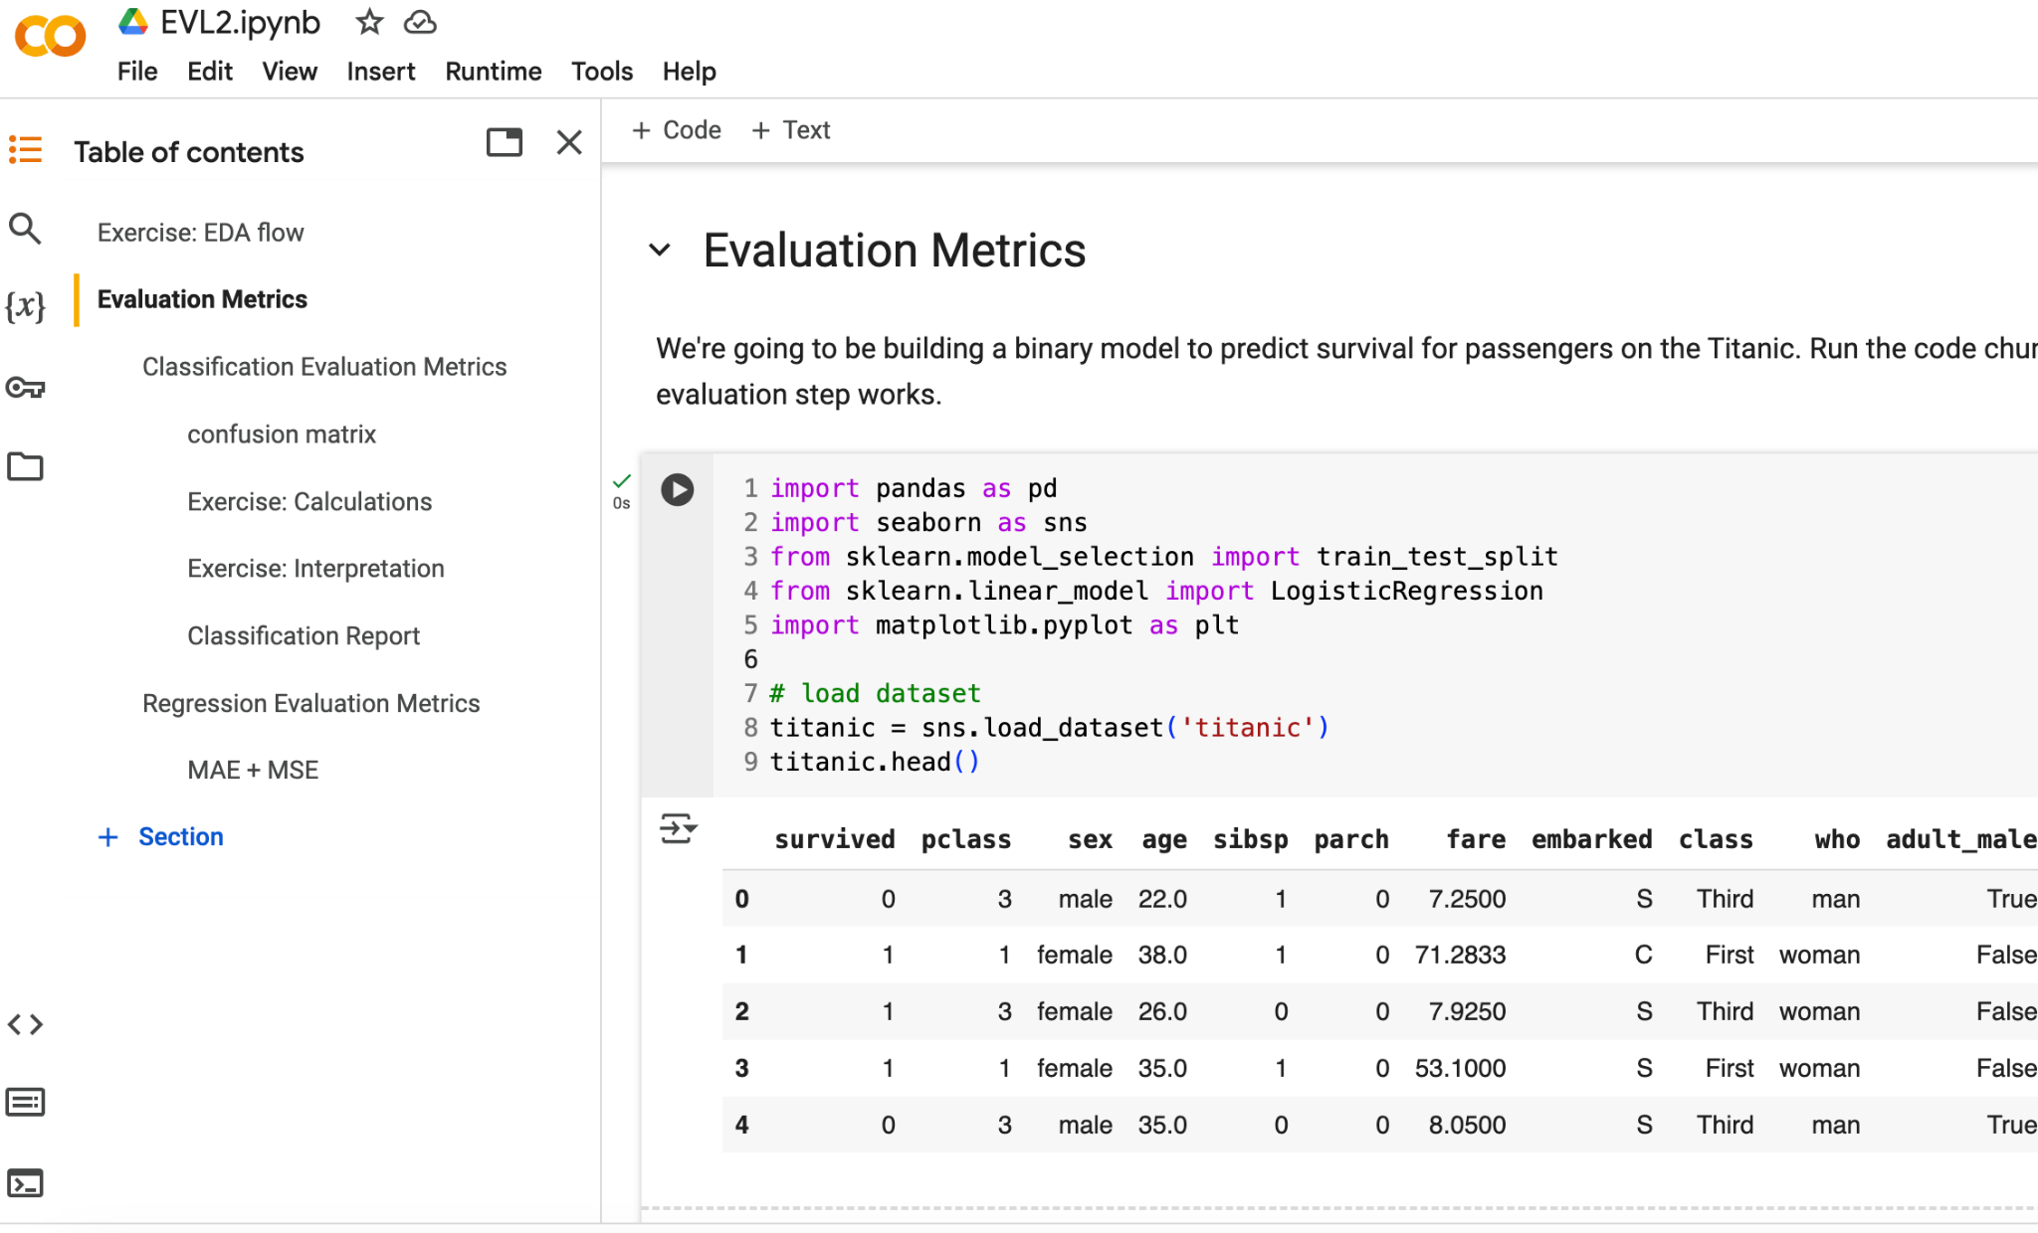
Run all code chunks in the Evaluation Metrics section

Slide 30
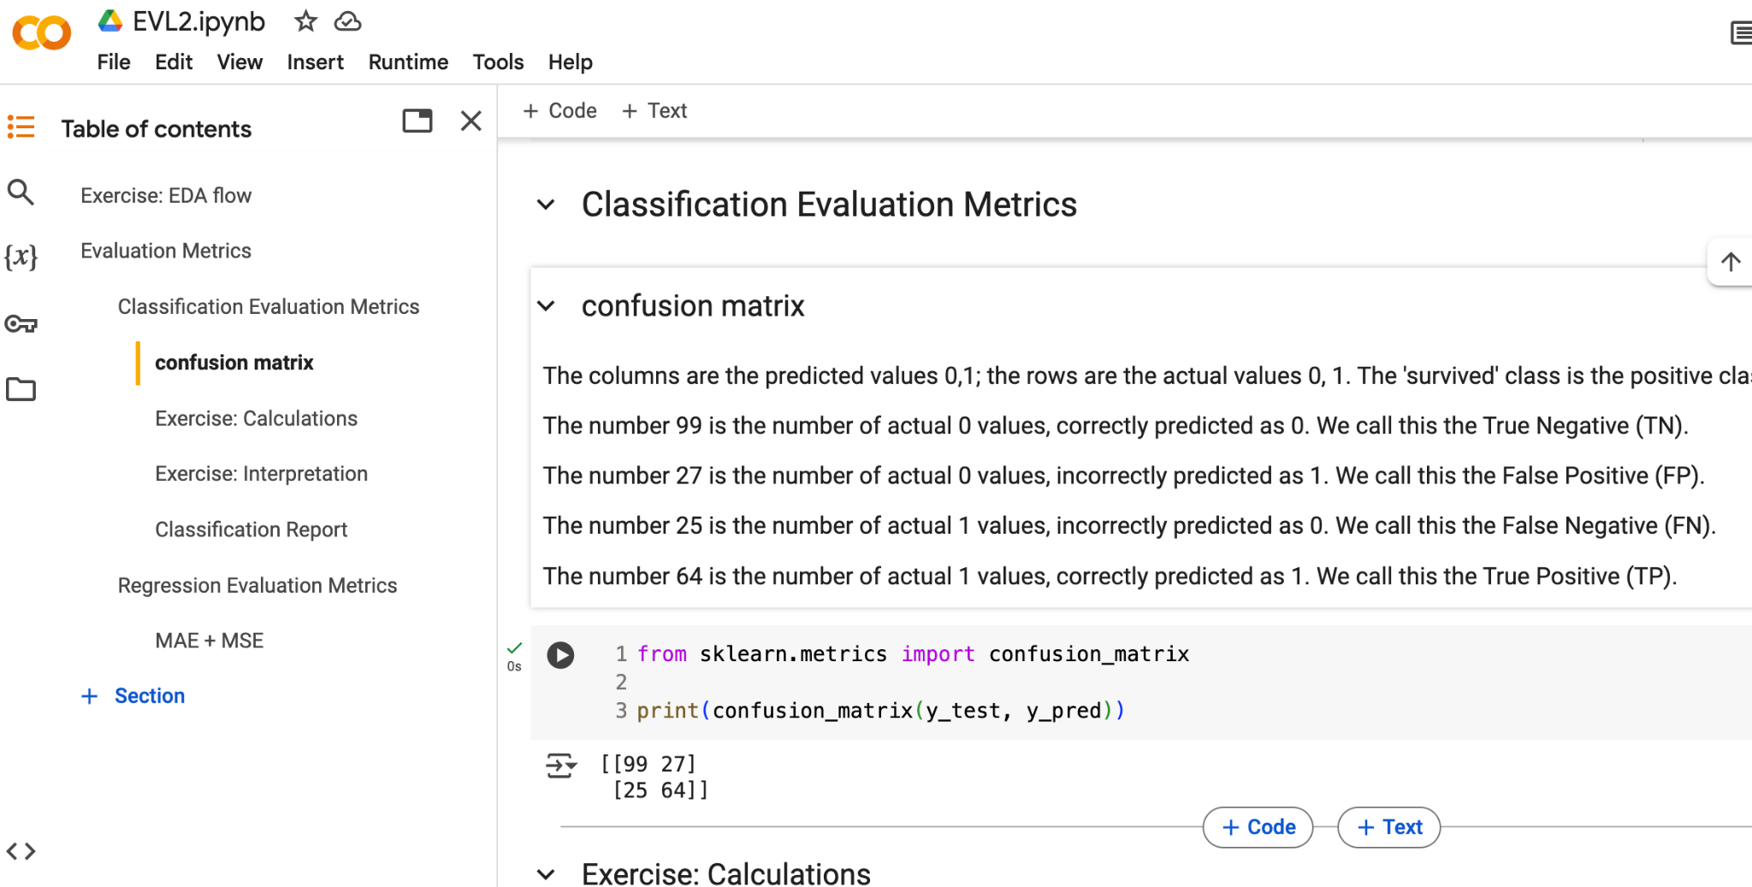
Let’s talk about the confusion matrix
classification

Slide 31
typically have our binary outcome 1 be the positive class 1
Confusion matrix
predicted
positive (1)
negative (0)
sensitivity
recall
TP
TP + FN
Of the records that were actually positive, the model correctly labeled R%
positive (1)
TP
FN
Type II error
actual
negative (0)
specificity
FP
TN
FP
FP + TN
Type I error
precision
TP
TP + FP
accuracy
TP + TN
TP + FP + TN + FN
A% of the records were correctly identified
Of the records the model predicted as positive, P% actually were
F1-score
helpful for imbalanced data. closer to 0 → poor; closer to 1 → ideal
2*R*P
R + P
classification

Slide 32
typically have our binary outcome 1 be the positive class 1
Confusion matrix
predicted
positive (1)
negative (0)
TP
FN
recall
TP
TP + FN
Of the passengers who survived, the model correctly labeled 72% of them
positive (1)
actual
negative (0)
FP
TN
precision
TP
TP + FP
accuracy
TP + TN
TP + FP + TN + FN
76% of the records were correctly identified as surviving and non-surviving
Of the records the model predicted to survive, 70% actually did
your turn! calculate the accuracy, precision, and recall of the confusion matrix in your workbook, and interpret what these metrics are saying about this model’s performance.

Slide 33
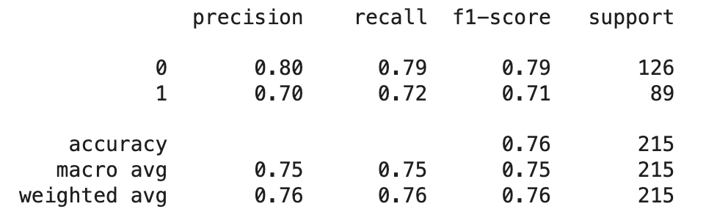
Let’s talk about the classification report
precision and recall given positive class is our success outcome
number of actual records of each class in testing set
accuracy
With both of these techniques, it is important to understand that certain metrics can have big impacts
For example, if a model was predicting whether or not a mushroom was poisonous, it would be catastrophic to have bad recall.
classification

Slide 34
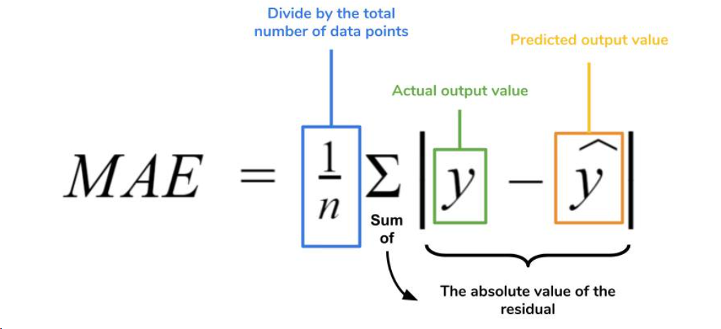
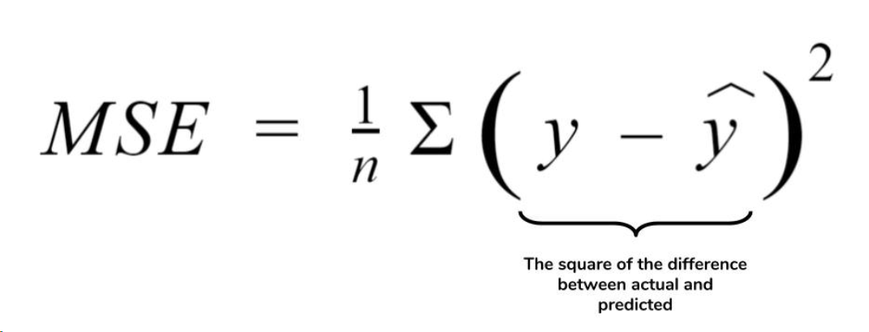
What about regression models?
link to more info: here
Mean absolute error (MAE) describes magnitude of errors (distance from regression line to data point) where a larger MAE indicates model struggled to fit, though this can be caused by outliers. Mean squared error (MSE) does similar calculation to MAE, but squares magnitudes. This means that MSE penalized large errors, while MAE only cares about the actual error. Also can compute root mean square error (RMSE) which is sqrt of MSE.
Regression

Slide 35
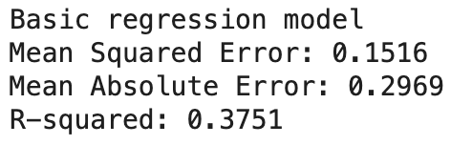
Let’s talk about the regression metrics
MSE is squaring the errors, so typically MSE > MAE. However, in this case, we're seeing MSE < MAE... why is this?
Our target is between 0 and 1, so the errors are small. Squaring values under 1 → smaller values under 1.
What to look for: MAE or MSE that is considerably better than the baseline (null) model. MAE is good to use when outliers may be present. Generally speaking, for a binary regression model MAE or MSE closer to 0 means good performance. Either below 0.2 is okay (closer to 0.1 or less is ideal). Any MAE >0.4 or MSE >0.3 is considered poor performance.
Regression

Slide 36
Work Time
HW2 Q#2-3
Let’s get a start on some more homework questions.
View on our website

Slide 37
Quiz EDA
We’ll continue content at 1:50. Spend ~5 minutes on each page, adding explanation where needed.

Slide 38
Machine Learning
With python
Evl3: Evaluation
ethical matrix + auditing algorithms
Notes:
Layout objects pulled from: https://slidesgo.com/
All icons are from: https://thenounproject.com/

Slide 39
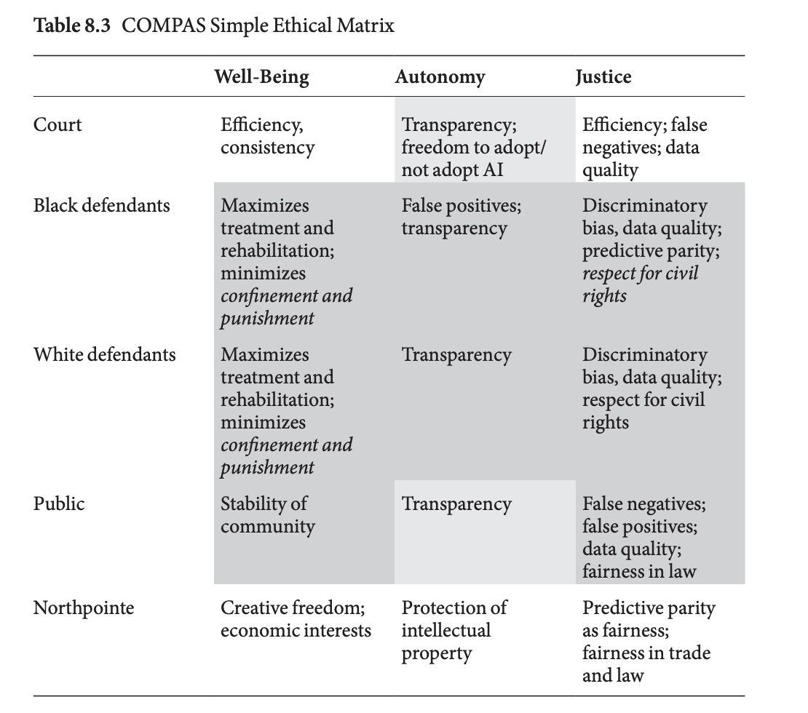
Define the issues. These are identified based off the algorithm being audited and the use case.
Ideally we consider how we can audit algorithms by looking at benefits, harm, accountability, fairness.
Define the key stakeholders. In any algorithmic system, there are various stakeholders who will be affected by the decisions made by the model.
The COMPAS (Correctional Offender Management Profiling for Alternative Sanctions) is an algorithm used in the criminal justice system to assess the risk of reoffending
ethical matrix
AI ethics textbook chapter with more examples (link)

Slide 40




auditing algorithms
Accountability
Who is responsible if the model makes a mistake? What steps should be taken if the model’s predictions are inaccurate or harmful?
Benefits
What positive outcomes might each stakeholder experience if the model is deployed?
Fairness
Is the model equally fair to all stakeholders, especially those from under-represented or vulnerable groups? Does the model avoid reinforcing bias?
Harms
What potential negative consequences might arise for each stakeholder? Could the model cause harm or lead to incorrect conclusions?
Based off the audit, what are concrete actions that can be taken to mitigate potential harms?

Slide 41
ethical matrix
issues can be many things, including safety, autonomy, etc.
issues → ↓ stakeholders | benefits | harm | accountability | fairness
Case Study: AI Recruitment and Hiring Systems
Scenario: A large corporation decides to implement an AI-driven recruitment and hiring system designed to screen resumes, assess job applications, and conduct initial interviews.
The goal is to streamline the hiring process, reduce human bias, and increase efficiency. However, the AI system has been shown to potentially inherent biases from historical hiring data, leading to questions about fairness and accountability.
applicants
faster feedback, hopefully objective
screened out for algo bias; lack of transparency
data formatting issues in resumes? any appeal system?
are all applicants treated equitably?
reduced time on screenings; hopefully data driven
loss of human judgment
cross-check decisions? how reliant are they?
actual give best candidate, or is the training data flawed?
HR dept or Hiring manager
company
cost savings, efficiency
legal risk, backlash
what if model is discriminatory?
is the model audited regularly?
get to build out and use AI in their work
responsible for bias in the AI they deploy
is the model reflective of the real-world?
are all candidates treated fairly? transparency in decision made?
Software + AI devs

Slide 42
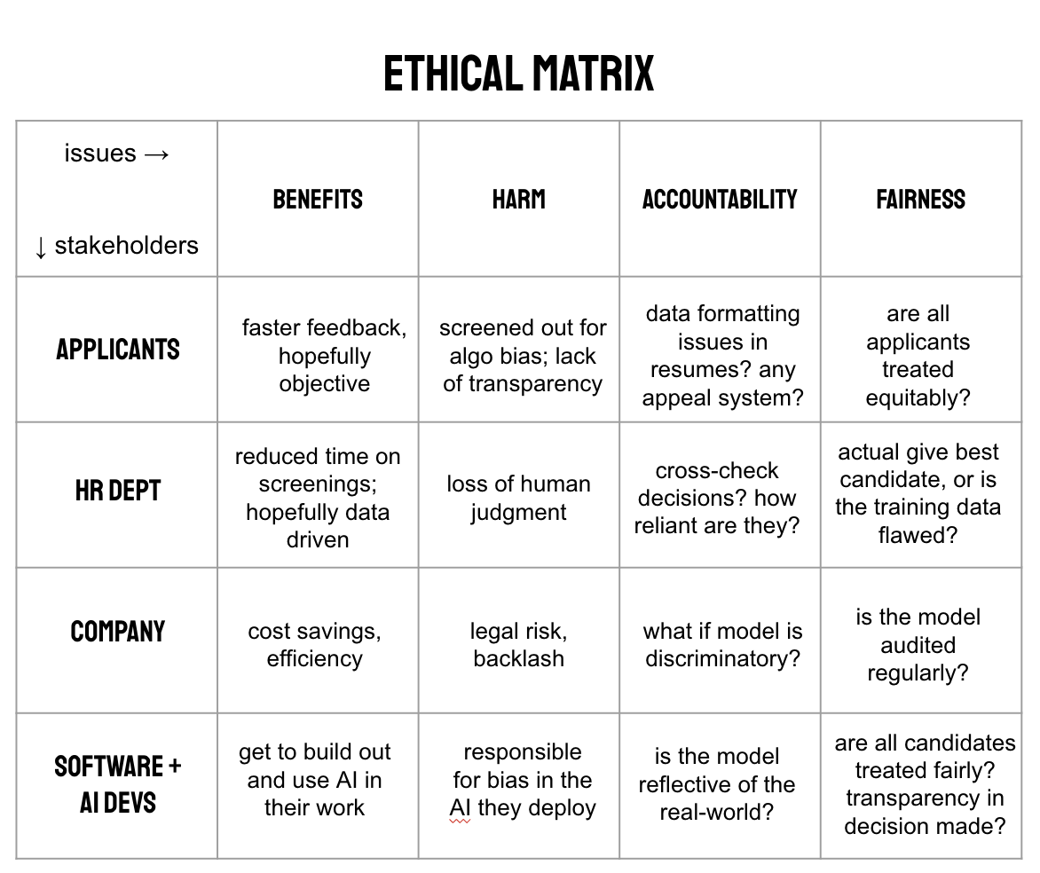
Exercise
Based on this matrix, what are two concrete actions that can be taken to mitigate potential harms?

Slide 43
Note: issues can be many things, so your answers may be different from mine
ethical matrix
Fill out stakeholders (yours may end up being different from mine). Then consider the issues for a single stakeholder and fill out a row
issues → ↓ stakeholders | benefits | harm | accountability | fairness
Case Study: Autonomous Vehicles in Urban Areas
Scenario: A major tech company is developing a new autonomous vehicle system designed to operate in highly urbanized environments. The vehicle will be integrated with an AI-driven system to optimize traffic patterns, reduce accidents, and increase fuel efficiency.
The company intends to deploy these vehicles in cities to improve transportation infrastructure and reduce congestion.
other drivers
reduced congestion, better air
job displacement, weird accidents
how will liability be determined?
how to prioritize safety?
profit$$, recognition
legal risks with accidents or fatalities
who is responsible if system malfunctions?
are all passengers treated fairly?
tech company
passengers
do other things, cost savings with ride share
privacy on travel patterns, dependency
who is responsible for harm to a person if system malfunctions?
equal safety measure? affordable?
reduced congestion, increased safety
regulation or policy gaps
who checks if safety standards are being met?
are all passengers treated fairly?
city (gov’t)

Slide 44
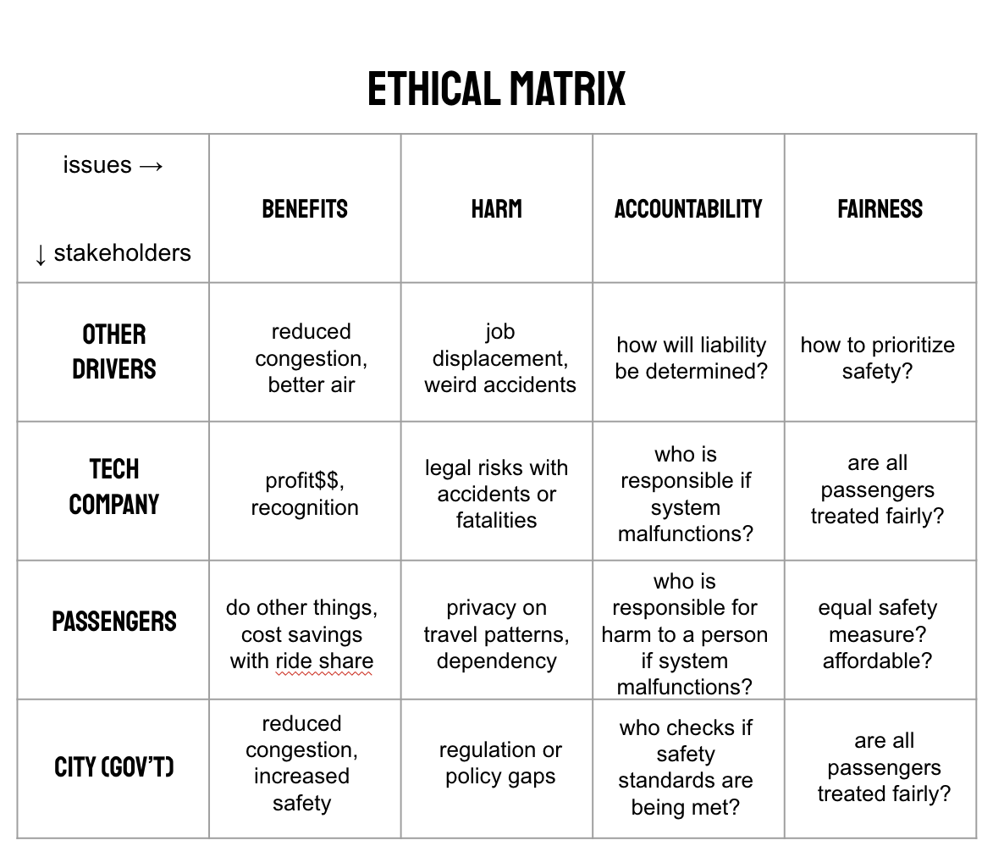
Exercise
Based on this matrix, what are two concrete actions that can be taken to mitigate potential harms?

Slide 45
lab work time
Lab EVL
View on our website

Slide 46

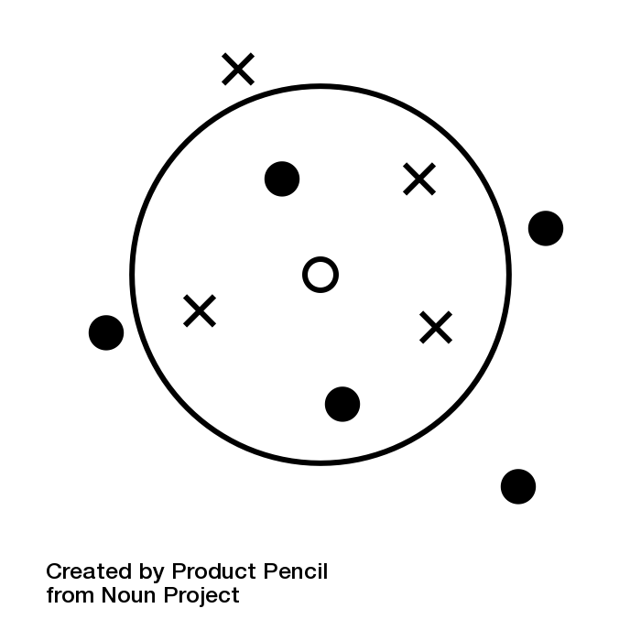


Decision
Tree
Linear Regression
Logistic Regression
Naive
Bayes
Clustering
SVM
Random Forest
k-means clustering
Neural Network
kNN
Deep Reinforcement
XGBoost
Genetic algorithm
NLP
Q-learning
Reinforcement

