Slide 1
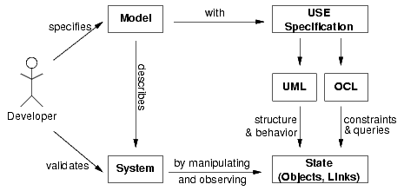
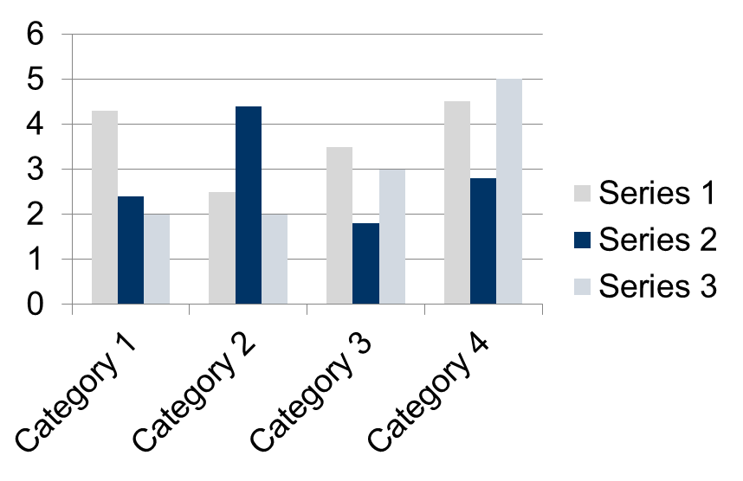
Petrol Supply System Specification and Validation Under UML-based Specification Environment (USE)
Author: Heying Cai, Junjie He
SOFTENG 752 - 2018 Assignment 2
Introduction
Design
Future Work
This poster describes the specification and validation of a petrol supply system with supports from Unified Modeling Language (UML), and Object Constraint Language (OCL) under UML-based Specification Environment (USE).
The main goal of using UML was to provide us with tools for analysis, design as well as implementation of the petrol supply system with object-oriented modeling aspect. The support from OCL provides a declarative language describing rules applying to UML models.
Results can be shown in form of tables or graphs or charts. Should be about 150 words.
Images of charts / tables/ graphs should be clear and readable.
Interactions are a common mechanism for describing systems that can be understood and produced.[3] This assignment focused on validating a model for petrol supply system between petrol company and petrol station. When it comes to real life, the interactions between customer and petrol station are also important which can be implemented into the model in the future.
It is obvious that restock is not likely to happen during night time. Further information such as time constraint can be added into the model which can make it closer to real life.
TABLE SAMPLE
1998 | 1999 | 2000
2001 | 2002 | 2003
2004 | 2005 | 2006
Methods / Procedures
Bibliography / References
Firstly, the structure of the petrol supply system in terms of classifiers and the relations between them are described in class diagrams based on UML language. After the static structure of a model has been specified, object diagrams paired with OCL constraint were used to described a snap-shot of the system during runtime. [2]
Based on UML and OCL, USE was used as the environment to validate our model. A general view of the USE approach is shown in figure 1.
[1] Database Systems Group, USE a UML based Specification Environment Preliminary Version 0.1. Bremen University, May 1978.
[2] Kyas, Marcel. (2018). Verifying OCL specifications of UML models : tool support and compositionality.
[3] Object Management Group, “Unified Modeling Language (OMG UML), Version 2.5.1”, December 2017.
Findings or Results of the algorithms used can be shown in this section
Verification
Todo….
Conclusion / Discussions
In object-oriented programming, every class is characterized by a class invariant. Class invariants are conditions that all objects of that class must satisfy while it can be observable by clients. It is a great idea to use them to ensure objects are always presented to their clients in a consistent state.
Figure 1, Overview of the Specification Workflow [1]

