Slide 1
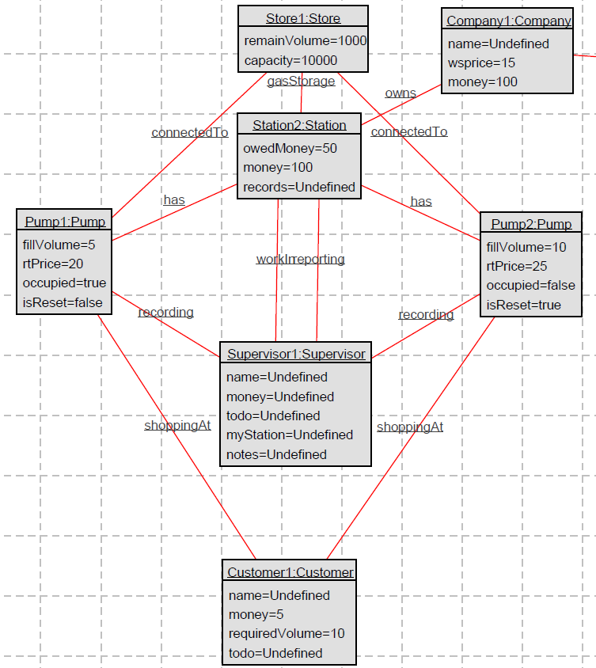
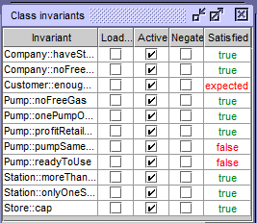
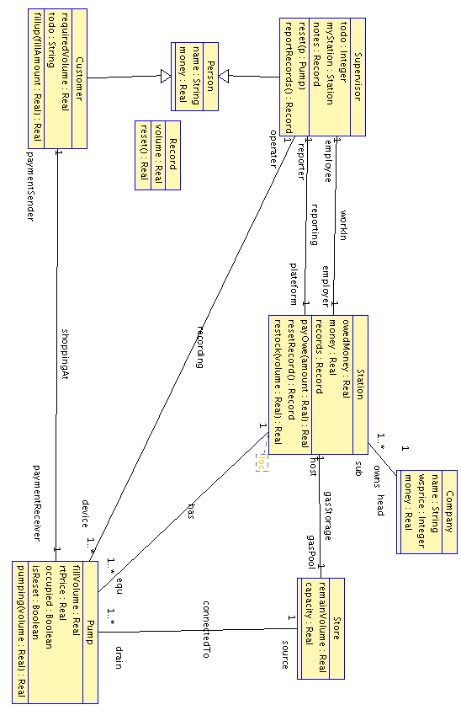
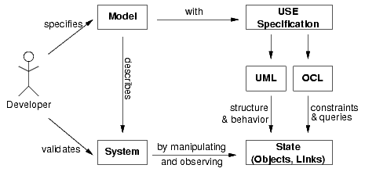
Petrol Supply System Specification and Validation Under UML-based Specification Environment (USE)
Author: Heying Cai, Junjie He
SOFTENG 752 - 2018 Assignment 2
Abstract
Design
Object Diagram
This poster describes the specification and validation of a petrol supply system with supports from Unified Modeling Language (UML), and Object Constraint Language (OCL) under UML-based Specification Environment (USE).
Some unique designs have been implemented in this petrol system. First, the pump will wait for a supervisor to reset before it can online again. Second, the supervisor will record the transaction every time a customer pumped gas from a pump. While he had reset every pump in the station, he will have a chance to report the Record he has to the Station. And the Record at station side will be updated base on this. The Record at Station side is the one used to calculate how much does a station need pay to the Company. Since the company can collect bill anytime they want, the stations have been given operation resetRecord(), pay-Owe (amount:Real) and restock (volume:Real) to simulate the real scenario.
Partial view of object diagram is shown in figure 3. It demonstrates the idea of the implementation of this petrol station. In this diagram, we create instances for each class to explain how the petrol station work.
Introduction
A petrol company owns a number of petrol stations. Each petrol station consists of a number of petrol pumps. Each pump can be reset by a supervisor, after which it can pump out petrol from a common store, recording at each stage the volume and cost of petrol pumped so far. When pumping is finished, the total cost is recorded by the supervisor and subsequently paid by the customer. Each pump in a petrol station sells petrol at the same price, although this price may vary between stations. The common store can be re-stocked by the petrol company at any time. The company supplies petrol at the same cost to each station. Records are
kept of the total volume of petrol supplied to each station, as well as the outstanding amount owed by each station. The amount owed to the company by a station is paid when requested by the company.
Class Diagram
Figure 3, Object Diagram
Class diagram describes the relationship between classes, and it can also provide the role name for easy observation. Start from the head - company; They own stations and sale gasoline to stations with a static wholesale price. They collect the bill from stations when they require them to do so. While that happens, Station::payOwe handles the situation. Pre/Post-conditions are used to ensure Station have money to pay, and Station holds a Record. This Record at Station gets cleared after they pay off the bill.
Validation
To verify the system invariant was add into UML specification to help with design. The invariant has been added into UML specification as verification
Methods / Procedures
Firstly, the structure of the petrol supply system in terms of classifiers and the relations between them are described in class diagrams based on UML language. After the static structure of a model has been specified, object diagrams paired with OCL constraint were used to described a snap-shot of the system during runtime. [2]
Based on UML and OCL, USE was used as the environment to validate our model. A general view of the USE approach is shown in figure 1.
Future Work
It is obvious that restock is not likely to happen during night time. Further information such as time constraint can be added into the model which can make it closer to real life.
Figure 2, Class Diagram
Bibliography / References
[1] Database Systems Group, USE a UML based Specification Environment Preliminary Version 0.1. Bremen University, May 1978.
[2] Kyas, Marcel. (2018). Verifying OCL specifications of UML models : tool support and compositionality.
Figure 1, Overview of the Specification Workflow [1]

