Slide 1
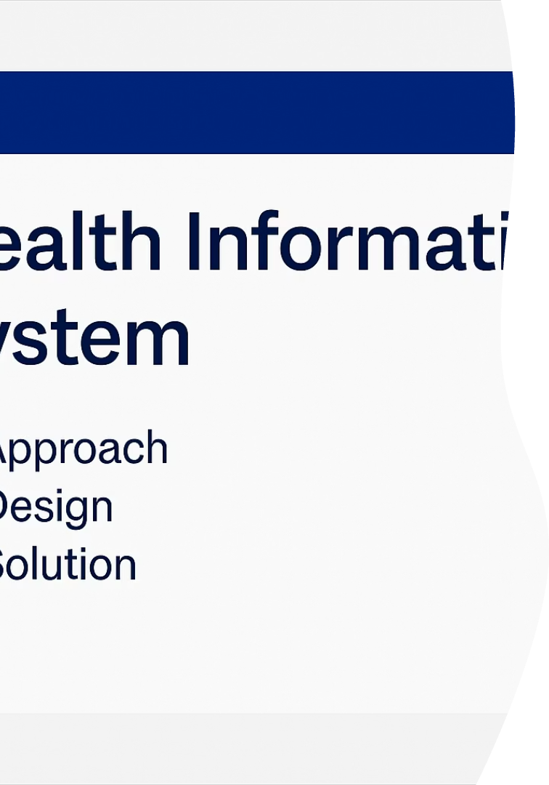

Health App: Streamlining Program Management & Client Enrollment
The Health App is a comprehensive web-based platform designed to simplify health program management and client enrollment. This solution enables administrators to create detailed health programs, register clients with essential information, and manage program participation efficiently.
Our platform features intuitive client search functionality, detailed profile viewing, and seamless program enrollment capabilities—all built with scalability and user experience in mind.
by MarkPaul Chege

Slide 2
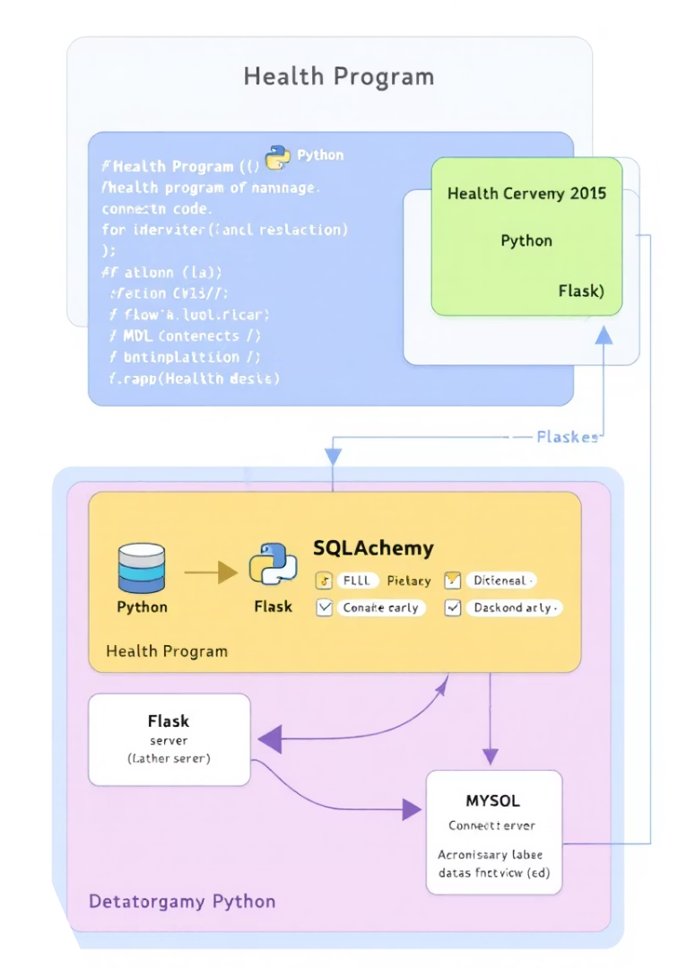




Key Features & Technologies
Create Health Programs
Administrators can create new health programs with detailed descriptions
Client Registration
Register clients with essential information (name, age, gender, email)
Program Enrollment
Easily enroll clients in available health programs
Profile & Search
View detailed client profiles and search clients by name
Built with Python and Flask on the backend, MySQL database with SQLAlchemy ORM, and a responsive frontend using HTML, CSS with Tailwind, and JavaScript. Version control is managed through Git.

Slide 3



Project Structure
/assets
Stores external files like videos and presentations
/static
Contains CSS and JS files for the frontend
/templates
HTML files for rendering the views
The project follows a structured organization with dedicated folders for assets (including demo videos and presentations), static resources, and HTML templates. This organization ensures clean separation of concerns and makes the codebase easy to navigate and maintain.

Slide 4








Client-Centric Approach
Client Registration
Program Management
Seamless onboarding process
Create and update health initiatives
Profile Tracking
Client Enrollment
Monitor participation and progress
Connect clients with programs
The app's approach focuses on simplifying health program management while ensuring clients can easily register and track their participation. This client-centric design prioritizes seamless registration and profile management, complemented by robust program administration capabilities.
The scalable architecture, built on Flask and SQLAlchemy, allows for expansion without significant changes to the underlying structure.

Slide 5
Database & Interface Design
Database Schema
User Interface
The database uses a relational model with two primary tables:
The frontend leverages modern web technologies:
HTML and CSS with Tailwind for responsive design
Client Table: Stores personal information (id, name, age, gender, email)
Glassmorphism theme for client dashboard
Clean, intuitive navigation for both clients and administrators
Program Table: Contains program details (id, name, description)
Associative Table: Manages many-to-many relationships for enrollments
The app includes essential routes and API endpoints for creating programs, registering clients, managing enrollments, viewing profiles, and searching for clients—all designed for intuitive navigation and efficient data management.

Slide 6




Solution & Key Functionalities
Challenges Addressed
Streamlined client enrollment tracking
Scalable architecture for new programs
Intuitive, user-friendly interface
Program Management
Efficiently create and manage health programs with flexible client relationships.
Client Registration
Simplified process to capture essential client details effectively.
Search & Profile
Quickly find clients and view detailed profiles with enrollment history.
The Health App offers an integrated solution for health program management, effectively addressing challenges in client enrollment, program creation, and profile tracking, all within a scalable and user-friendly interface.

Slide 7
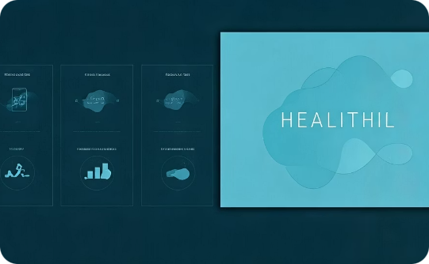

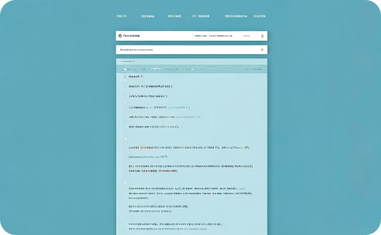
Resources & Documentation
PowerPoint Presentation
Demo Video
Setup Instructions
A comprehensive presentation explaining the app's approach, design, and solution is available in the /assets/presentations/ folder.
A detailed video demonstration showcasing client registration, program creation, enrollment, and profile viewing is available in the /assets/videos/ folder.
Complete setup guide including prerequisites (Python 3.x, MySQL, Flask, SQLAlchemy, Flask-Migrate) and installation steps for getting the application running locally.
These resources provide comprehensive guidance for understanding and implementing the Health App solution.

Slide 8
Setup & Conclusion
Launch Application
Run Migrations
Start the Flask application with "flask run" and access at http://127.0.0.1:5000/
Configure Environment
Initialize the database with Flask-Migrate commands: flask db init, migrate, and upgrade
Install Prerequisites
Ensure Python 3.x and MySQL Server are installed on your system
Clone the repository, install dependencies with pip, and set up the MySQL database
The Health App efficiently manages health programs and client data, offering a clean and scalable solution. Its client-centric approach, combined with robust program management capabilities, creates a comprehensive platform for health program administration.
This presentation has provided an overview of the project's approach, design, and implementation details, complemented by additional resources to aid in understanding and deploying the solution.

