Slide 1
Android Audio HAL
Connects higher-level, audio-specific framework APIs in android.media to the underlying audio driver and hardware
Defines standard interface that audio services call into and that you must implement for your audio hardware to function correctly
Interfaces are located in hardware/libhardware/include/hardware

Slide 2
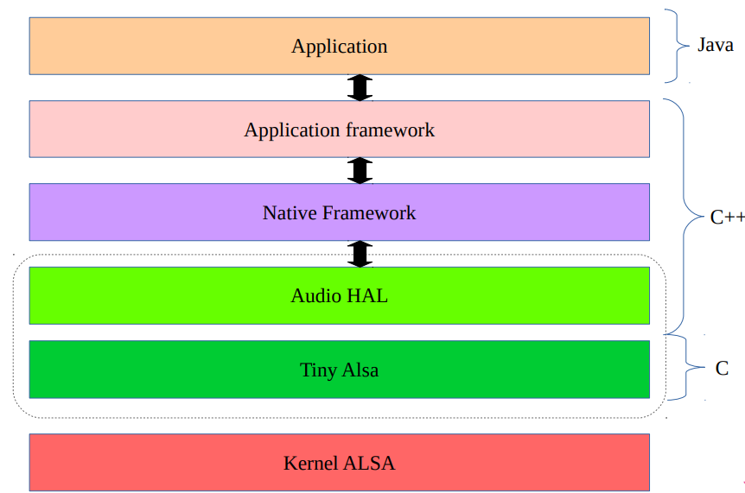
Hal layer view

Slide 3
Hal Implementation steps
Implement interfaces described in audio.h, audio_effect.h files
Create an audio policy configuration file – Describe audio topology and package the HAL implementation into a shared library
Configure pre-processing effects such as automatic gain control and noise suppression

Slide 4
HAL Interfaces
Main functions - – hardware/libhardware/include/hardware/audio.h
– audio_stream_t
– stream_callback_t
– audio_stream_out_t
– audio_stream_in_t
– audio_hw_device_t
Effects (downmixing, echo, or noise suppression)
– hardware/libhardware/include/hardware/audio_effect.h
– audio_effect_library_t
– struct effect_interface_s

Slide 5
Audio policy configuration
Naugat introduced new XML based audio policy – New audio policy configuration file audio_policy_configuration.xml – Location : /system/etc – Include build option USE_XML_AUDIO_POLICY_CONF := 1 in device makefile
Old policy (audio_policy.conf) is deprecated – Location : device///audio/audio_policy.conf –

Slide 6
XML files from other folders can be included using Xinclude element – Example :
Audio policy files – A2DP: a2dp_audio_policy_configuration.xml –
Reroute submix: rsubmix_audio_policy_configuration.xml – USB: usb_audio_policy_configuration.xm

Slide 7
Advantages of XML based policy)
Audio profiles are now structured similar to HDMI Simple Audio Descriptors and enable a different set of sampling rates/channel masks for each audio format .
Explicit definitions of all possible connections between devices and streams
– Previously, an implicit rule made it possible to interconnect all devices attached to the same HAL module, preventing audio policy from controlling connections requested with audio patch APIs
– In XML format, topology description now defines connection limitations
Support for includes avoids repeating standard A2DP, USB, or reroute submit definitions
Customizable volume curves
– Previously, volume tables were hard-coded
– In XML format, volume tables are described and can be customized

Slide 8
HAL MODULE
Audio module shall be initialized as mentioned below
Name shall be HAL_MODULE_INFO_SYM
The hal_module_methods points to open function
struct audio_module HAL_MODULE_INFO_SYM = {
.common = {
.tag = HARDWARE_MODULE_TAG,
.module_api_version = AUDIO_MODULE_API_VERSION_0_1,
.hal_api_version = HARDWARE_HAL_API_VERSION,
.id = AUDIO_HARDWARE_MODULE_ID,
.name = "Raspberry Pi Audio HW HAL",
.author = "The Android Open Source Project",
.methods = &hal_module_methods,
},
};

Slide 9
TINY ALSA
ALSA is an open source sound architecture for Linux
TinyALSA is a small ALSA library aimed to be used in Android
Source code is available in “external/tinyalsa” directory
Utility executables
– tinyplay
– tinymix
– tinycap
– Tinypcminfo
Shared library - libtinyalsa

Slide 10
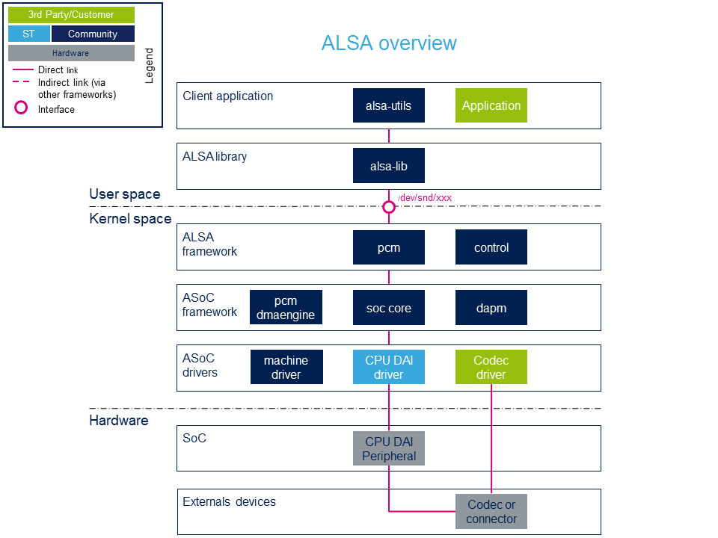
ALSA ARCHITECTURE

