Slide 1
Android Audio Architecture

Slide 2
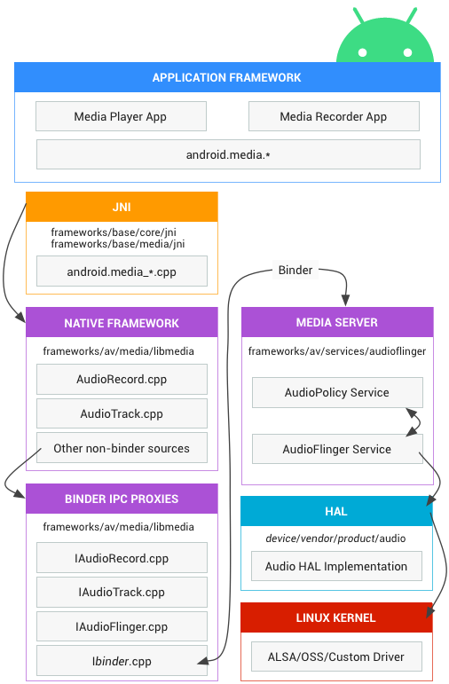

Slide 3
Audio Java Section
Code Path: frameworks/base/media/java/android/media
Audio associated with the Java package is android.media, Audio system consists mainly of Audio Manager and several classes
Audio JNI Section
Code Path: frameworks/base/core/jni
Library: libandroid_runtime.so
Audio part of the framework
Header File Path: frameworks/base/include/media/
Source Path: frameworks/base/media/libmedia
Audio local media library is part of the framework, this section is compiled into a library libmedia.so, provides Audio part of the interface (including those based on Binder's IPC mechanism).

Slide 4
Audio Flinger
Code Path: frameworks/base/libs/audioflinger
This section is compiled into a library libaudioflinger.so, Audio system, which is part of
the local Services.
Audio Hardware Abstraction Layer Interface
Code Path: hardware/libhardware_legacy/include/hardware
Audio hardware abstraction layer implemented in various systems may be different, you need to inherit the appropriate class code and implement them. Audio hardware abstraction layer provides an interface to the hardware for AudioFlinger call.

Slide 5
Relationships between various levels is shown below
 | Audio Management | Audio Output | Audio Input
Java Layer | Android.media.AudioSystem | Android.media.AudioTrack | Android.media.AudioRecorder
Local Framework Layer | AudioSystem | AudioTrack | AudioRecorder
AudioFlinger | IAudioFlinger | IAudioTrack | IAudioRecorder
Hardware Abstraction Layer | AudioHardwareInterface | AudioStreamout | AudioStreamIn

Slide 6
Audio Flinger
It is a system service which starts during boot and enables the platform for audio related use-cases in the following ways.
1. Provide the access interface for the upper layer for using
Audio.
2. Uses the HAL to manage the audio devices.

Slide 7
AudioFlinger Service: Startup and Operation.
System services in Android fall into two categories
Java Services
Native Services.
Mediaserver starts all the native layer services [Viz: AudioFlinger, MediaPlayerService, CameraService, and AudioPolicyService] for achieving media related From the file frameworks/av/media/mediaserver/main_mediaserver.cpp.

Slide 8
AudioFlinger is the executor of the strategy defined and decided and does some of the following tasks.
1. How to communicate specifically with the audio device.
2. How to maintain the audio sstate sanity in the existing system.
3. How to deal with the mixture of multiple audio streams, etc.

Slide 9
Audio policy manager
Audio policy manger is the policy maker. It decides some of the important things like.
1. When to open the audio interface device.
2. What kind of Stream-type audio corresponds to what device etc.
AudioPolicyManagerBase () reads the contents of the file of audio_policy.conf and then opens the different types of audio interfaces

Slide 10
Audio Binder IPC

