Slide 1
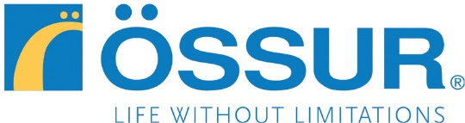
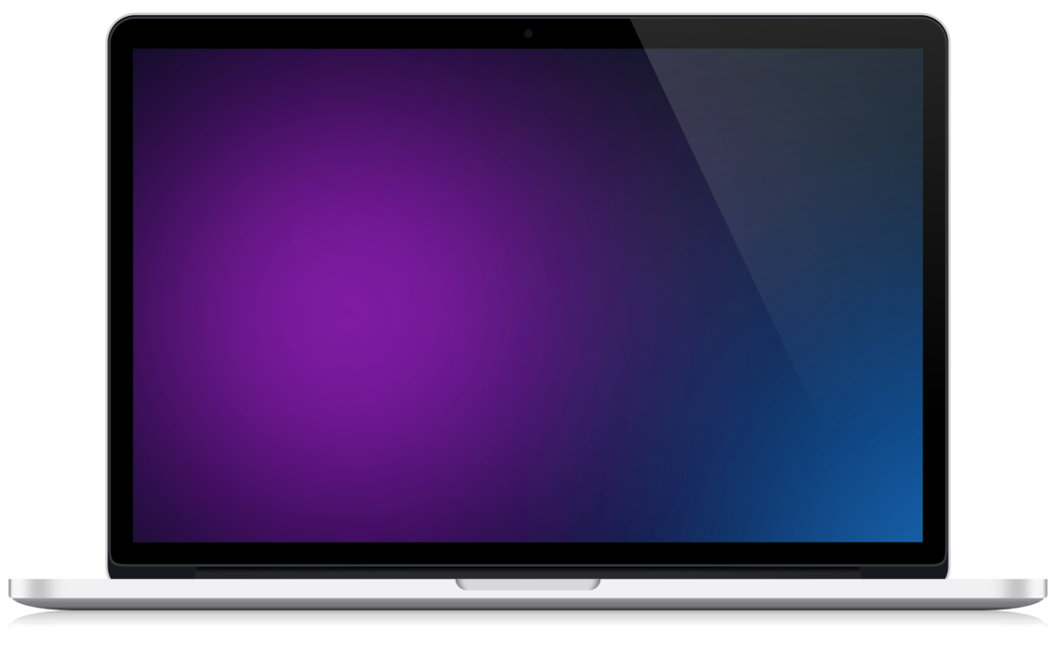
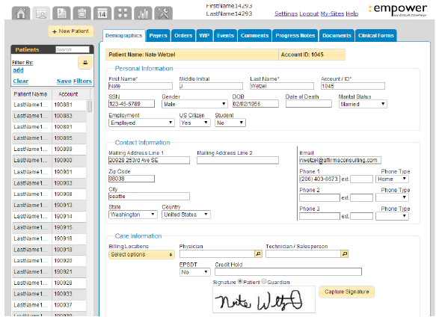
Ossur - Medical Record Product
Business Need
Ossur Americas, a global leader in orthopedics, had a critical medical billing application that was failing for key customers. The current engaged team could not solve the complex business problems and there was no continuity for how to support and maintain the application going forward.
What We Did
We rebuilt the failing medical billing application that was critical to the business. We evaluated their most critical business problems, bringing in expertise in Business, Finance, and Technology to reconcile complex billing algorithms. We assessed the overall architecture and provided findings and recommendations to stabilize the system. We also provided a comprehensive plan for maintaining the application going forward.
Results
We delivered an enterprise scale, market viable medical billing system that is exceeding customer expectations. The system is stable and maintained, monitored and improved by our team.

Slide 2
Ossur – Medical Record Application
Business Need
Ossur Americas, a global leader in orthopedics, had a critical medical billing application that was failing for key customers. The current engaged team could not solve the complex business problems and there was no continuity for how to support and maintain the application going forward.
What We Did
We rebuilt the failing medical billing application that was critical to the business. We evaluated their most critical business problems, bringing in expertise in Business, Finance, and Technology to reconcile complex billing algorithms. We assessed the overall architecture and provided findings and recommendations to stabilize the system. We also provided a comprehensive plan for maintaining the application going forward.
Results
We delivered an enterprise scale, market viable medical billing system that is exceeding customer expectations. The system is stable and maintained, monitored and improved by our team.

