Slide 1
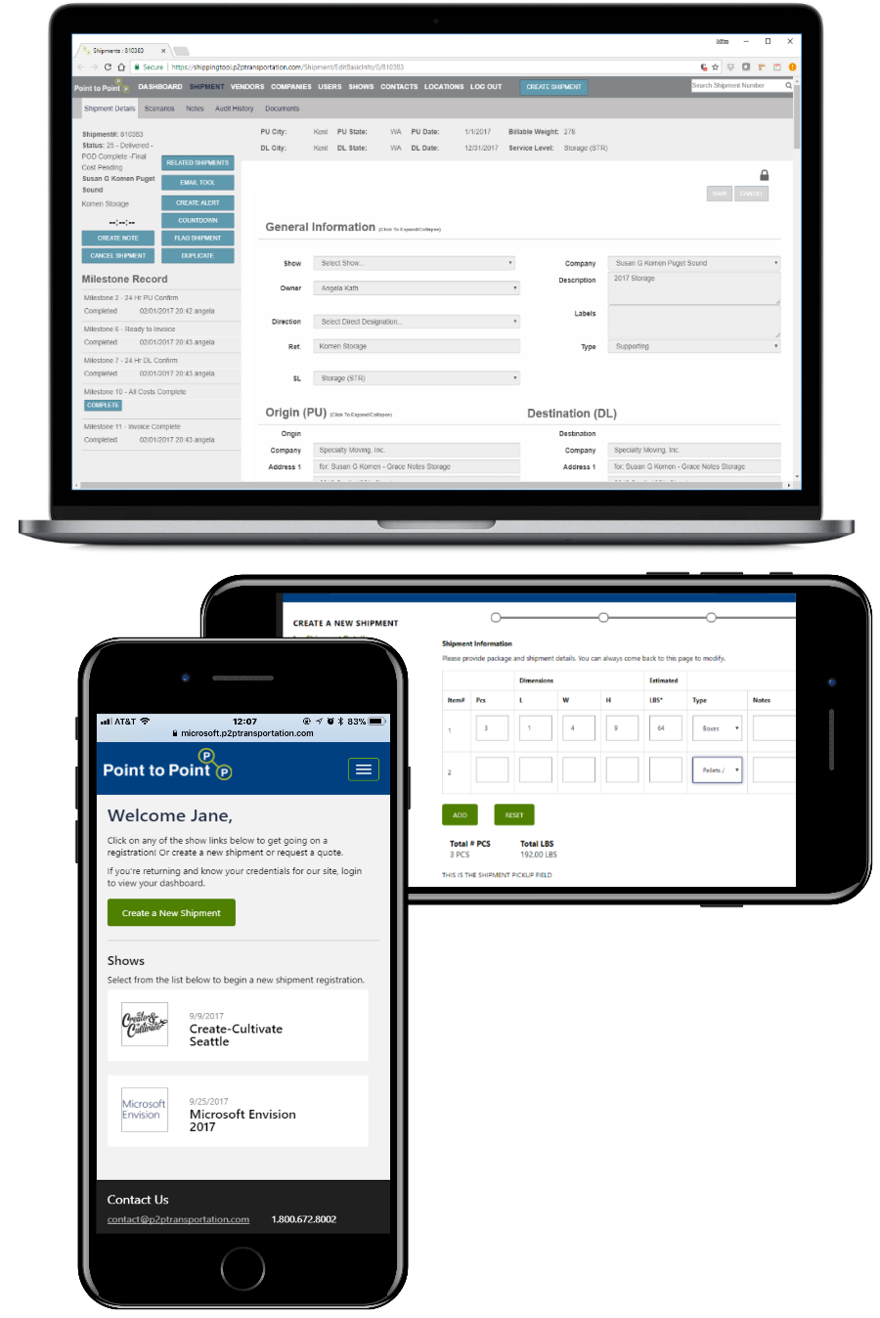

P2P Transportation – Digital Workflows
Business Need
Point 2 Point is a shipping company that manages large tradeshows. They came to Affirma with a mission-critical initiative to transition off of a paper based system – their internal collaboration systems consisted of hundreds of index cards. They wanted to update and streamline their processes via a digital solution.
What We Did
Built a custom application that has transformed their entire internal collaboration system to get rid of the painful manual paper processes and implement digital workflows.
Result
The client was extremely happy with Affirma’s work and continued to be a long term partner with us. Following the completion of the initial shipment tracking project, we worked with Point 2 Point to develop and implement a customer-facing portal for clients to log-in and order/manage shipments directly.

