Slide 1
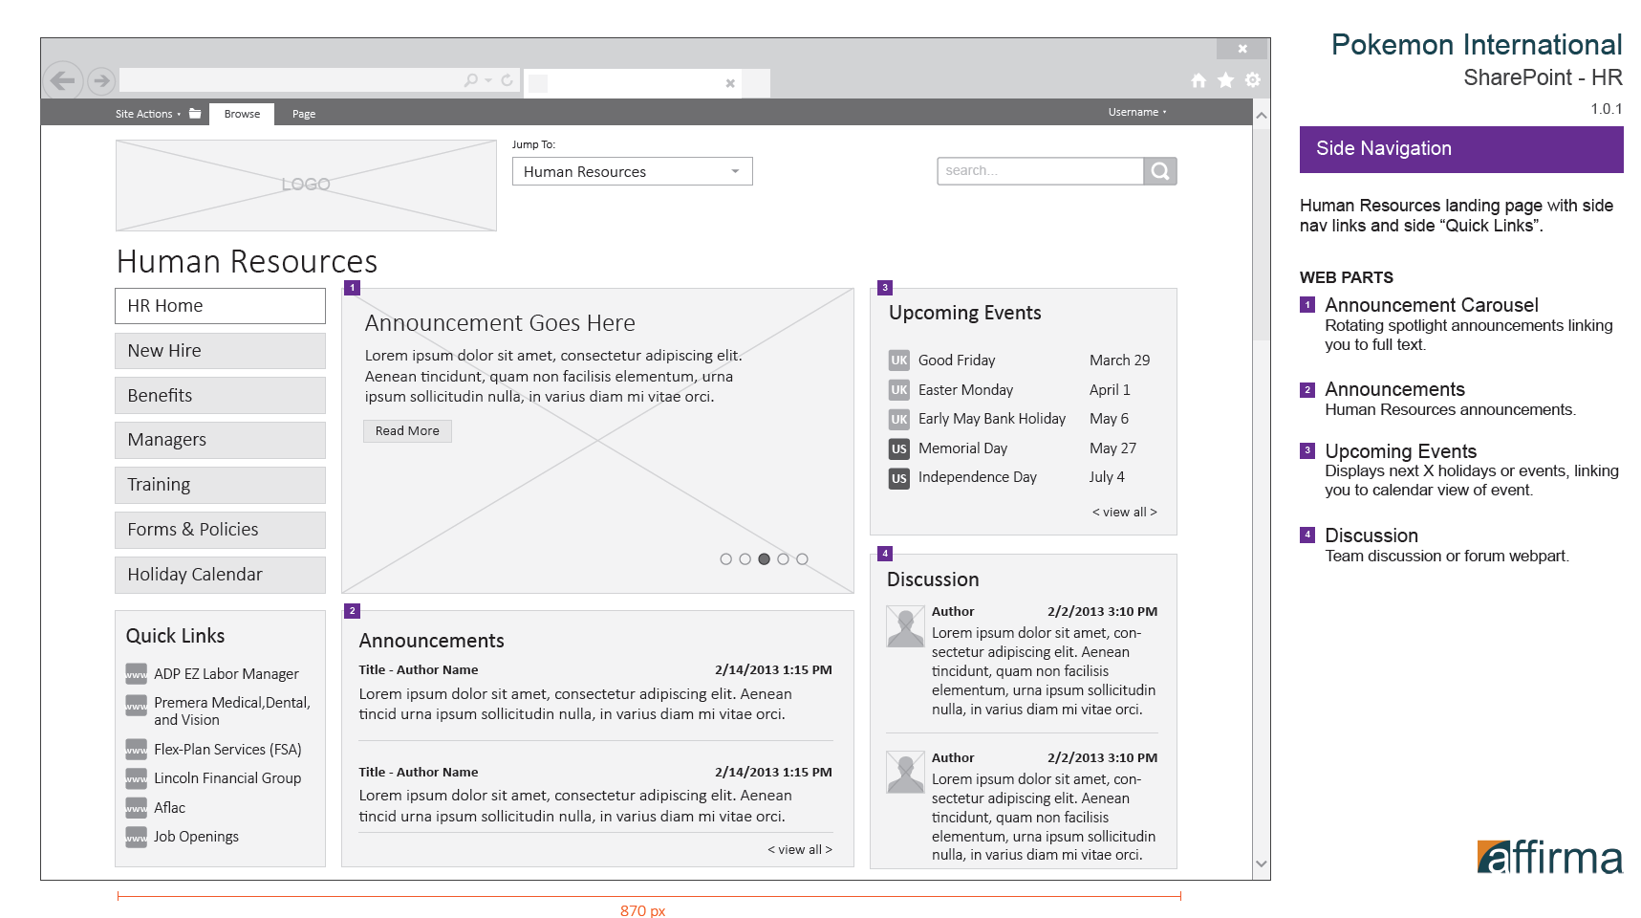
Pokemon/IA & Design
The Challenge
Pokemon, a large international organization, came to Affirma seeking a highly usable SharePoint site. Previous application of the client’s portal had received poor adoption due to user challenges around navigation, so we worked closely with the client to design a working site which fixed existing issues.
What We Did
Affirma created Wireframes and User flows for the SharePoint site, mapping out key behaviors and creating patterns of use that could be replicated across existing and future sites.
We worked with stakeholders to collect requirements, recommend solutions, and create visual mockups. These were then combined with the strong visual identity of Pokemon and developed for use across their SharePoint sites.
Results
Initial adoption of the site was very strong, and users have given favorable responses to the new look and layout. The information architecture direction has been applied to other sites and has been used as a model of implementation on various other projects.

