Slide 1
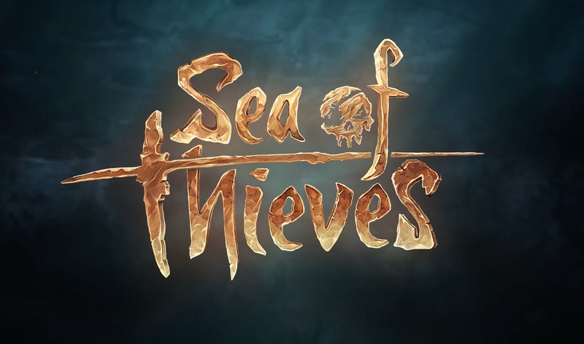

Rare Studies – CRM & Data Engineering
Business Need
Affirma supports and extends Rare’s CRM instance for their highly popular game, Sea of Thieves. Having built trust in Affirma’s capabilities and service, the Rare team came to us, requesting for two high priority, business impact driven projects to be executed simultaneously:
A new long-term end to end data handling solution that will migrate specific data currently housed in their data Warehouse by creating new pipelines for data flow leveraging existing data sources.
A new solution for processing partner data to satisfy an immediate high priority business need and to extend into a long-term data extraction and processing solution, with three weeks execution time.
What We Did
The team designed, executed and delivered the two complex Azure Data Factory based solutions for the client within an unusual short timeframe. We delivered a POC and started the first project’s full development within a week from client’s request. Fully satisfied with that work, the client made the request for the second project within few days from the first POC.
Our expertise in technologies required, knowledge of the RARE product and development environments and experience with the Microsoft landscape allowed us to deliver two solutions that are extensible, scalable, cost effective, and fully compliant.
Results
Both projects were completed ahead of schedule to and above the clients’ expectations.
Enhanced the clients’ ability to meet their short term and long term data handling needs: they can now process data on an optimal daily schedule to keep pace with business needs.

