Slide 1


Veracuity
Overview
Veracuity is a digital Health Care company that operates in the Pharmaceutical space, focusing on drug and vaccine safety. Their need was to develop an application around their intake process that would facilitate the collection of adverse drug and vaccine effects. These side effect data points drive a series of reports that were designed to provide analytics that convey valuable safety insights to both consumers and health care professionals.
Serves as a detailed, reliable, and accurate resource about drugs, vaccines, and interactions between them
Is able to detect trends in Consumer concerns based on data entry, and deliver alerts and notifications to subscribers
Social media monitoring augments trend detection
Web and mobile apps available, ad-free & consume-friendly
What We Did
Serves as the vehicle for collecting and reporting adverse drug events
The data from RDE drives the DrugVisual data store
Adverse Events are automatically reported to the FDA
Allows doctors and other health care professionals to track patient data and receive configured alerts on adverse events, with patient consent
Web and mobile app
Affirma was tasked with the development and delivery of a pair of web portals – DrugVisual and ReportDrugEvents. DrugVisual serves as a portal for consumers to access insights about specific drugs and possible side effects

Slide 2
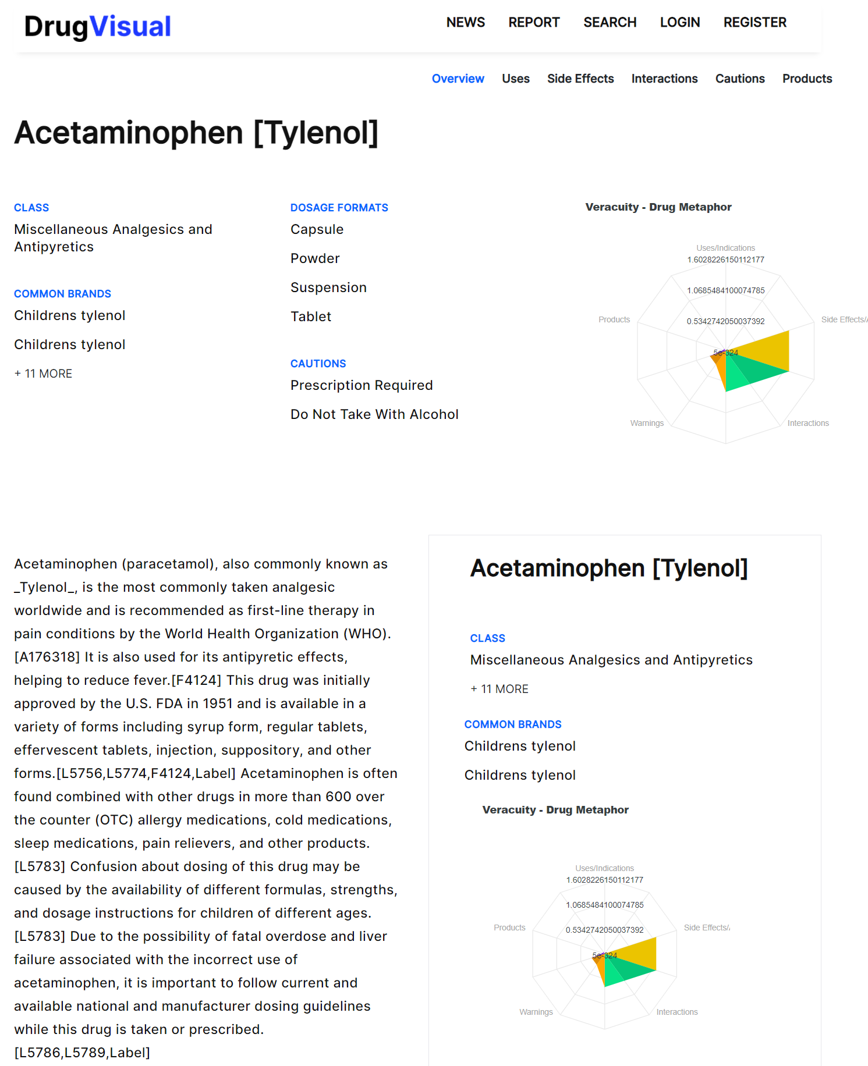
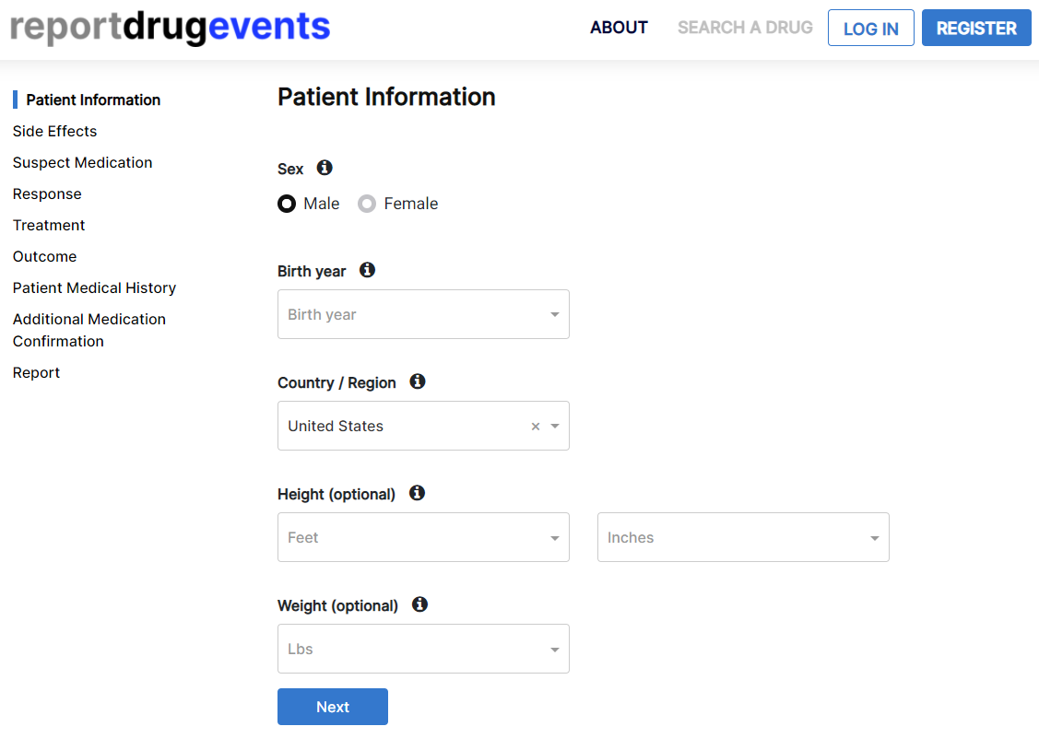
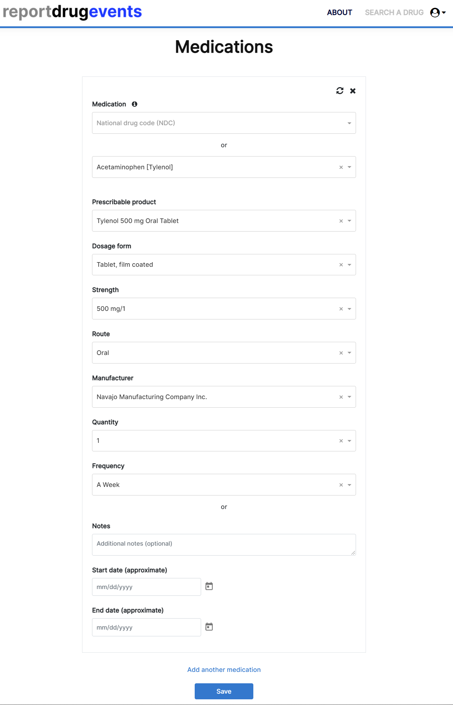
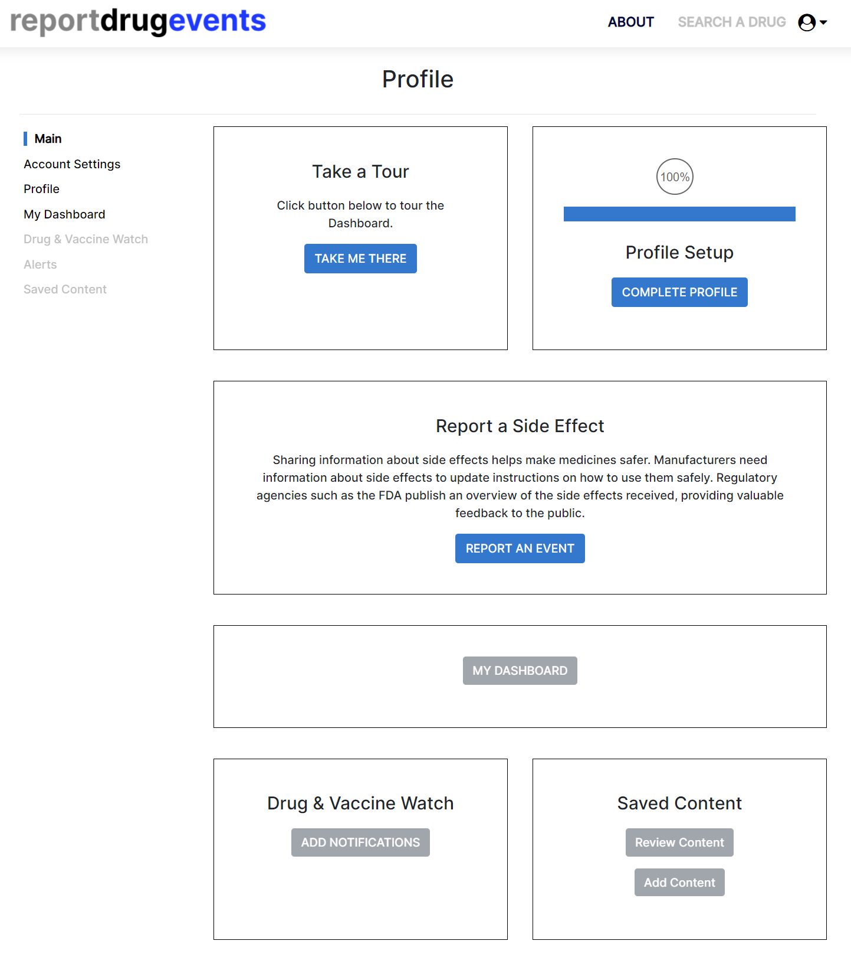
Veracuity – Portal UI

