Slide 1

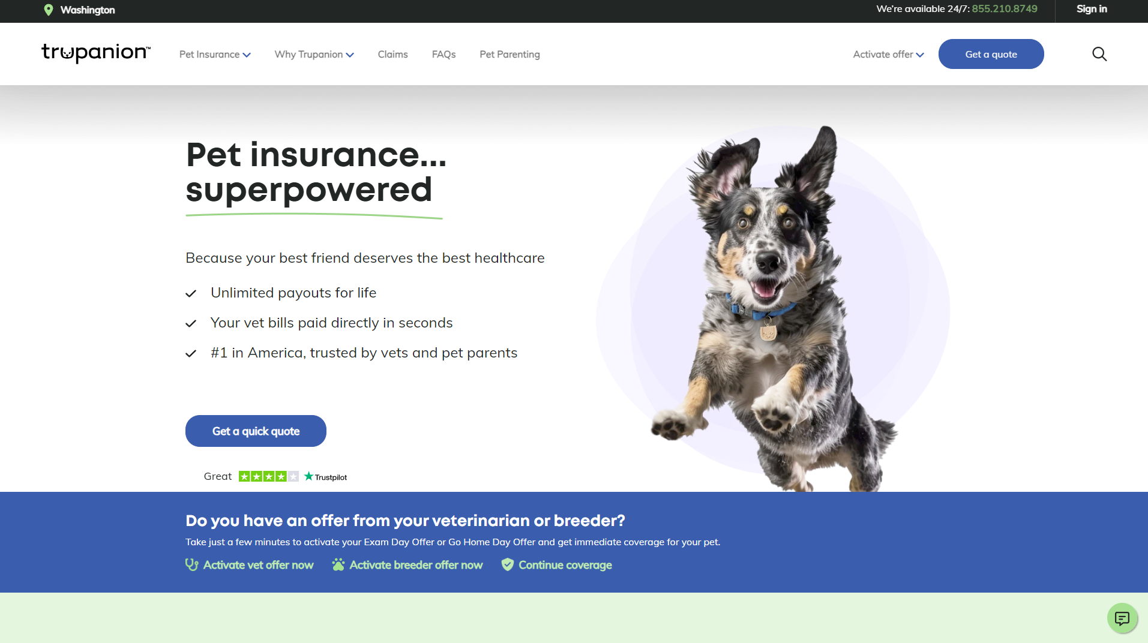
Trupanion – Marketing Website and Enrollment
Business Need
Trupanion, a premium pet insurance company, was looking to revamp their marketing website and completely rebuild their enrollment process to simplify the process and increase enrollment.
What We Did
Affirma migrated Trupanion to new enterprise CMS system that would allow them to meet their goals. A new design and content strategy was implemented and enrollment logic across different policies and locations was greatly simplified for end users and Trupanion admins.
Outcomes
Improved conversion rate
Optimized the mobile user experience
Improved the personalization and effectiveness of enrollment path content
Updated brand assets
Enhanced the overall UX/UI
Improved the efficiency and flexibility in building new pages and updating content
Enabled and scaled personalization across the entire web experience
Improve error reporting
Added localization for multiple countries
Reduced page load times
Optimized content for discoverability

Slide 2
Trupanion- Marketing Website and Enrollment
Business Need and Project Objective
Trupanion, a premium pet insurance company, was looking to revamp their marketing website and completely rebuild their enrollment process to simplify the process and increase enrollment.
What We Did
Affirma migrated Trupanion to new enterprise CMS system that would allow them to meet their goals. A new design and content strategy was implemented and enrollment logic across different policies and locations was greatly simplified for end users and Trupanion admins.
Results
Improved conversion rate
Optimized the mobile user experience
Improved the personalization and effectiveness of enrollment path content
Updated brand assets
Enhanced the overall UX/UI
Improved the efficiency and flexibility in building new pages and updating content
Enabled and scaled personalization across the entire web experience
Improve error reporting
Added localization for multiple countries
Reduced page load times
Optimized content for discoverability

Slide 3



Trupanion
Problem
Process
Outcome
Complicated signup process, meant that customers were being lost in the flow
Limited story-telling to back up the product
Technical platform was challenging to update, inflexible, and non-performant
Discovery, stakeholder interviews, competitor analysis, and redesign of improved user flows.
Explored Trupanion brand to extend into insurance
Technical audit and recommendations on approach for CMS and integrations.
SEO Research + Content Evaluation
A more defined customer journey
Attainment of SEO goals
Significant decrease in inbound customer service calls related to challenges with online experiences

Slide 4
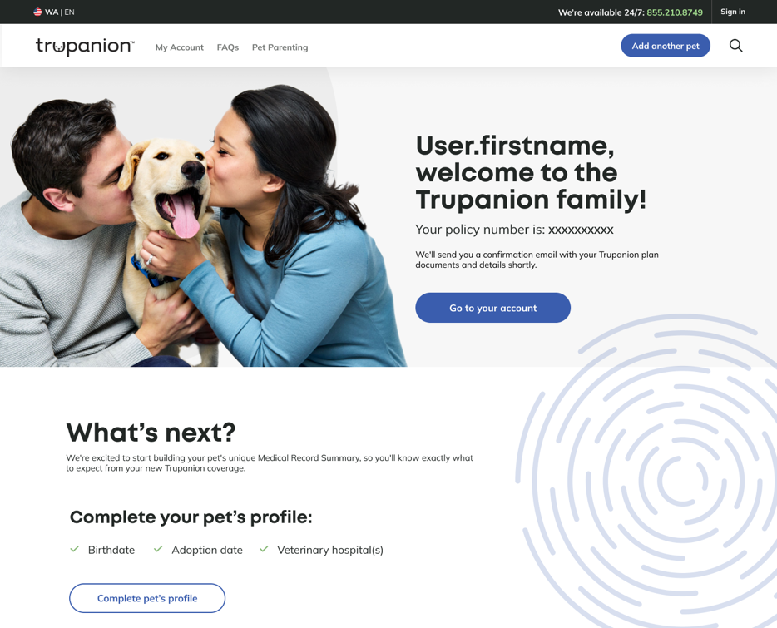
Trupanion

Slide 5
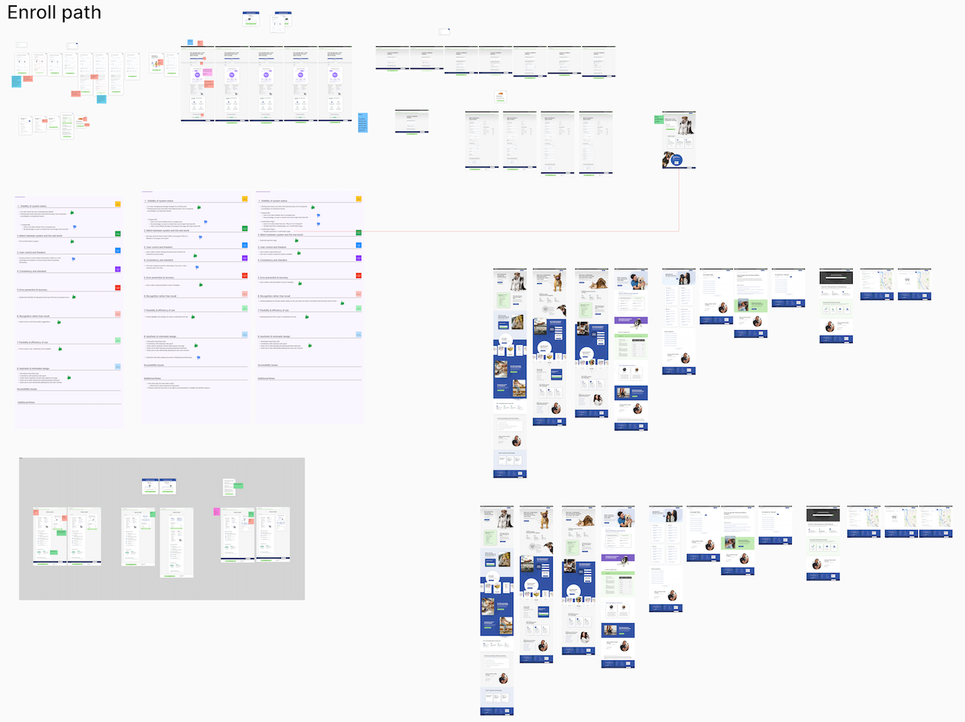
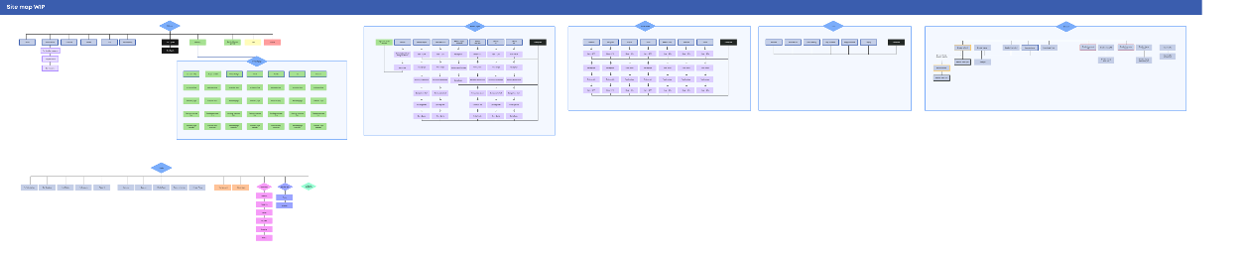
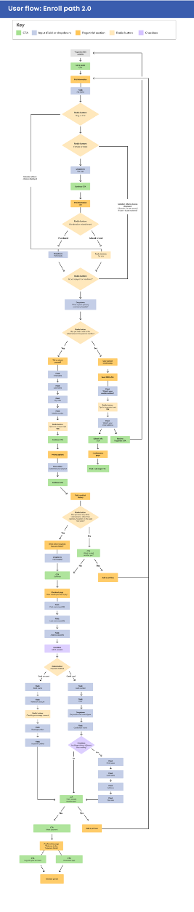
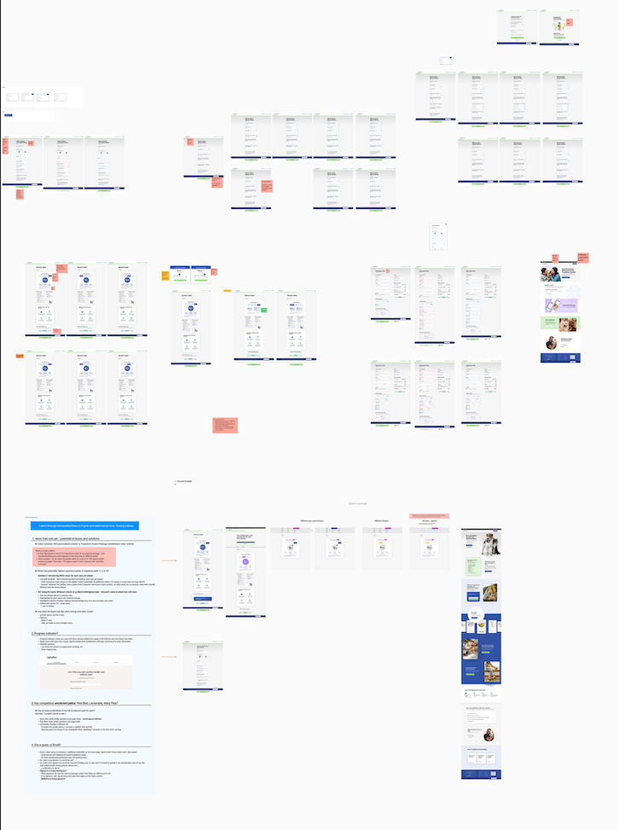
Trupanion

