Slide 1
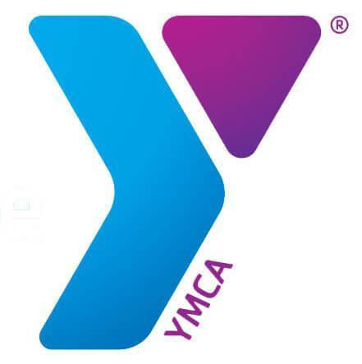
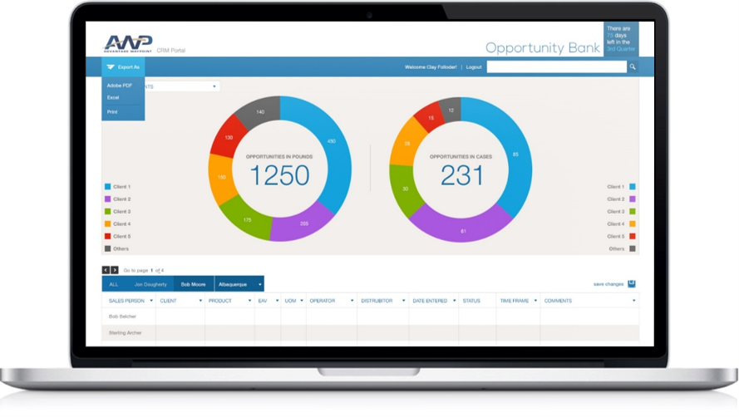
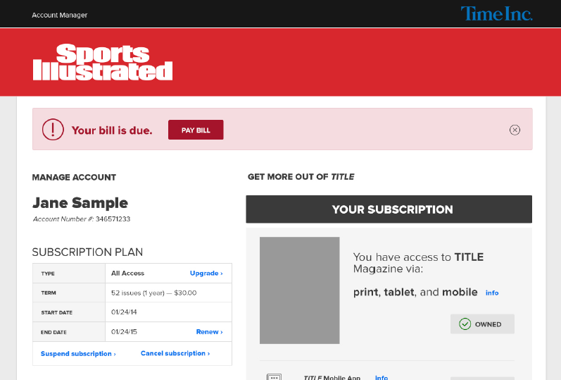

The YMCA
Who They Are
YMCA of the USA is the American unit of the Geneva-based Young Men's Christian Association, a non-profit organization for youth development, healthy living, and social responsibility. In the US, the Y is comprised of YMCA of the USA, a national resource office, and more than 2,700 locations with approximately 19,000 full-time staff and 600,000 volunteers across the country.
Business Need
This engagement kicked off with a meeting between Affirma and the YMCA team to discuss their current system and discover the solutions/enhancements they wanted to see out of their current site.
Affirma stepped in and performed a UX analysis of the site and conducted stakeholder interviews to delve further into what they wanted out of their CMS and shared calendar in terms of usability.
Affirma’s Custom Development Team was then brought in to implement the new designs and deployed rigorous testing to ensure the dashboard worked properly.

