Slide 1
Ngo management
and Donation
system
Team members:
Chehak Nayar 1PE15CS042
Divyaksh Shukla 1PE15CS051

Slide 2
Aim
In our project we aim at helping out a non profit organisation, “Ekk Pahel” by creating a Database management web application to collect and manage its records

Slide 3
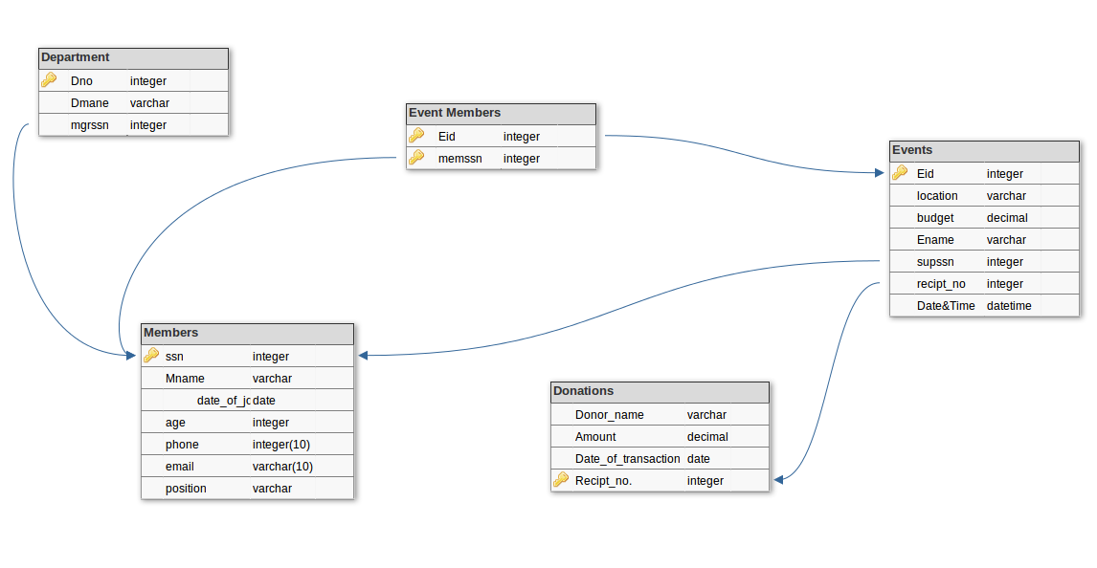
SCHEMA

Slide 4
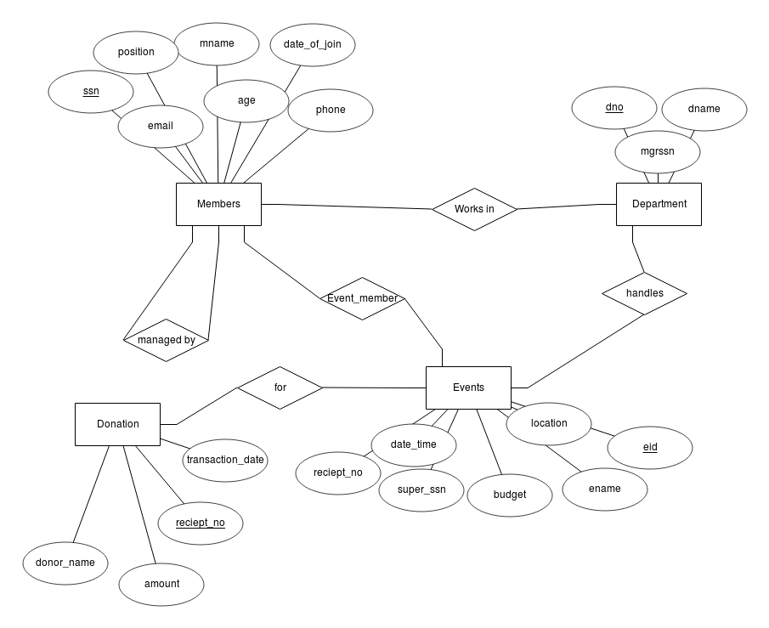
Er diagram

Slide 5
Department
mysql> desc Department;
+--------+-------------+------+-----+---------+-------+
| Field | Type | Null | Key | Default | Extra |
+--------+-------------+------+-----+---------+-------+
| dno | int(11) | NO | PRI | NULL | |
| dname | varchar(20) | YES | | NULL | |
| mgrssn | int(11) | YES | MUL | NULL | |
+--------+-------------+------+-----+---------+-------+
3 rows in set (0.01 sec)
Event Members
mysql> desc Event_Members;
+--------+---------+------+-----+---------+-------+
| Field | Type | Null | Key | Default | Extra |
+--------+---------+------+-----+---------+-------+
| eid | int(11) | NO | PRI | NULL | |
| memssn | int(11) | NO | PRI | NULL | |
+--------+---------+------+-----+---------+-------+
2 rows in set (0.00 sec)

Slide 6
Events
mysql> desc Events;
+------------+---------------+------+-----+---------+-------+
| Field | Type | Null | Key | Default | Extra |
+------------+---------------+------+-----+---------+-------+
| eid | int(11) | NO | PRI | NULL | |
| location | varchar(20) | YES | | NULL | |
| budget | decimal(10,0) | YES | | NULL | |
| ename | varchar(20) | YES | | NULL | |
| supssn | int(11) | YES | MUL | NULL | |
| reciept_no | int(11) | YES | MUL | NULL | |
| date_time | datetime | YES | | NULL | |
+------------+---------------+------+-----+---------+-------+
7 rows in set (0.01 sec)

Slide 7
Members
mysql> desc Members;
+--------------+-------------+------+-----+---------+-------+
| Field | Type | Null | Key | Default | Extra |
+--------------+-------------+------+-----+---------+-------+
| ssn | int(11) | NO | PRI | NULL | |
| mname | varchar(20) | YES | | NULL | |
| joining_date | date | YES | | NULL | |
| age | int(11) | YES | | NULL | |
| phone | varchar(10) | YES | | NULL | |
| email | varchar(10) | YES | | NULL | |
| position | varchar(20) | YES | | NULL | |
+--------------+-------------+------+-----+---------+-------+
7 rows in set (0.01 sec)

Slide 8
Donations
mysql> desc Donations;
+------------------+---------------+------+-----+---------+-------+
| Field | Type | Null | Key | Default | Extra |
+------------------+---------------+------+-----+---------+-------+
| donor_name | varchar(20) | YES | | NULL | |
| amount | decimal(10,0) | YES | | NULL | |
| transaction_date | date | YES | | NULL | |
| receipt_no | int(11) | NO | PRI | NULL | |
+------------------+---------------+------+-----+---------+-------+
4 rows in set (0.00 sec)

