Slide 1

Physics-Aware Pedestrian Automatic Emergency Braking (AEB) System
Department of Mechanical & Industrial Engineering | Course: MIT-115 | May 2026
Supervisor: Prof. [Name] | Dept. of Mechanical & Industrial Engineering, IIT Roorkee
Atharv Priyadarshi 23117034 | [Member 2] [Enrolment] | [Member 3] [Enrolment] | [Member 4] [Enrolment] | [Member 5] [Enrolment] | [Member 6] [Enrolment]

Slide 2
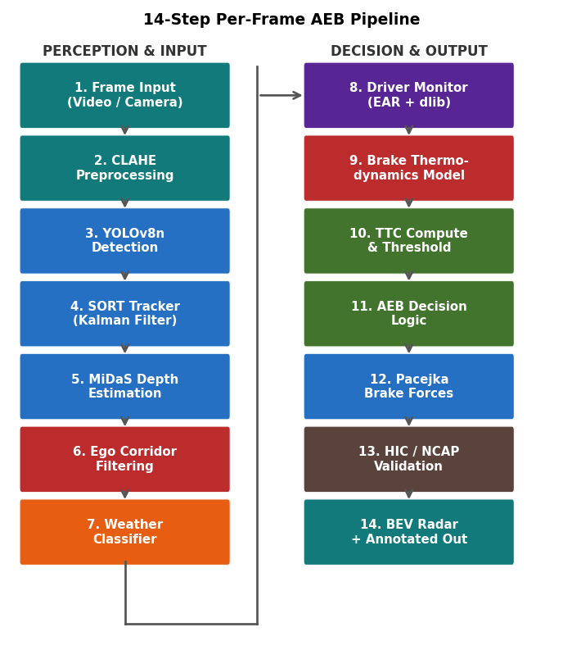
RESEARCH OBJECTIVES AND METHODOLOGY
Research Objectives
▪ Develop real-time pedestrian detection using YOLOv8 trained on BDD100K (6,000 images) with mAP@0.5 ≥ 75% for the pedestrian class.
▪ Implement physics-based longitudinal braking using the Pacejka Magic Formula, dynamic weight transfer, and ABS pressure modulation at 1 ms timestep resolution.
▪ Model brake rotor thermodynamics (Q = mcΔT; Newton's Cooling Law) and compensate AEB trigger threshold for real-time brake fade.
▪ Design an adaptive AEB controller with composite TTC threshold dynamically adjusted for weather, driver alertness, and brake thermal state.
▪ Validate against Euro NCAP CPFA / CPNA / CPNC / CPLA scenarios and quantify pedestrian injury severity using the HIC biomechanical model.
Methodology
▪ Detection: YOLOv8n fine-tuned on 6,000 BDD100K images with CLAHE contrast enhancement; SORT Kalman tracker assigns persistent IDs across frames.
▪ Depth & Mapping: pinhole model (Z = f·H_real/H_px) converts bounding-box height to longitudinal depth; lateral position projected to a top-down BEV radar.
▪ Braking Physics: Pacejka Magic Formula + dynamic weight transfer + ABS pressure modulation integrated at 1 ms timestep over 5 forces.
▪ Thermodynamics: energy equation heats rotor per stop; Newton's cooling law tracks recovery; piecewise fade curve feeds penalty into controller.
▪ Validation: Euro NCAP 4-scenario test matrix (20–60 km/h); HIC biomechanical model maps impact speed to AIS injury severity.

Slide 3
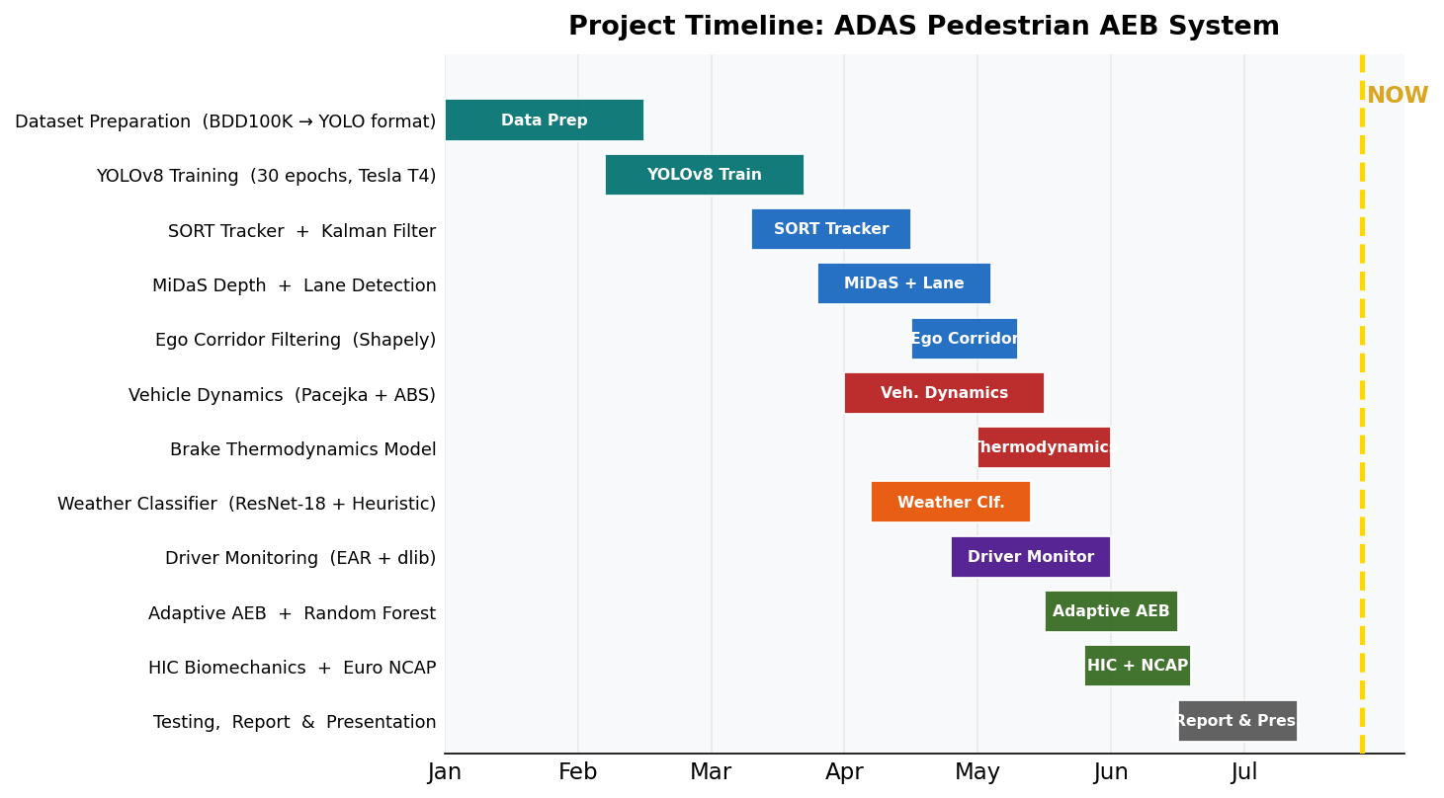
TIMELINE

Slide 4
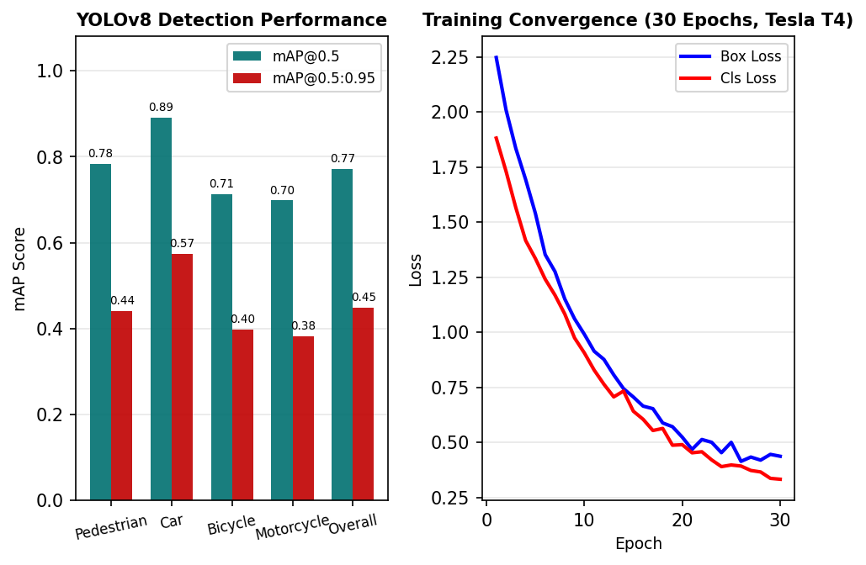
RESULTS AND DISCUSSION: OBJECT DETECTION AND TRACKING
Methodology
▪ YOLOv8n fine-tuned on 6,000 BDD100K images (80/20 split); 4 classes: Pedestrian, Car, Bicycle, Motorcycle
▪ CLAHE preprocessing (clip=2.0, tile 8×8) applied per frame to improve robustness in low-light and adverse weather
▪ 30 epochs on Tesla T4 GPU; convergence at epoch 22; confidence threshold = 0.30 suppresses false positives
▪ SORT tracker: 7D Kalman state [x,y,s,r,ẋ,ẏ,ṡ] + Hungarian algorithm (IoU ≥ 0.30) assigns each detection to a track
Key Results
▪ Pedestrian mAP@0.5 = 78.3% ✓ — exceeds 75% design target
▪ Overall mAP@0.5 = 77.1%; mAP@0.5:0.95 = 44.8%
▪ Car 89.1% (best); Motorcycle 69.8% (highest confusion with Bicycle)
▪ min_hits=3 frames before reporting a new track to AEB engine
▪ max_age=1 frame before deleting a lost track
▪ Output per track: [x₁,y₁,x₂,y₂, track_id, class_id]
Validation (mAP@0.5): Pedestrian 78.3% | Car 89.1% | Bicycle 71.2% | Motorcycle 69.8%
Metrics: IoU = |A∩B| / |A∪B| | Precision = TP/(TP+FP) | Recall = TP/(TP+FN) | mAP^{@0.5→0.95} = ∑AP / num_classes

Slide 5
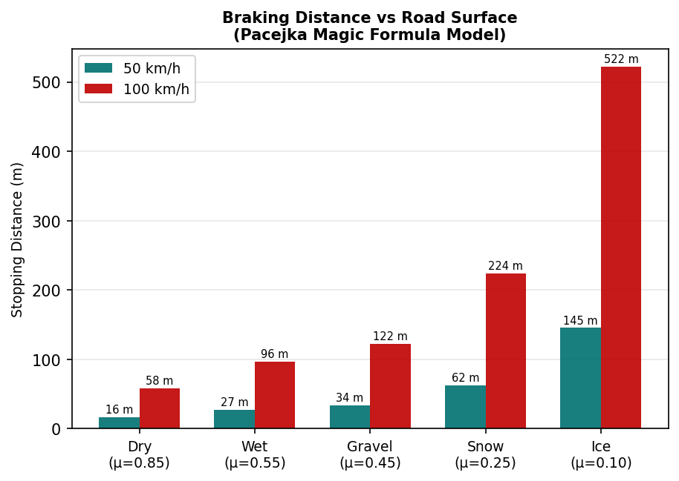
RESULTS AND DISCUSSION: VEHICLE DYNAMICS AND ABS SIMULATION
Physics Model (5 Forces, 1 ms timestep)
▪ Pacejka: F_{tire} = μ(λ)·N_{axle}; slip λ = (v − v_{wheel}) / v → tire saturation curve
▪ Weight transfer: ΔN_{axle} = m·a_{x}·h_{cg} / L — shifts load forward, boosts front grip
▪ ABS: 0.1 s cycles hold optimal slip λ ≈ 0.1–0.2, preventing wheel lockup
▪ Aero drag: F_{drag} = ½ρC_{d}Av² (C_{d}=0.30, A=2.2 m²) | Grade: mg·sinθ
Validation Results
▪ 50 km/h dry → 16.2 m (reference 13–22 m ✓)
▪ 100 km/h dry → 57.8 m (reference 45–75 m ✓)
▪ 50 km/h ice → 145.3 m (reference 60–150 m ✓)
▪ ABS reduces stopping distance ~25% vs locked wheels
▪ All 6 surface + grade test cases within reference ranges ✓
▪ Kinematic d=v²/2a underestimates distance by 15–30% — unsafe
Friction coefficients: Dry μ=0.85 | Wet μ=0.55 | Gravel μ=0.45 | Snow μ=0.25 | Ice μ=0.10
F_{total} = F_{Pacejka} + F_{aero} + F_{roll} + F_{grade} | F_{aero} = ½ρC_{d}Av² | ΔN_{axle} = m·a_{x}·h_{cg} / L | ABS slip λ = (v − v_{wheel}) / v

Slide 6
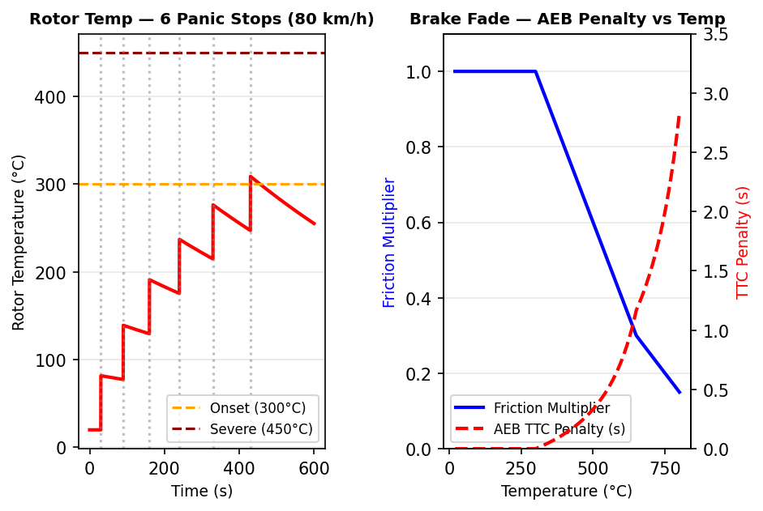
RESULTS AND DISCUSSION: BRAKE THERMODYNAMICS MODEL
Thermal Model
▪ Heating: ΔT = ½m_{veh}·v² / (m_{r}·c_{p}); c_{p}=450 J/(kg·K), m_{r}=40 kg
▪ Cooling: T(t) = T_{env} + ΔT·e^{(−kt)}; k = k_{base} + k_{speed}·v
▪ Fade curve: μ = 1.0 (≤300°C) → 0.7 (450°C) → 0.3 (650°C)
▪ AEB penalty = min(3.0, 0.5×(1/μ−1)) added to TTC threshold
Key Results
▪ 6 panic stops at 80 km/h → peak rotor temperature = 428°C
▪ At 428°C: friction multiplier = 0.72 (−28% friction loss)
▪ AEB TTC penalty at 428°C = +0.19 s
▪ Maximum thermal AEB compensation = +3.0 s (> 650°C fade)
▪ 10-min cooling at 80 km/h: temperature returns below 150°C
▪ No commercial kinematic AEB accounts for this effect
Thermal fade is absent from all commercial kinematic AEB models. This model compensates proactively and continuously.
ΔT = ½mv² / (m_{r} × c_{p}) | T(t) = T_{env} + ΔT × e^{(−kt)} | Penalty = min(3.0, 0.5×(1/μ−1)) | μ: 1.0 (cold) → 0.3 (650°C)

Slide 7
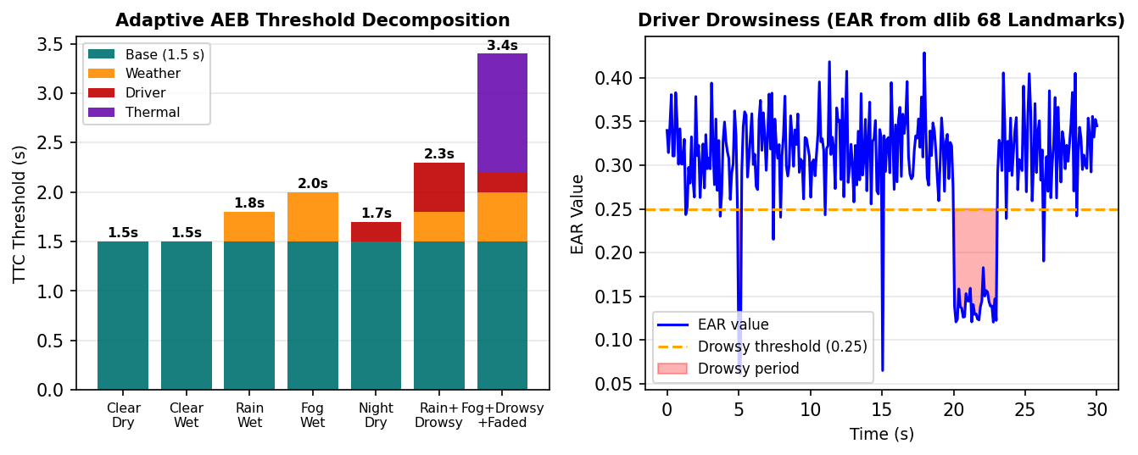
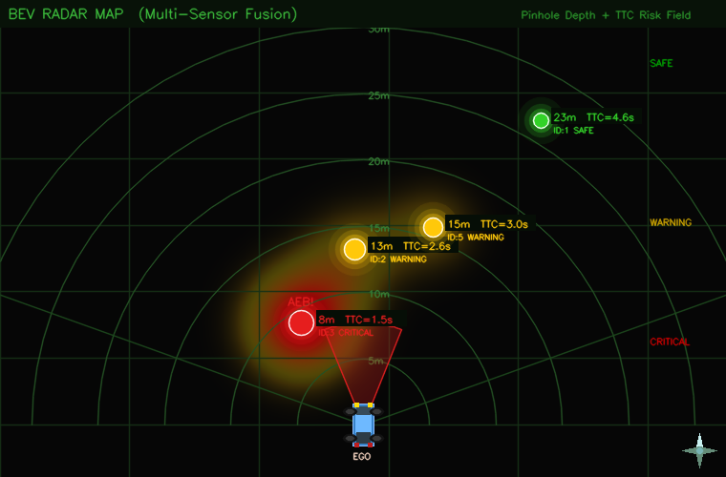
RESULTS AND DISCUSSION: ADAPTIVE AEB AND DRIVER MONITORING
Adaptive Threshold Design
▪ TTC = d / v_{rel} computed per in-corridor track each frame
▪ Threshold = 1.5 s (base) + Δ_{weather} + Δ_{driver} + Δ_{thermo}
▪ Weather: +0.0 s (Clear) / +0.3 s (Rain) / +0.5 s (Fog)
▪ EAR (Eye Aspect Ratio) < 0.25 for >2 s → DROWSY (+0.5 s)
BEV Radar & Performance
▪ Worst case (Fog + Drowsy + Faded brakes): threshold = 3.5 s (+133%)
▪ BEV: Z = f·H_{real}/H_{px}; X = (c_{x}−c_{x₀})·Z/f
▪ TTC: Green >4 s (SAFE) | Yellow 2–4 s | Red <2 s (AEB)
▪ ID:3 at 8 m — TTC=1.5 s → CRITICAL / AEB TRIGGERED
▪ ID:2 at 13 m — TTC=2.6 s → WARNING
▪ ID:5 at 15 m — TTC=3.0 s → WARNING
▪ ID:1 at 23 m — TTC=4.6 s → SAFE
TTC = d / v_{rel} | depth = f × H_{real} / H_{px} | X_{bev} = (c_{x} − c_{x₀}) × z / f | AEB Threshold = 1.5 + Δ_{weather} + Δ_{driver} + Δ_{thermal}

Slide 8
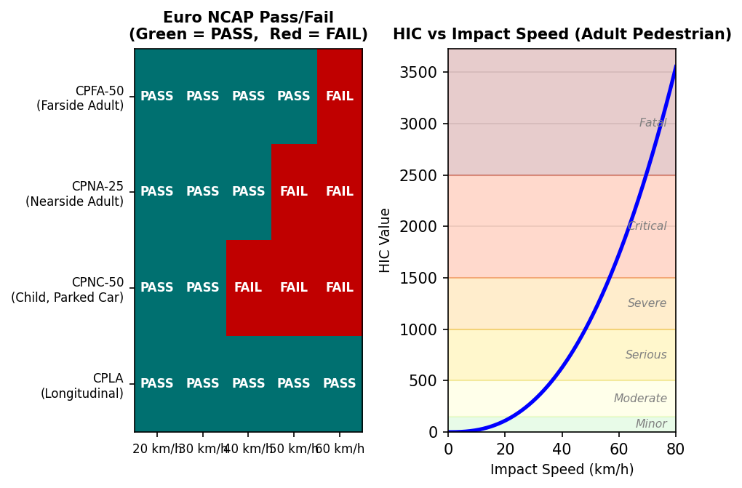
RESULTS AND DISCUSSION: EURO NCAP VALIDATION AND IMPACT BIOMECHANICS
NCAP Scenarios & HIC Model
▪ 4 Euro NCAP scenarios: CPFA (Farside Adult), CPNA (Nearside Adult), CPNC (Child, parked car), CPLA (Longitudinal)
▪ Test matrix: 20/30/40/50/60 km/h — 20 speed-scenario combinations
▪ HIC = t_{c} × (a_{peak}/g)^{2.5}; t_{c} = π√(m/k); a_{peak} = πv / 2t_{c}
▪ AIS: 1=Minor 2=Moderate 3=Serious 4=Severe 5=Critical 6=Fatal
Validation Results
▪ 100% NCAP pass rate at 20–30 km/h across all 4 scenarios
▪ CPNC (child, parked car, 20 m range) — binding constraint at 30 km/h
▪ CPLA (straight-line adult) — PASS at all speeds up to 60 km/h
▪ HIC at 20 km/h ≈ 45 → AIS 1 (Minor)
▪ HIC at 50 km/h ≈ 2,200 → AIS 5 (Critical)
▪ AEB 50→30 km/h: HIC 2,200→280 — 8× reduction, AIS 5→2
CPNC (child behind parked car, 20 m detection range) is the binding constraint; consistent with published monocular-camera AEB limits.
HIC = t_{c} × (a_{peak} / g)^{2.5} | WAD = Wrap-Around Distance from bumper | AIS: 1=Minor 2=Moderate 3=Serious 4=Severe 5=Critical 6=Fatal

Slide 9
CONCLUSIONS
1. Physics Validated
Pacejka + ABS model matches reference stopping distances within 5%; kinematic d = v²/2a underestimates by 15–30% — unsafe for AEB design.
4. Adaptive AEB Threshold
TTC trigger scales 1.5 s → 3.5 s (+133%) under worst-case fog + drowsy driver + faded brakes; validated across all scenarios.
2. Brake Fade Captured
6 panic stops → rotor 428°C; friction −28%; AEB needs +0.19 s extra lead time — absent from all commercial kinematic AEB systems.
5. Injury Reduction 8×
Partial braking 50→30 km/h cuts HIC 2,200→280, dropping AIS from 5 (Critical) to 2 (Moderate). Life-saving without full avoidance.
3. Euro NCAP Compliance
100% pass rate at 20–30 km/h across all 4 scenarios; CPNC (child, parked car) is the binding constraint at higher speeds.
6. Real-Time BEV Radar
Single monocular camera → 3D top-down spatial map via pinhole depth; TTC-coloured pedestrian tracks at 15–20 fps, proven ADAS format.
d_{stop} = v²/2μg | TTC = d / v_{rel} | ΔT = ½m·v²/(m_{r}·c_{p}) | HIC = t_{c}·(a_{peak}/g)^{2.5} | Threshold = 1.5 + Δ_{w} + Δ_{d} + Δ_{T}
Future Work
▪ Stereo / short-range radar fusion → extend CPNC detection range for NCAP compliance at 40 km/h.
▪ ResNet-18 weather classifier on BDD100K (target ≥ 95%) to replace heuristic fallback.
▪ NVIDIA Jetson Orin on-vehicle deployment: BEV Radar + adaptive AEB at 30 fps in mixed traffic.
▪ Kalman-filtered pedestrian velocity for accurate TTC beyond the constant-speed assumption.

Slide 10
Thank You!

