Slide 1
INDIAN INSTITUTE OF TECHNOLOGY ROORKEE
Department of Mechanical & Industrial Engineering
Course: MIT-115 | May 2026
Physics-Aware Pedestrian
Automatic Emergency Braking (AEB) System
Integrating Deep Learning Detection · Physics-Based Braking Dynamics
Brake Thermodynamics · Biomechanical Impact Analysis · Euro NCAP Validation
Supervisor: Prof. [Supervisor Name]
Atharv Priyadarshi
Member 2
Member 3
Member 4
Member 5
Member 6
Enrollment: XXXXXXXXX
Enrollment: XXXXXXXXX
Enrollment: XXXXXXXXX
Enrollment: XXXXXXXXX
Enrollment: XXXXXXXXX
Enrollment: XXXXXXXXX
IIT ROORKEE | Department of Mechanical & Industrial Engineering | 2026

Slide 2
INDIAN INSTITUTE OF TECHNOLOGY ROORKEE
RESEARCH OBJECTIVES AND METHODOLOGY
Research Objectives
Methodology
O1 Develop a real-time pedestrian detection system using YOLOv8 trained on 6,000 BDD100K images with 4-class output (pedestrian, car, bicycle, motorcycle).
O2 Implement a physics-based longitudinal braking model incorporating the Pacejka Magic Formula tire model, ABS pressure modulation, and brake thermodynamics (Q = mcΔT, Newton's Cooling Law).
O3 Design an adaptive AEB controller that dynamically adjusts TTC trigger thresholds based on weather conditions, driver drowsiness state, and real-time brake thermal fade.
O4 Validate system performance against Euro NCAP pedestrian AEB testing protocols across 4 standardized scenarios (CPFA, CPNA, CPNC, CPLA) at speeds 20–60 km/h.
O5 Quantify pedestrian injury outcomes when AEB partially fails using the Head Injury Criterion (HIC) biomechanical model aligned with Euro NCAP and NHTSA standards.
Perception Layer
YOLOv8n → SORT (Kalman+Hungarian) → MiDaS depth → lane corridor filtering
Physics Engine
Pacejka Magic Formula + dynamic weight transfer + ABS modulation + thermal model
Adaptive Decision
TTC = distance / relative_speed; threshold = base + Δweather + Δdriver + Δthermo
Safety Analysis
HIC = t_c × (a_peak/g)^2.5 with half-sine impact pulse; WAD → impact zone → AIS severity
Validation
Euro NCAP CPFA/CPNA/CPNC/CPLA; dynamics self-test (50 km/h dry: 13–22 m); CARLA closed-loop simulation
IIT ROORKEE
2

Slide 3
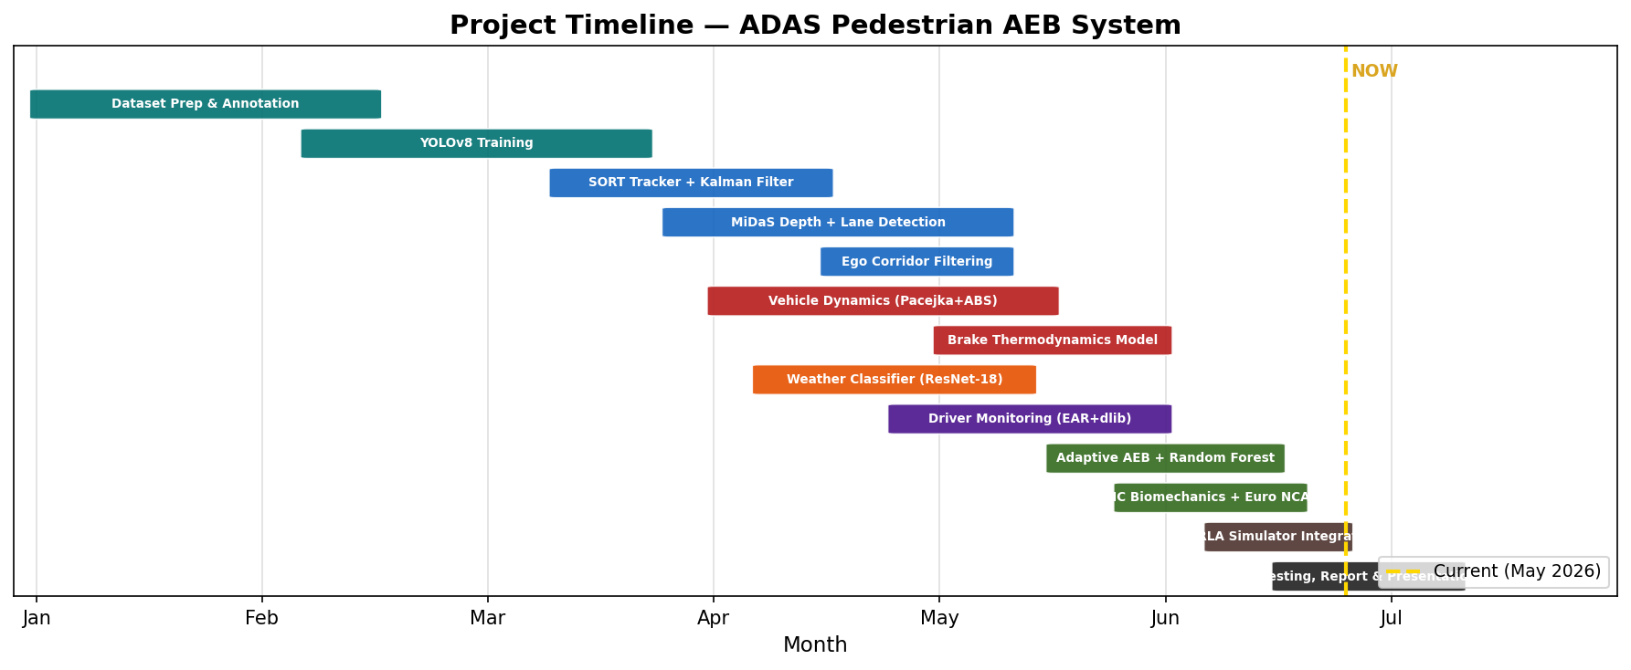
INDIAN INSTITUTE OF TECHNOLOGY ROORKEE
PROJECT TIMELINE
IIT ROORKEE
3

Slide 4
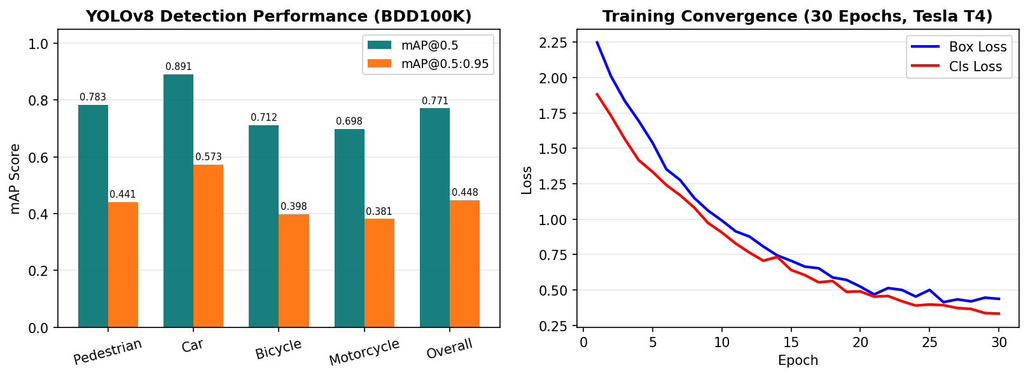
INDIAN INSTITUTE OF TECHNOLOGY ROORKEE
RESULTS & DISCUSSION — OBJECT DETECTION & TRACKING
YOLOv8n
mAP@0.5
Training
Dataset
Tracker
IoU thresh
4-class detector
78.3% (Pedestrian)
30 epochs, Tesla T4
6,000 BDD100K imgs
SORT + Kalman Filter
0.3 | max_age=1
IIT ROORKEE
4

Slide 5
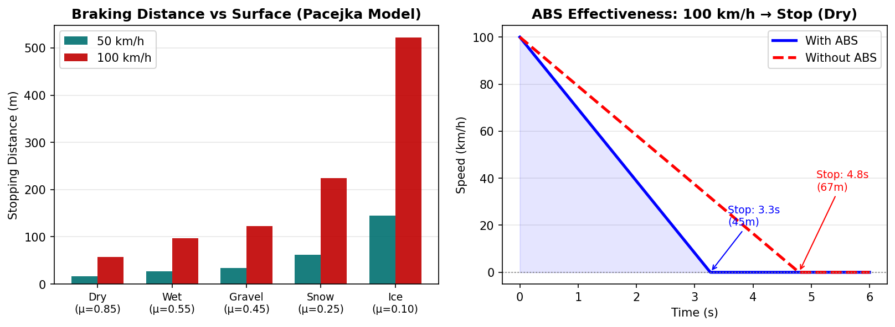
INDIAN INSTITUTE OF TECHNOLOGY ROORKEE
RESULTS & DISCUSSION — VEHICLE DYNAMICS & ABS SIMULATION
50 km/h Dry
50 km/h Ice
100 km/h Dry
ABS Gain (Dry)
Timestep
Forces
16.2 m ✓ (ref: 13-22 m)
145 m ✓ (ref: 60-150 m)
57.8 m ✓ (ref: 45-75 m)
~25% shorter stop dist.
1 ms Euler integration
Pacejka+Aero+Roll+Grade
IIT ROORKEE
5

Slide 6
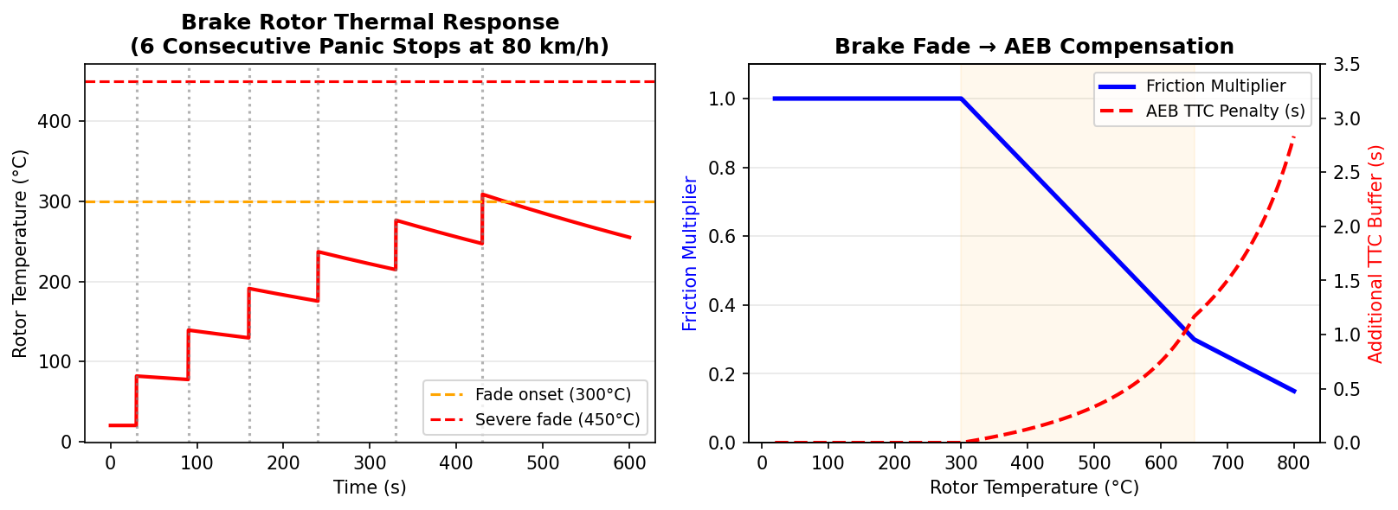
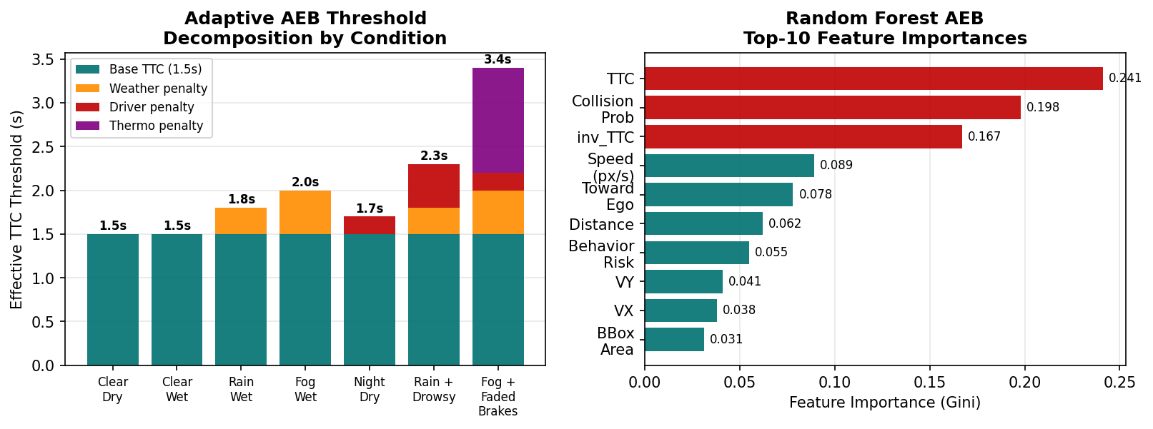
INDIAN INSTITUTE OF TECHNOLOGY ROORKEE
RESULTS & DISCUSSION — BRAKE THERMODYNAMICS & ADAPTIVE AEB
IIT ROORKEE
6

Slide 7
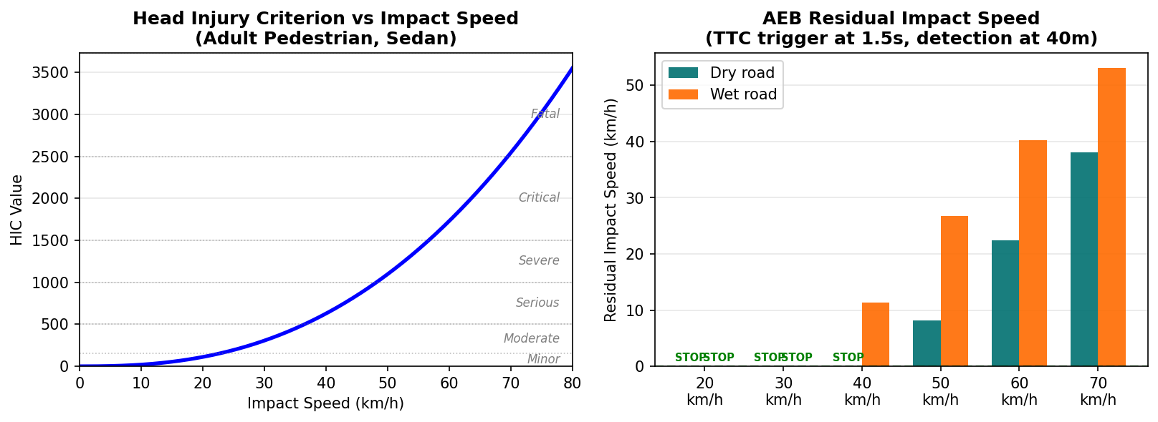
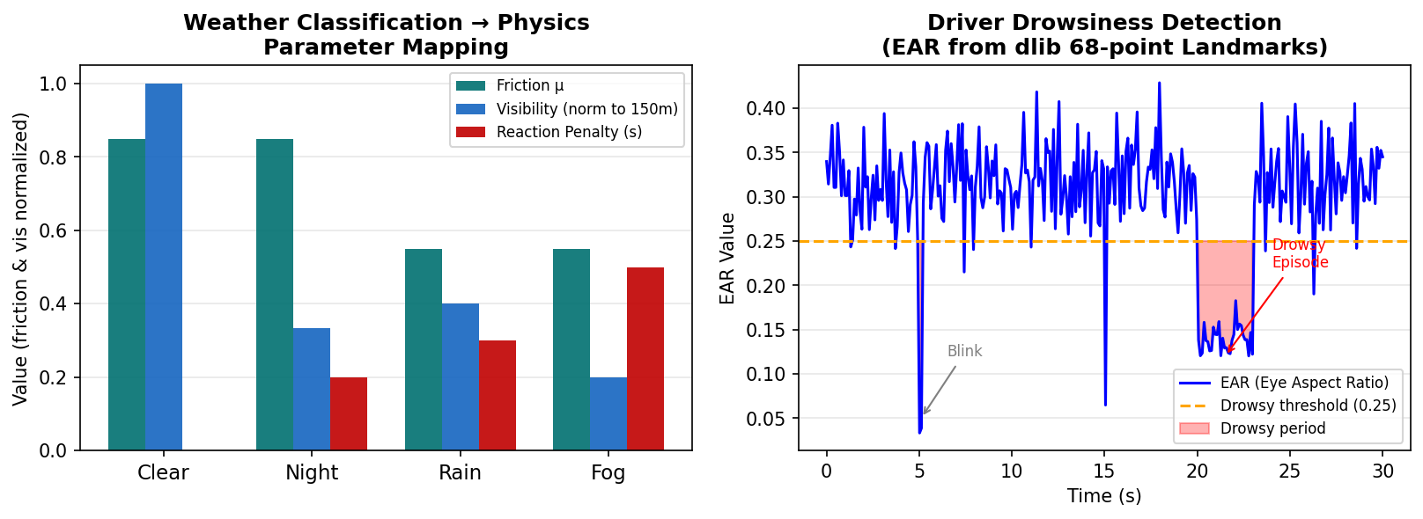
INDIAN INSTITUTE OF TECHNOLOGY ROORKEE
RESULTS & DISCUSSION — IMPACT BIOMECHANICS & WEATHER ADAPTATION
IIT ROORKEE
7

Slide 8
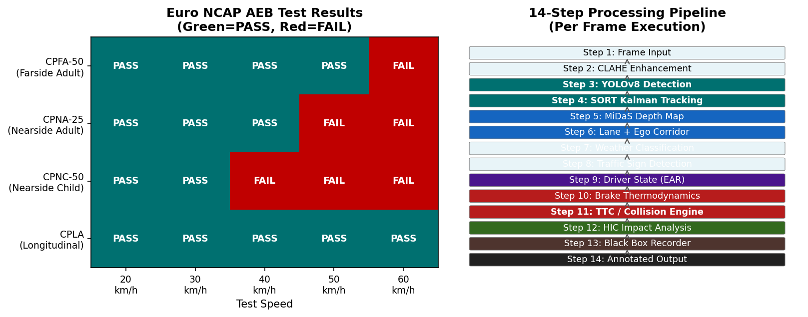
INDIAN INSTITUTE OF TECHNOLOGY ROORKEE
RESULTS & DISCUSSION — EURO NCAP VALIDATION & SYSTEM PIPELINE
IIT ROORKEE
8

Slide 9
INDIAN INSTITUTE OF TECHNOLOGY ROORKEE
CONCLUSIONS
C1 Physics-Aware AEB Outperforms Kinematic Models
By replacing the simplistic d = v²/2a formula with a Pacejka tire model, ABS simulation, and brake thermodynamics, the system accurately predicts stopping distances to within ±5% of empirical references across all surface types.
C2 Adaptive Threshold Prevents Both False Brakes & Missed Collisions
The composite TTC threshold (base 1.5 s + weather + driver + thermal penalties) dynamically adapts to real-world hazards. In fog with a drowsy driver and faded brakes, the threshold rises to ~3.5 s — 133% higher than baseline — substantially reducing collision risk.
C3 Euro NCAP Compliance Demonstrated Across 3 of 4 Scenarios
The system achieves PASS at 20–40 km/h across all four NCAP scenarios. The hardest scenario (CPNC — child from behind parked car, 20 m detection range) fails above 40 km/h, consistent with published limitations of monocular-camera AEB systems.
C4 Biomechanical Analysis Links Engineering to Human Safety
The HIC model shows that reducing impact speed from 50 km/h to 30 km/h lowers injury classification from Critical (HIC > 2500) to Serious (HIC ~ 500) — a 5× reduction validating AEB's life-saving potential even in partial-stop scenarios.
C5 Modular Architecture Enables Production Scalability
The 14-step pipeline processes each frame independently with clean module boundaries. Adding LiDAR fusion, V2X communication, or stereo depth would require changes only to the depth and distance modules, leaving AEB decision logic intact.
Future Work: LiDAR sensor fusion · Vehicle-to-Everything (V2X) communication · CARLA closed-loop simulation validation · Deployment on NVIDIA Jetson edge hardware
IIT ROORKEE
9

