Slide 1
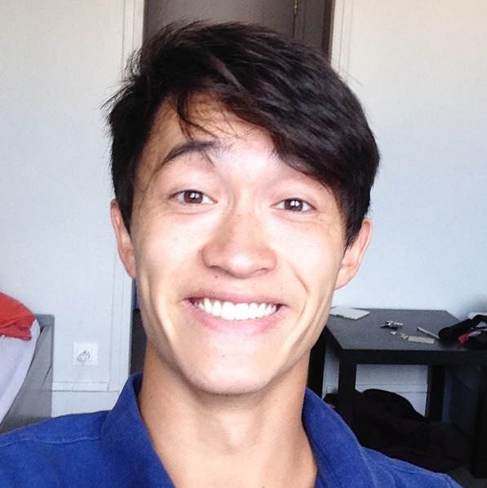


Deep Transformation-Invariant Clustering
Neural Information Processing Systems 2020
Tom Monnier, Thibault Groueix, Mathieu Aubry
LIGM, Ecole des Ponts, Univ Gustave Eiffel, CNRS, France
Notes:
Hi I am Tom Monnier and I am going to present our work on deep transformation invariant clustering.

Slide 2
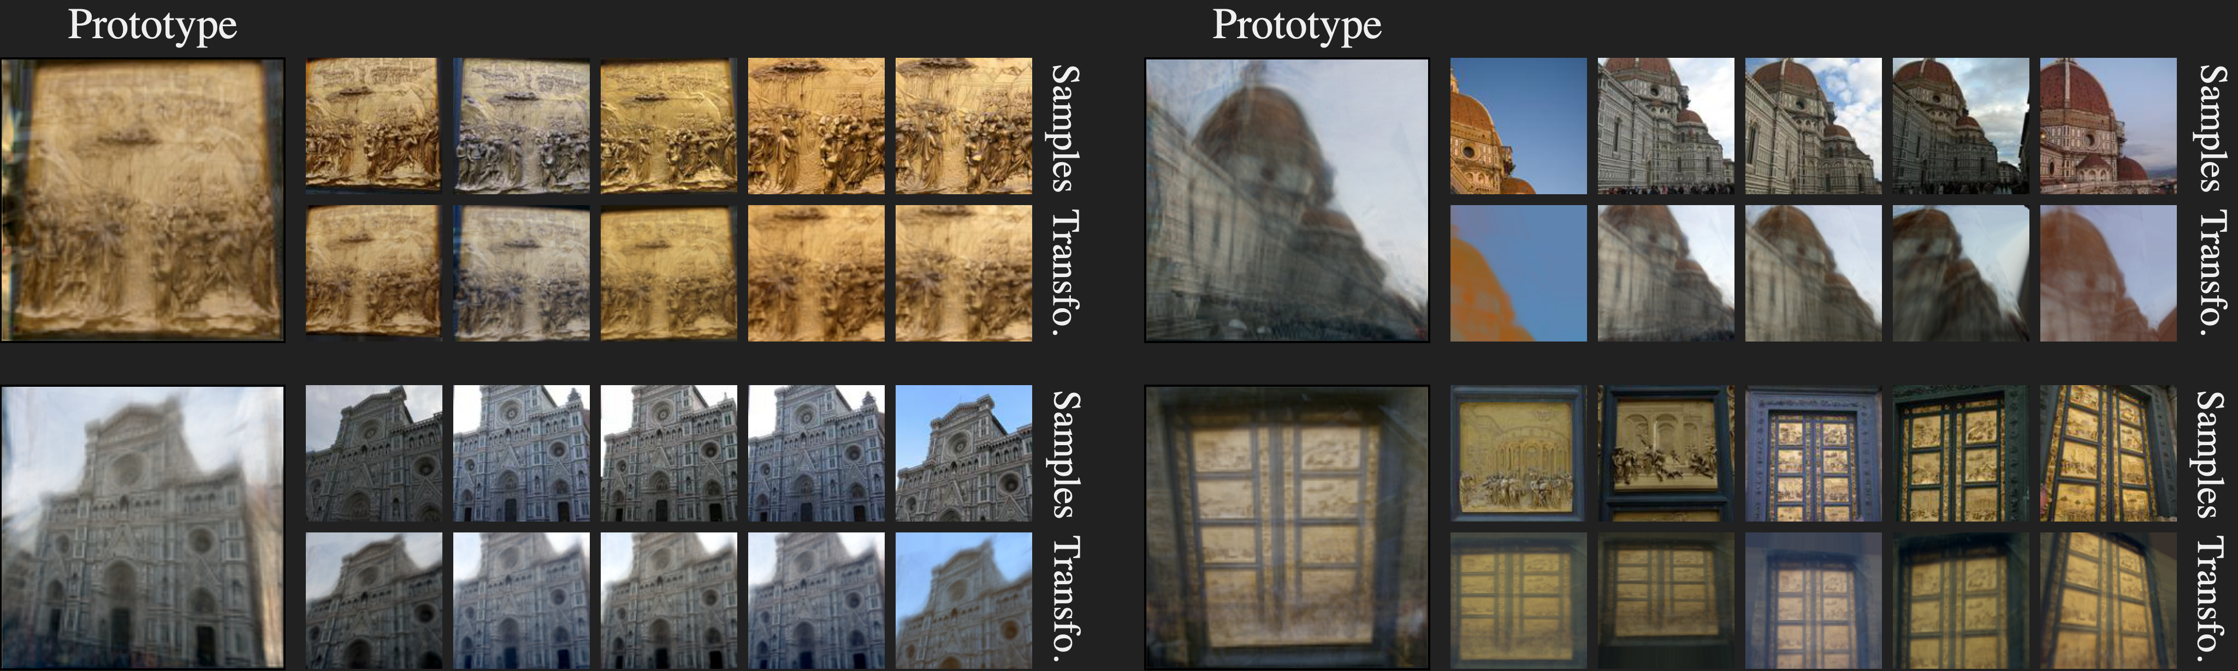
Our work
A deep clustering framework which jointly learns prototypes
and prototype-to-sample alignments to match raw input data
state-of-the-art
high interpretability
web images application
Notes:
In a nutshell, we introduce a deep clustering framework that jointly learns prototypes and prototype to sample alignments to match raw input data. It is state of the art, strongly interpretable and can be applied to web image collections. “break”

Slide 3
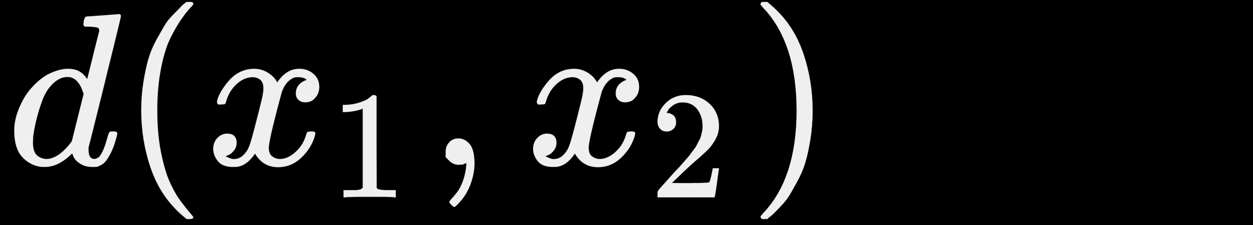




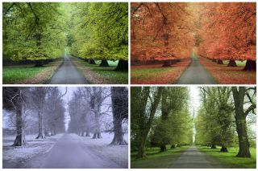





Why traditional clustering algorithms fail on images?
K-means
GMM
Hierarchical clustering
Not invariant to image transformations!
Spatial transformations
Morphological
Color & Illumination
Notes:
Why do traditional clustering algorithms fail on images?
If you look at standard clustering algorithms, they typically rely on distances which are not invariant to image transformations.
Even in the simplest case of translated images, resulting L2 distance is not informative if images are not aligned,
and this observation holds for more complex image transformations, like other spatial modifications, morphological deformations or color changes.

Slide 4
Common solutions
1
perform clustering in a feature space likely to resolve invariance
Autoencoders DEC (ICML 2016) VaDE (IJCAI 2017) SCA (NeurIPS2019)
Constrastive JULE (CVPR 2016) DAC (ICCV 2017) SpectralNet (ICLR 2018)
GANs InfoGAN (NIPS 2016) DASC (CVPR 2018) ClusterGAN (AAAI 2019)
Mutual information IMSAT (ICML 2017) ADC (GCPR 2018) IIC (ICCV 2019)
state-of-the-art struggle with real images hard to interpret
2
model transformations to align images before clustering them
TI clustering Frey and Jojic (CVPR 1999, NIPS 2002, TPAMI 2003)
Congealing Miller et al. (CVPR 2000, TPAMI 2005) Cox et al. (CVPR 2008, ICCV 2009) Annunziata et al. (ICCV 2019) Weber et al. (NeurIPS 2019)
Multi congealing Li et al. (PatRec 2006) Liu et al. (ICCV 2009) Mattar et al. (UAI 2012)
highly interpretable difficult optimization small datasets simple alignments
Notes:
For this reason, most image clustering methods perform clustering in a feature space that is likely to resolve invariance. Learning meaningful representations is challenging and
this type of methods yields the best results on standard benchmarks. However they still struggle with real images and clustering results are difficult to interpret.
On the contrary, a second set of approaches aims at explicitly modeling transformations to align images in pixel space before clustering them.
Although much more interpretable, they typically involve complex optimizations, limiting their application to simple alignments and small datasets. We propose to revisit this line of works and to explicitly resolve transformation invariance with deep learning.

Slide 5
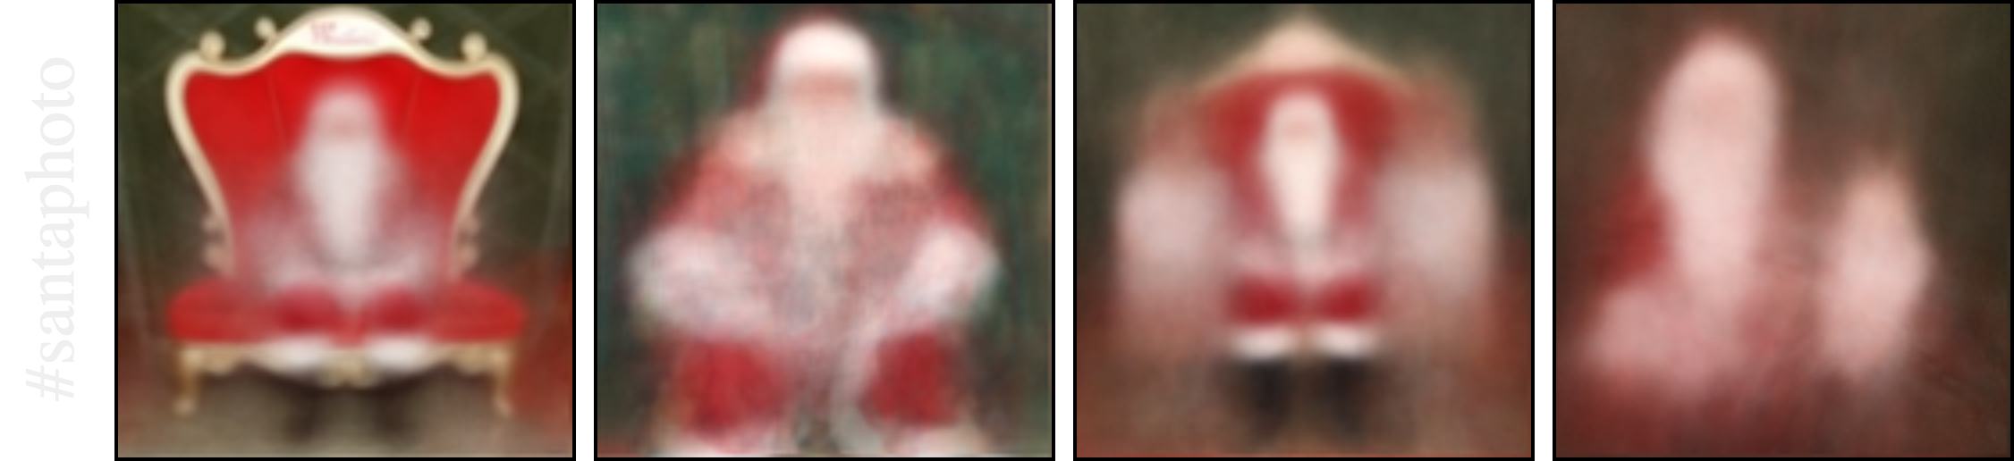
Our work
A prototype-based approach which performs clustering in pixel space
by explicitly aligning prototypes using deep learning
state-of-the-art
simple formulation
complex alignments
high interpretability
web images application
Notes:
In this work, we present a prototype-based approach that performs clustering in pixel space by explicitly aligning prototypes using deep learning.
By modeling complex alignments, we demonstrate state of the art results on standard benchmarks as well as applicability to unfiltered web image collections, like Instagram hashtags.

Slide 6
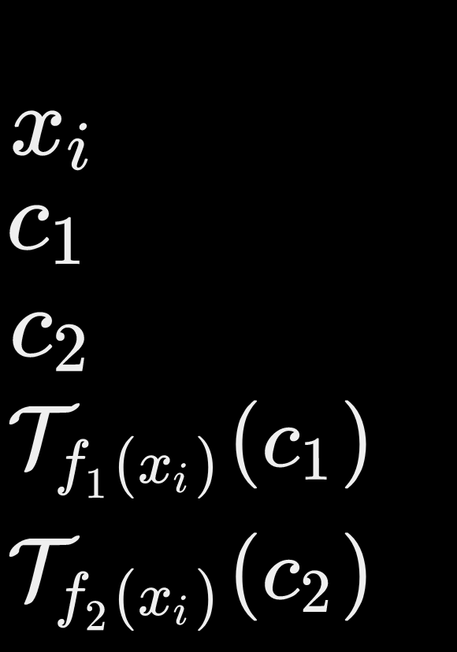
Standard prototype-based clustering
Notes:
Prototype-based clustering methods typically aim at learning a set of prototypes by minimizing a quantization error.
Once the problem is solved, each sample is then assigned to the closest prototype.

Slide 7
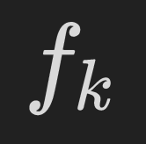

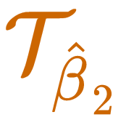
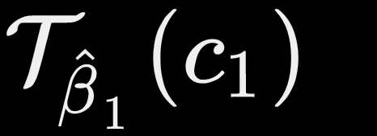

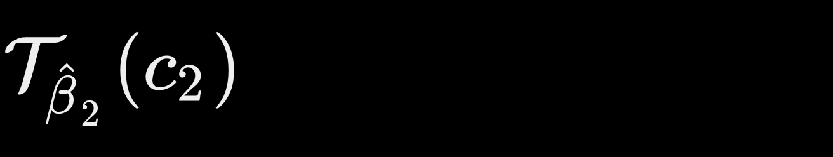
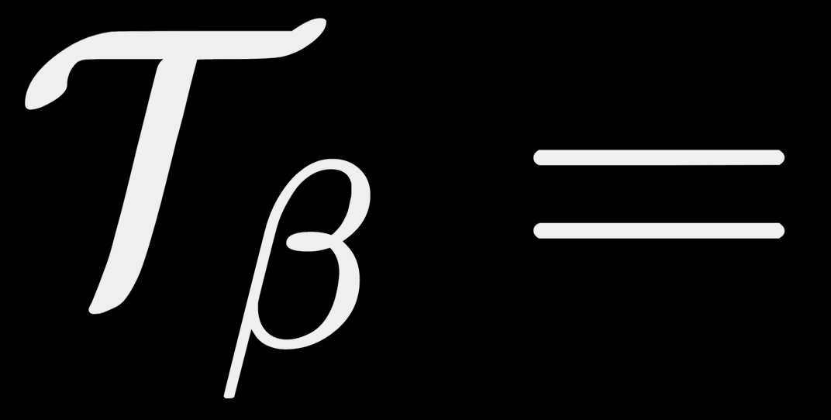
Deep Transformation–Invariant clustering
Assumption: access to rotation
Notes:
Our key insight is to explicitly model transformations, in this case a rotation, to which we want to make the clustering invariant.
For each sample, we first predict alignments of the prototypes.
Then we use the transformed prototypes to compute the quantization error.
We propose to predict alignment using deep learning and to jointly learn prototype and deep alignment by minimizing a single quantization loss.

Slide 8
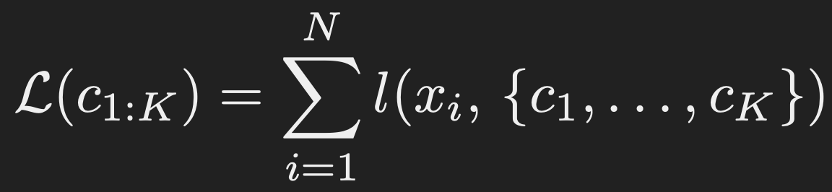
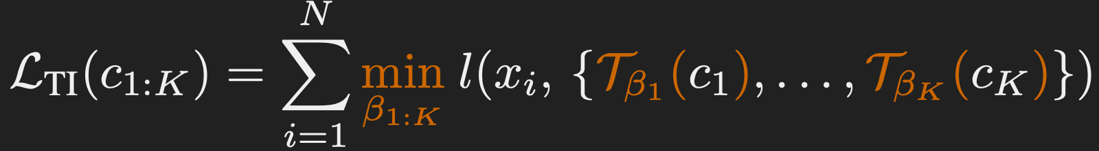
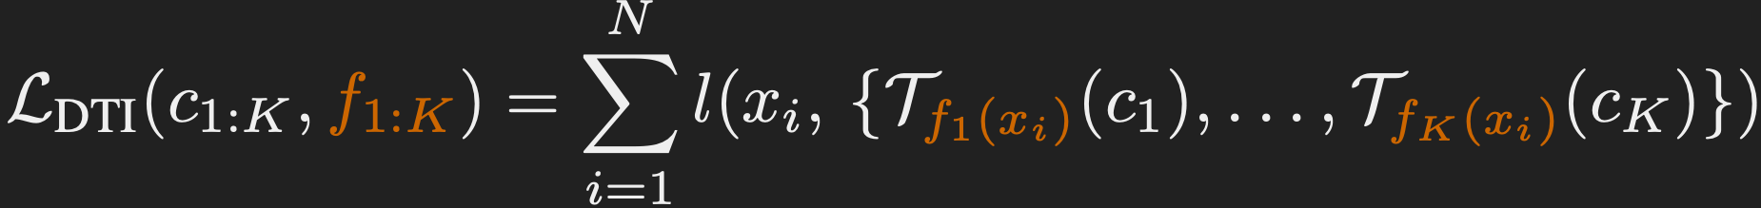
Formalization
Standard prototype-based loss
Transformation-Invariant loss
Deep Transformation-Invariant loss
Notes:
More formally, gradient based prototype methods optimize a set of prototypes to minimize a loss which evaluates how well they represent the samples. For example in K-means, L corresponds to the L2 distance to the closest prototype.
Assuming we have access to a group of transformations T parametrized by beta, one can instead minimize the following transformation invariant loss: where the minimum over betas is taken for each sample independently. We provide proof of the loss invariance to prototypes transformations in our paper.
We experimentally show it is faster and actually better to instead learn K deep prototype-specific predictors, where each predictor aims at associating to each sample the transformation parameters minimizing the loss. Because parameter predictors are now shared for all samples, this structure naturally regularizes the parameters for each sample, leading to better clustering results especially when modeling complex transformations.

Slide 9
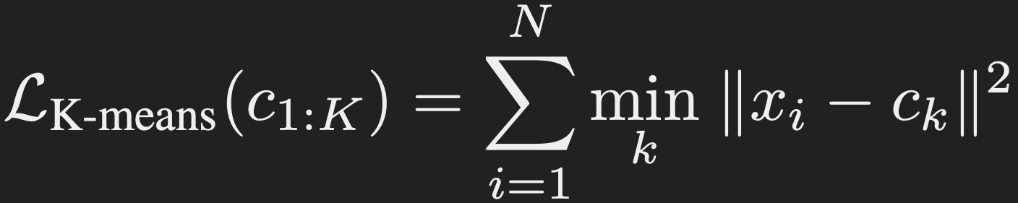
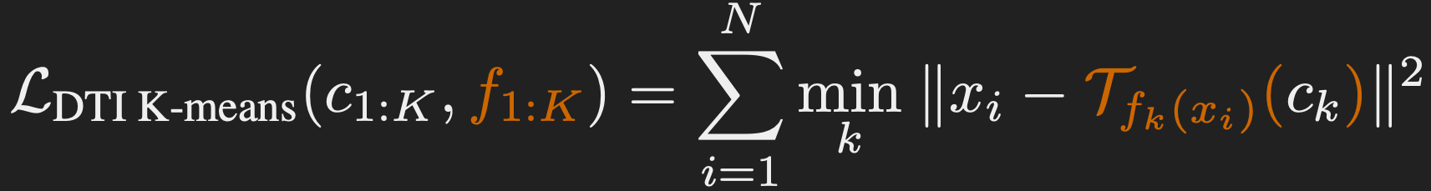
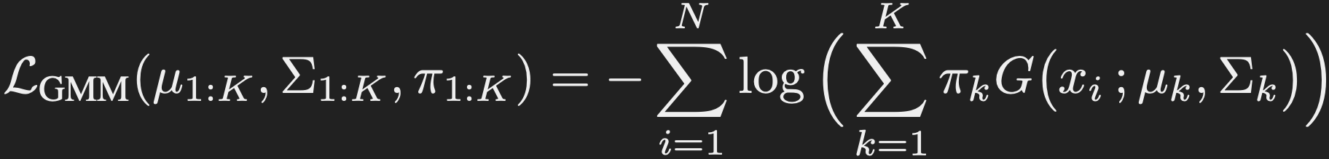
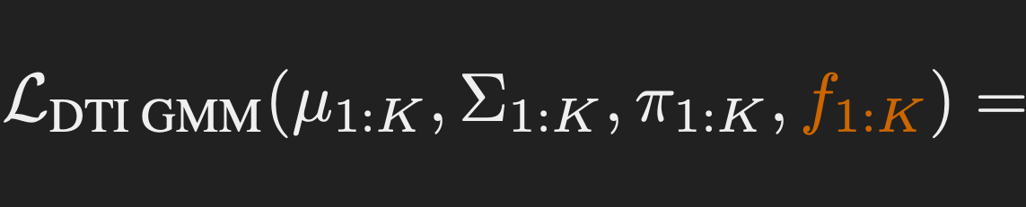
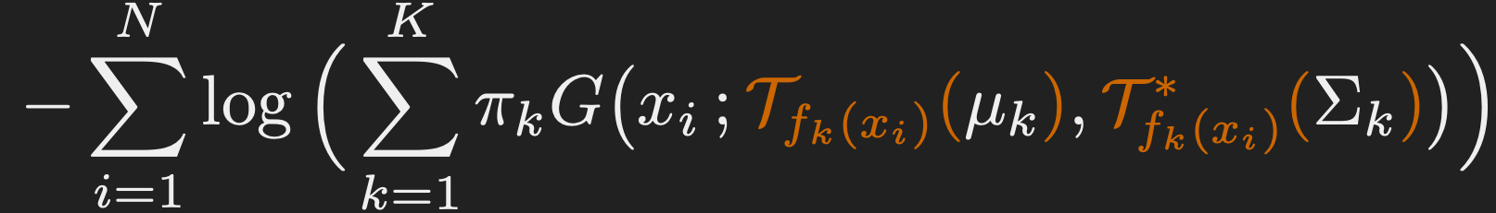
Applications
K-means
Gaussian mixture model
Notes:
We apply this clustering framework to classical gradient based adaptations of K-means and Gaussian mixture model.
For K-means the quantization loss to minimize is the average Euclidean distance between each sample and the closest prototype.
This loss can be adapted to a deep transformation invariant loss, which we simply minimize jointly over prototypes and deep parameter predictors using a batch gradient descent algorithm.
For Gaussian mixture model, the loss to minimize is a negative log likelihood where mu_k and sigma_k are the mean and covariance matrices, and pi_k are the mixing probabilities.
Similarly it can be adapted to a deep transformation invariant loss, which is minimized over Gaussian parameters, mixing probabilities and deep predictors using a gradient based Expectation Maximization procedure.

Slide 10
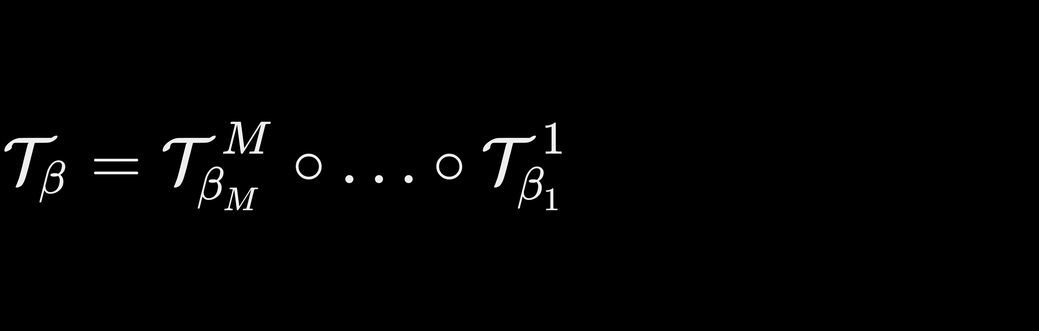



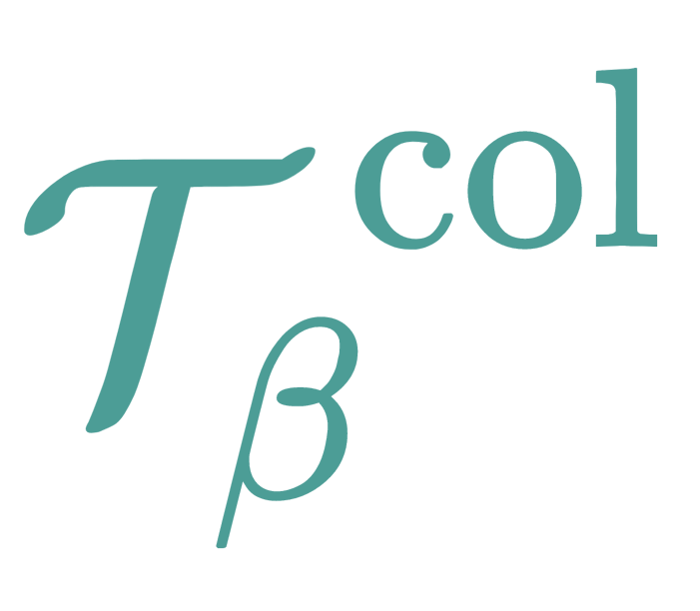

Learning image transformations
Transformation sequence
Transformation module
spatial transformers [1] (affine , projective , thin-plate spline )
color transformation
morphological transformation
Key elements for training
curriculum learning of transformations
empty cluster reassignment
[1] Jaderberg et al., Spatial Transformer Networks (NIPS 2015)
Notes:
Learning image transformations is a hard task, we thus propose to model transformations as a sequence of transformation modules which are successively applied to the prototypes.
A transformation module can take the form of any parametric transformation that is differentiable. We defined 3 useful types of modules, namely the spatial transformers from Jaderberg et al, a color transformation corresponding to a channel-wise affine transformation and finally a morphological transformation that predicts dilation and erosion.
We found 2 intuitive elements were key to obtain good results. We adopted a curriculum learning strategy to learn the transformations sequentially, starting by the simplest one. And we reassign clusters that become empty during training, which is rather standard for a quantization method.

Slide 11











Example on MNIST
Sample
Prototype
Transformed
prototype
Transformed
prototype
Transformed
prototype
Notes:
How does it look like on real image cases? Here is a MNIST query sample with a given learned prototype.
For MNIST dataset, we first learn to coarsely align the prototype to the sample using a single affine transformation.
Then we learn to adapt the thickness of the prototype using our morphological transformation.
Finally we model local elastic deformations using a thin plate spline transformation. Note how resulting prototype matches accurately the query sample.

Slide 12
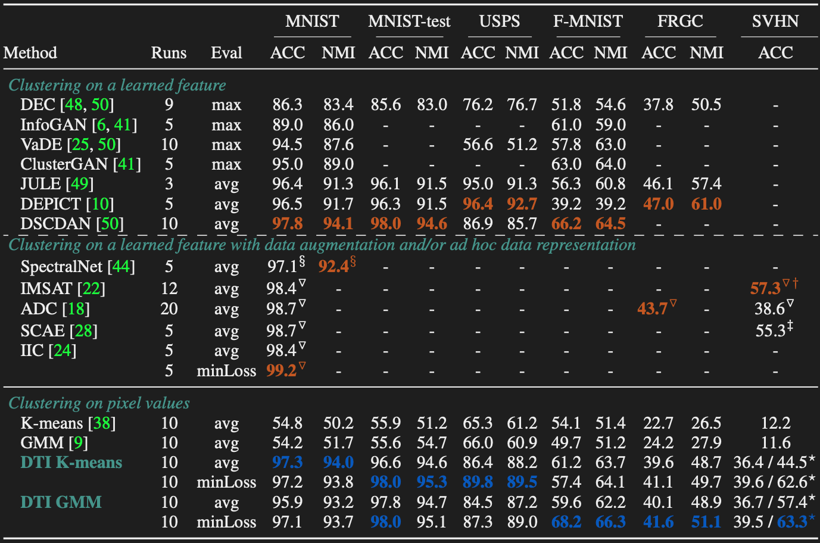
Results on standard clustering benchmarks
Notes:
We evaluated our approach on standard image clustering benchmarks. We visually separated feature based methods and pixel based ones and mark methods that use data augmentation or ad hoc data representation. Both DTI K-means and DTI GMM obtain results on par with the best concurrent methods
In particular, we improve state of the art on both Fashion MNIST and SVHN datasets by a significant margin.

Slide 13
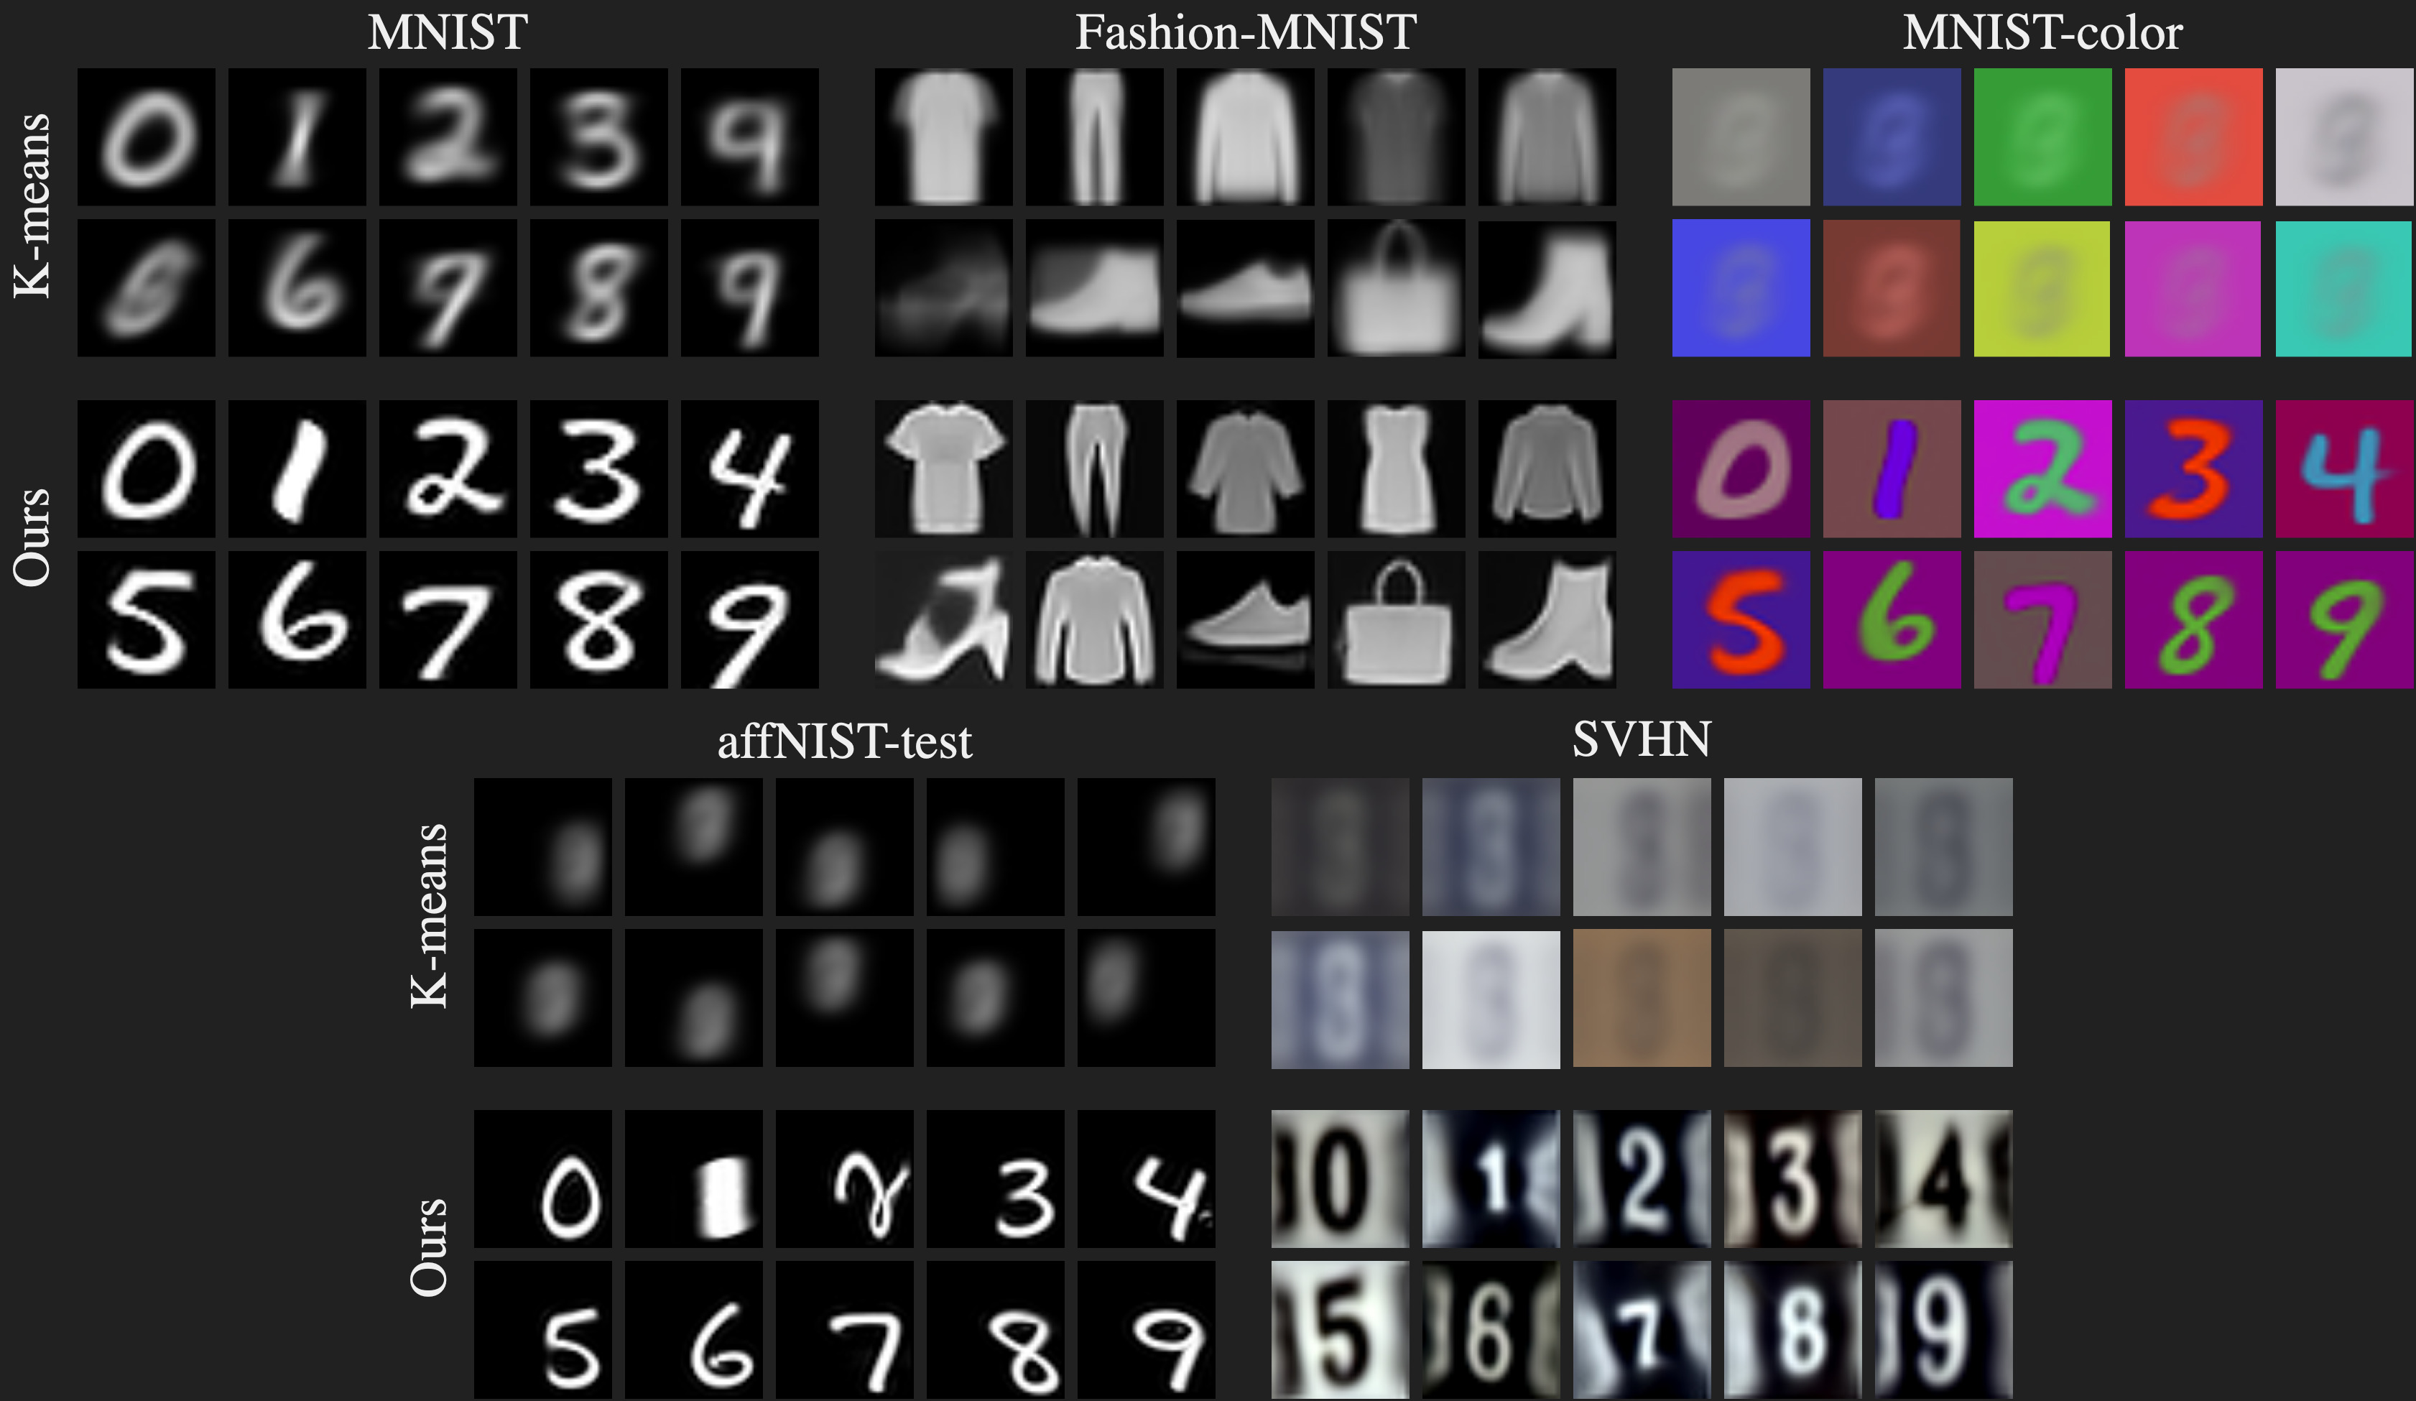
Qualitative results – prototypes
Notes:
Compared to most concurrent methods, we believe our approach also has the advantage to be strongly interpretable.
When we apply standard K-means, we observe that learned prototypes are mainly driven by color or spatial biases.
By explicitly modeling color and spatial alignments, our method yields much better and sharper prototypes.

Slide 14

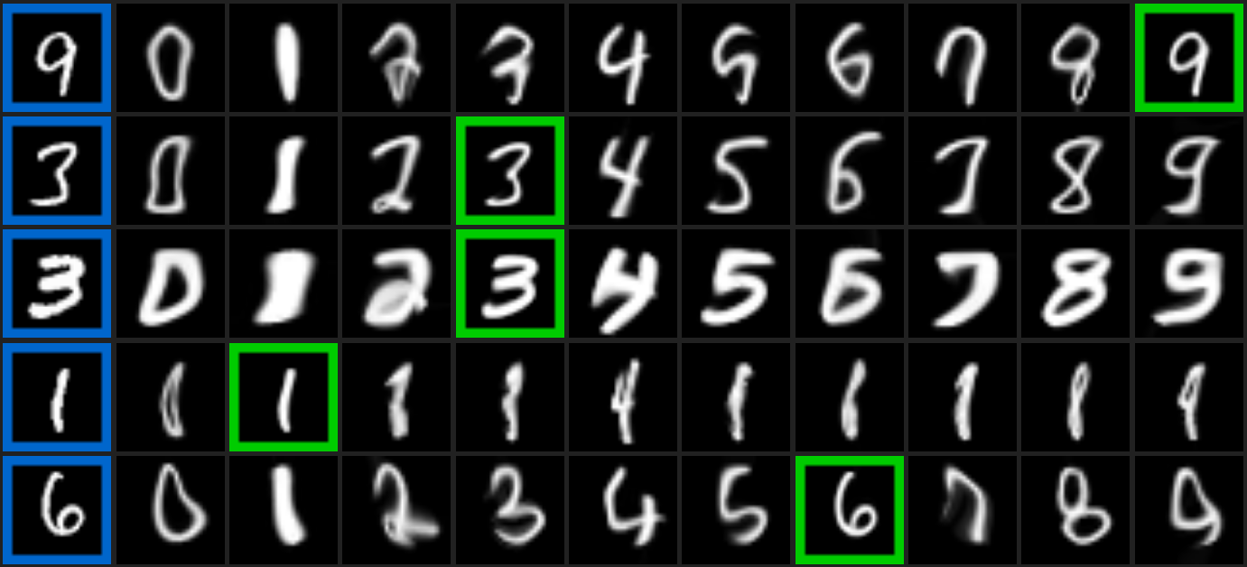
Qualitative results – transformations on MNIST
Notes:
The sharpness of our prototypes (visualized at the top in purple) directly stems from the quality of the learned transformations. For a given query sample (in blue), we show aligned prototypes and highlight the closest prototype in green. Note how we manage to accurately model complex transformations like thickness or local elastic deformations.

Slide 15

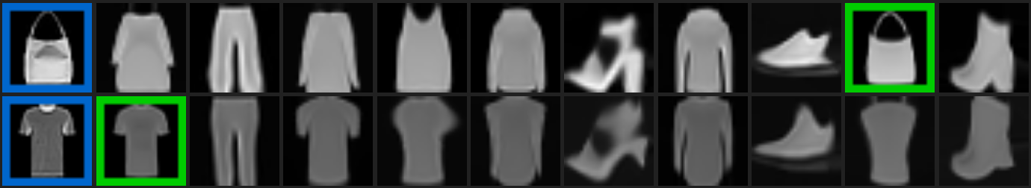
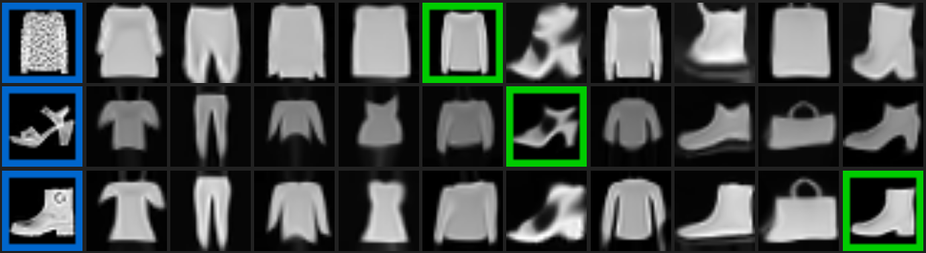
Qualitative results – transformations on F-MNIST
Notes:
Similarly, when applied to object datasets like Fashion-MNIST, we manage to accurately deform the prototypes to match the different object instances.

Slide 16

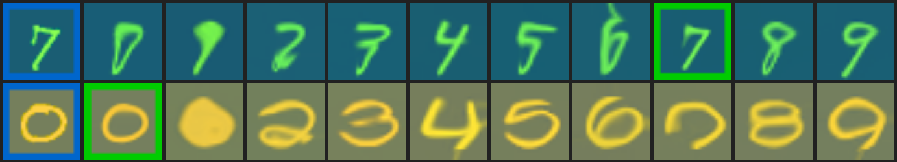
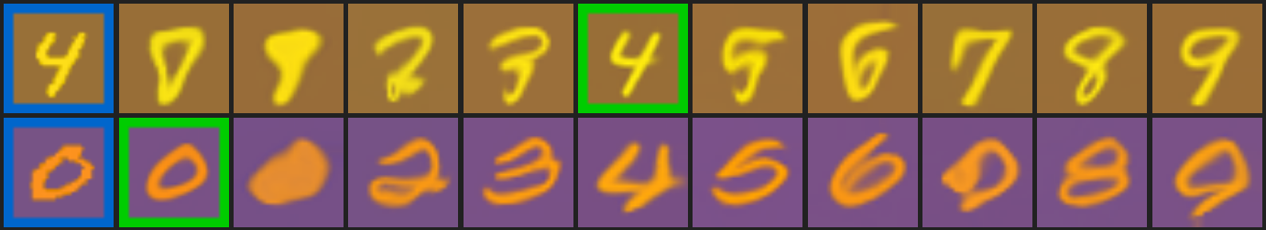
Qualitative results – transformations on MNIST-color
Notes:
For colored images like this colored MNIST dataset, we explicitly resolve color invariance with the dedicated module. In contrast to concurrent methods, it enables us to directly work with colored images without any pre-processing or manual ad hoc representations like Sobel filters.

Slide 17
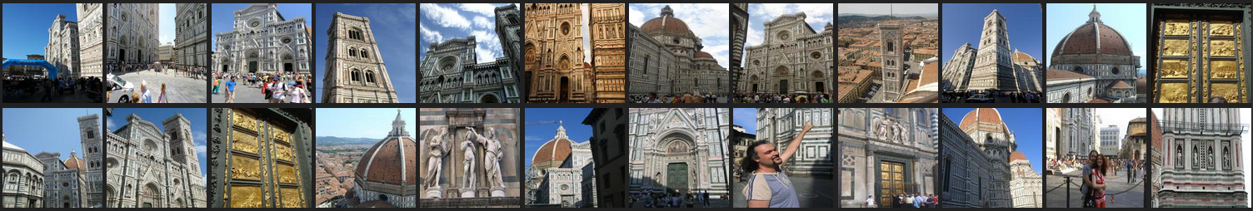
Results on web images
Li and Snavely, MegaDepth: Learning Single-View Depth Prediction from Internet Photos (CVPR 2018)
1892 images 128x128
Notes:
We also demonstrate our approach robustness by visualizing clustering results on web photo collections, like this collection of Florence images.
We show the 4 best qualitative prototypes learned with our approach when applied with 20 clusters. They are extremely sharp and detailed.
Expect few outlier samples, the clusters found have a surprisingly high purity.
Even for such complex images, we manage to model real transformations like illumination variations and viewpoint changes.

Slide 18
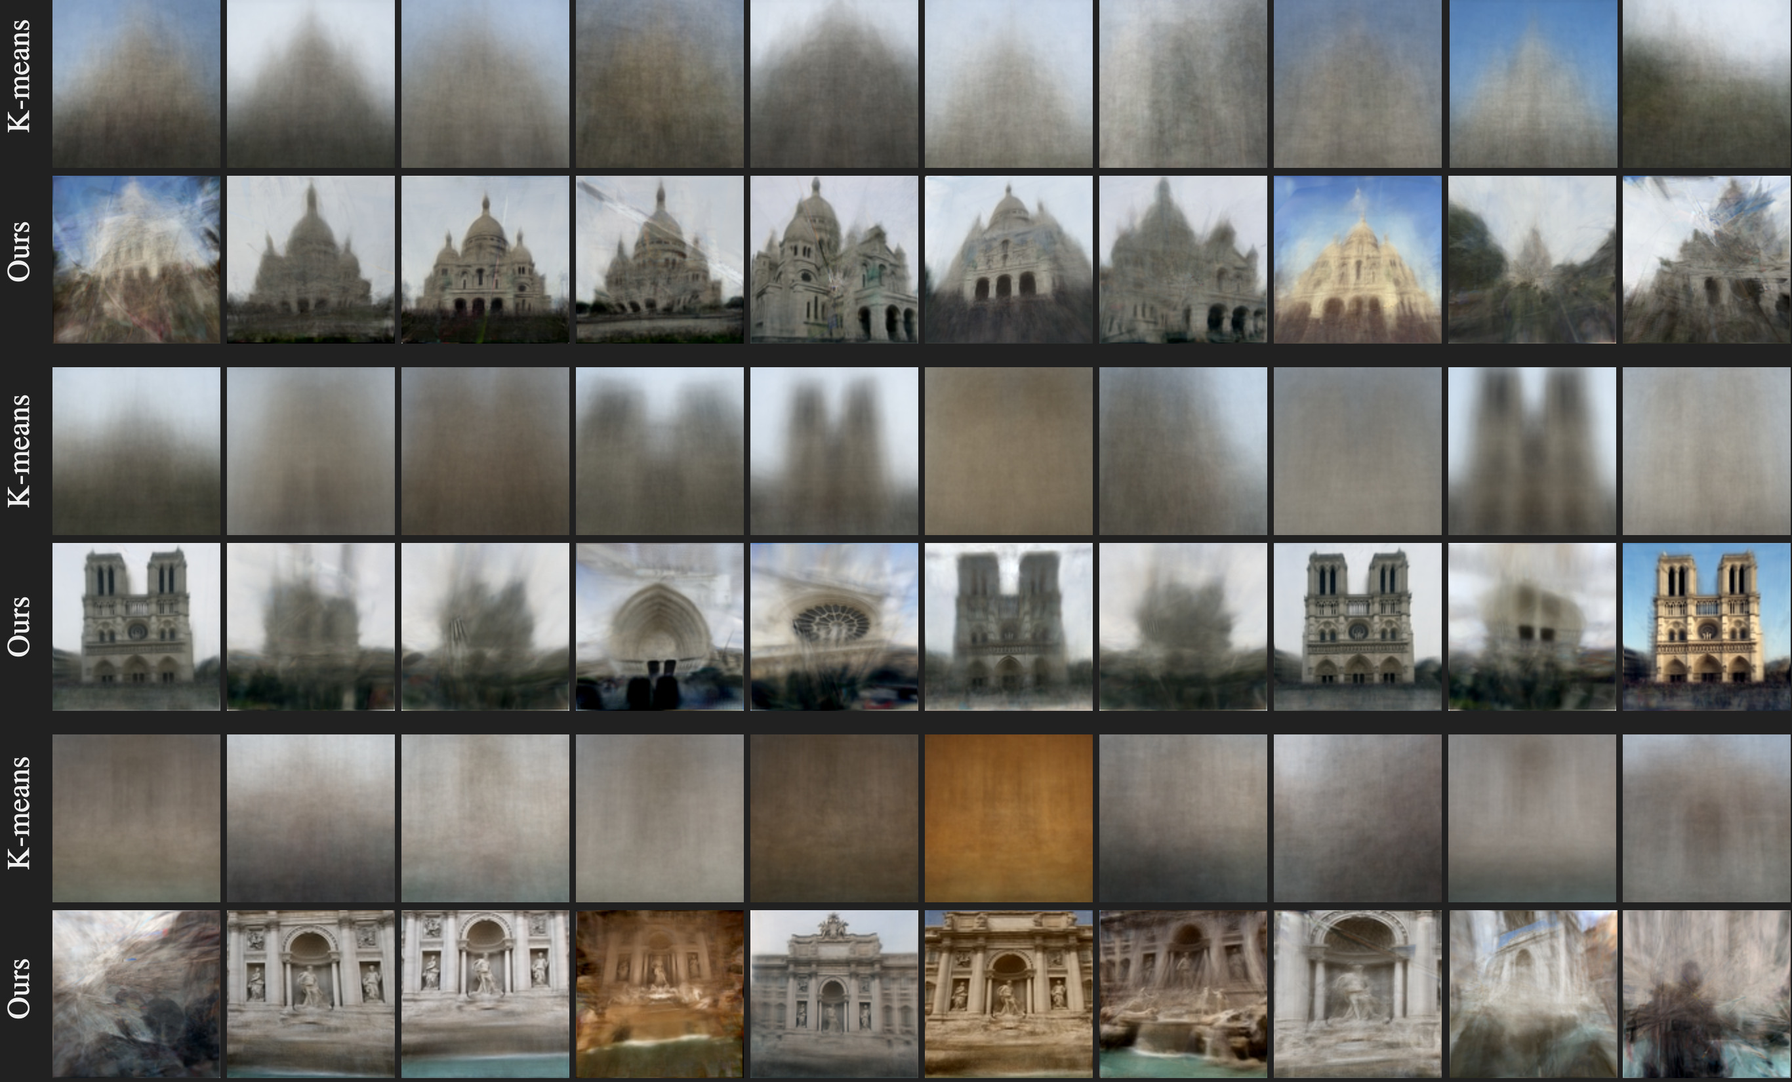
Results on web images – prototypes
Notes:
When we compare the full sets of prototypes learned with standard K-means and our deep transformation invariant adaptation, the results are impressive. The simple combination of our color and spatial alignments allows us to turn a failing K-means algorithm into a successful clustering method that is able to discover meaningful clusters.

Slide 19


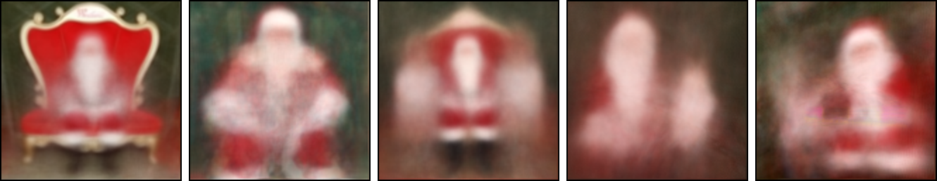
Results on Instagram hashtags
#santaphoto
Notes:
Finally, we show that our clustering method could be applied to unfiltered sets of Instagram images associated to specific hashtags. Even if most images look like noise,
we manage to discover iconic photos and iconic poses. In particular, we recognize a santa in a red chair, alone or seated next to two children.

Slide 20
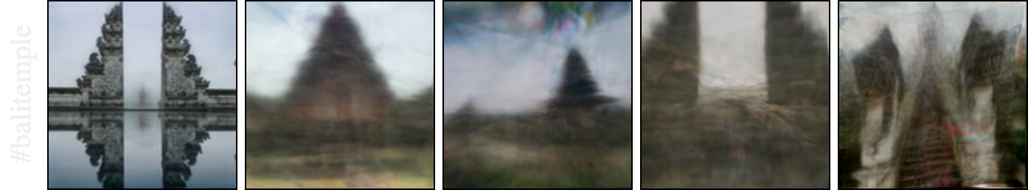
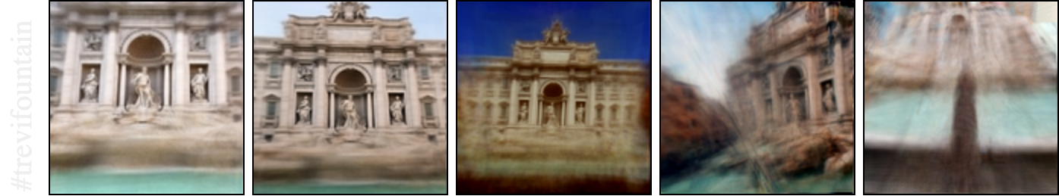
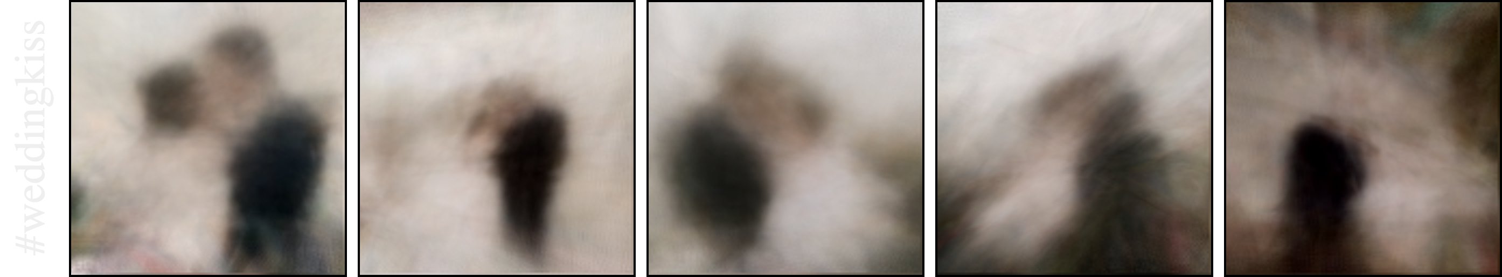
Notes:
These successful results are validated on other Instagram hashtags, like bali temple, trevi fountain or wedding kiss. To the best of our knowledge, we are the first to report this type of results from raw social network image collections
Interestingly, some of the prototypes are still really sharp like the top left one. By looking at associated samples,

Slide 21
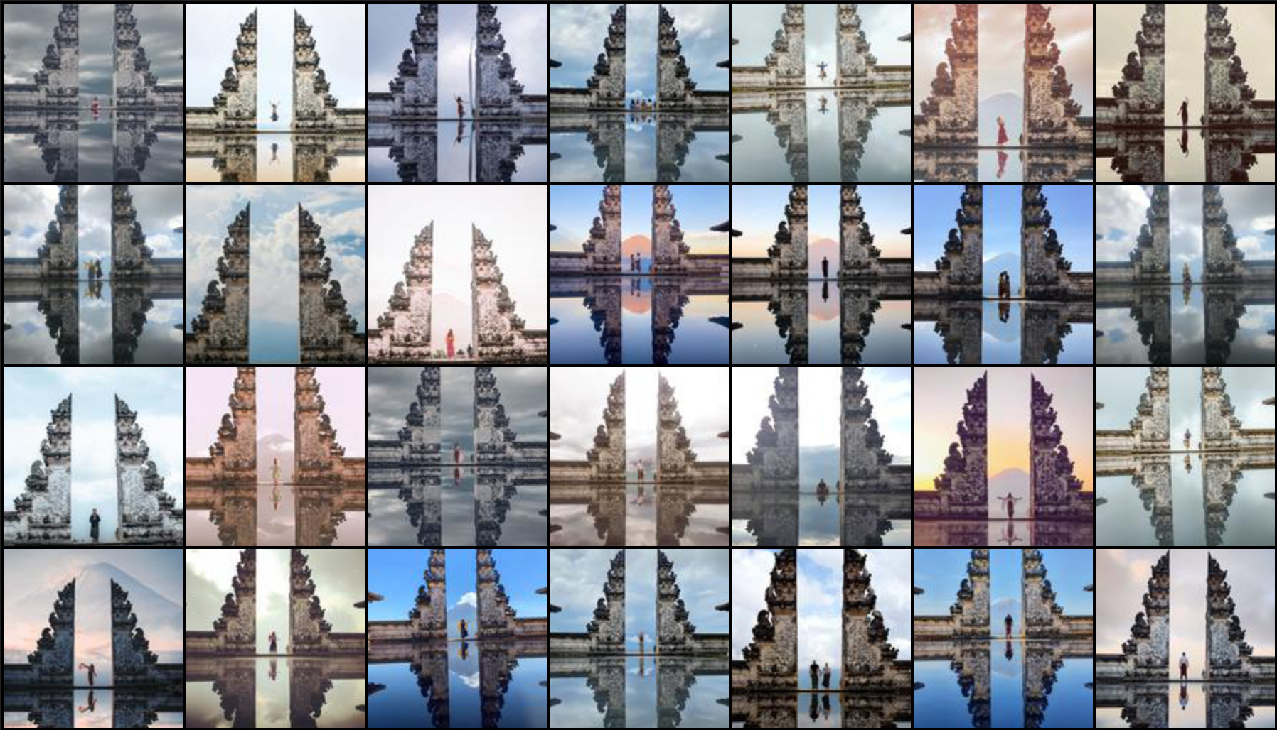
Notes:
we found that it actually corresponds to an iconic photograph usually shot when travelling to Bali.

Slide 22
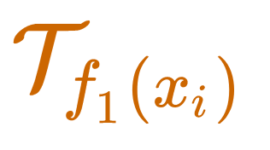
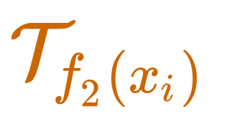
Conclusion
A deep clustering approach which jointly learns prototypes
and transformation-invariant assignments to match raw input data
Advantages
state-of-the-art
high interpretability
control over invariance
Notes:
To conclude, we introduced a deep clustering approach which jointly learns prototypes and transformation invariant assignments to match raw input data.
Despite its apparent simplicity, our method comes with several advantages, including state of the art performances and a strong interpretability of clustering results. Finally, note that the framework is generic and could be applied to other types of data with known transformation-invariant semantics, like 3D point clouds or time series.

Slide 23
Deep Transformation-Invariant Clustering
Neural Information Processing Systems 2020
Tom Monnier, Thibault Groueix, Mathieu Aubry
LIGM, Ecole des Ponts, Univ Gustave Eiffel, CNRS, France
Project webpage
http://imagine.enpc.fr/~monniert/DTIClustering/
Code
https://github.com/monniert/dti-clustering
Notes:
The code is online, check out our paper for additional experiments and details, thanks!

