Slide 1
Snowflake and Architecture

Slide 2
What is Snowflake?
Snowflake is a data warehouse that runs entirely on cloud infrastructure.
Faster, easier to use, and far more flexible than traditional data warehouse.
Snowflake data warehouse uses a new SQL database engine with a unique architecture designed for the cloud.
It is available on AWS and Azure cloud only.
Key Capabilities
PK/FK concepts
Snowflake supports DDL/DML, functions, stored procedures, views, materialized views,
analytical functions, window functions etc..
Snowflake client tools like Snowflake web UI and Snowflake CLI are used for query
writing.

Slide 3
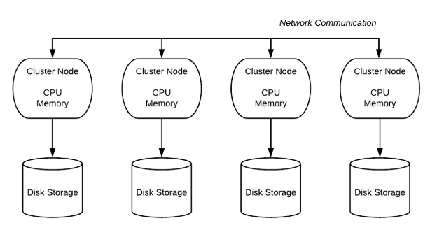
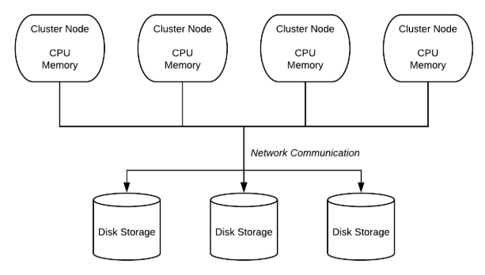
Shared-Disk vs Shared-Nothing Architecture
Shared Architecture
Shared Nothing Architecture

Slide 4
Snowflake Hybrid Architecture
Snowflake’s architecture is a hybrid of traditional shared-disk database architecture and shared-nothing database architecture.
Snowflake has 3 different layers:
Storage Layer
Compute Layer/Query Processing Layer
Cloud Services Layer

Slide 5
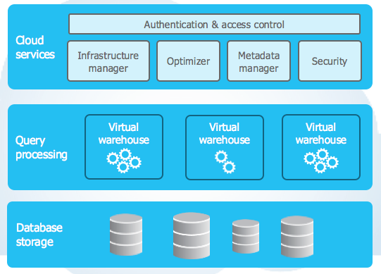
Snowflake Hybrid Architecture

Slide 6
Different Layers of Snowflake Architecture
Storage Layer:
Snowflake organizes the data into multiple micro partitions that are internally
optimized and compressed.
Snowflake is provisioned on the Cloud, storage is elastic and is charged as per
the usage per TB every month.
Compute Layer:
Snowflake uses “Virtual Warehouse” for running queries.
Virtual Warehouses are MPP compute clusters consisting of multiple nodes with
CPU and memory provisioned on the cloud.
Multiple Virtual Warehouses are created to mange the workload.

Slide 7
Different Layers of Snowflake Architecture
Cloud Services Layer:
All the activities such as authentication, security, load management and query
optimization are done by cloud service layer.
When a login request is placed it has to go through this layer.
Query submitted to snowflake will be sent to the optimizer in this layer and then forwarded
to compute layer for query processing.
Snowflake charges for storage and virtual warehouse separately. Services layer is handled within compute nodes, so hence not charged

