Slide 1

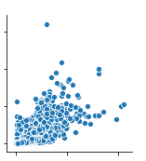
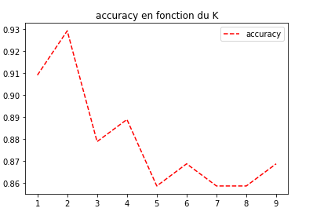
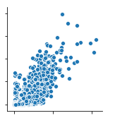
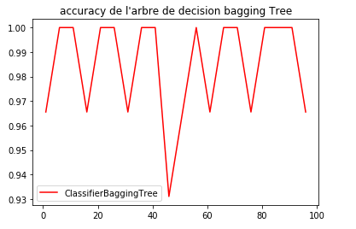
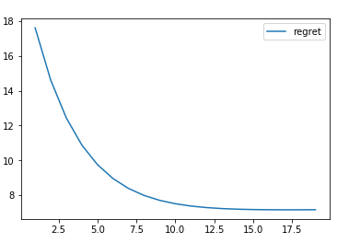
Film Data Analysis
Hakim CHEKIROU
Introduction:
To analyse and extract meaningful information from the IMDB data. We preprocess the data. For the sake of deciding what dataset to use , We statistically analyse the data before applying the machine learning algorithms.
Looking for the optimal cluster number
Regression
Classification
In this section, we are aiming at prediction the rating of a movie.
Our goal here is to predict the type of the movie.
Correlation
Indice de Xie & Beni
Weighted Movie rating
Actor ratings
PRE-PROCESSING:
> Reduction of Ratings’ size.
> Deleting the meaningless features on every table.
> Dropping missing values.
> Adding new features.
> Link all the tables together.
K
Analysis on the resulting clusters
Movie Ratings
Movie Ratings
K = 2
Perceptron batch
We have trained the algorithm on 25000 films, with a 0,002 learning rate.
Decision Tree
Prediction if a person is a director.
Epsilon = 0.01.
Non Supervised Learning : K-means
Cluster 1 male actors
Cluster 2 only composed of actresses
Regret
K = 5
Our goal in this section is to find clusters of actor based on the types of movies they play in and there performance in them. The roles have been grouped by actor and new features have been added. We limited this analysis on only the first 10000 actors
Regret
PHOTO HERE
iteration
Number of trees

