Slide 1
Pneumonia classification
Detecting pneumonia from chest Ct scans using deep learning
Hakim Chekirou

Slide 2
Why does it matter ?
Pneumonia accounts for over 15% of all deaths of children under 5 years old.
It requires review of a chest radiograph (CXR) by highly trained
specialists and confirmation through clinical history.
the diagnosis of pneumonia on CXR is complicated because of a
number of other conditions in the lungs such as fluid overload (pulmonary edema),
bleeding, volume loss (atelectasis or collapse), lung cancer, or post-radiation
or surgical changes.
A number of factors such as positioning of the patient and depth
of inspiration can alter the appearance of the CXR.
In addition, clinicians are
faced with reading high volumes of images every shift.

Slide 3
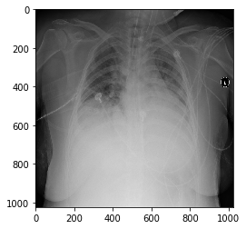
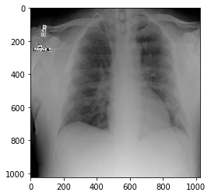
Dataset
Pneumonia detection challenge
26,684 Chest X rays in the form of
Dycom files.
Unbalanced dataset (20672
negative vs 6012 positive examples.
High resolution 1024*1024
Positive example
Negative example

Slide 4
Data preparation

Slide 5
Resnet ( 50 and 19)

Slide 6
MobilNet

Slide 7
Our proposition ( Transformers)

