Slide 1
How does mRNA stability affect mRNA localization in neurons?

Slide 2

Subcellular localization of mRNAs in neurons
Up to 1 meter long
Soma
Axon
Dendrites

Slide 3
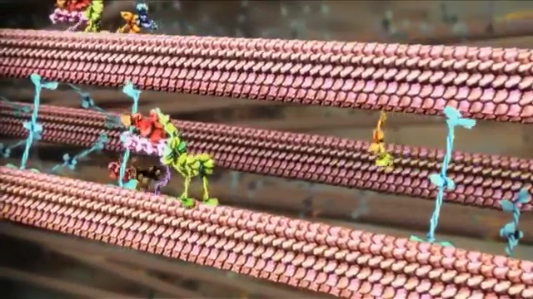
mRNAs are moved by motor proteins

Slide 4
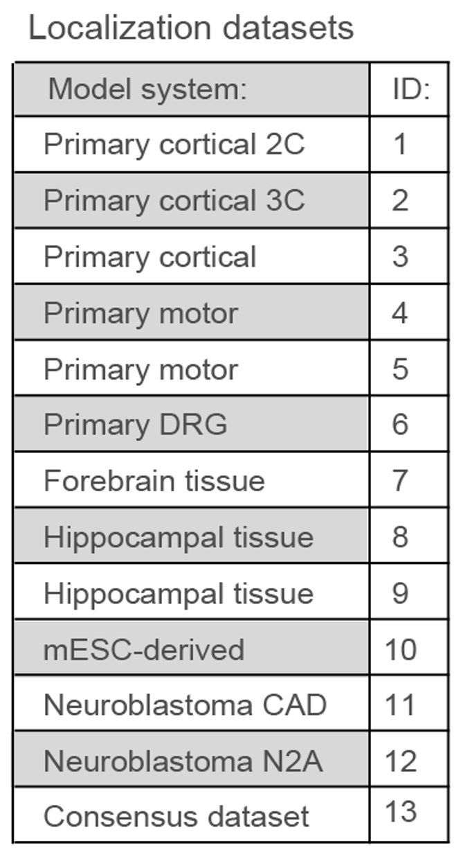
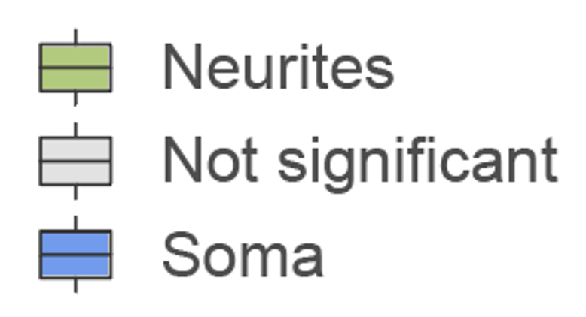
Method to measure mRNA localization in neurons
Neurons
Soma
RNA-seq
mRNAs are classified as:
Axons
Microporous membrane

Slide 5
Types of elements that regulate mRNA stability analyzed in this study
RNA Motifs:
RNA motifs are specific patterns or sequences in RNA that have particular functions. Think of them as “codes” within the RNA that tell the cell to do something special, e.g. to interact with other molecules.
Here I analyze one type of motifs – ARE

Slide 6
Types of elements that regulate mRNA stability analyzed in this study
m6A:
m6A (N6-methyladenosine) is a chemical modification that can be added to RNA. It’s like a small “tag” or “mark” on certain adenine bases (A) in the RNA. This tag helps the cell control how the RNA is processed, how long it lasts, and when and where it’s used to make proteins. It’s one way the cell fine-tunes gene expression.

Slide 7
Types of elements that regulate mRNA stability analyzed in this study
Codon Optimality (tAI):
Codon optimality refers to how efficiently a cell reads specific codons in the RNA to make proteins. Codons are 3-letter sequences that tell the cell which amino acid to add to a protein. Some codons are read faster and more accurately than others, making them “optimal” because they help the protein be made more efficiently. Codon optimality can influence how quickly and well a protein is produced by the cell.

Slide 8
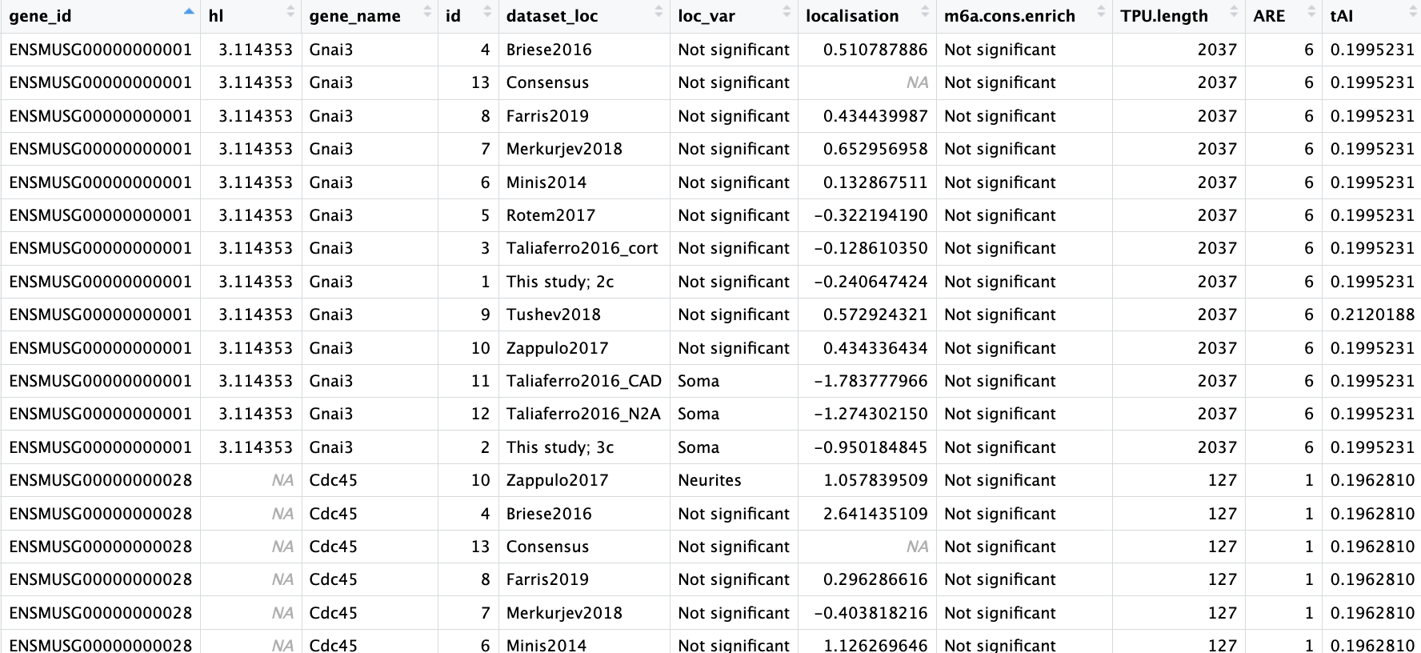
Data:

Slide 9
ARE is not normaly distributed
9

Slide 10
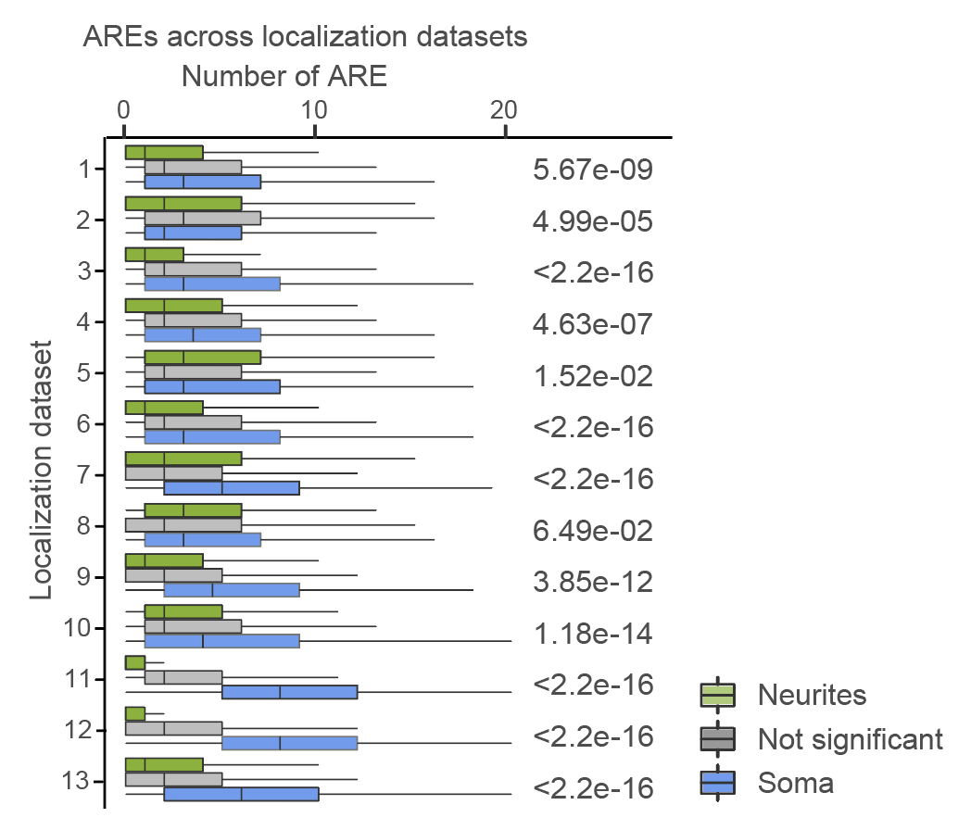
ARE is depleted from neurites
Boxplots showing average number of AREs in 3'UTRs of neurite- (green) and soma-localized transcripts (blue) across multiple RNA localization datasets. P-values were computed with Wilcoxon Rank-Sum test*.
*Mann-Whitney U Test (Wilcoxon Rank-Sum Test): The non-parametric analog of the unpaired t-test; it compares the ranks of two independent groups.
# Perform the Mann-Whitney U test (Wilcoxon rank-sum test)
mann_whitney_result = mannwhitneyu(group_neurites, group_soma, alternative='two-sided')
10

Slide 11
Codon optimality (tAI) is normaly distributed
11

Slide 12
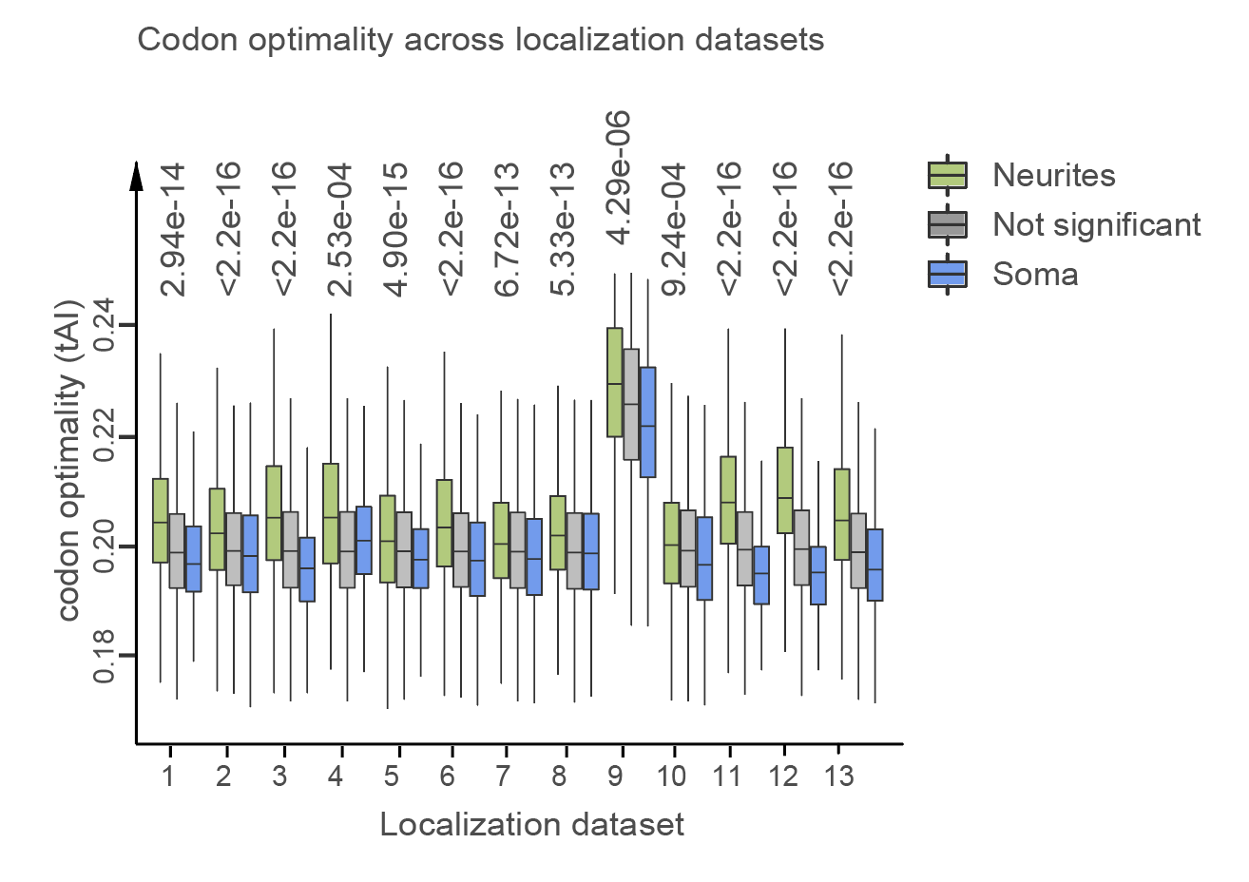
Neurite-localized mRNAs have higher codon optimality
Optimal codons are associated with localization to neurites across multiple neuronal datasets. Boxplots showing codon optimality (Y) for neurite-localized (green), soma-localized (blue) and transcripts that do not show significant enrichment in subcellular compartments (grey). P-values were calculated with Welch test*.
*Welch’s t-test: A variation of the t-test used when the variances of the samples being compared are unequal.
# Perform Welch's t-test (by setting equal_var=False)
welch_result = ttest_ind(group_neurites, group_soma, equal_var=False)
12

Slide 13
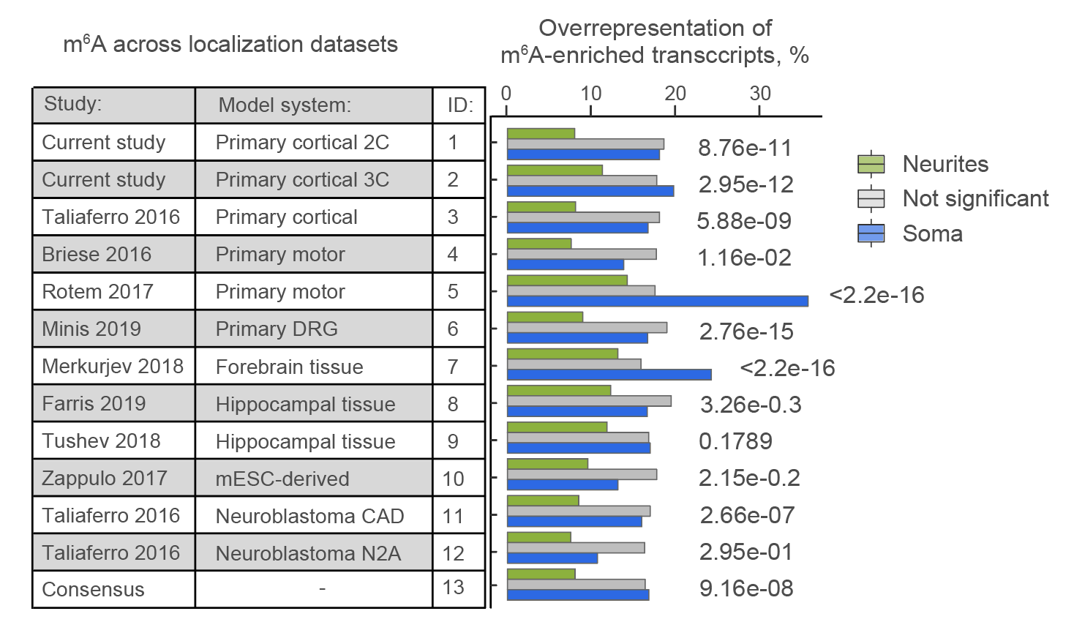
m6A is depleted from neurites
m⁶A-enriched transcripts are preferentially localized to soma across multiple neuronal datasets, annotated on the left. The bar plots represent the fraction of m⁶A-enriched transcripts (Y) among neurite- (green bars) and soma-localized transcripts (blue). P-values were computed with Chi-squared test.
*Chi-squared test is a statistical test used to determine whether there is a significant difference between the expected frequencies and the observed frequencies
# Create a contingency table using pd.crosstab
m6a_contingency_table = pd.crosstab(table['m6a.enrich'], table['loc_var’])
# Perform Chi-squared test
chi2_result = chi2_contingency(m6a_contingency_table)
13

Slide 14
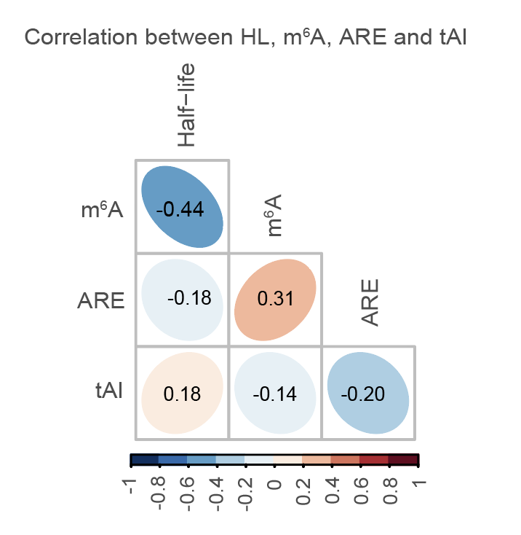
Interplay of multiple destabilizing elements in mRNA localization
Correlation between the presence of multiple types of destabilizing elements in mRNAs. The numbers and color scale represent Pearson correlation coefficients* between the indicated features.
*Pearson correlation coefficient (often symbolized as r) is a statistical measure that describes the strength and direction of a linear relationship between two variables.
# Select the relevant columns: HL, ARE, tAI, and m6a.enrich
variables_to_correlate = table[['HL', 'ARE', 'tAI', 'm6a.enrich']]
# Calculate the Pearson correlation coefficient matrix
correlation_matrix = variables_to_correlate.corr(method='pearson')
14

Slide 15
Conclusions
1) Features that destabilize mRNA – m6A, ARE, low codon optimality – are depleted from neurites
15

Slide 16
Conclusions
1) Features that destabilize mRNA – m6A, ARE, low codon optimality – are depleted from neurites
2) mRNAs that contain one of the destabilization elements tend to carry other destabilizing elements as well. One possible interpretation of this observation is redundancy: the presence of multiple elements ensures that mRNA is quickly degraded
16

Slide 17
My cheat sheet
Parametric tests are used for data that are continuously distributed, normally distributed, and free from spurious outliers. These tests compare means:
Unpaired (Independent) t-test: Compares the means of two independent samples.
Paired t-test: Compares the means of the same samples at different time points, such as before and after treatment.
ANOVA (Analysis of Variance): Compares the means of more than two samples.
Welch’s t-test: A variation of the t-test used when the variances of the samples being compared are unequal.
Non-Parametric Tests are used for data that do not meet the criteria for parametric tests, such as data that are not normally distributed or contain outliers. These tests compare ranks instead of means. The non-parametric equivalents of the above tests are:
Mann-Whitney U Test (Wilcoxon Rank-Sum Test): The non-parametric analog of the unpaired t-test; it compares the ranks of two independent groups.
Wilcoxon Signed-Rank Test: The non-parametric analog of the paired t-test; it compares the ranks of the same group at different time points, such as before and after treatment.
Kruskal-Wallis Test: The non-parametric analog of ANOVA; it compares the ranks of more than two groups.

