Slide 1
Data Visualization
& Dashboarding
Week 4 | Superstore Sales Dataset
Microsoft Power BI · Interactive Dashboard · Business Insights

Slide 2
Dataset Overview
Slide 2 of 7
📋
📊
✅
🔵
9,995
21
None
Power BI
Total Rows
Columns
Missing Values
Tool Used
About the Dataset
The Superstore Sales Dataset is a US retail dataset containing 9,995 transaction records across 21 columns. It tracks customer orders including product details, shipping information, geographic data, and financial metrics such as Sales, Profit, Quantity, and Discount — making it ideal for business performance analysis.
Order & Shipping:
Order ID, Order Date, Ship Date, Ship Mode
Product:
Product ID, Category, Sub-Category, Product Name
Customer:
Customer ID, Name, Segment
Financial:
Sales, Quantity, Discount, Profit
Location:
Country, City, State, Region, Postal Code

Slide 3
Business Problem & KPIs Defined
Slide 3 of 7
Business Problem:
How can the business identify top-performing regions, products, and customer segments to improve profitability and drive strategic decisions?
$2.30M
$286.40K
9,994
Total Revenue
Total Profit
Total Orders
12.47%
38,000 units
West ($725K)
Profit Margin
Total Quantity
Top Region

Slide 4
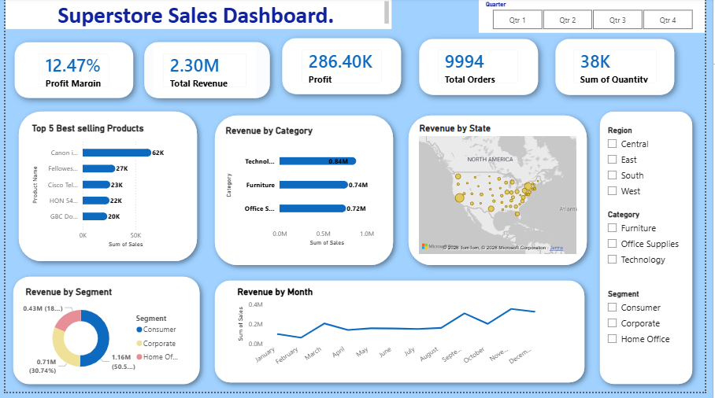
Dashboard Overview
Slide 4 of 7
Visualizations Included:
KPI Cards — Total Sales, Profit, Orders, Profit Margin, Quantity
Bar Chart — Sales by Category
Line Chart — Monthly Sales Trend
Pie/Donut Chart — Sales by Segment
Map Visual — Sales by State | Top Products Bar Chart

Slide 5
Key Insights
Slide 5 of 7
01
Technology Drives Revenue:
Technology is the top category at $0.84M, led by Canon Image Class at $62K. Prioritize tech inventory.
02
Strong Q4 Seasonality:
Sales peak in November ($352K) — nearly 6x February's low ($59K). Prepare stock and staff for Q4.
03
Consumer Segment Dominates:
Consumer segment generates $1.16M — more than double Home Office ($0.43M). Focus retention here.
04
West Region Leads Geographically:
West region generates $725K, the highest of all regions. Strong customer base on the West Coast.
05
Profit Margin Needs Attention:
12.47% margin on $2.30M revenue suggests discounting or high costs are eroding profitability.

Slide 6
Recommendations & Challenges
Slide 6 of 7
Recommendations
Challenges Faced
Increase Technology stock heading into Q4 to capitalize on seasonal demand peaks.
Launch targeted marketing campaigns for the Consumer segment to sustain revenue dominance.
Review discount strategies — especially in Furniture — to improve the 12.47% profit margin.
Expand West region logistics capacity given its leadership in revenue at $725K.
Develop growth strategies for the Home Office segment which remains underserved at $0.43M.
Template dataset mismatch: A pre-built .pbix template had a different data structure and had to be abandoned in favor of a blank file.
DAX table naming: The table name required exact spacing ('Sample - Superstore') — deviations caused 'too many arguments' errors in the Profit Margin measure.
Total Orders decimal issue: Dragging Order ID directly produced decimal formatting; resolved by creating a COUNT measure.
Data type corrections: Postal Code and Order ID required manual conversion to Text type in Power Query.

Slide 7
Conclusion
This dashboard project demonstrates the ability to transform raw sales data into meaningful business intelligence using Microsoft Power BI.
Explored and validated a 9,995-row retail dataset with 21 columns
Defined 7 meaningful KPIs using DAX measures in Power BI
Built 6 interactive visualizations across multiple chart types
Applied slicers for Region, Segment, Category, and Date filtering
Generated 5 data-driven business insights to support decision-making

