Slide 1

Parallel Computing Parallelization of Bucket Sort Algorithm
Ana Filipa Rodrigues Pereira PG46978
Carolina Gil Afonso Santejo PG47102
Raquel Sofia Miranda da Costa PG47600

Slide 2
Bucket Sort Algorithm
There are four steps in this algorithm:
Initialize an array of buckets
Insert each number of the array in the respective bucket
Sort each bucket
Put the numbers, now sorted, into the final array

Slide 3
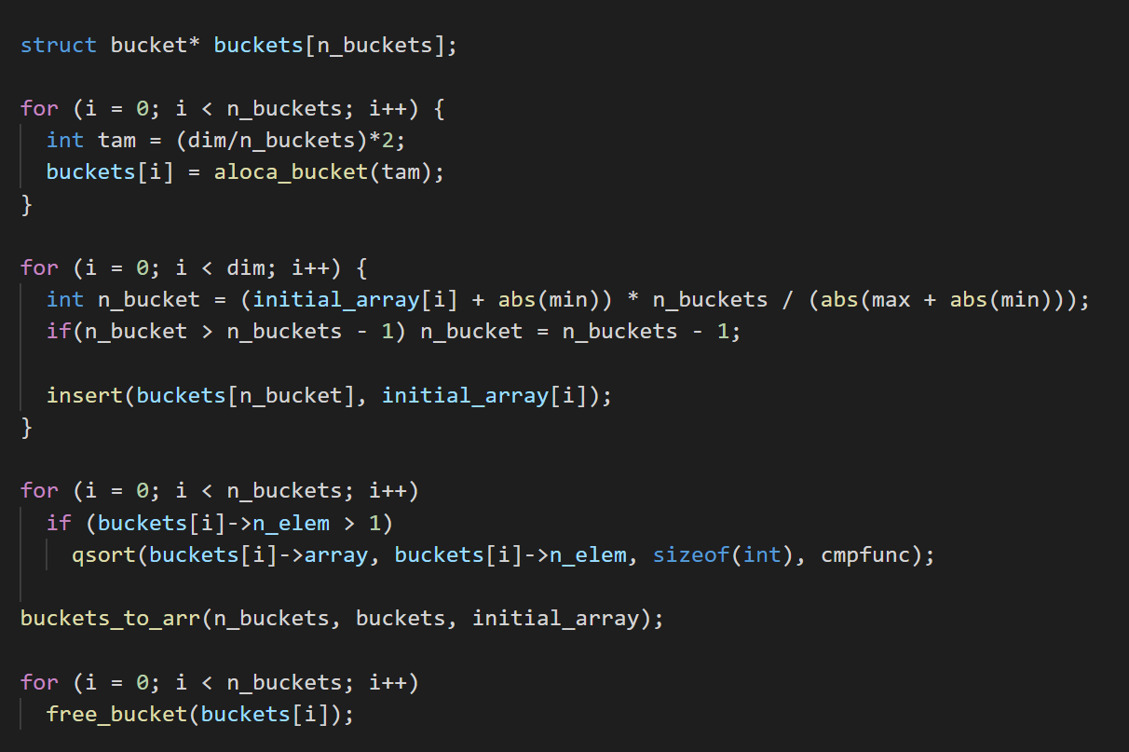
Sequential Bucket Sort
1: Initialize array
2: Insertion of numbers into buckets
3: Sorting of buckets
4: Putting sorted numbers into buckets

Slide 4
Sequential algorithm optimizations
The optimization methods that were used : loop unrolling and vectorization
When loop unroll and vectorization were applied individually the results didn’t change much
However when the two methods were applied simultaneously it was noticeable a reduction the number of instructions, the Wall clock time and the number of clock cycles (as expected).
The improvement wasn’t very significantly
Num. Buckets | Flags
 | no loop-unrolling and no vectorization (-O2) | loop-unrolling and vectorization (-O3)
30 | 18763 | 17786
300 | 19057 | 17477
3000 | 19107 | 17841
Note: Wall clock time in the sequential version when the size of the input array is 500000 elems;

Slide 5
Sequential algorithm optimizations
With the optimizations the number of L1 cache misses stays practically the same , but the number of L2 cache misses increases significantly
In this sequential algorithm the loop unrolling and vectorization do not have much impact in the overall performance.
Num. Buckets | Flags
 | no loop-unrolling and no vectorization (-O2) |  | loop-unrolling and vectorization (-O3)
 | L1 | L2 | L1 | L2
30 | 300051 | 13202 | 299654 | 69937
300 | 221291 | 24023 | 222195 | 80577
3000 | 219442 | 39749 | 216243 | 96252
Note: Cache misses in the sequential version when the size of the input array is 500000 elems;

Slide 6

Parallel Bucket Sort
The sequential algorithm developed could not be paralelized as it is, due to the fact that it would lead to multiple threads accessing the same bucket
It was necessary to change the algorithm and make the outter loop go through the number of buckets.
This said, we make sure that only one thread will acess one bucket
Critical section

Slide 7
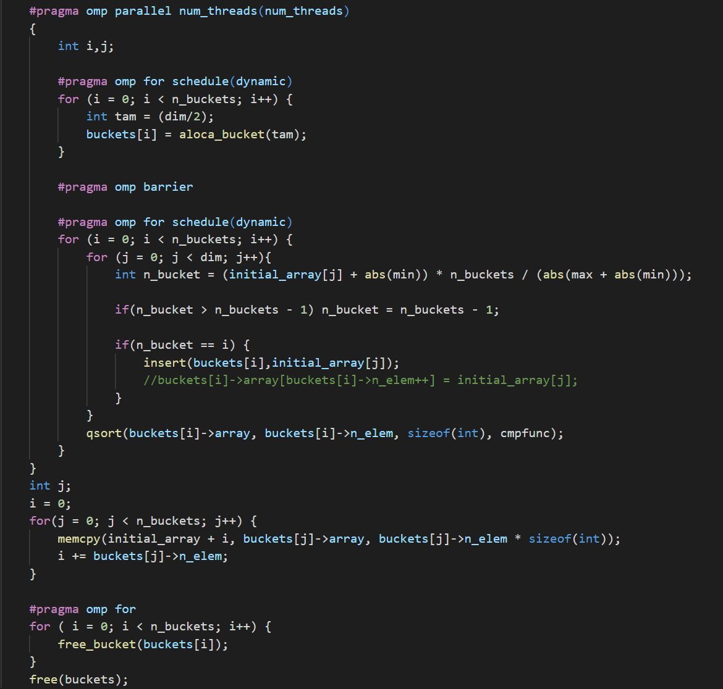
Parallel Bucket Sort
Parallel Bucket Sort
1: Initialize array of buckets
2: Insertion of numbers into buckets
3: Sorting of buckets
4: Putting sorted numbers into buckets

Slide 8
Compromises of the parallel algorithm
For every bucket this algorithm has to iterate through all the elements of the unsorted array in order to know if the current element belongs in the bucket
Considering n the size of unsorted array and n_buckets the total number of buckets, the total number of iterations will increase from n (sequential) to n*n_buckets (parallelized)

Slide 9
OpenMP - pragma clauses
Pragma omp parallel : Delimitates a parallel region and creates a set of threads
Pragma omp for Schedule (dynamic) : Dynamically assigns workload to threads when they become free
Pragma omp barrier: Before starting the step of inserting elements into buckets we need to make sure that all threads have finished allocating buckets

Slide 10
Performance evaluation
As expected the Wall clock time decrements when using a cluster node with better hardware specifications.
Array Size | Cluster Nodes
 | 113-2 (cores = 4) | 134-18 (cores = 8) | 134-115 (cores = 12)
32KB (≈8000 int) | 4820 | 2288 | 2055
256KB (≈64000 int) | 25422 | 12142 | 8967
25600KB (≈6400000 int) | 2455759 | 906104 | 663990
Note: Wall Clock Time in each node for: 500 buckets. Measure unit : usecs

Slide 11
Performance evaluation
It is possible to verify that we got the better results when the number of buckets is equal to the number of threads
When the number of buckets is greater than the number of threads the Wall clock Wall tends to increase
Num. Threads | Num. Buckets
 | = Num. Threads | = Num. Threads * 2 | = Num. Threads * 8 | = Num. Threads * 16
4 | 195420 | 229720 | 456432 | 798054
8 | 132107 | 194946 | 468275 | 878484
16 | 112973 | 177170 | 454222 | 874076
24 | 129018 | 198018 | 585309 | 1145959

Slide 12
Performance evaluation
It is possible to verify that when the array size increases the number of L1 and L2 cache misses tends to increase as well
Array Size (KB) | Num. Threads
 | 4 |  | 8 |  | 16 |  | 24
 | L1 | L2 | L1 | L2 | L1 | L2 | L1 | L2
32 | 27390 | 3843 | 19841 | 3845 | 13694 | 4019 | 10297 | 4148
256 | 519704 | 37981 | 273165 | 24443 | 147853 | 19638 | 113195 | 18913
Note: Cache misses; Array sizes used: 32KB (≈8000 int), 256KB (≈64000 int), 25600KB (≈6400000 int); Values considered: Buckets = 500. The cluster node used is “compute-134-115”.

Slide 13
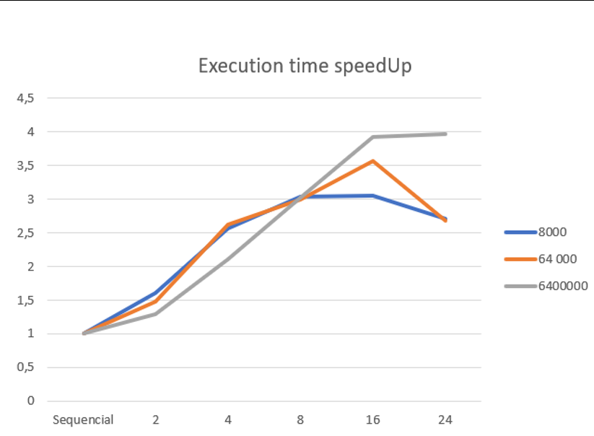
Strong scalability analysis
Speedup increases with threads for a fixed data size
Ideal Speedup is proporcionally to threads
As expected, increasing the number of threads will translate into better Wall clock times, compared to the sequential algorithm
Num. Threads/ Num. Buckets | Time | Speedup
Sequencial (4 buckets) | 278471 | 1
2 | 215646 | 1,29
4 | 132039 | 2,11
8 | 92241 | 3,02
16 | 70869 | 3,93
24 | 70154 | 3,97
Note: Wall Clock Time and Speedup for both algorithm versions. Values considered: Array size = 6.4×10^6 elements; The cluster node used is “compute-134-115”.
Execution time SpeedUp with num.threads = num.buckets related to the sequential version with 4 buckets

Slide 14
Weak scalability analysis
Increase problem data size as the number of threads increases
Ideally the execution time should remain constant
Array Size | Num. Threads
 | 4 | 8 | 16 | 24
4000 | 556 | 296 | 220 | 230
8000 | 897 | 600 | 402 | 311
16000 | 1781 | 1097 | 602 | 703
24000 | 2416 | 1668 | 1015 | 642
Note: Wall Clock Time. Values considered: Buckets = 50. The cluster node used is “compute-134-115”.

Slide 15
Conclusion
Parallelizing the algorithm ended up significantly improving the overall performance of the bucket sort
A few improvements that could be done include searching new pragma clauses or using other metrics to evaluate the algorithm.

Slide 16
Parallel Computing Parallelization of Bucket Sort Algorithm
Ana Filipa Rodrigues Pereira PG46978
Carolina Gil Afonso Santejo PG47102
Raquel Sofia Miranda da Costa PG47600

