Slide 1
Aperiodic Nonpreemptive EDF & Bratley’s Algorithm
Mike Walker EEE8068
EEE8068 Newcastle University 2014

Slide 2



Overview
Tasks
Scheduler
Real-time Operating System
Hardware
Definitions
Aperiodic
Nonpreemption
Earliest Deadline First (EDF)
Notes:
The scheduler context – makes choice of what task to run on the hardware for the operating system
Aperiodic – without regular repetition
Nonpreemption – not allowed to interrupt the currently running process
Earliest Deadline First – A Technique for scheduling, not a constraint… Always choose the task with the most pressing deadline

Slide 3
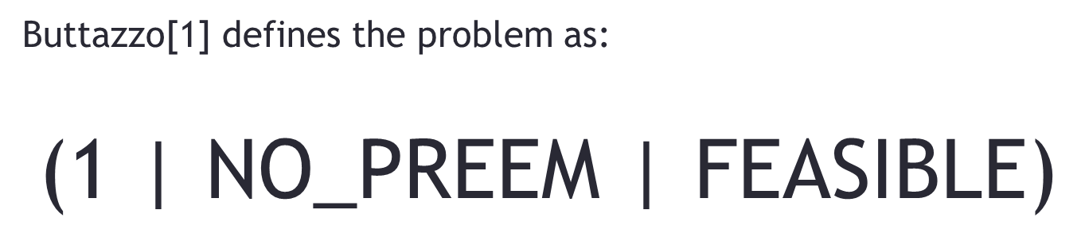
What’s the problem?
Buttazzo[1] defines the problem as:
$$\text{(1 | }\text{NO}\text{_}\text{PREEM}\text{ | }\text{FEASIBLE}\text{)}$$
α
β
γ
1
Single Processor System
NO-PREEM
Preemption Not Allowed
FEASIBLE
Find Schedule that works
Notes:
Alpha – the machine environment
Beta – the task characteristics & constraints
Gamma – the goal, performance measure

Slide 4
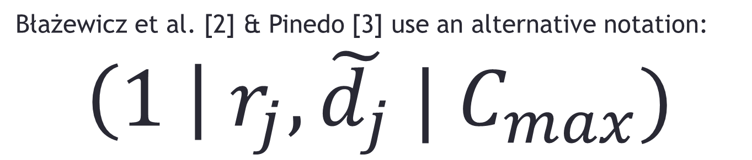
Further Taxonomy
Błażewicz et al. [2] & Pinedo [3] use an alternative notation:
$$\left(1 \right| r_{j}, \tilde{d_{j}} | C_{max})$$
$$C_{max}$$
𝑪_𝒎𝒂𝒙
Nonpreemption and Aperiodicity are implied
Different Task Ready Times
Task Deadlines are imposed
Try to minimize schedule length
$$\tilde{d_{j}}$$
(𝒅_𝒋 ) ̃
$$r_{j}$$
𝒓_𝒋
?
“ Scheduling of nonpreemtable and independent tasks of arbitrary processing times, arriving at different time moments and associated completion constraints on a single processor, with the objective to minimize schedule length”
Notes:
Blazewicz notation and have noticed it being used more frequently in the literature. I Prefer to think in Buttazzo’s terms
D means due-date, ~ means it MUST be met i.e. deadline.
‘C’ = ‘makespan’ – completion of the last job on the system, alternatively use Lmax, minimize maximum lateness

Slide 5
EDF
KEY
a – arrival time
C – computation time
d – Deadline time
 | Task 1 | Task 2
a | 0 | 0
C | 3 | 4
d | 6 | 7
Task 1
Task 2
Time
0
1
2
3
4
5
6
7

Slide 6
Preemptive EDF
Nonpreemptive EDF
KEY
a – arrival time
C – computation time
d – Deadline time
 | Task 1 | Task 2
a | 1 | 0
C | 3 | 4
d | 6 | 7
Task 2
Task 1
Task 2
Task 2
Task 1
Time
0
1
2
3
4
5
6
7

Slide 7
Nonpreemptive EDF
✓ Easy to implement
✓ Less Overhead (No Context Switching)
✗ Not Optimal
✗ May not find a Feasible solution!

Slide 8
What to do?
Complete Search to Find Optimal Solution
$𝓝𝓟–hard$ problem
𝓝𝓟–𝐡𝐚𝐫𝐝 problem
Find Feasible Solutions:
Find lowest value:
Calculate $C_{max}$ for every permutation of tasks.
Calculate 𝐶_𝑚𝑎𝑥 for every permutation of tasks.
Select Schedule with Minimal $C_{max}$
Select Schedule with Minimal 𝐶_𝑚𝑎𝑥
$$Ο(n∙n!)$$
𝚶(𝒏∙𝒏!)
Complexity Theory
Intractable as n increases

Slide 9
How to do it?
Static
Vs
Dynamic
Too slow – use Off-line/Static
But this does not mean it’s useless!
Time-triggered systems
Pre-defined timer processes
Task activation list
For Dynamic use a Heuristic algorithm
Know task parameters a priori
Notes:
Only for finding optimal solution… for dynamic use a heuristic algorithm – may find a feasible solution in polynomial time.

Slide 10
Bratley’s Algorithm
Proposed by Paul Bratley et al. in 1971.
“Scheduling with earliest start and due date constraints” Naval Research Logistics, Volume 18, Issue 4, pages 511–519, December 1971
Uses Branch and Bound method
Find solution by Backtracking in Tree of all solutions.
Tree nodes represent Tasks
Each branch is a possible schedule of tasks
‘B&B’
Common for Optimization Problems

Slide 11
Tree of all Solutions
…there are 24 Solutions for 4 tasks
120 for 5, 720 for 6, 5040 for 7, 40320 for 8 etc…
Root
(J1)
(J2)
(J3)
(J4)
(J1,J2)
(J1,J3)
(J1,J4)
(J2,J1)
(J2,J3)
(J2,J4)
(J3,J1)
(J3,J2)
(J3,J4)
(J4,J1)
(J4,J2)
(J4,J3)
(J1,J2,J3)
(J1,J3,J2)
(J1,J4,J2)
(J2,J1,J4)
(J2,J3,J1)
(J2,J4,J1)
(J3,J1,J2)
(J3,J2,J1)
(J3,J4,J1)
(J4,J1,J2)
(J4,J2,J1)
(J4,J3,J1)
(J1,J2,J4)
(J1,J3,J4)
(J1,J4,J3)
(J2,J1,J3)
(J2,J3,J4)
(J2,J4,J3)
(J3,J1,J4)
(J3,J2,J4)
(J3,J4,J2)
(J4,J1,J3)
(J4,J2,J3)
(J4,J3,J2)
(J1,J2,J3,J4)
(J1,J3,J2,J4)
(J1,J4,J2,J3)
(J2,J1,J4,J3)
(J2,J3,J1,J4)
(J2,J4,J1,J3)
(J3,J1,J2,J4)
(J3,J2,J1,J4)
(J3,J4,J1,J2)
(J4,J1,J2,J3)
(J4,J2,J1,J3)
(J4,J3,J1,J2)
(J1,J2,J4,J3)
(J1,J3,J4,J2)
(J1,J4,J3,J2)
(J2,J1,J3,J4)
(J2,J3,J4,J1)
(J2,J4,J3,J1)
(J3,J1,J4,J2)
(J3,J2,J4,J1)
(J3,J4,J2,J1)
(J4,J1,J3,J2)
(J4,J2,J3,J1)
(J4,J3,J2,J1)

Slide 12
Pruning the branches
Branch
&
Bound
Branching
Split solution & recursively process each one (tree)
Bounding
Test against criteria, Abandon Pruned Branches
Pruning
Criteria
Abandon current branch if:
Adding any remaining task causes deadline miss
Feasible Schedule Found

Slide 13
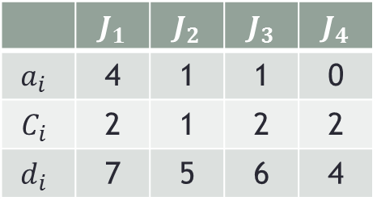
Branching
 | $$J_{1}$$ | $$J_{2}$$ | $$J_{3}$$ | $$J_{4}$$
$$a_{i}$$ | 4 | 1 | 1 | 0
$$C_{i}$$ | 2 | 1 | 2 | 2
$$d_{i}$$ | 7 | 5 | 6 | 4
Root
1
2
3
4
(J₁, J₂)
(J₁, J₃)
(J1,J₄ )
(J₂, J₁)
(J₂, J₃)
(J₂, J₄)
(J₃, J₁)
(J₃, J₂)
(J₃, J₄)
(J₄, J₁)
(J₄, J₂)
(J₄, J₃)
2
3
4
1
3
4
1
2
4
1
2
3
(J1,J2,J3)
(J1,J3,J2)
(J1,J4,J2)
(J2,J1,J4)
(J2,J3,J1)
(J2,J4,J1)
(J3,J1,J2)
(J3,J2,J1)
(J3,J4,J1)
(J4,J1,J2)
(J4,J2,J1)
(J4,J3,J1)
(J1,J2,J4)
(J1,J3,J4)
(J1,J4,J3)
(J2,J1,J3)
(J2,J3,J4)
(J2,J4,J3)
(J3,J1,J4)
(J3,J2,J4)
(J3,J4,J2)
(J4,J1,J3)
(J4,J2,J3)
(J4,J3,J2)
(J1,J2,J3,J4)
(J1,J3,J2,J4)
(J1,J4,J2,J3)
(J2,J1,J4,J3)
(J2,J3,J1,J4)
(J2,J4,J1,J3)
(J3,J1,J2,J4)
(J3,J2,J1,J4)
(J3,J4,J1,J2)
(J4,J1,J2,J3)
(J4,J2,J1,J3)
(J4,J3,J1,J2)
(J1,J2,J4,J3)
(J1,J3,J4,J2)
(J1,J4,J3,J2)
(J2,J1,J3,J4)
(J2,J3,J4,J1)
(J2,J4,J3,J1)
(J3,J1,J4,J2)
(J3,J2,J4,J1)
(J3,J4,J2,J1)
(J4,J1,J3,J2)
(J4,J2,J3,J1)
(J4,J3,J2,J1)

Slide 14


 | $$J_{1}$$ | $$J_{2}$$ | $$J_{3}$$ | $$J_{4}$$
$$a_{i}$$ | 4 | 1 | 1 | 0
$$C_{i}$$ | 2 | 1 | 2 | 2
$$d_{i}$$ | 7 | 5 | 6 | 4
Branching
Root
$$a_{i}+C_{i}$$
$$6$$
2
3
2
1
2
3
4
6
4
4
6
3
3
2
4
1
3
4
4
1
2
C = 2
d = 6
C = 1
d = 5
C = 2
d = 4
C = 2
d = 7
C = 2
d = 6
C = 2
d = 4
f+C>d
6+1>7
6
5
3
4
1
3
2
1
3
7
3
1
3
1

Slide 15
Feasible Solution Found
 | $$J_{1}$$ | $$J_{2}$$ | $$J_{3}$$ | $$J_{4}$$
$$a_{i}$$ | 4 | 1 | 1 | 0
$$C_{i}$$ | 2 | 1 | 2 | 2
$$d_{i}$$ | 7 | 5 | 6 | 4
4
4
2
3
1
2
3
5
7
2
(J₄,J₂,J₃,J₁)
3
1
(J₄,J₂,J₃,J₁)

Slide 16
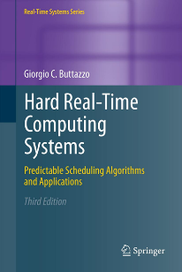
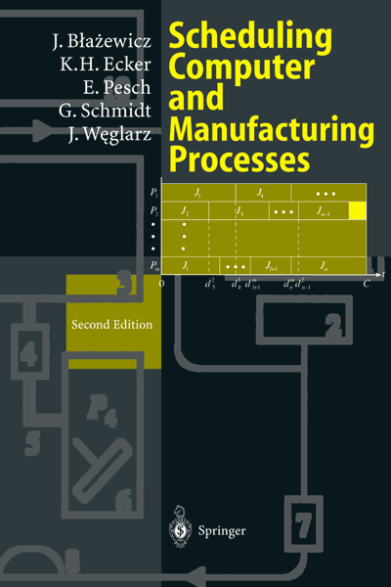
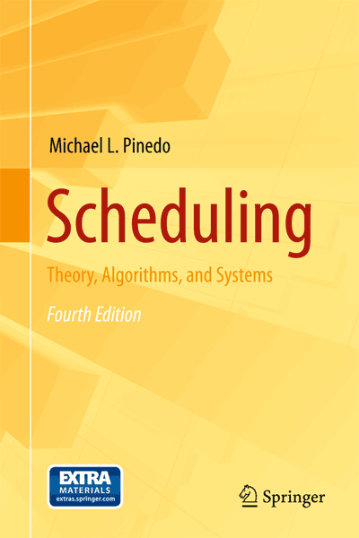
References
Hard Real-time Computing Systems
Buttazzo, G. C. (2005) Springer.
Scheduling Computer and Manufacturing Processes
Błażewicz J., Ecker K.H., Pesch E., Schmidt G., Weglarz J. (2001) Springer.
Scheduling: theory, algorithms, and systems
Pinedo, M. (2012) Springer.

Slide 17
Any Questions?

