Slide 1
Chicago Food Deserts
Aditya Yellajosyula
Mark DiSomma
Michelle Ibanez
GWU Data Analytics Bootcamp – Project 1
July 27, 2019

Slide 2
Agenda
Motivation & Summary
Questions & Data
Data Cleanup & Exploration
Data Analysis
Discussion
Post Mortem
Questions

Slide 3
Food Deserts
“Food deserts are defined as parts of the country vapid of fresh fruit, vegetables, and other healthful whole foods, usually found in impoverished areas. This is largely due to a lack of grocery stores, farmers’ markets, and healthy food providers.” (USDA, 2019)
Census tracts with NO grocery stores
Food deserts have been documented as an issue in Chicago for over a decade
USDA ERS - https://www.ers.usda.gov/amber-waves/2011/december/data-feature-mapping-food-deserts-in-the-us/

Slide 4
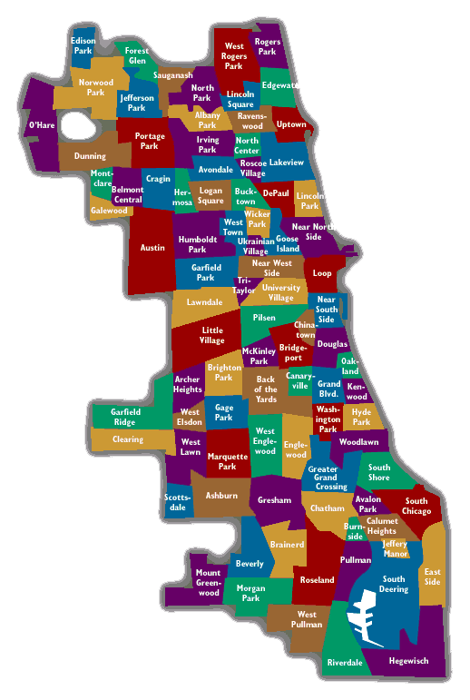
Chicago Overview
Population of 2.72M
Median age 34.6
Median household income $55,295
Median property value $255,900
Poverty rate 20.6%
Data USA - https://datausa.io/profile/geo/chicago-il/

Slide 5
Questions & Data
Questions
Where do food deserts exist in Chicago?
Is there a higher rate of food related crimes in food deserts?
Are there any areas that qualify as food deserts in non-low-income areas?
Is there a correlation between food deserts and public health factors related to prenatal care and infant health?
Data
Census Tract Data – Boundaries
Chicago Neighborhoods
Chicago Grocery Stores
Chicago Crime Data
Chicago Public Health Indicators by Community

Slide 6
Data Cleanup & Exploration

Slide 7
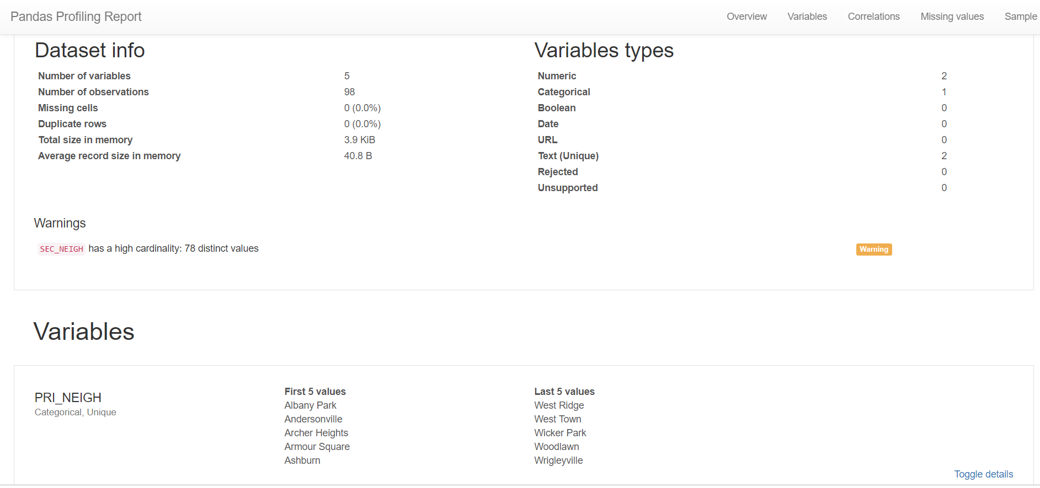
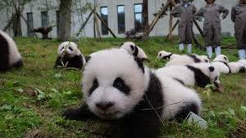
General Data Frames
Read all data files into data frames
Pandas profiling
Renamed data fields
Merged data frames
Created additional variables

Slide 8
Geo Data

Slide 9
Data Analysis

Slide 10
Chicago Food Deserts

Slide 11
Crime

Slide 12
Income

Slide 13
Public Health – Maternal/Infant Health

Slide 14
Discussion

Slide 15
Observations

Slide 16
Lessons Learned
Challenges
TBD

Slide 17
Future Work
Develop a more sophisticated definition – consider additional factors
Overlay Google APIs
Map Fast Food Establishments
Map Produce Cart Locations
Notes:
Produce Cart - Neighbor Capital is a social enterprise that runs a produce cart program that employs difficult to employ people who manage and operate a cart on a public sidewalk or private plaza across the city. The City of Chicago legalized this business model in 2012 with the requirement that half be set up in low-food access areas. Each cart carries a full line of fresh locally grown produce on an 8 feet by 6 foot stand generally between early morning and early evening hours.

Slide 19
Datasets Source
Census Tract Data – Boundaries
Need Source
Chicago Neighborhoods
Need Source
Chicago Grocery Stores
Need Source
Chicago Crime Data
https://data.cityofchicago.org/Public-Safety/Crimes-2018/3i3m-jwuy
Chicago Public Health Indicators by Community
https://data.cityofchicago.org/Health-Human-Services/Public-Health-Statistics-Selected-public-health-in/iqnk-2tcu

