Slide 1
Chicago Food Deserts
Aditya Yellajosyula
Mark DiSomma
Michelle Ibanez
GWU Data Analytics Bootcamp – Project 1
July 27, 2019

Slide 2
Agenda
Motivation & Summary
Questions & Data
Data Cleanup & Exploration
Data Analysis
Discussion
Post Mortem
Questions

Slide 3
Food Deserts
“Food deserts are defined as parts of the country vapid of fresh fruit, vegetables, and other healthful whole foods, usually found in impoverished areas. This is largely due to a lack of grocery stores, farmers’ markets, and healthy food providers.” (USDA, 2019)
Food deserts → Census tracts with NO grocery stores
The "Census Tract" is an area roughly equivalent to a neighborhood established by the Bureau of Census for analyzing populations. They generally encompass a population between 1,200 to 8,000 people. (Census.gov, 2019)
Chicago is the fourth largest food desert in the U.S.
USDA ERS - https://www.ers.usda.gov/amber-waves/2011/december/data-feature-mapping-food-deserts-in-the-us/
Census - https://www2.census.gov/geo/pdfs/education/CensusTracts.pdf
Notes:
The "Census Tract" is an area roughly equivalent to a neighborhood established by the Bureau of Census for analyzing populations. They generally encompass a population between 2,500 to 8,000 people.

Slide 4
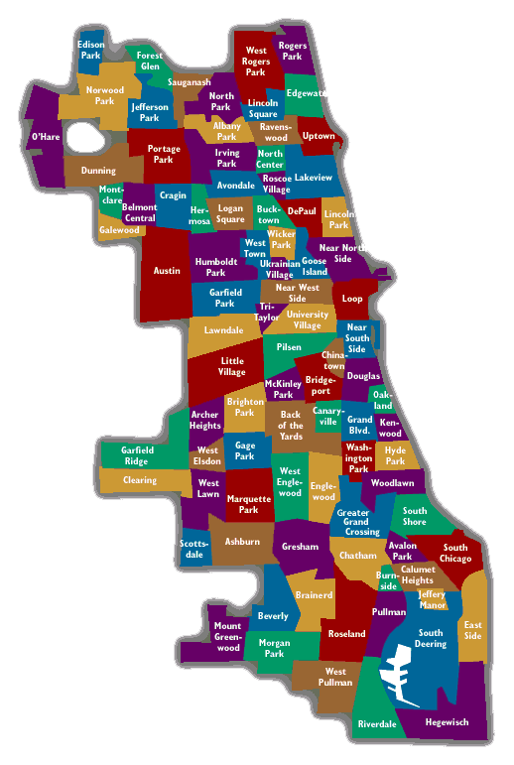
Chicago Overview
Population of 2.72M
Median age 34.6
Median household income $55,295
Median property value $255,900
Poverty rate 20.6%
Data USA - https://datausa.io/profile/geo/chicago-il/
Notes:
98 Neighborhoods

Slide 5
Questions & Data
Questions
Do food deserts exist in Chicago?
Where do food deserts exist in Chicago?
Is there a higher rate of food related crimes in Chicago food deserts?
Are there external indicators that connect to prevalence of food deserts (income, demographics)?
Data
Census Tract Data
Chicago Neighborhoods
Chicago Grocery Stores
Chicago Crime Data

Slide 6
Data Cleanup & Exploration

Slide 7
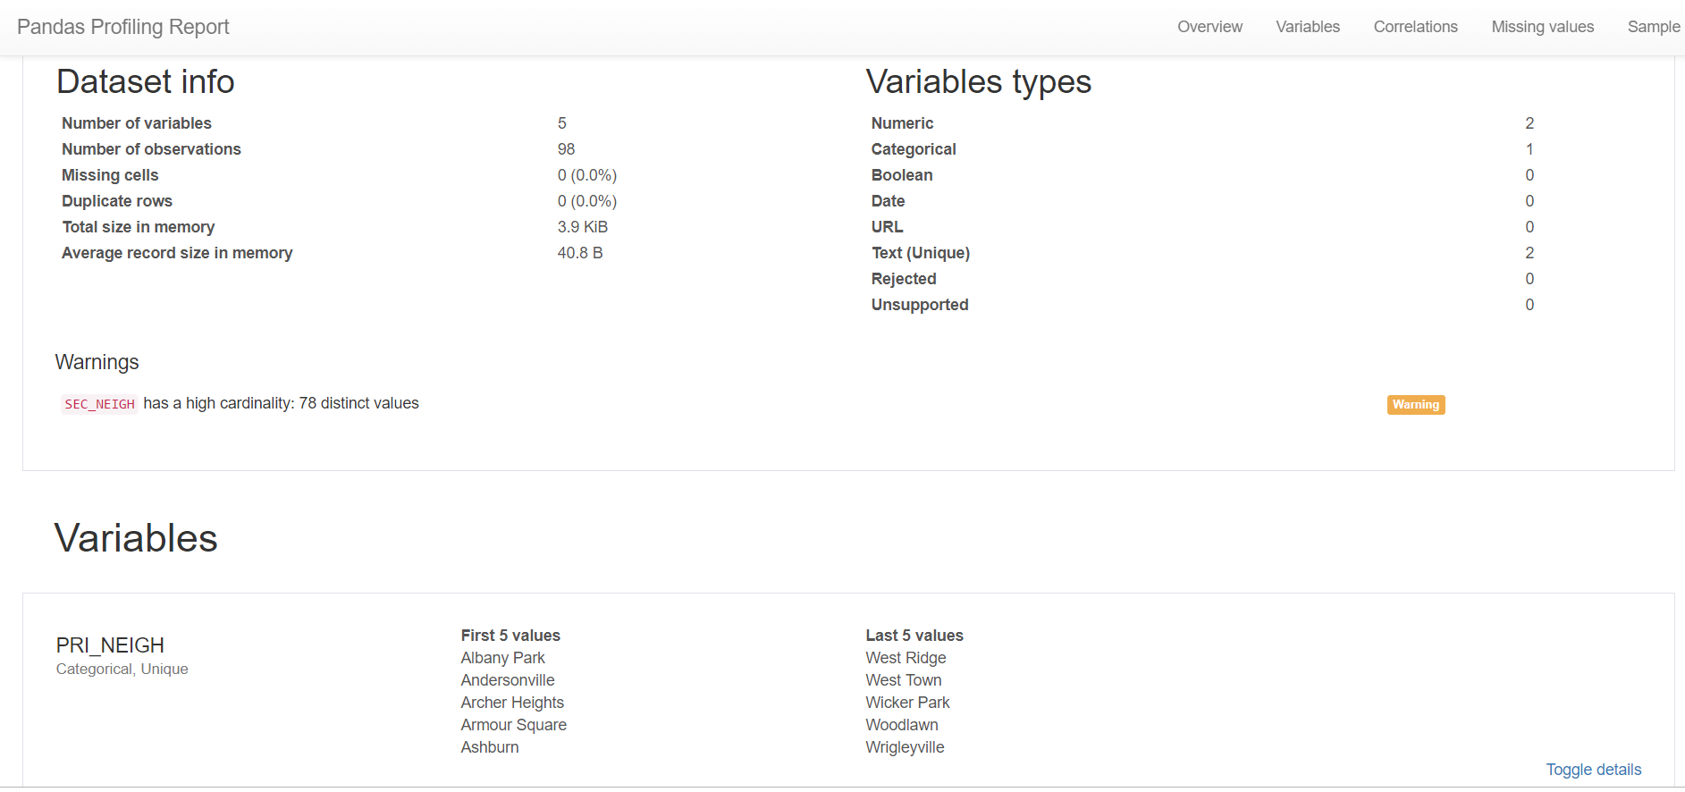

General & Geo Data Frames
Pull geo data
Read all data files into data frames
Pandas profiling
Renamed data fields
Merged data frames
Created additional variables

Slide 8
Geographic Data
Pull geo data
Geojson – coordinate data
Primary package – Geopandas
Data Wrangling and merging

Slide 9
Data Analysis

Slide 10
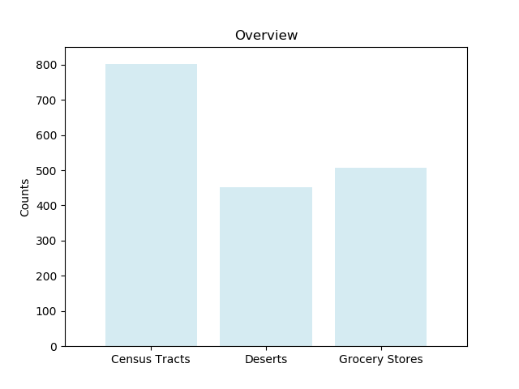
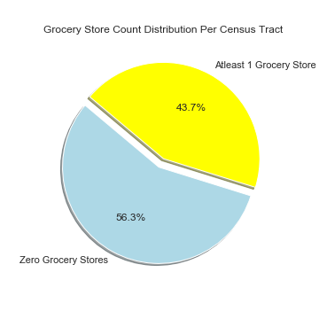
Food Deserts
801
506
451
Notes:
There are 506 grocery stores in Chicago – 2019
Of the 801 census tracts, 451 or 56% are food deserts based on the definition of this project

Slide 11
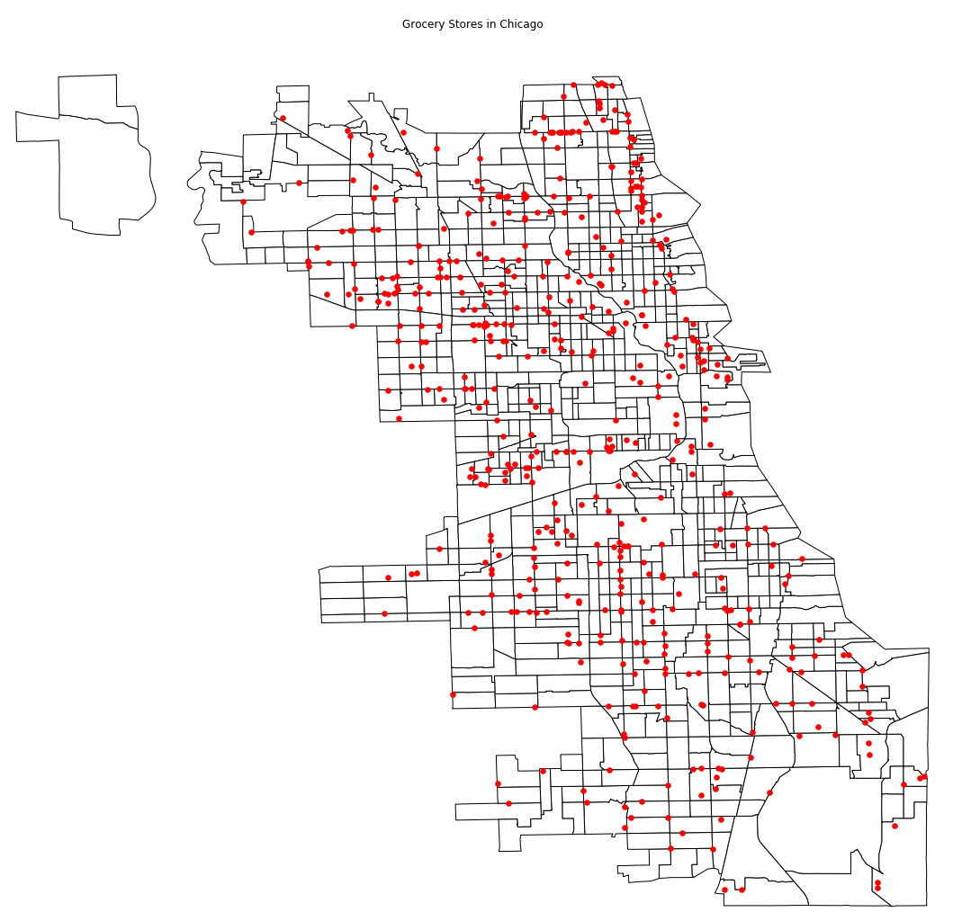
Food Deserts – Grocery Stores

Slide 12
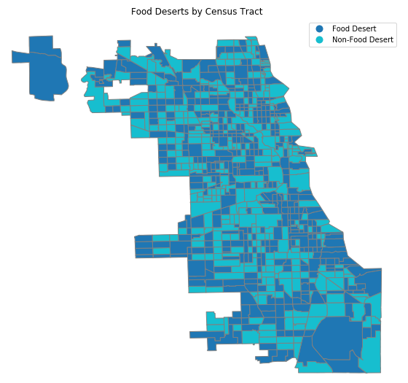
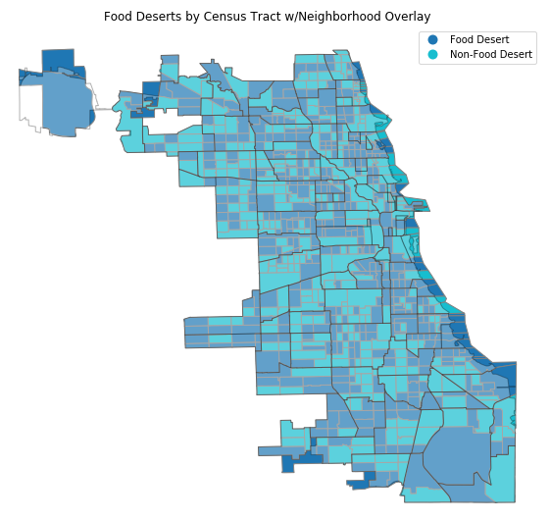
Food Deserts – Geo
Food Deserts – Census Tract
Neighborhoods Overlay
Notes:
Census tracts – 801
Food Deserts – 691
Neighborhoods – 98

Slide 13
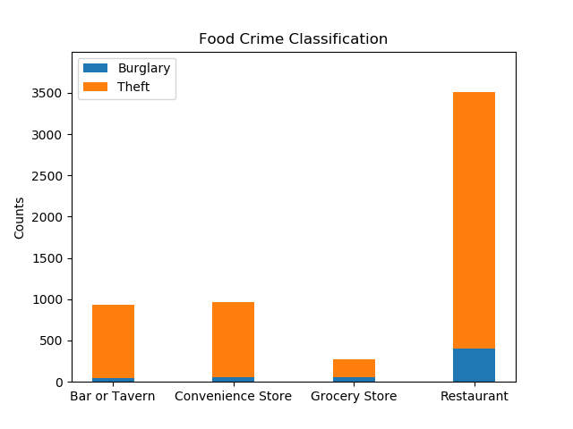
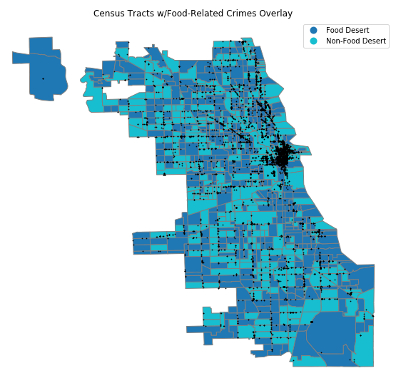
Food Related Crime
Notes:
Food related crime = burglary or theft from a Bar or Tavern, Convenience Store, Grocery Store, or Restaurant
Burglary = 558 (Bar - 43, Convenience - 57, Grocery - 52, Restaurant - 406)
Theft = 7101 (Bar - 892, Convenience - 904, Grocery - 220, Restaurant - 3102)
Bar = 935 (Burglary – 43, Theft – 892)
Convenience = 961 (Burglary – 57, Theft – 904)
Grocery = 2255 (Burglary – 52, Theft – 2203)
Restaurant = 3508 (Burglary – 406, Theft – 3102)

Slide 14
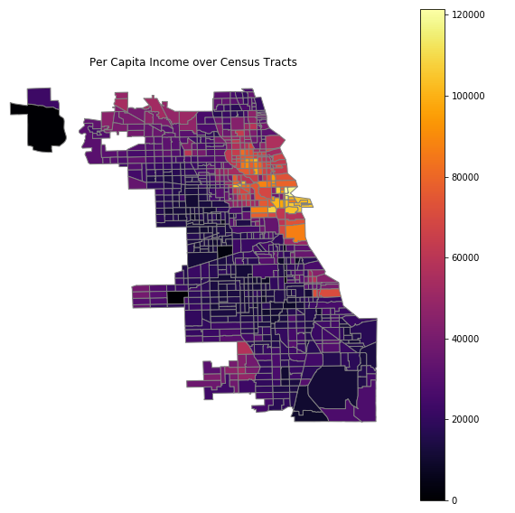
Income

Slide 15
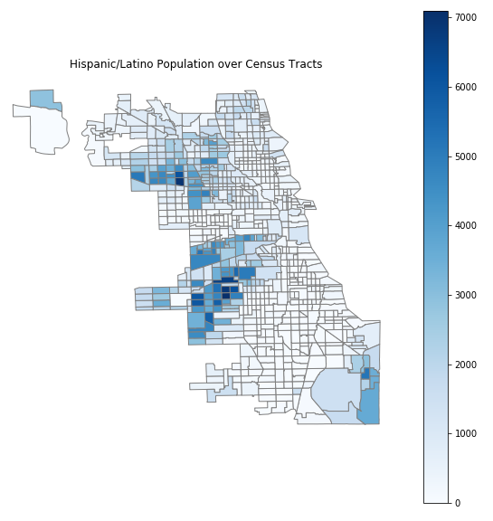
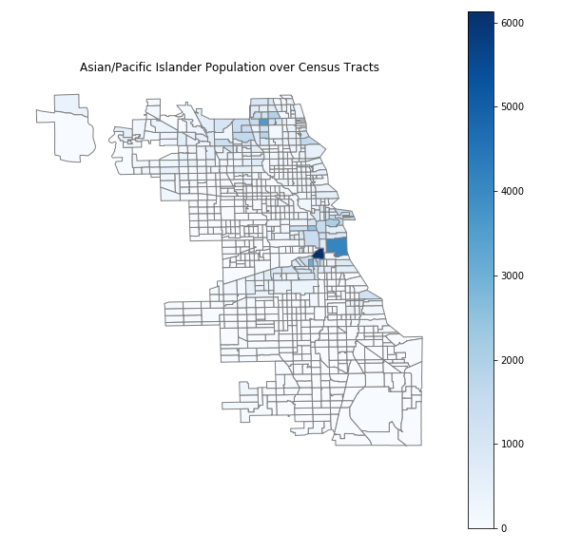
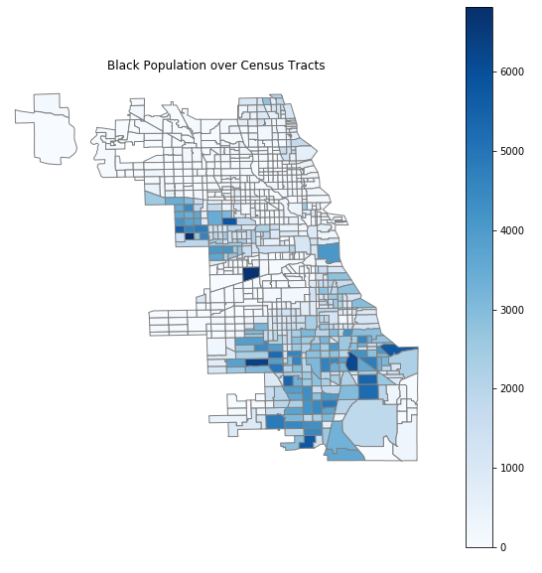
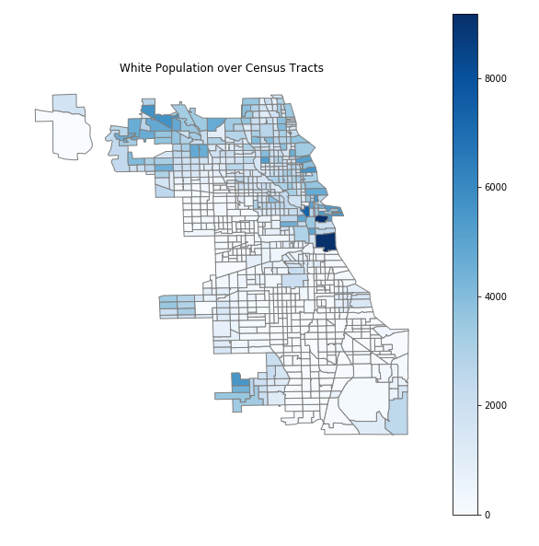
Demographics

Slide 16
Discussion

Slide 17
Questions
Do food deserts exist in Chicago?
Yes, per the definition used for this project
Where do food deserts exist in Chicago?
In 56% of the census tracts in Chicago
Is there a higher rate of food related crimes in Chicago food deserts?
No, it does not appear to have an association
Are there external indicators that connect to prevalence of food deserts (income, demographics)?
No, based on our definition we did not observe this.

Slide 18
Challenges
Simplistic definition due to time constraints
Mapping
Level of analysis

Slide 19
Future Work
Develop a more sophisticated definition of food deserts – consider additional factors, proximity measures, use more statistical measures
Leverage Google Places API to identify Farmers’ Markets
Map Produce Cart Locations
Map Fast Food Establishments
Notes:
Produce Cart - Neighbor Capital is a social enterprise that runs a produce cart program that employs difficult to employ people who manage and operate a cart on a public sidewalk or private plaza across the city. The City of Chicago legalized this business model in 2012 with the requirement that half be set up in low-food access areas. Each cart carries a full line of fresh locally grown produce on an 8 feet by 6 foot stand generally between early morning and early evening hours.

Slide 21
Datasets Source
Census Tract Data
https://factfinder.census.gov/faces/nav/jsf/pages/index.xhtml
Chicago Neighborhoods
https://data.cityofchicago.org/
Chicago Grocery Stores
https://data.cityofchicago.org/Community-Economic-Development/Grocery-Stores-2013/53t8-wyrc
Chicago Crime Data
https://data.cityofchicago.org/Public-Safety/Crimes-2018/3i3m-jwuy
Chicago Public Health Indicators by Community
https://data.cityofchicago.org/Health-Human-Services/Public-Health-Statistics-Selected-public-health-in/iqnk-2tcu

