Slide 1

STAGE - II

Slide 2
Summary
01
Startup name
07
Market Size
02
One line about Idea
08
Product UVP
03
Problem Statement
09
Business Model
Market Research
Competitor Analysis
04
10
05
Customer
11
Road Map
06
Proposed Solution
12
Funding
13
Team Infomation

Slide 3
STARTUP NAME
SMART URBAN LIGHTING INFRASTRUCTURE MANAGEMENT SYSTEM
Tag : Bright City Be Safety

Slide 4
Briefly describe your idea
Our project aims to enhance urban street lighting infrastructure by creating an automated system that detects faults in real time, accurately tracks their locations, and facilitates efficient maintenance. Each street light will be equipped with sensors to monitor parameters such as light intensity, power consumption, voltage fluctuations, and motion detection. This data will be collected and processed using IoT technologies to identify any anomalies. GPS technology will pinpoint the exact location of faults, enabling quick response. Automated alerts will notify relevant stakeholders, including the police and Tamil Nadu Electricity Board (TNEB), via SMS, email, or emergency alerts, thereby improving safety, security, and power management in urban areas.

Slide 5
Problem statement
How might we develop an automated system that enables real-time detection of street light faults, precise location tracking, and efficient maintenance in urban areas to significantly enhance the management and functionality of city lighting infrastructure?

Slide 6
Market Research
Traditional street lighting systems often rely on manual inspections, which lead to delayed fault detection and increased maintenance costs. Additionally, inefficiencies in energy use result in higher operational expenses

Slide 7
Customer
City Governments
Municipal Lighting Authorities
Public Safety Departments
Utility Companies

Slide 8
Our solution is an automated system for managing street lights more effectively. Each light is equipped with sensors to track its performance, such as light levels and power usage. This data is sent to a central system that detects any issues in real-time. GPS technology helps locate any problems precisely, allowing maintenance teams to be dispatched quickly. Automated alerts are sent to relevant authorities via SMS or email, ensuring prompt action. This system reduces the need for manual checks, cuts down on maintenance costs, and makes urban lighting more reliable and efficient.
Proposed Solution

Slide 9
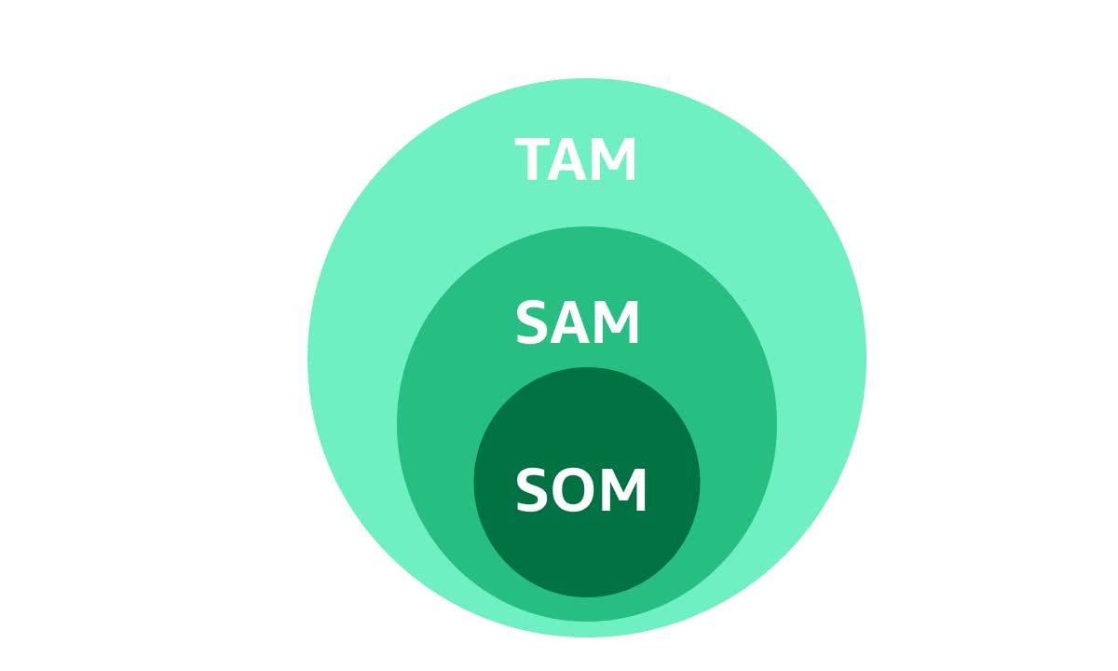
Market Size
Smart Lighting Market: The global smart lighting market, which includes smart street lighting, is projected to grow significantly. According to market reports, it is expected to reach billions of dollars by the mid-2020s, driven by technological advancements and increasing urbanization.
Government Initiatives: Many governments are investing in smart city initiatives, including advanced street lighting systems, to improve urban infrastructure and sustainability.

Slide 10
Product UVP
Increased efficiency
Reduced maintenance costs
improved urban safety

Slide 11
Business Model
Problem:
Delayed Fault Detection
High Maintenance Costs
Inefficient Energy Use
Solution:
Real-Time Fault Detection
Precise Location Tracking
Automated Alerts
Unique Value Proposition:
Our system provides an integrated solution with real-time fault detection, precise location tracking, and automated alerts, delivering superior efficiency, cost savings, and reliability for urban street lighting management.
Customer Segments:
Municipal Authorities
Urban Planning and Development Agencies
Public Safety Departments
Utility Companies
Private organizations
Key Metrics:
Fault Detection Time
Maintenance Response Time
Cost Savings
Energy Efficiency Improvement
System Uptime
Alert Accuracy Rate
Channels:
Path to Customers:
Direct sales to municipal corporations and utility companies.
Partnerships with IoT and smart city solution providers.
Exhibitions and conferences on urban infrastructure and smart city technologies.
Unfair Advantage:
Our system’s combination of real-time fault detection, precise GPS-based location tracking, and automated alerting provides a unique, integrated solution that is difficult for competitors to replicate or match.

Slide 12
Business Model
Cost Structure:
Customer Acquisition Costs: Expenses for marketing and sales efforts to acquire new customers.
Hosting: Costs for maintaining cloud services or server infrastructure to support the system.
Distribution Costs: Costs related to deploying and installing the system in urban areas.
People: Salaries and wages for staff involved in development, support, and maintenance
Revenue Streams:
Revenue Model: Income generated from sales of the system, including hardware, software licenses, and ongoing service agreements.
Life Time Value: The projected revenue from each customer over the duration of their relationship with the company
.
Revenue Gross Margin: The difference between the cost of goods sold and revenue, indicating profitability.

Slide 13
Competitor Analysis
Existing solutions in the market offer features like remote monitoring and energy management. However, our system's emphasis on real-time fault detection, precise location tracking, and automated alerts provides a distinct advantage over some of these solutions.

Slide 14
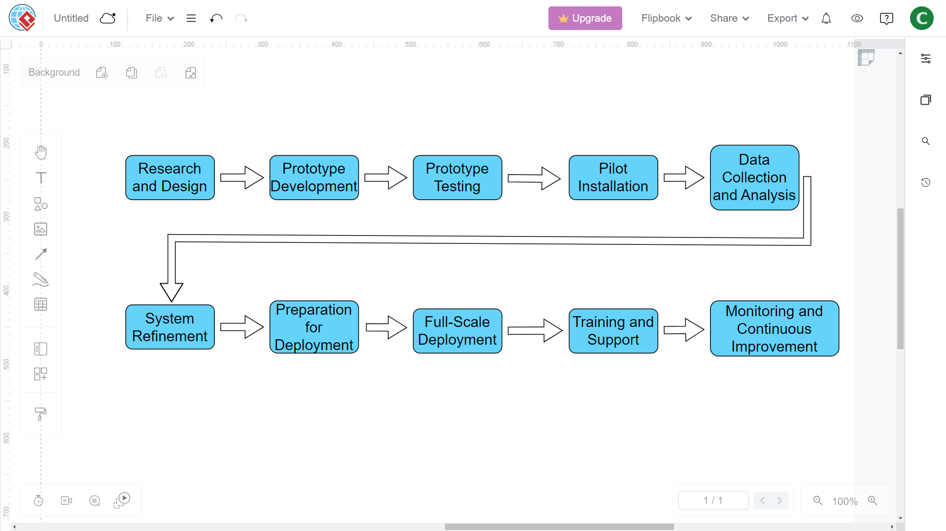
Road Map

Slide 15
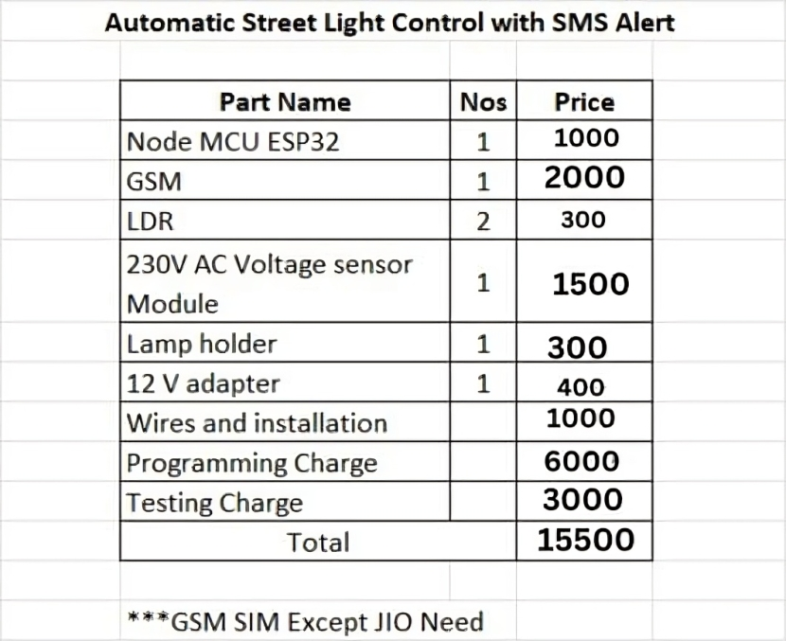
Funding
OUR PROTOTYPE:
The total funding of ₹15,00,000 will enable the development, marketing, and scaling of the Smart Urban Lighting Infrastructure Management System, ensuring its successful implementation and operational efficiency

Slide 16
Team Info
Name of Individuals
M.CHELLAPANDI
chellapandi24680@gmail.com
Email
https://www.linkedin.com/in/chellapandi-m-52b774292/
Social Media
6381117405
Call us
One minute pitching video link:
https://drive.google.com/file/d/1agjcHUiXSZXWDPnulb6vgucEO48zgXzK/view?usp=drive_link

Slide 17
Team Info
Name of Individuals
A.MUGILAN
mugilanmass413@gmail.com
Email
https://www.linkedin.com/in/mugilan-a-427735304?utm_source=share&utm_campaign=share_via&utm_content=profile&utm_medium=android_app
Social Media
7826987567
Call us
One minute pitching video link:
https://drive.google.com/file/d/1agjcHUiXSZXWDPnulb6vgucEO48zgXzK/view?usp=drive_link

Slide 18
Team Info
Name of Individuals
R.PRADEEP BALA
balap1674@gmail.com
Email
https://www.linkedin.com/in/pradeepbala-r-0825b8304?utm_source=share&utm_campaign=share_via&utm_content=profile&utm_medium=android_app
Social Media
7305402965
Call us
One minute pitching video link:
https://drive.google.com/file/d/1agjcHUiXSZXWDPnulb6vgucEO48zgXzK/view?usp=drive_link

Slide 19
pitching video.mp4
Team Info
Name of Individuals
A.MOHAMED AADIL
mohamedaadil930@gmail
Email
www.linkedin.com/in/mohamed-aadil-a-46b1a42b0
Social Media
7904259279
Call us
One minute pitching video link:
https://drive.google.com/file/d/1agjcHUiXSZXWDPnulb6vgucEO48zgXzK/view?usp=drive_link

Slide 20
Team Info
Name of Individuals
S.SAMSUDEEN
deen38813@gmail.com
Email
https://www.linkedin.com/in/samsudeen-s-478891304?utm_source=share&utm_campaign=share_via&utm_content=profile&utm_medium=android_app
Social Media
9159465163
Call us
One minute pitching video link:
https://drive.google.com/file/d/1agjcHUiXSZXWDPnulb6vgucEO48zgXzK/view?usp=drive_link

Slide 21
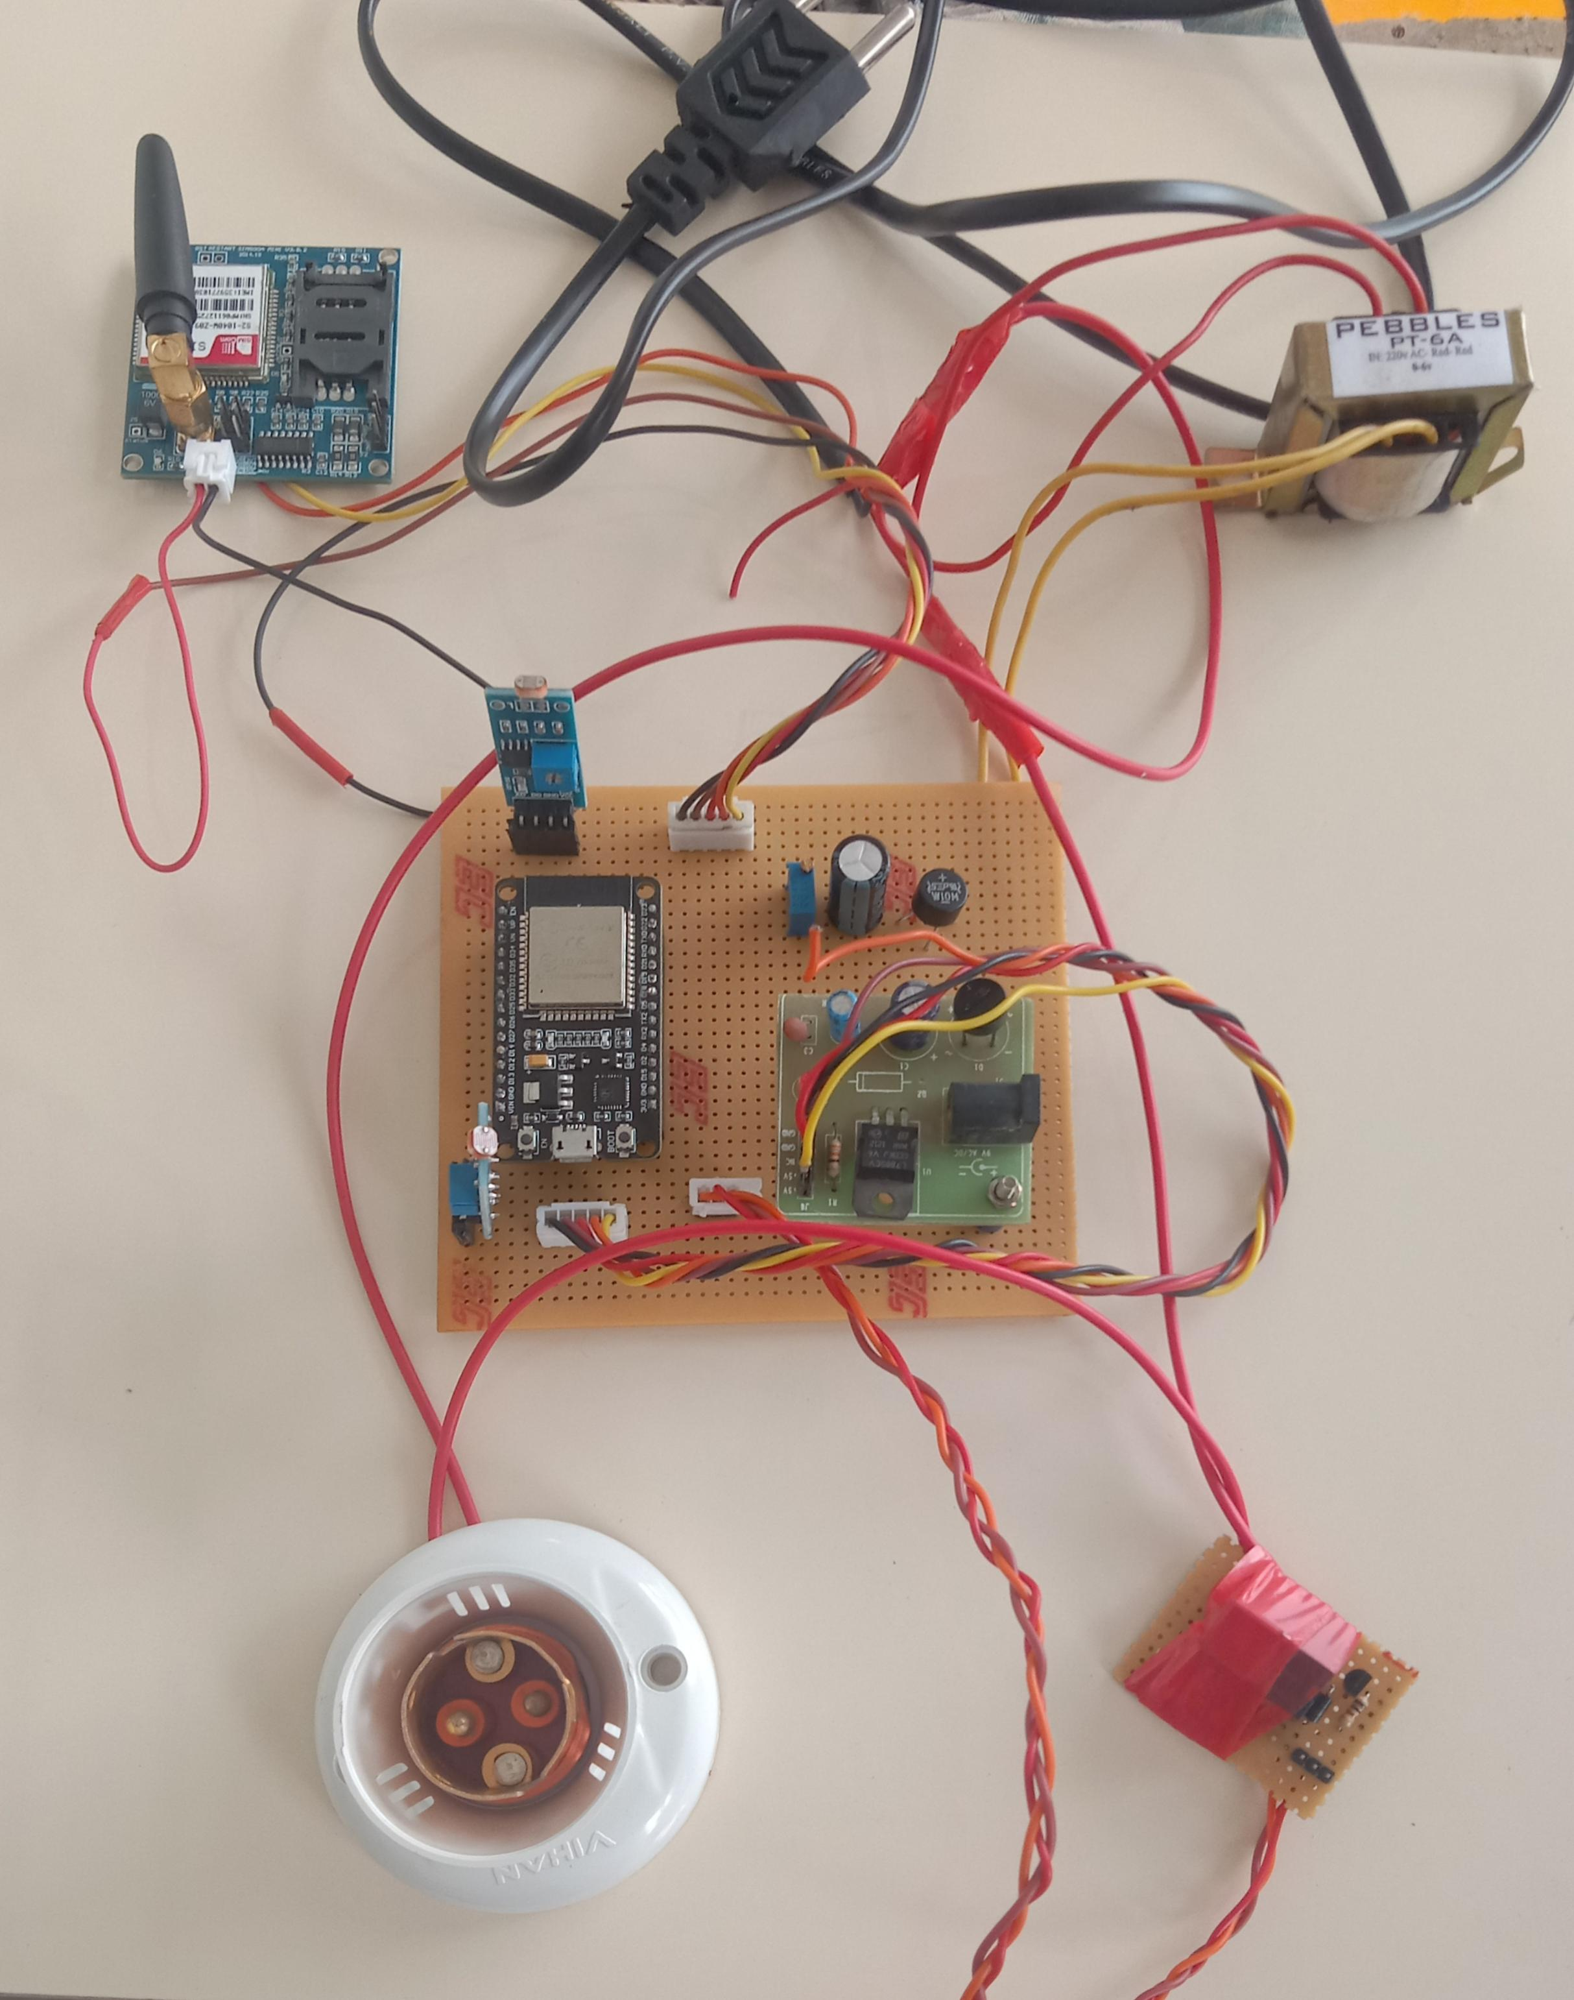
DEMO VIDEO
OUR PROTOTYPE
https://drive.google.com/file/d/13o5UScsnBH9HTplfYqIYgY7wSbx0tMKQ/view?usp=drivesdk

