Slide 1
Classifying Emails as Spam or No Spam
By: Michelle Sickels
School: Entity Academy

Slide 2
Michelle Sickels
38 year old female
Mother of three boys
Paralegal Diploma
Associate and Bachelors in Criminal Justice
Currently employed with trucking company, in Human Resources and Safety Department

Slide 3

Significance of Study
Informs people how emails are classified
Classifies emails as they are sent to people
Helps to receive only important or wanted emails
Keeps your email inbox clear of junk emails

Slide 4
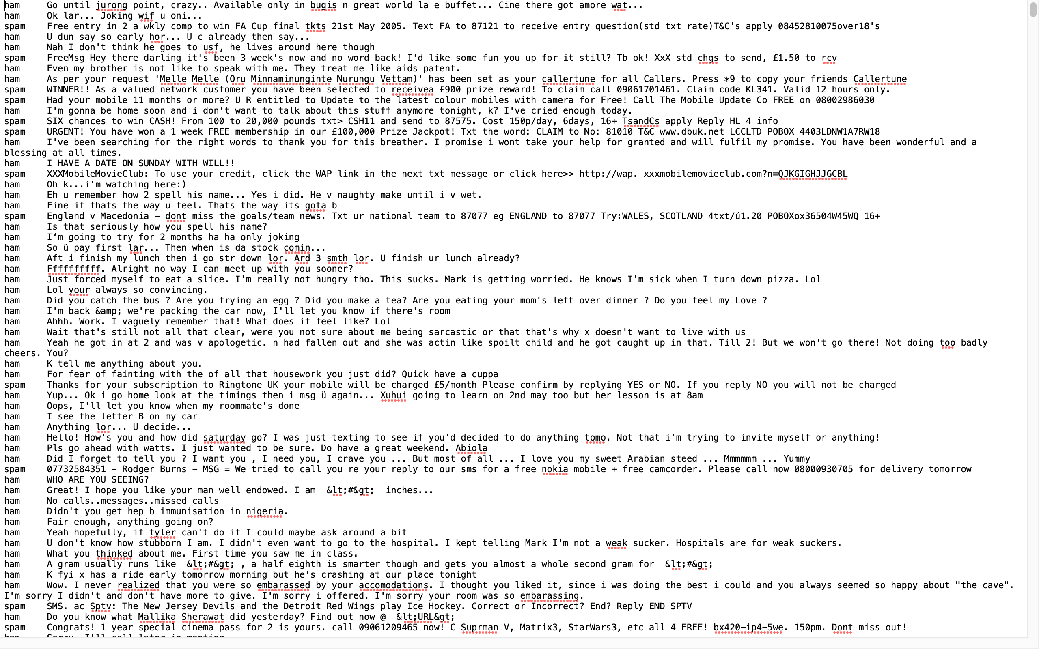
Data

Slide 5
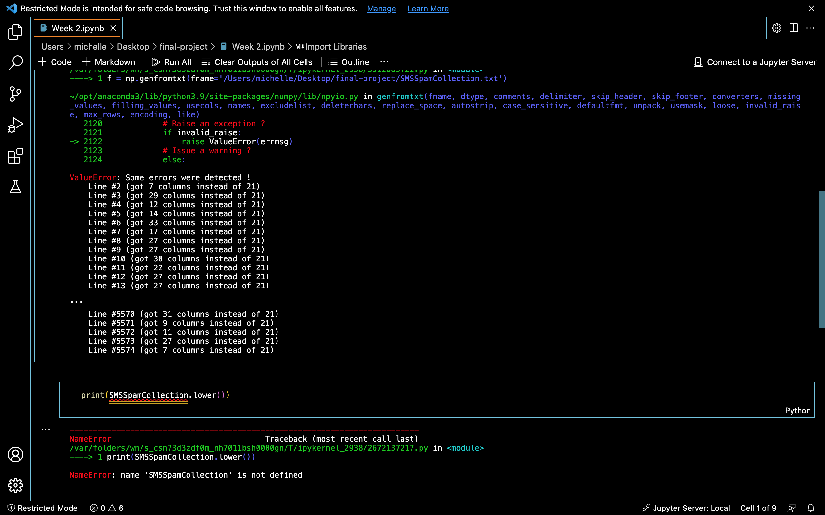
Data Wrangling

Slide 6
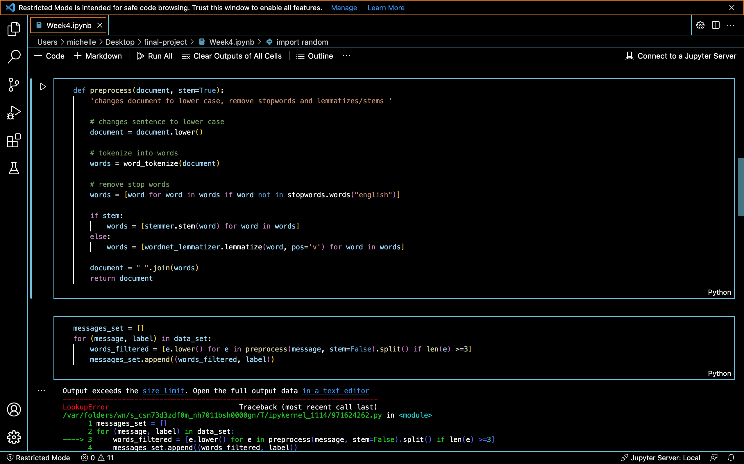
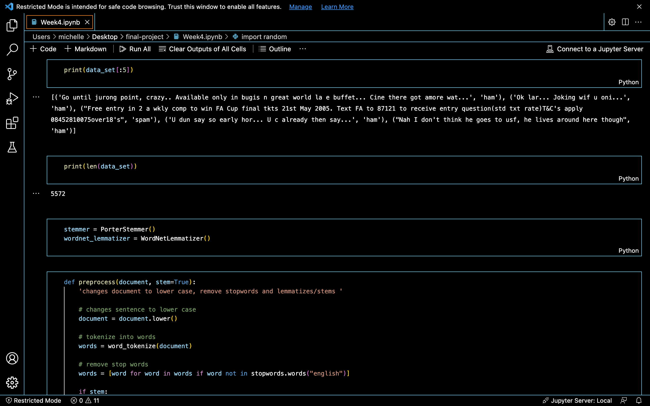
Exploratory Analysis

Slide 7
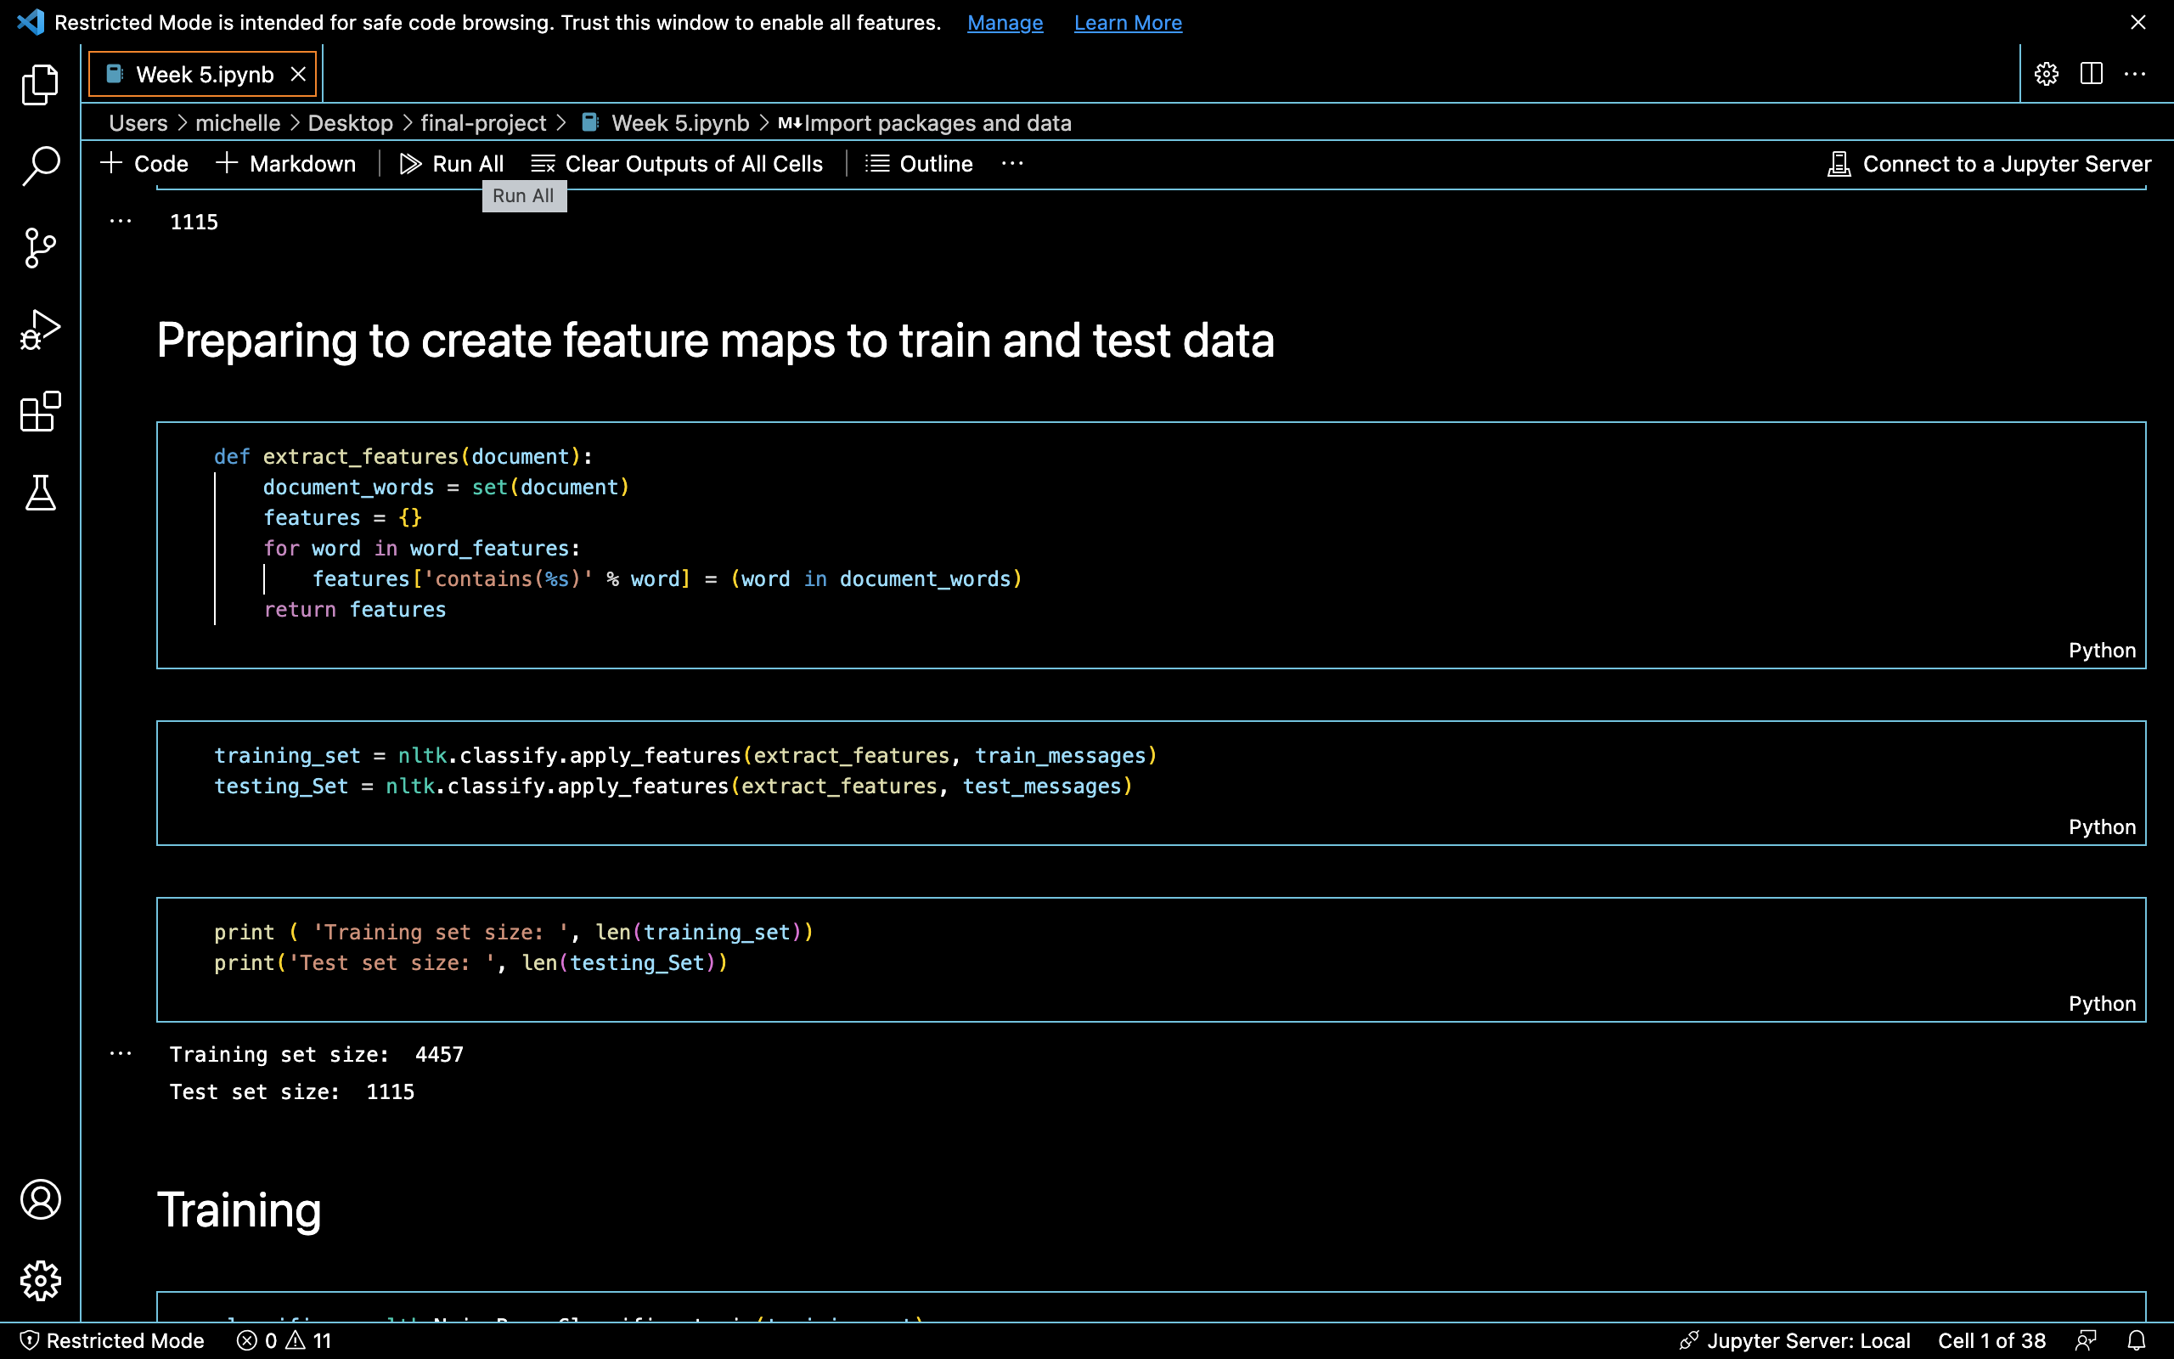
Analyze Data

Slide 8
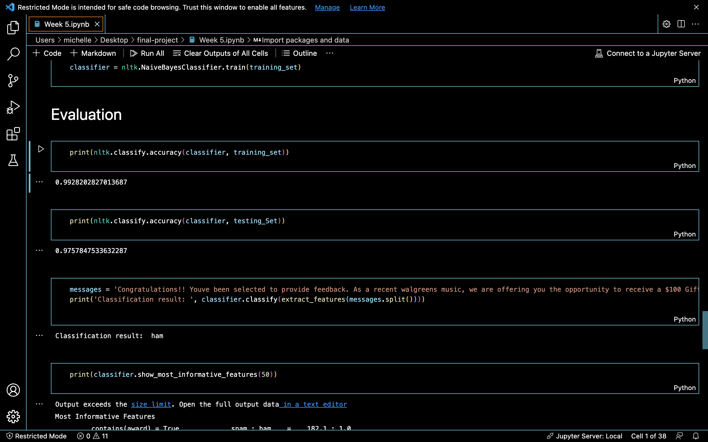
Data Visualization and Reporting

Slide 9
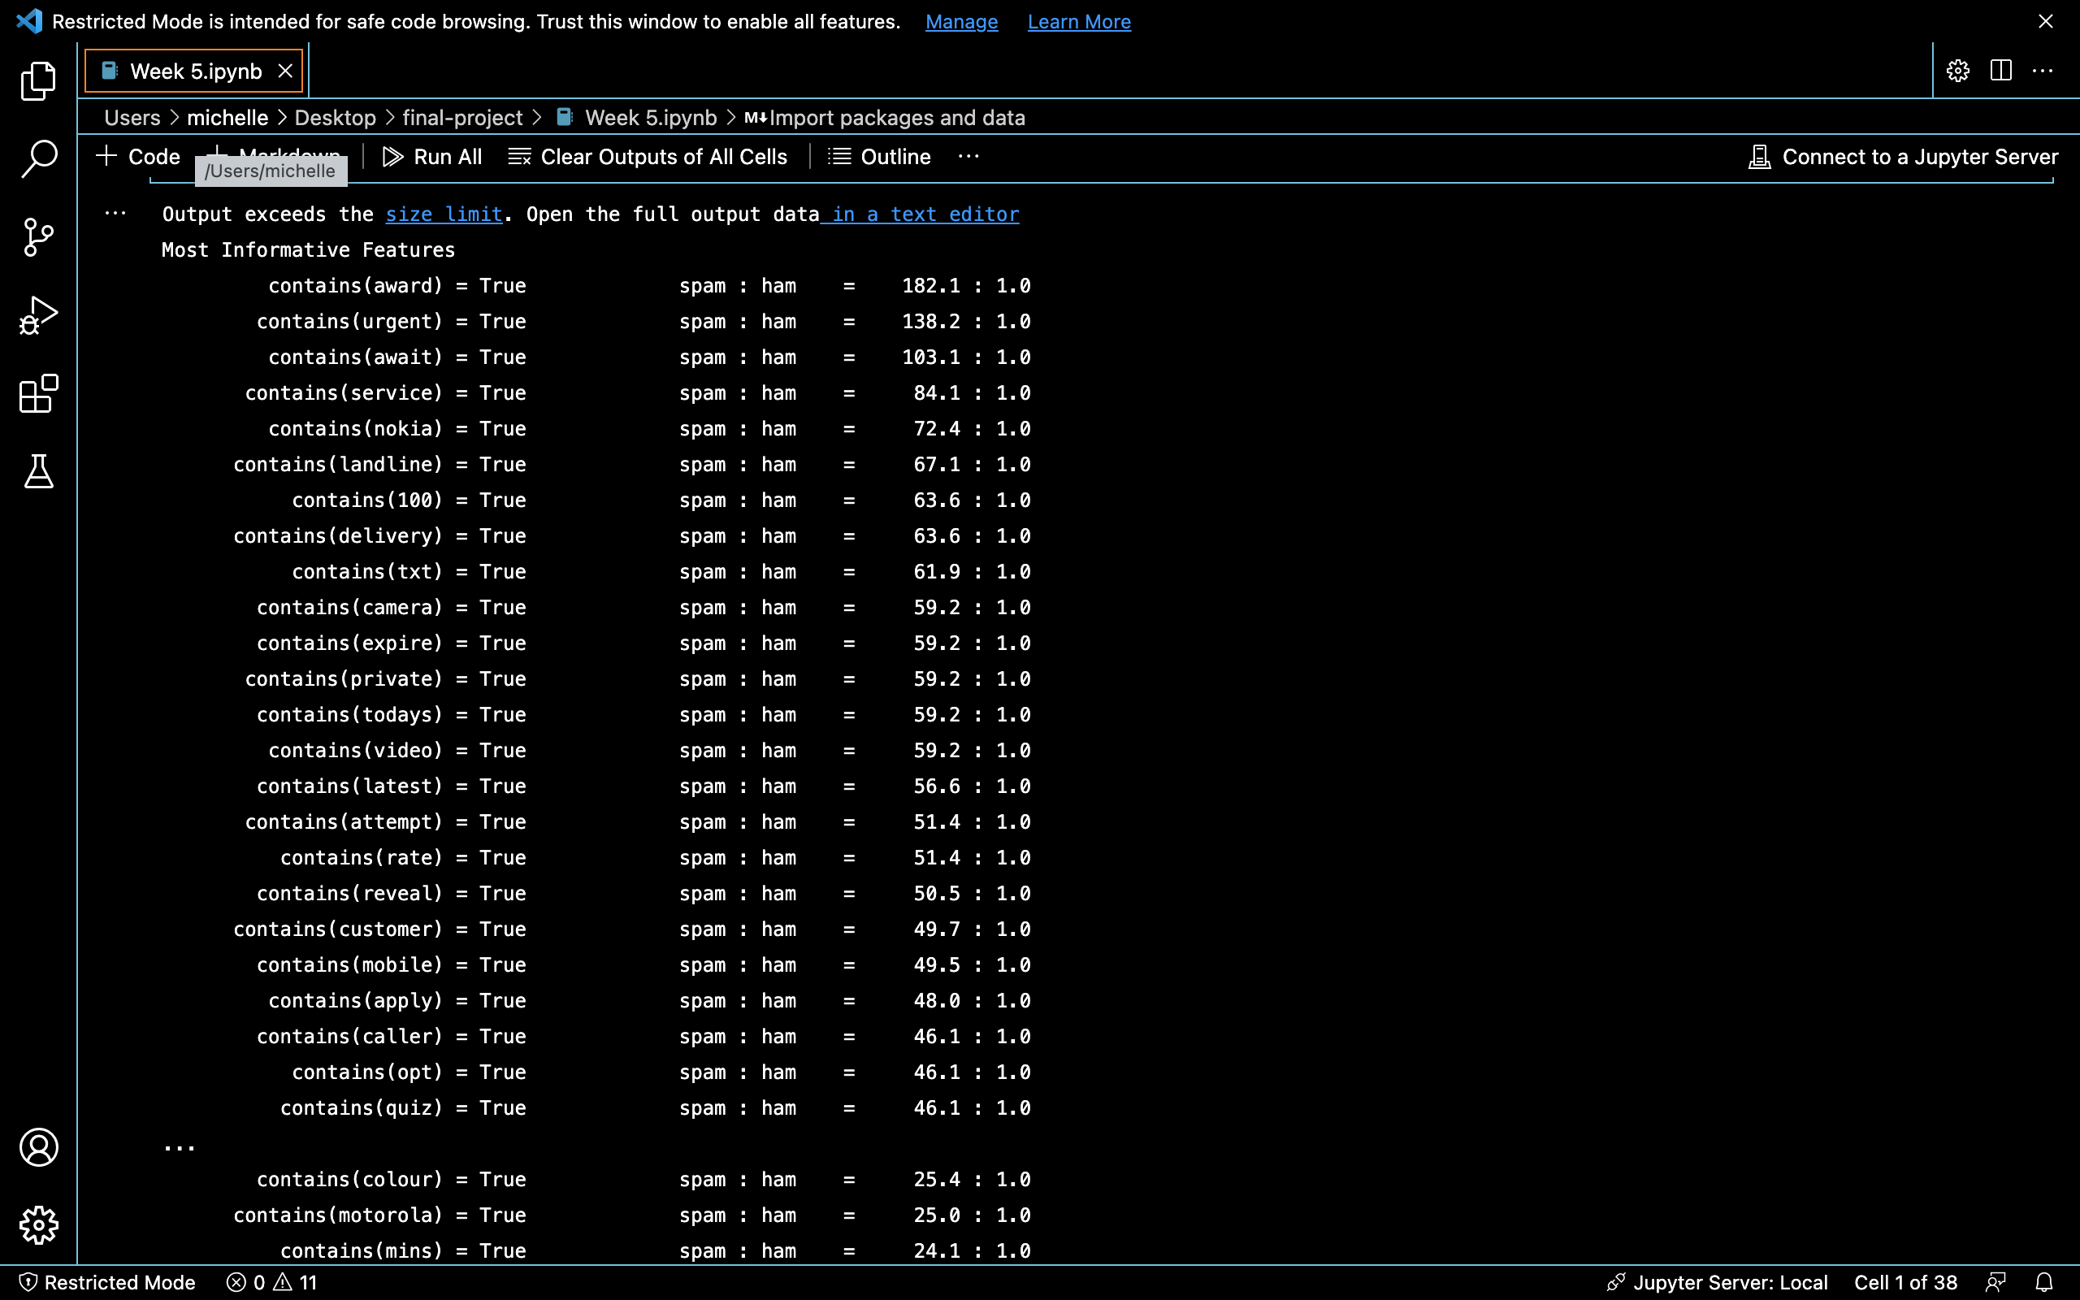
Final Result

Slide 10
Final Thoughts
Limitations
Does not catch all emails
Future Recommendations
Keep updating code

Slide 11
Questions

