Slide 1



Slide 2






Programs/Languages Used

Slide 3
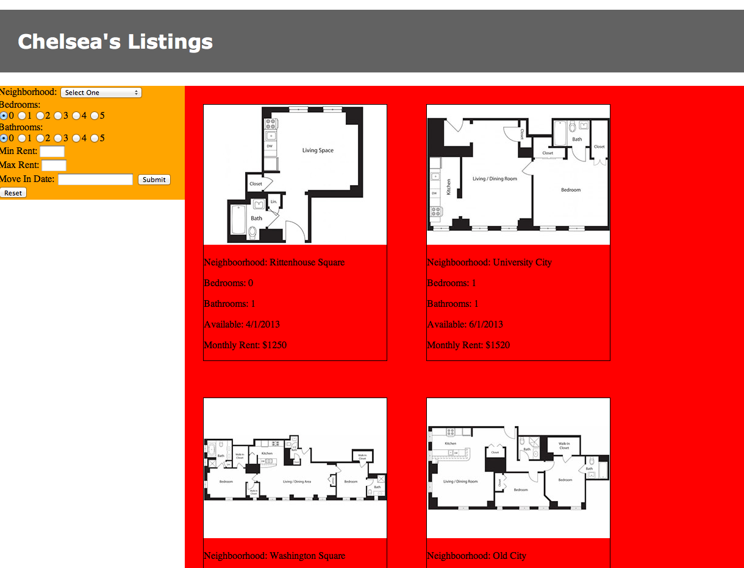

Slide 4
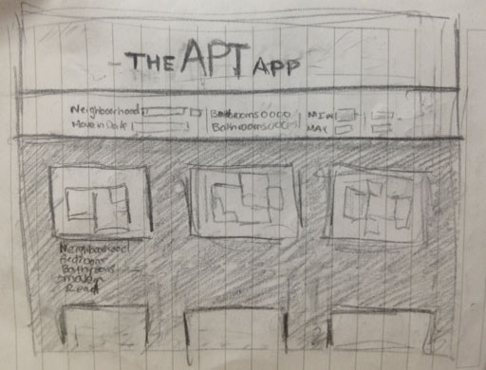
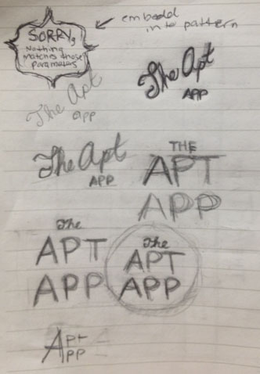




Slide 5
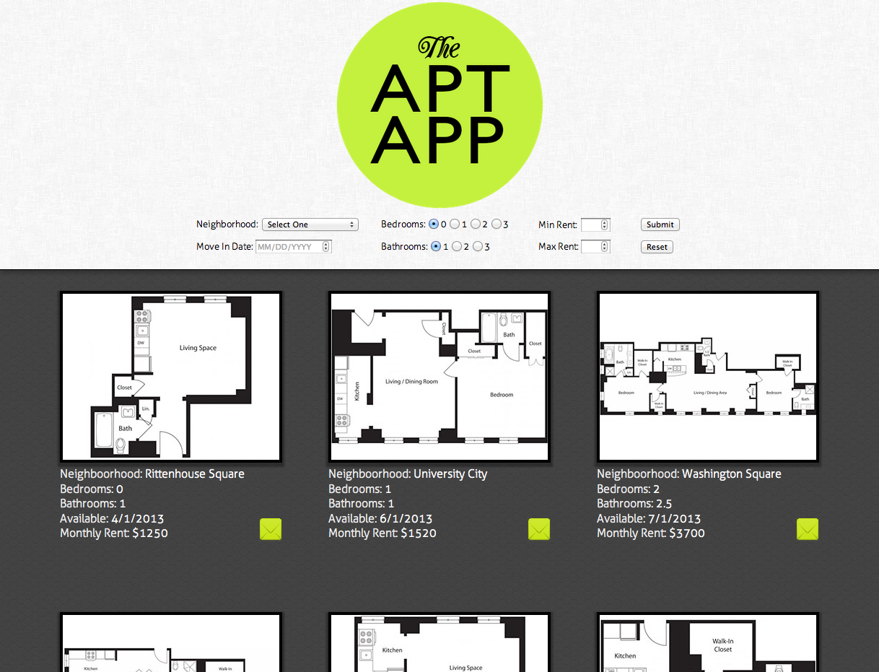

Slide 6

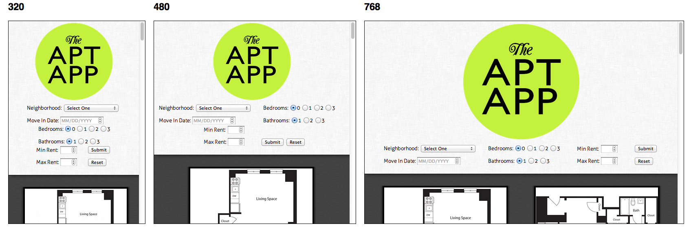
also: input types for mobile ease, mailto: subject lines for contact ease, failed search display

Slide 7
www.chelmyers.com/js

