Slide 1
PHONE GUARDIAN
Dangerous events reporting application for Android platform
Nemanja Stolic 814842
Mirjam Skarica 836505
Milica Jovanovic 835953

Slide 2
Objectives
The system have the following functionalities:
Reporting of dangerous situations by users
View events on map
Add comment on event
View comments of event
Filtering reported events based on various criteria
Detailed view of each reported event
Notify authorities about reported events
Take job to solve event
Review a job
Notes:
Add commenview events on mapts add review

Slide 3
Target group
This application will have two types of users:
Regular citizen
Authority representative (policeman, fireman, medic staff)
For each of the user groups we will develop a separate application which will communicate through our server implemented in PHP.

Slide 4
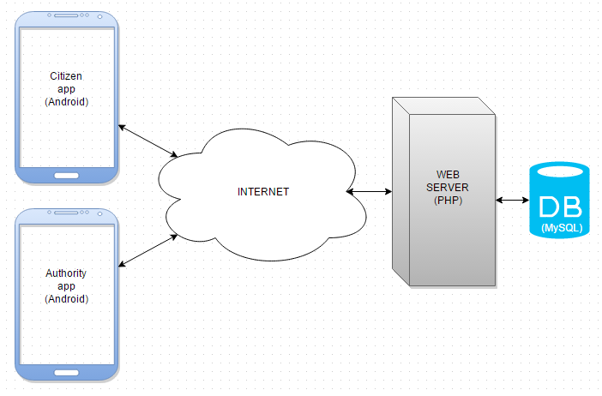
System architecture
Notes:
PhoneGuardian is a software system that consists of three parts.
Main purpose of the system is giving real-time information about events that happened.
Information about reported events can be seen either from CitizenApp or from AuthorityApp (authority staff i.e. policeman, fireman or medical staff on the field).
CitizenApp is an Android application used for reporting emergency events or searching among reported events by applying a filter. Main purpose of the application is to offer insight to dangerous zones of cities. User can also follow reported event and current development of the situation through comments posted by other users.
AuthorityApp is an Android application used for receiving reports about events that happened i.e. the application works in real-time. The user of the application (usually authority staff) can accept a job they want to deal with and after checking situation they can write a review about it and notify other users.
WebServer is a medium that connects CitizenApp and AuthorityApp. The server deals with data transfer and connects the applications to the database.

Slide 5
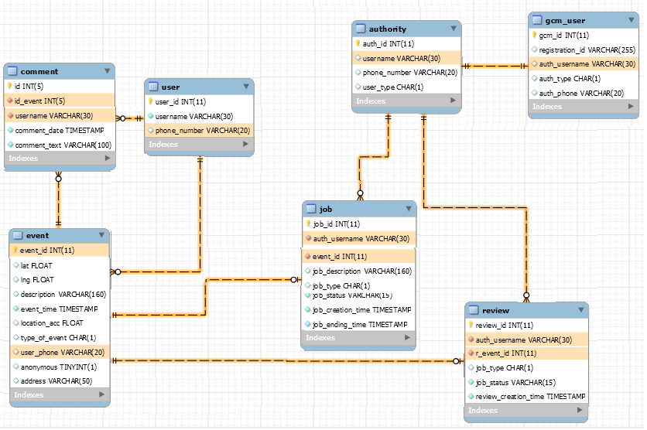

Database (MySQL)

Slide 6
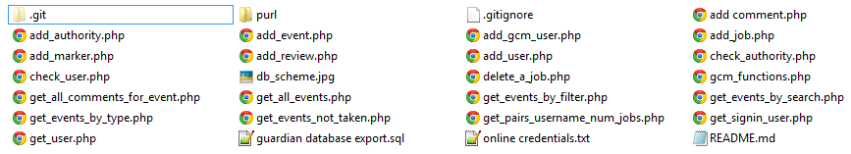
Web Server (PHP)

Slide 7
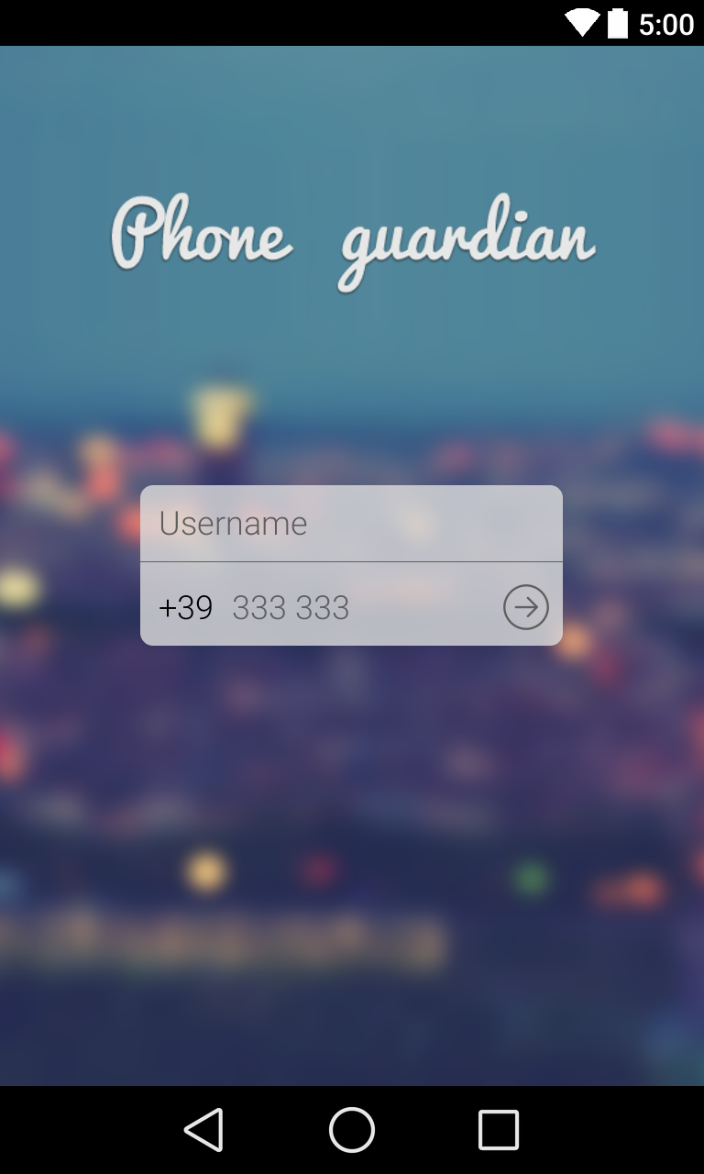
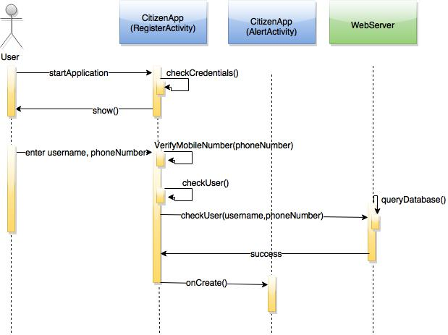
CitizenApp - Registration

Slide 8
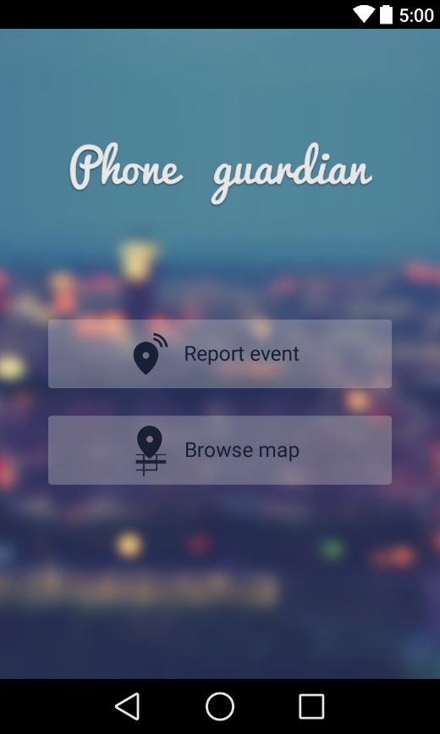
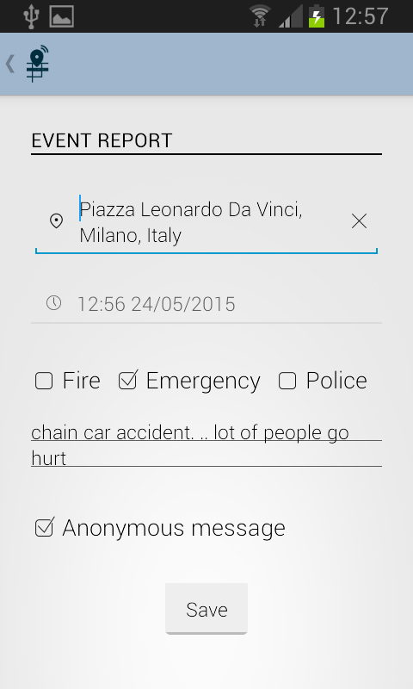
CitizenApp – Report event

Slide 9
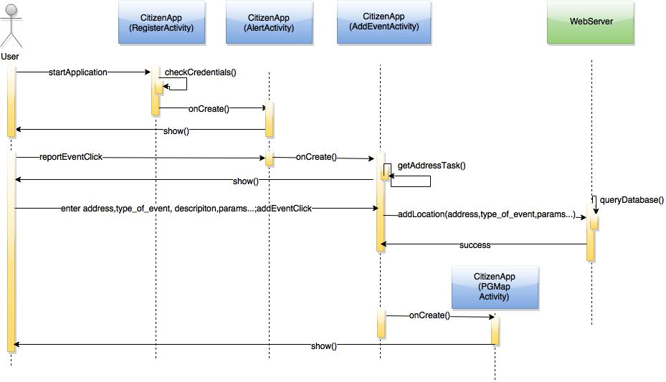
CitizenApp – Report event

Slide 10
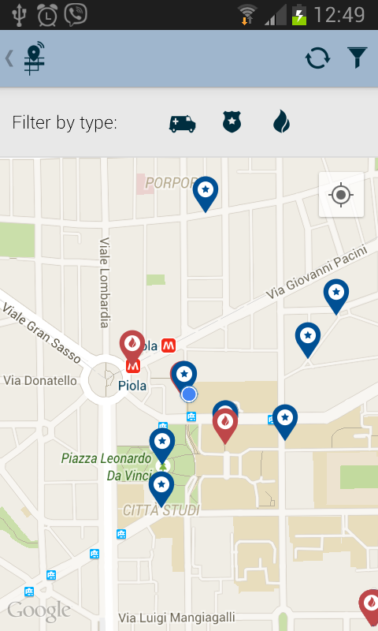
CitizenApp – View events nearby

Slide 11
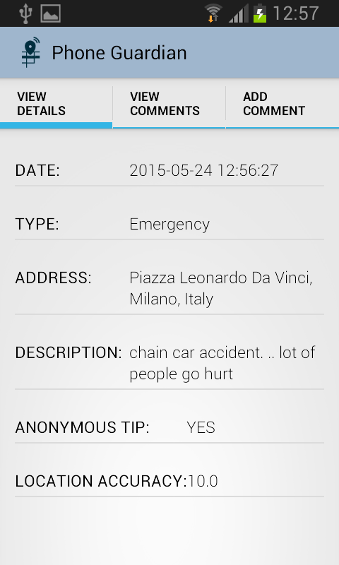
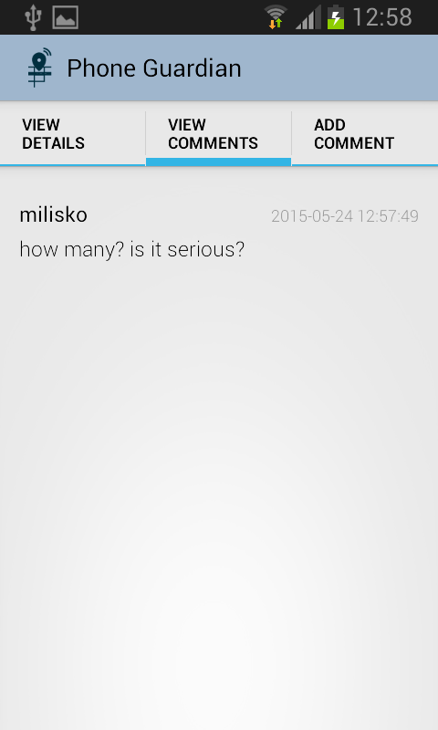
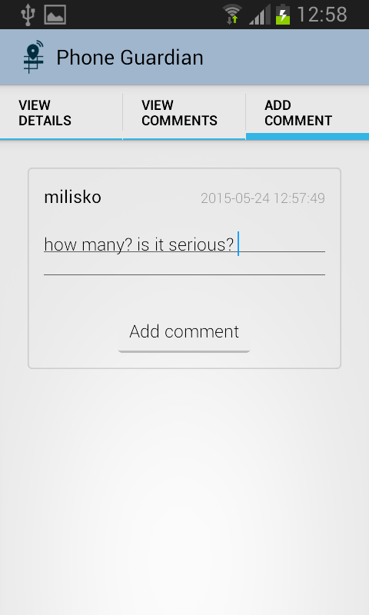
CitizenApp – Event details

Slide 12
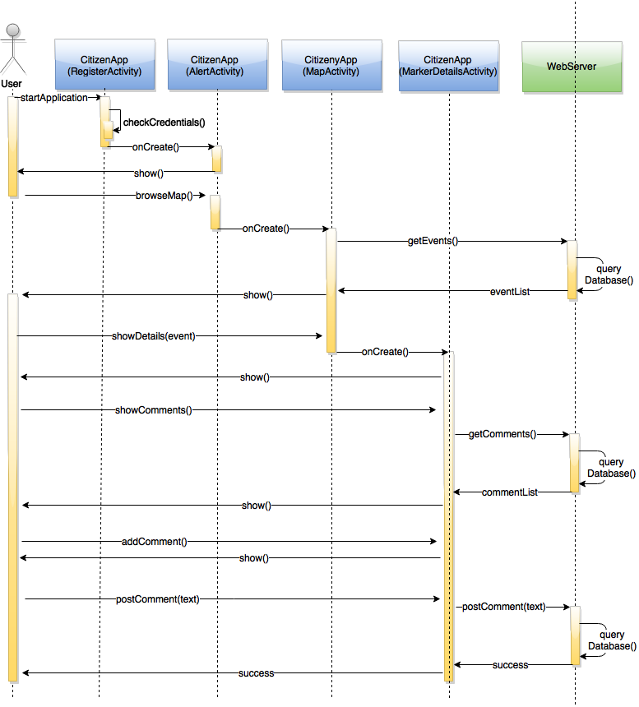
CitizenApp – View Details, View/Add Comment(s)

Slide 13
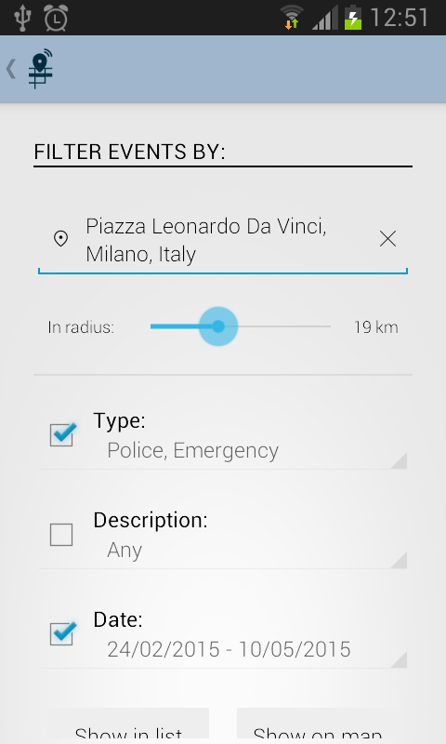
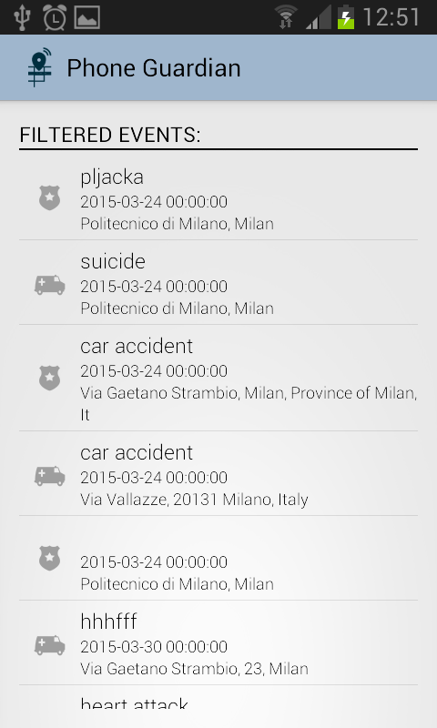
CitizenApp – Filter events, list of filtered events

Slide 14
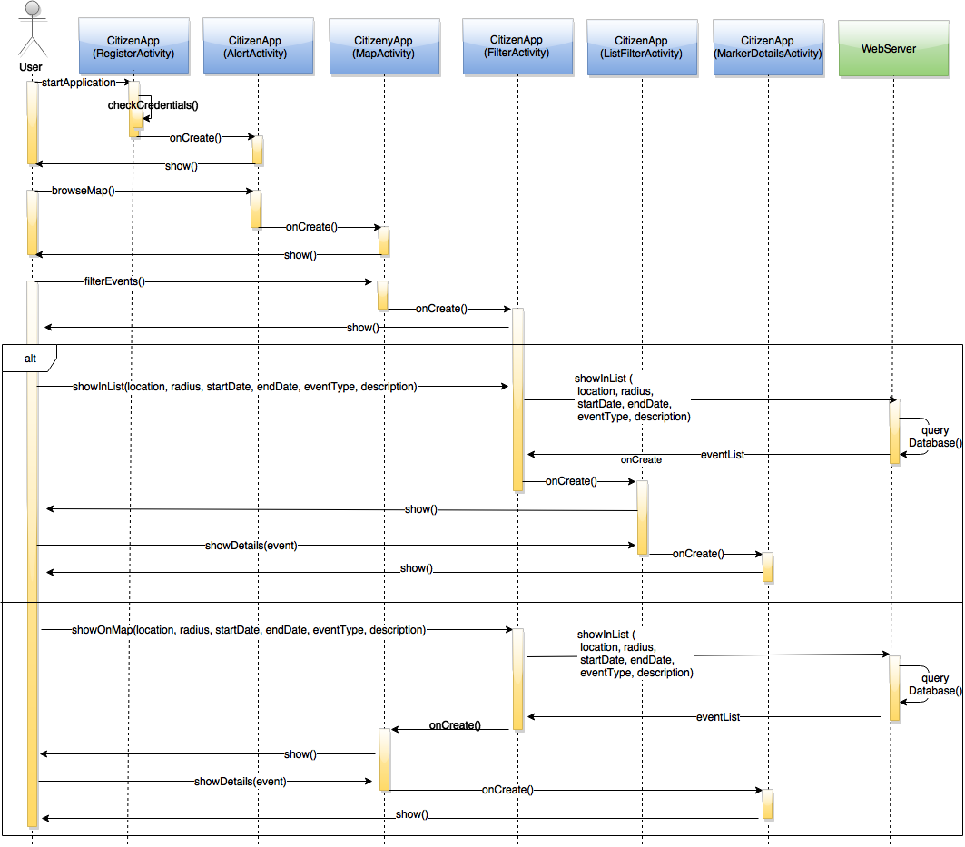
CitizenApp – Filter events, list of filtered events

Slide 15
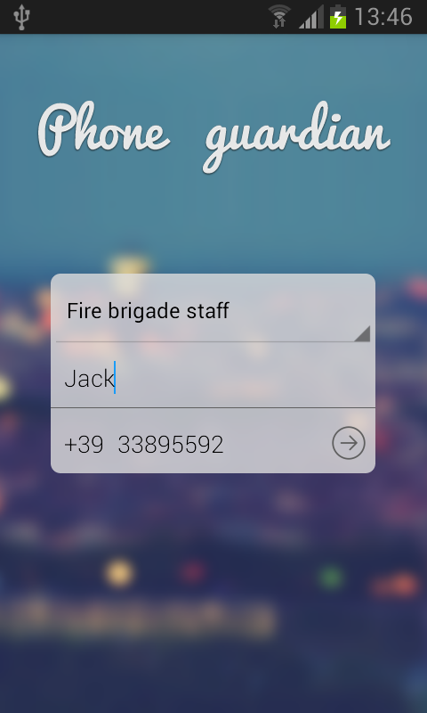
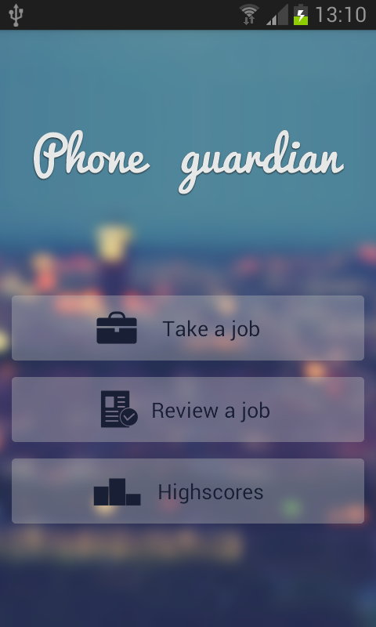
AuthorityApp - Registration
Notes:
Police staff, Fire brigade staff, Medic staff
User of this application will receive a call to verify that he is really an owner of the number specified.

Slide 16
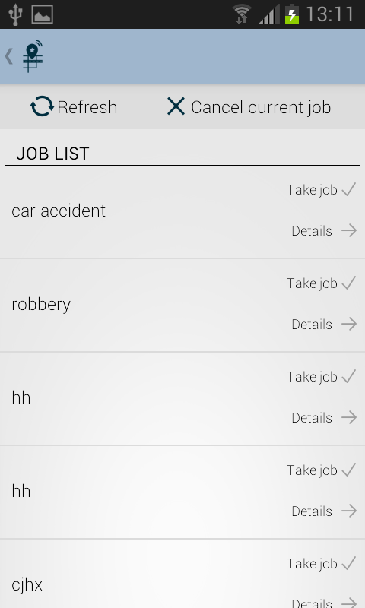
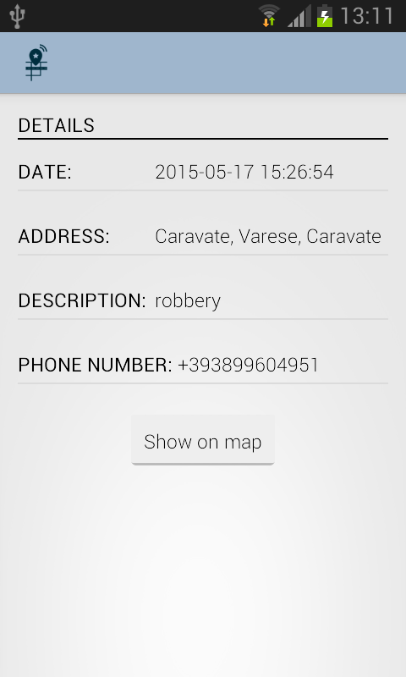
AuthorityApp – View/take available job(s)
Notes:
Jobs are sorted based on user’s GPS location.
Asynchronous task for getting the list of available jobs

Slide 17
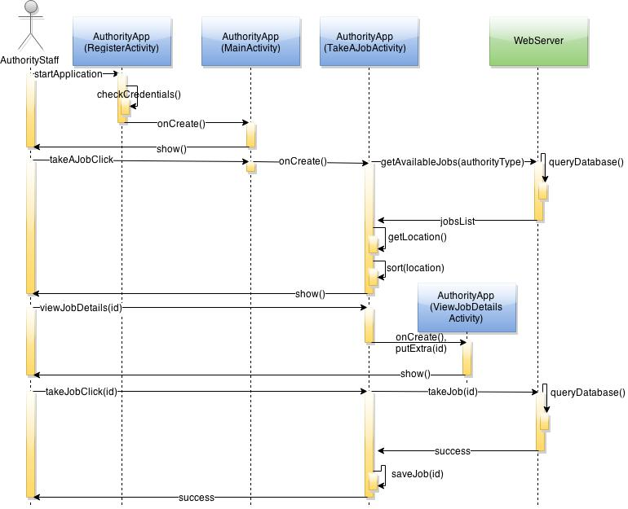
AuthorityApp – View/take available job(s)
Notes:
Get information about all available jobs. After a click to view details data is forwarded to activity to show details.
Taking the job requires interracton and confirmation from server. (add_job.php)

Slide 18
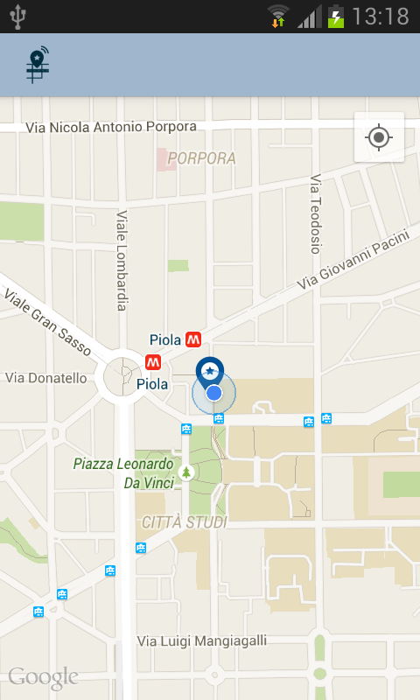
AuthorityApp – View job on map

Slide 19
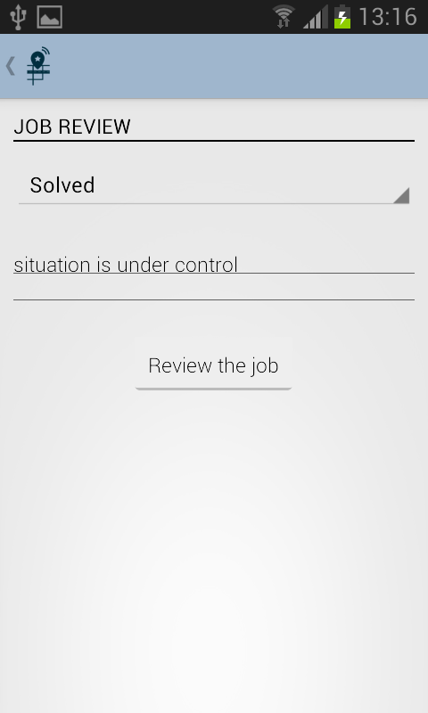
AuthorityApp – Review job
Notes:
Three types of review: Solved, False alarm and Impossible to solve.

Slide 20
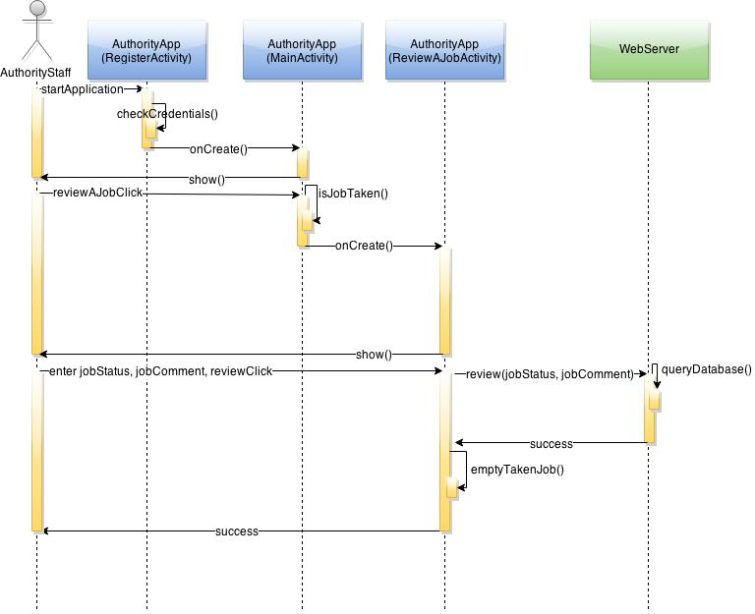
AuthorityApp – Review job

Slide 21
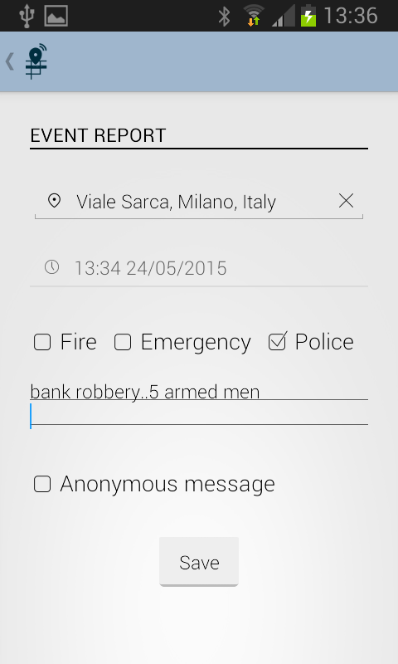
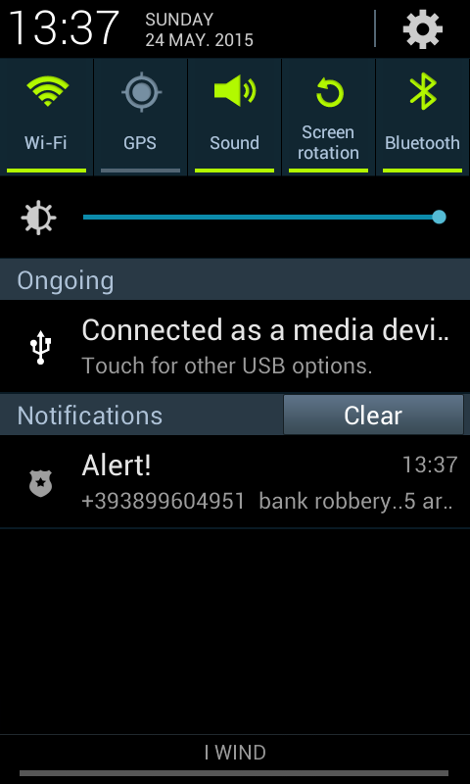
AuthorityApp – Notify user

Slide 22
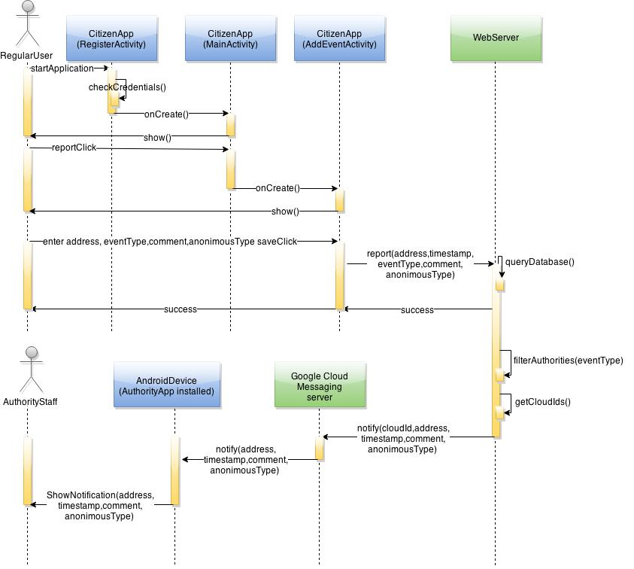
AuthorityApp – Notify user

Slide 23
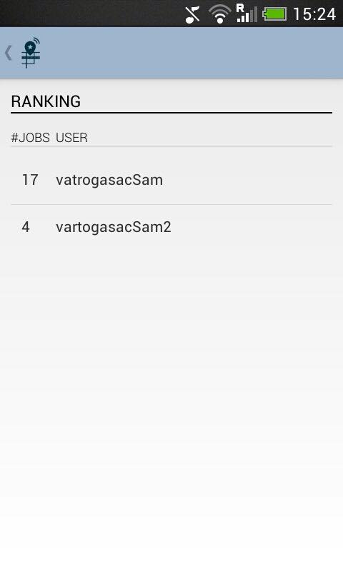
AuthorityApp – View highscores

Slide 24
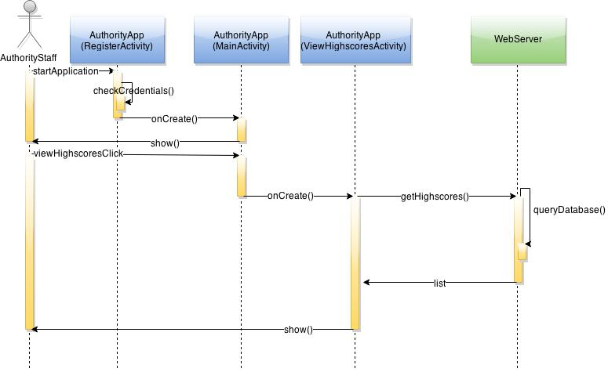
AuthorityApp – View highscores

Slide 25
Demonstration
Demonstration
time

Slide 26
Questions
THANK YOU
FOR YOUR ATTENTION

