Slide 1
MiCHELiN VEHiCLE INSURANCE
GROUP: 10
Nikhil Chavan Mithila Raut Chelsea Dsouza
UNDER THE GUIDANCE OF: Muskan Gulrajani

Slide 2
WHY ONLINE VEHICLE INSURANCE ?
Getting insurance is a very tiring and complicated process in India. It may take from weeks to months for loans to get approved and people have to visit the office again and again for documents and verification.
This processing time can be reduced if we go for an online solution of the same problem .
We have designed an application for Vehicle Insurance using which customer can avail insurance very easily without any cumbersome documentation.
Since the customer buys directly from the insurer, the distributor's margin (or commissions) is saved. Also, the entire process is carried in the virtual world and is paperless, reducing the costs further.

Slide 3
SCOPE
To deliver a proper function software in every sprint.
PRESENT SCOPE
We are providing services for only car insurance in our present scope.
FUTURE SCOPE
We will focus to develop a software that will combine all categories of vehicles

Slide 4
Project vision:
PROJECT VISION: To develop an Integrated application for availing Vehicle Insurance.
Insurance could be either Third party or Comprehensive.
Calculate Insurance Premium on adding Vehicle Details.
Claim Insurance
.

Slide 5
SOFTWARE TOOLS USED
Oracle 10g
Eclipse Java EE for web Developers 2018.
Tomcat server 8.0
JAVA 8
Spring maven MVC
HTML5, CSS3, JAVASCRIPT, BOOTSTRAP
GIT

Slide 6
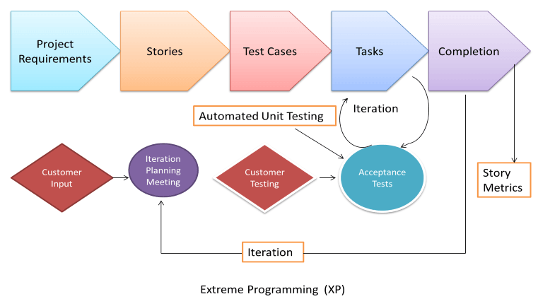
WHAT IS AGILE ?
Agile software development is an approach to software development under which requirements and solutions evolve through the collaborative effort of self-organizing and cross-functional teams and their customers.
Agile is an incremental and iterative approach for project management.

Slide 7
SPRING MVC
Spring is a light weight framework.
Spring uses Dependency Injection design pattern that removes dependencies in the code
Dependency Injection makes our programming code loosely coupled.
Some of the spring annotations that we have used in our project are:
@requestmapping
@autowired
@controller
@modelattribute

Slide 8
