Slide 1

Galileo Binoculars
Team 13: Chelsea Alford, Anika Abrahamson, Karry Lu, Joe Werthan, Lisiman Hua

Slide 2
Relying on Taizhou
Two major uncertain factors
Days until Taizhou can resume production
Capacity of the plant once resumed
For each factor we collaborated with Taizhou to evaluate 3 cases:
Optimistic
Most Likely
Pessimistic
Mean total profit = ¥248,246.46
19.94% chance of losses
Notes:
Despite the recent damages to the Taizhou plant, we first wanted to evaluate Galileo’s total profits if we chose not to place an additional order with Kunshan. The two major uncertainties we’re dealing with are days until Taizhou resumes production and Capacity of their plant once resumed. For our initial model we collaborated with Taizhou to evaluate the optimistic, most likely and pessimistic cases for each of the uncertainties previously mentioned. We found mean total profit to be 249,246 RMB, and a 19.94% Chance of occurring losses instead of profits.

Slide 3
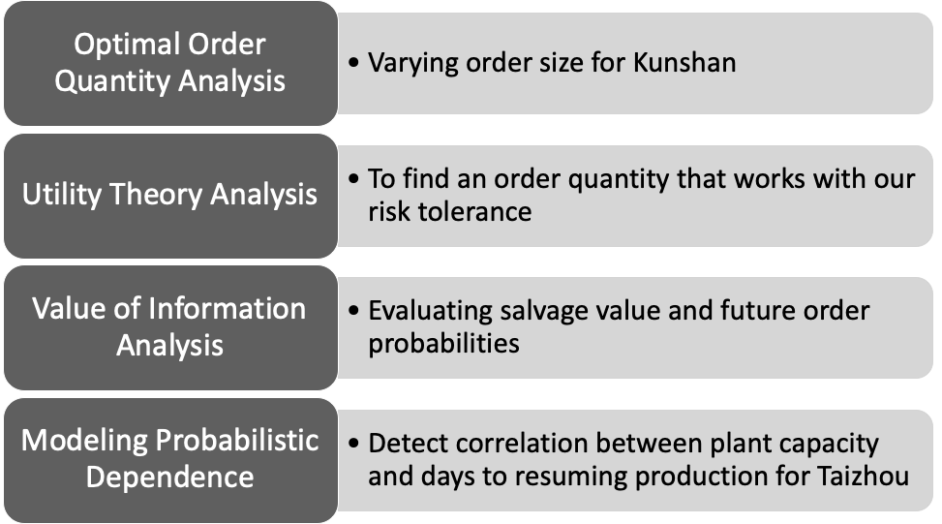
Kunshan is an Option
To determine our recommendation for optimal order quantity from Kunshan our team conducted...
Notes:
The opportunity to place an additional order with Kunshan could potentially increase our profits by allowing us to fulfill more of our demand. Our team conducted Sensitivity Analysis, Utility Theory Analysis, Value of Information Analysis, and Modeling Probabilistic Dependence to determine an optimal order quantity from Kunshan recommendation.

Slide 4
Optimal Order Quantity Analysis

Slide 5
Process
Create a Data Table with order quantities increasing in 1,000 unit increments
Run 10,000 trials of Monte Carlo Simulation using Crystal Ball to forecast profit
Analyze the overlay charts to determine the optimal quantity
Check for stochastic dominance
If not, balance the risks and rewards

Slide 6
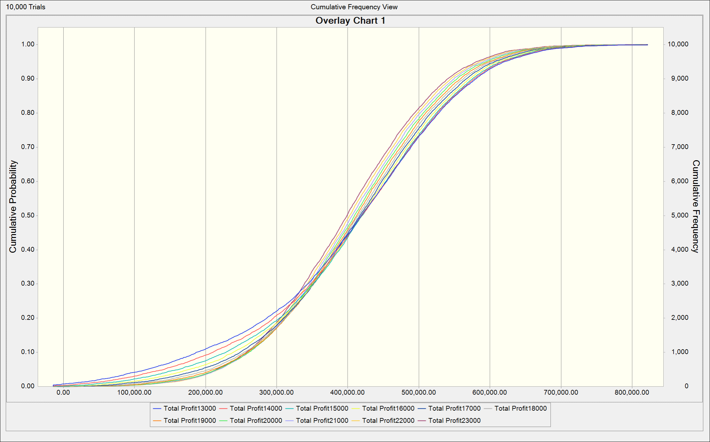
Notes:
Checking quantities 13,000 to 23,000
No clear best option from these quantities
The lower the quantity below 17,000, the higher probability on the low end → can eliminate them as options
Need to break it down further to more accurately examine the options

Slide 7
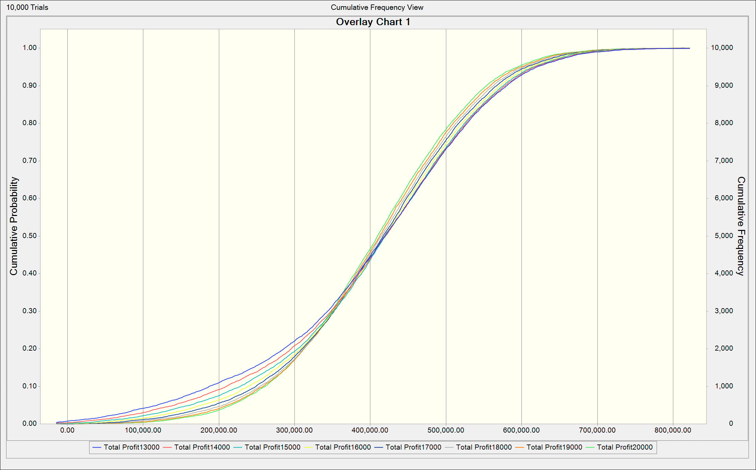
Notes:
Quantities 13,000 to 20,000
20,000 stochastically dominates the other options
Lower low end, higher high end

Slide 8
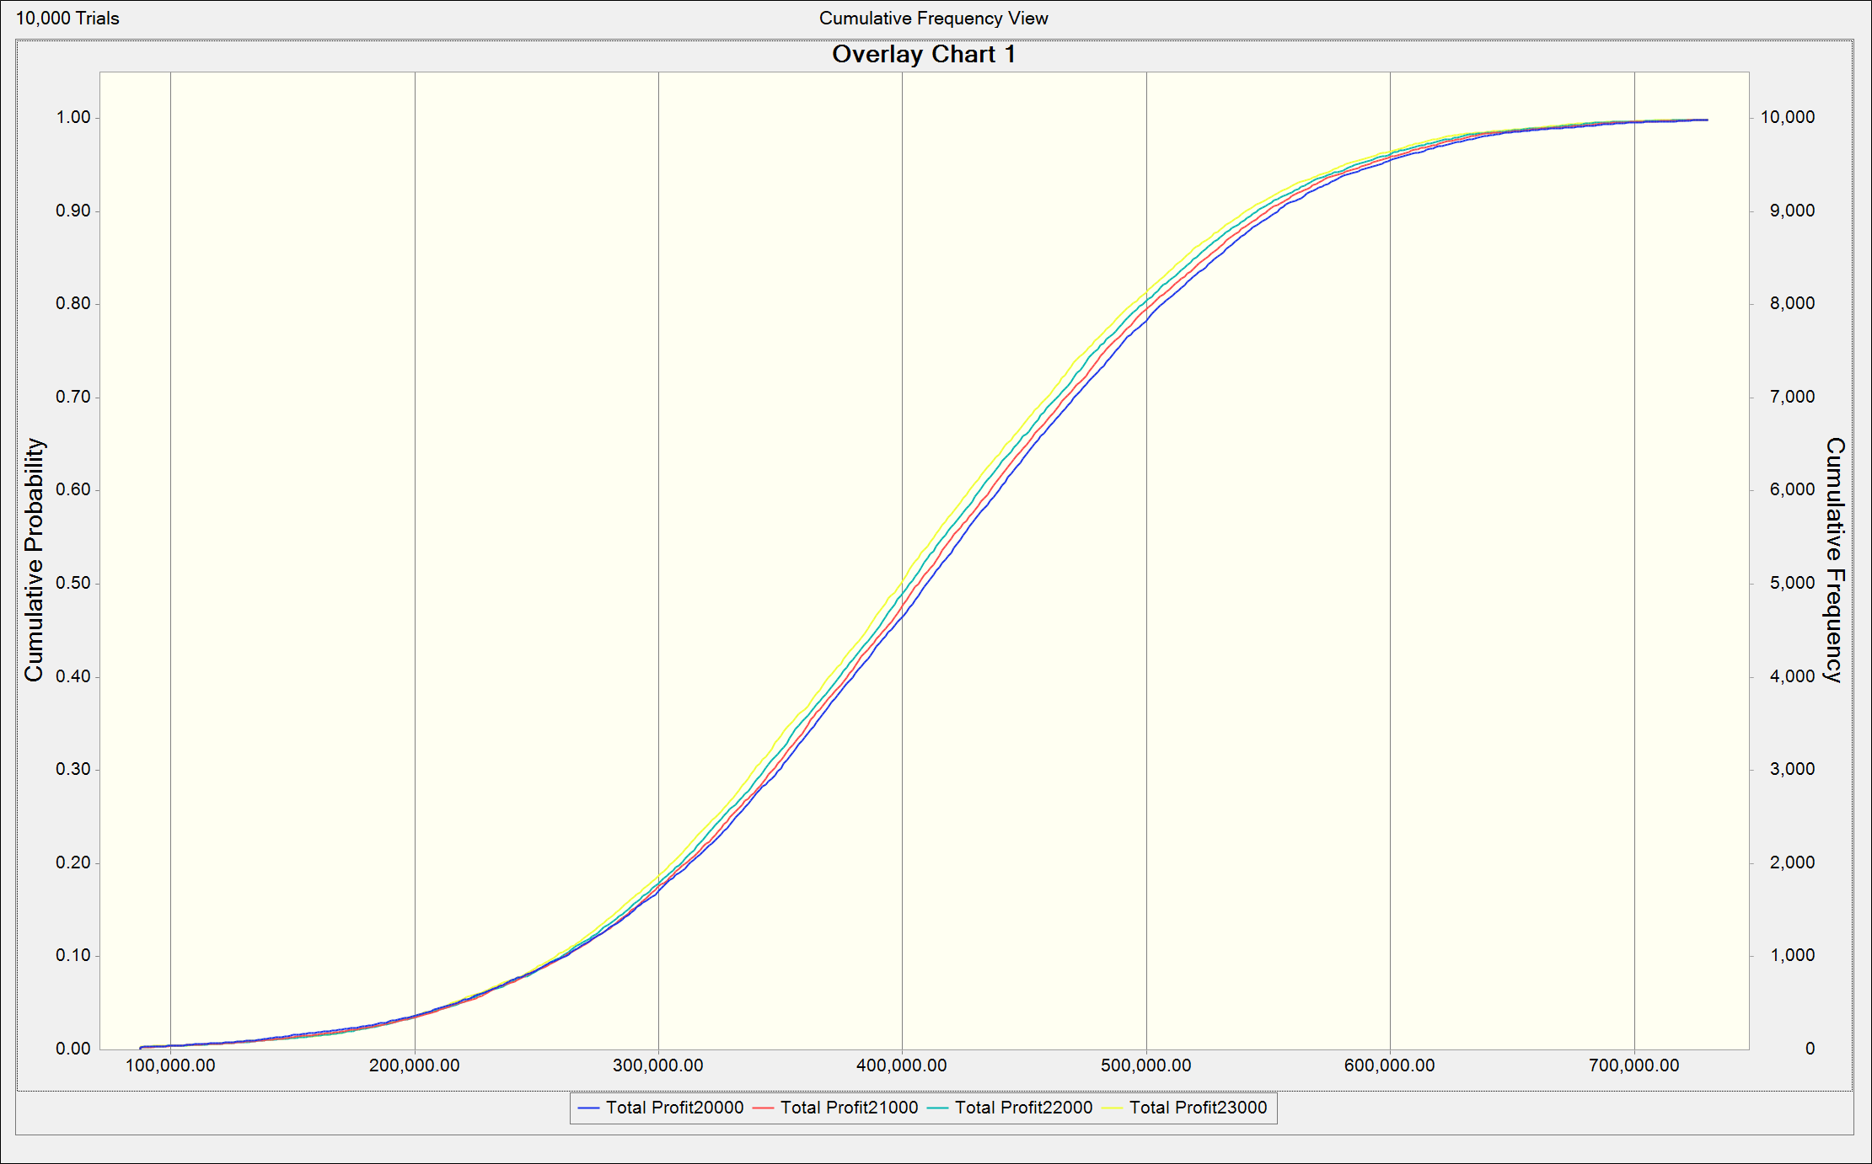
Notes:
Quantities 20,000 to 23,000
All pretty much the same on the lower end, no clear crossing of lines
20,000 is on the right side of the other options → the best option when referring to profits

Slide 9
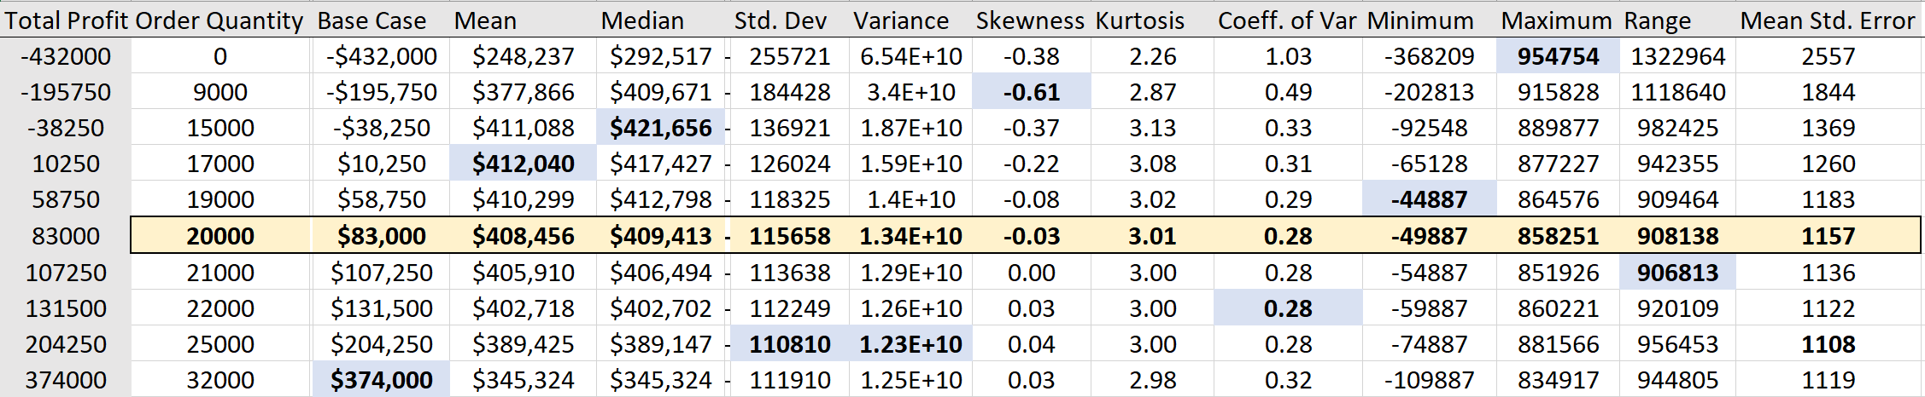
Condensed Data Table
Notes:
Condensed version of the data table that only shows the order quantities with the optimal attributes (in blue and bolded) along with the recommended quantity (20,000) shown in yellow

Slide 10
Utility Theory Analysis

Slide 11
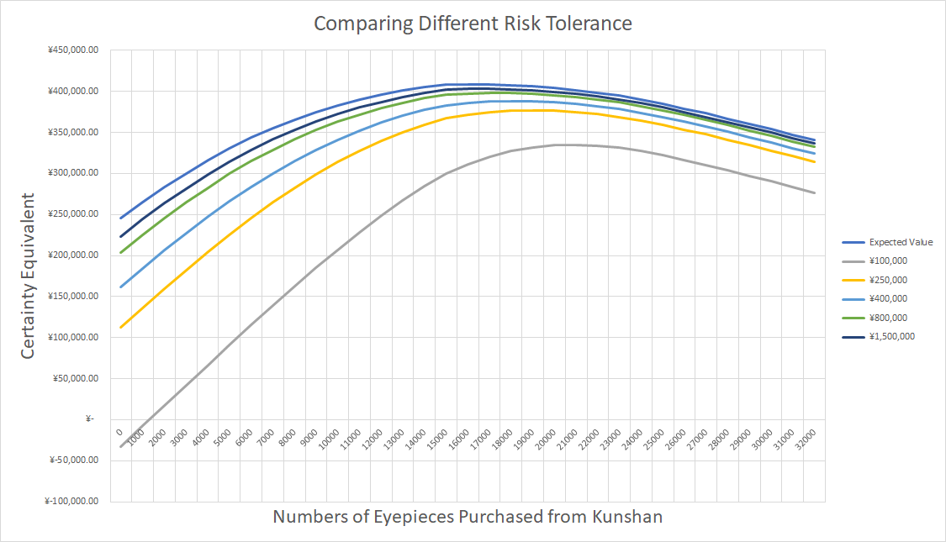
Certainty Equivalents at Different Risk Tolerance
Notes:
Expected Revenue Approximation = 22 USD * 16000 units * 7 RMB/USD = 2,464,000 RMB
Assume our risk tolerance is ~⅙ of the total revenue, then RT is ~ 400,000 (indicated by the middle light blue line).
We explored different RT levels of certainty equivalents for Galileo. For each 1,000 addition in Kunshan order quantity, we calculated the utility and profit. With 1,000 simulations, CB calculated the expected profit, mean utility, and certainty equivalent for each Kunshan order quantity level at each RT level (¥100k, 250k, 400k, 800k, 1.5m)
The top blue line indicates the expected value. As RT increases to infinite, the CE line approaches the expected value line.
Optimal quantity to order from Kunshan are 21000 19000 18000 17000 17000 respectively (ranking from low to high RT) for that one particular simulation.

Slide 12
Value of Information Analysis

Slide 13
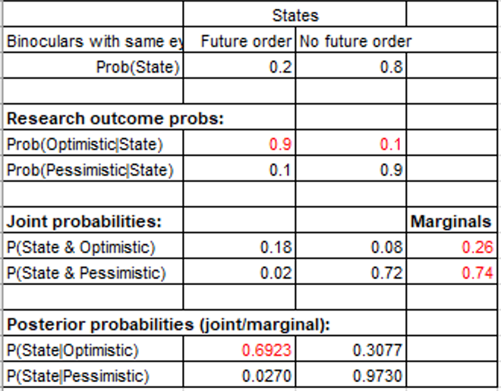
Value Of Imperfect Information
Goal: Predict/increase the expected probability (certainty) that Galileo would get future orders for similar binoculars with same type of eyepieces, and minimize the chance to see shortage or surplus due to uncertainty for demand.
Methodology: Market research for justifying demand in the near future.
Parameter Changes: If the demand for future order increases, we would see higher volume of such product being traded in the market, thus less likely such product would be salvaged. Thus, the normal salvage value would increase from ¥5 to ¥6 per unit (this value equals to unit cost from Taizhou, and an increase in demand incurs increase in unit price). Meanwhile, the likelihood for discounted salvage turn minimal, thus the discounted value decreases.
 | Demand (Future Order)¹ | Volume in Market | Volume to Salvage | Demand (Discounted salvage)² | Salvage Value | Discounted Salvage Value | Expected Total Profits³
Initial | 20% | Low | High | 80% | ¥ 5 | ¥ 2 - 4 | ¥ 407,987
Research | 69% | High | Low | 31% | ¥ 6 | ¥ 1 - 3 | ¥ 424,695
Maximum volume Galileo can salvage by normal salvage value, but subject to less likelihood of salvage due to high demand Maximum volume Galileo can salvage by discounted value Assume fixed order quantity (17,000) and fixed unit price (¥22) in this analysis |  |  |  |  |  | EVSI | ¥ 16,709
Notes:
Value of Imperfect Information: 16,709 RMB
Candace and Z.T. assessed the probability of getting the same future orders to be 20%. Suppose Galileo has the option to consult for a market research to justify the demand for binoculars (with the same type of eyepieces) in the near future.
Suppose the probabilities of research suggesting optimistic market given they have future order is 90%, and the same outcome given they don't have future order is 10%. Thus there is a 26% chance that the research would return a optimistic forecast of the market. Therefore, the probability of Galileo still getting future order of the same binoculars will be 69% if the research suggest an optimistic demand up ahead. Otherwise, there will only be an 2.7% chance of having the same order if the research suggest a pessimistic market.
Meanwhile, the research also mentions that if there is an optimism toward the near future, the salvage value would increase and the discounted salvage value would then decrease, based on the economics theory. Because the expected value of normal salvage value increases given the higher chance, and demand for a discounted salvage decreases. The research suggests a new discounted value that ranges from 1 to 3 (uniformly distributed). With the research, we can see an increase in the average total profit, and decrease in its standard deviation.

Slide 14
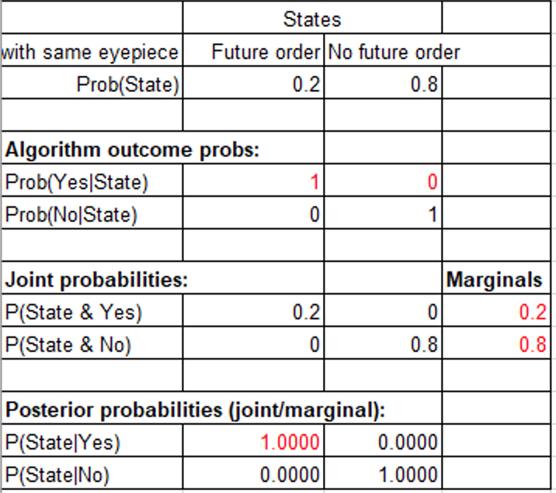
Value Of Perfect Information
Goal: Somehow solidifies 100% probability of demand for the future orders, so that Galileo can possibly eliminate the chance for shortage or surplus.
Methodology: Spying, monopoly, competition (you never know)
Parameter Changes: If Galileo is sure that there is 100% chance to expect future orders of the products, it would prepare for the optimal order quantity to satisfy the demand. Therefore, the chance to see either salvage or discounted salvage is minimal. Meanwhile, the normal salvage value would continue to increase given an increase in demand for the products.
 | Demand (Future Order)¹ | Volume in Market | Volume to Salvage | Demand (Discounted salvage)² | Salvage Value | Discounted Salvage Value | Expected Total Profits³
Initial | 20% | Low | High | 80% | ¥ 5 | ¥ 2 - 4 | ¥ 407,987
Research | 100% | High | Minimal | 0% | ¥ 7 | ¥ 0 | ¥ 450,197
Maximum volume Galileo can salvage by normal salvage value, but subject to less likelihood of salvage due to high demand Maximum volume Galileo can salvage by discounted value Assume fixed order quantity (17,000) and fixed unit price (¥22) in this analysis |  |  |  |  |  | EVPI | ¥ 42,211
Notes:
Value of Perfect Information: 42,211 RMB
Although the research can provide a base for more accurate and profitable evidence, there is still variability in the forecast of demand. Therefore, there will still be either shortage or surplus from our ordered quantity. Suppose Galileo can implement a namic demand forecasting algorithm to achieve high prediction accuracy. Thus, at this point in time, they are sure with 100% probability that Galileo will get future orders. Therefore, such perfect information will attach 100% for normal salvage and leave no possibility for salvaging at a discounted value. Similarly, the salvage value would go up to reflect the stable demand.

Slide 15
Modeling Probabilistic Dependence

Slide 16
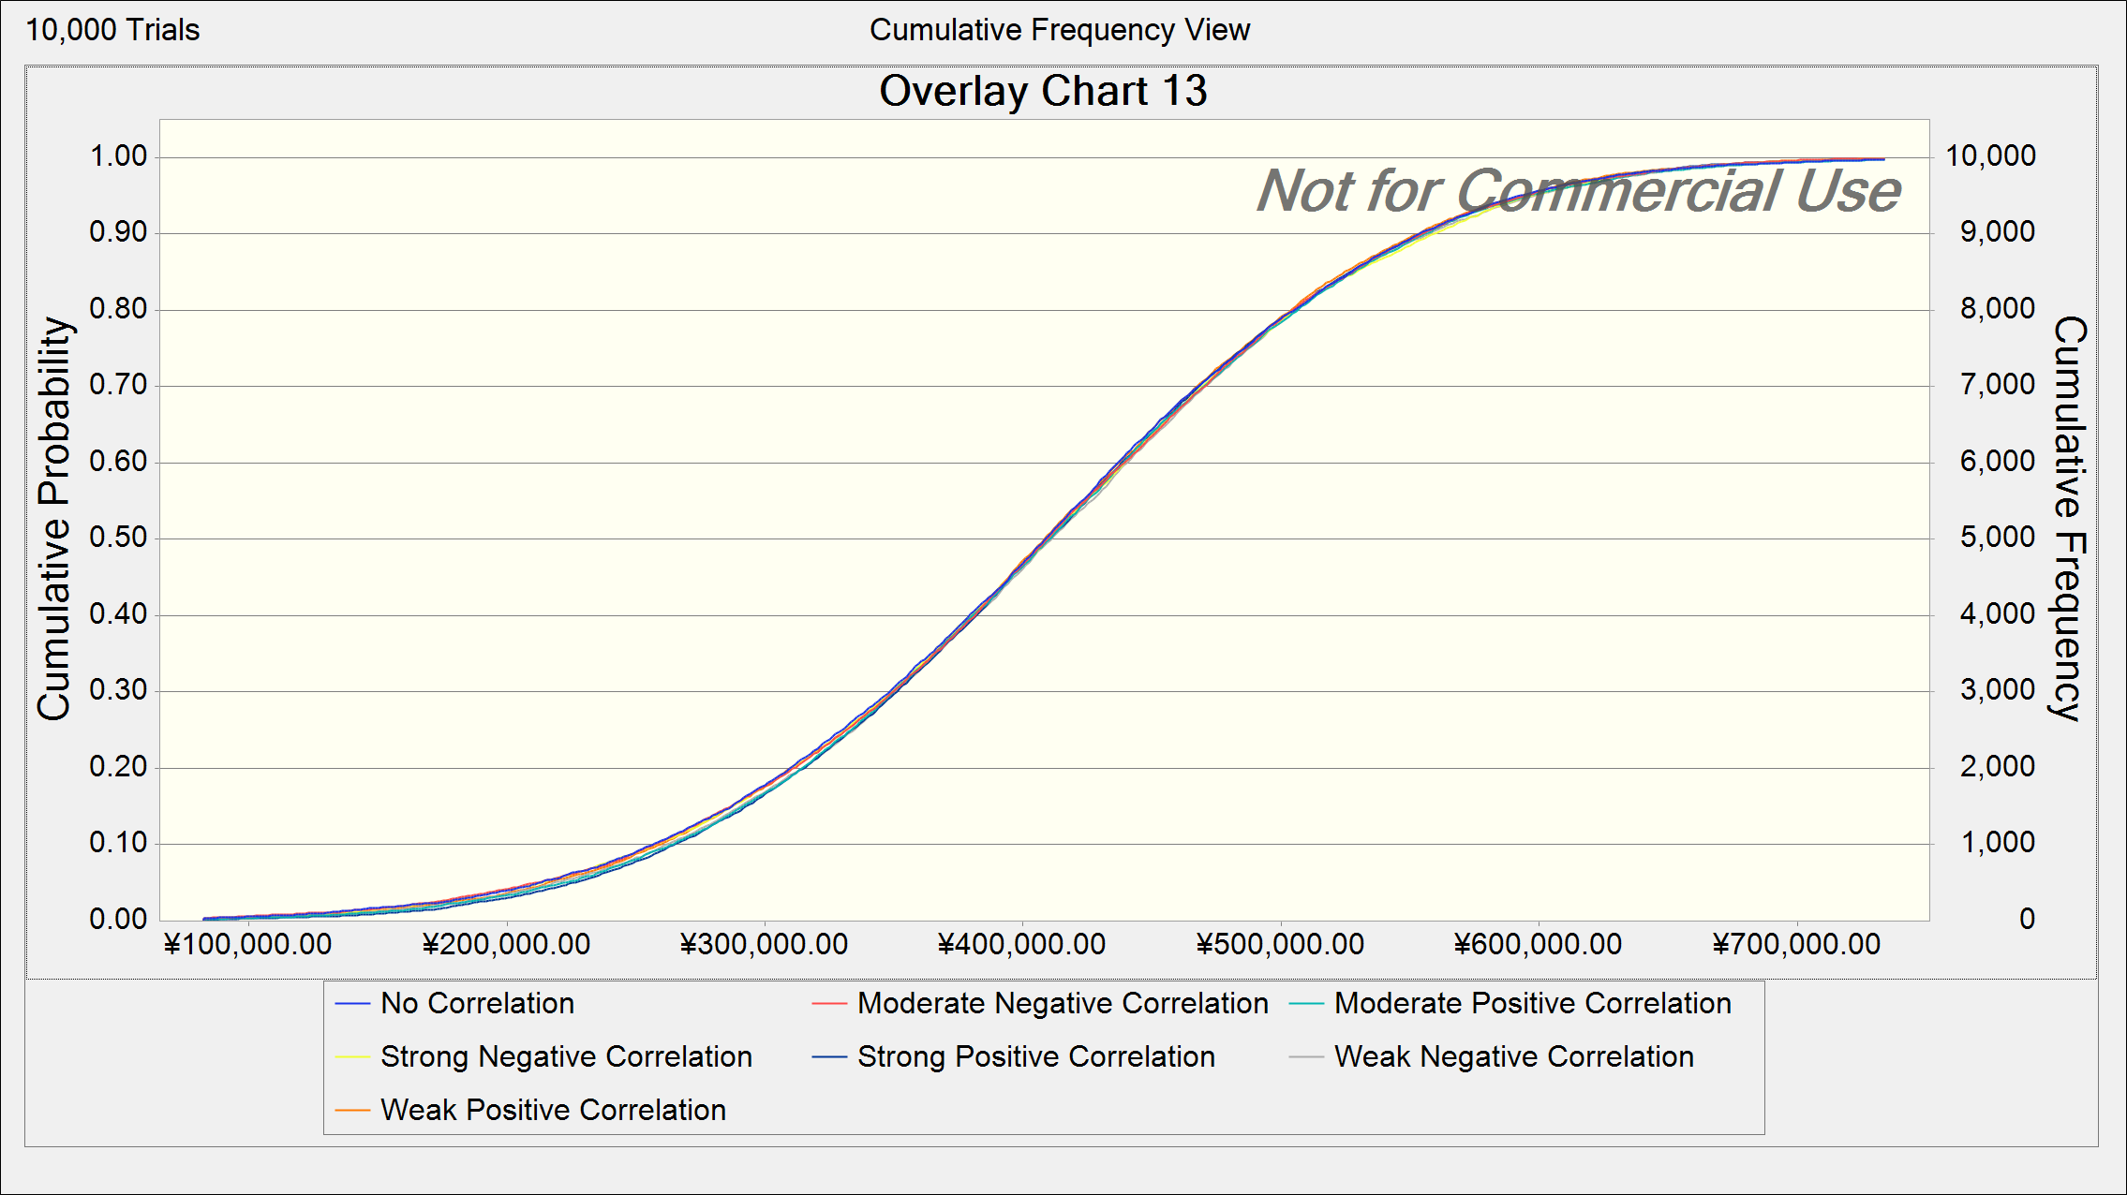
Modeling the correlation between days until operations resume and plant capacity is inconsequential to expected total profits.
Notes:
Though we do see some variations in expected total profits when modelling different levels of correlation, there is no significant difference between forecasted profits. We assume that this is because these two variables are dependent on one another, regardless of any modelled dependence. Modelling the correlation between these two variables does not affect the actual dependence of plant capacity on days until operations resume.

Slide 17
Our Recommendation
Sensitivity analysis leads us to recommend an optimal order quantity from the Kunshan supplier of 20,000 eyepieces.
Utility theory analysis indicates an optimal order quantity from the Kunshan supplier ranging from 17,000 - 21,000, depending on Galileo’s preferred risk tolerance.
Obtaining information to more accurately predict the probability of future orders requiring the same eyepieces would boost the expected total profits by increasing the likelihood of eyepieces being salvaged from surplus.
Modeling dependence is unnecessary in this situation.

Slide 18
Appendix

Slide 19
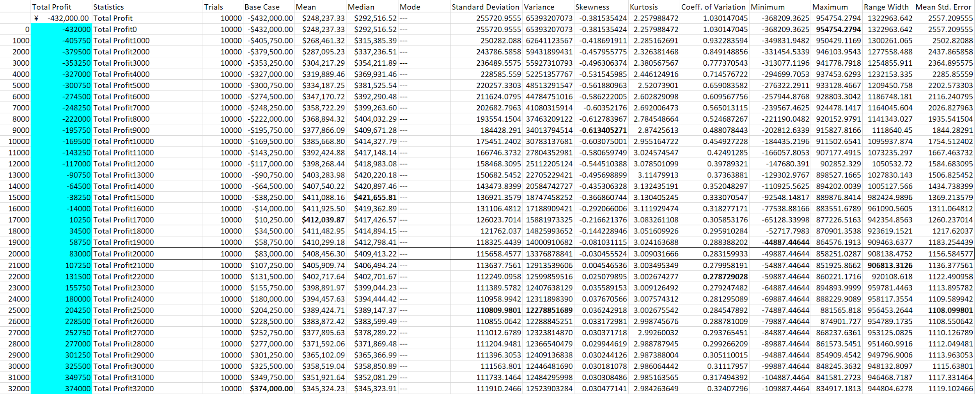
Expanded Data Table

