Slide 1
Grupo Nogueira
Team 13: Chelsea Alford, Anika Abrahamson, Karry Lu, Lisiman Hua, Joe Werthan

Slide 2
Basic Model
Decision Variables:
Amount of sugarcane from each supplier freighted to each plant (16 variables)
Amount of molasses freighted from each plant to each distillery (18 variables)
Objective Function:
Maximize profit
Constraints:
Must buy all of the sugarcane produced from suppliers
Must operate each plant between 50% to 100% capacity, with constraints on the total amount of sugarcane refined and sugar purified
Must meet minimum guaranteed quantities of molasses sold to each distillery and cannot exceed maximum capacities of molasses sold to each distillery

Slide 3
 | Londrina | Franca
Jaú | 480 | 0
Bariri | 0 | 850
Cosmópolis | 133 | 507
Itapira | 651 | 0
Pirassununga | 0 | 970
São Carlos | 107 | 0
Diadema | 80 | 0
Santa Bárbara d'Oeste | 310 | 0
Araraquara | 0 | 0
Maximum Profit of R$183,135

Slide 4
Plant Efficiency
Both plants are currently running between 50-100% capacity
At optimality, Londrina is running at approximately 62% capacity and Franca is running at approximately 86% capacity

Slide 5
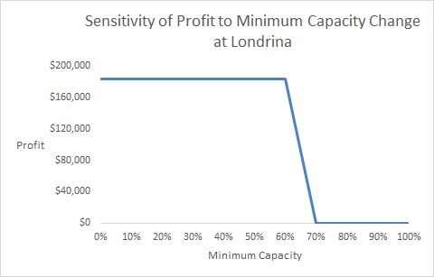
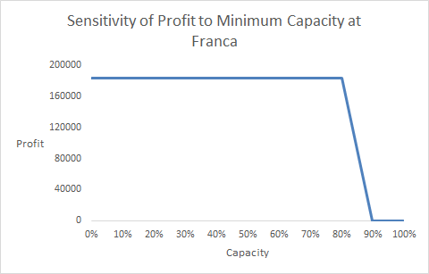
Varying Minimum Capacity at Both Plants
Varying capacity has no change on the optimal solution for suppliers or customers. After 60% capacity there are no feasible solutions.
Optimal amounts for customers go unchanged at each minimum capacity, the suppliers Maringá and Rancharia however do change at 40%, 70% and 80%. With more sugarcane from Maringá going to Franca, and all from Rancharia going to Londrina.

Slide 6
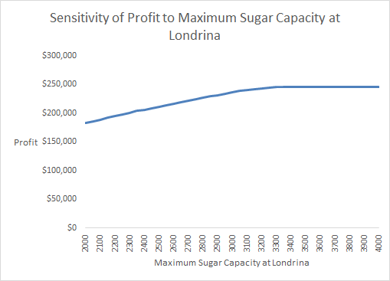
Max Sugar at Londrina, a Binding Constraint
Doubling the maximum capacity for sugar at Londrina to equal the maximum capacity at Franca can increase profits by 34% to R$245,453.94.
GN should pay at most R$62,318 in equipment or improvements to double the sugar capacity at Londrina in order to increase profits.

Slide 7
Dracena:
Potential Supplier
R$15.30 shipping cost from Dracena to Londrina
R$13.10 shipping costs from Dracena to Franca
Notes:
(R$/t)

Slide 8
R$31 Maximum Price to Buy From the Additional Supplier
Dracena Price (R$/t) | Profit
30.50 | $183,486.17
30.60 | $183,391.13
30.70 | $183,296.09
30.80 | $183,201.04
30.90 | $183,150.34
31.00 | $183,135.11
31.10 | $183,135.11
31.20 | $183,135.11
threshold
Notes:
We used to SolverTable to calculate the profit with different Dracena prices and found the threshold to be R$31/t. If Dracena can offer a price that is lower than the threshold, we will be able to make additional profit.

Slide 9
Renegotiating Supply Agreements with Distilleries
Current Maximum Profit: R$183,135
Potential Savings from Renegotiation: R$16,962
Maximum Profit after Renegotiation: R$200,097
Profitability increases by 9.5%

Slide 10
Profitability Under Current Supply Agreements
Customers | Londrina | Franca | Total | Status (min) | Shadow $ (min) | Status (max) | Shadow $ (max)
Jaú | 480 | 0 | 480 | Binding | -9.8 | Not Binding | 0
Bariri | 0 | 850 | 850 | Binding | -24.8 | Not Binding | 0
Cosmópolis | 133.1 | 506.9 | 640 | Binding | -0.4 | Not Binding | 0
Itapira | 651.1 | 0 | 651.1 | Not Binding | 0 | Not Binding | 0
Pirassununga | 0 | 970 | 970 | Binding | -6.3 | Binding | 0
São Carlos | 107 | 0 | 107 | Binding | -10.1 | Not Binding | 0
Diadema | 80 | 0 | 80 | Binding | -5.1 | Not Binding | 0
Santa Bárbara d'Oeste | 310 | 0 | 310 | Not Binding | 0 | Binding | 0.9
Araraquara | 0 | 0 | 0 | Binding | -7.8 | Not Binding | 0
Notes:
Red: the plants that would create the most value from reducing the minimum amount
Green: the plants that would create the most value from adding the difference in amount
Black: the plants which would not create value through changing the amount
The plants with the most negative shadow prices (in relation to the min) are the ones where the minimum supply agreements hurt the transportation costs (and therefore profit) the most. For example, reducing 1 ton of molasses to Bariri would lower the cost by R$24.8. The plants with the most positive shadow prices (in relation to the max) are the ones where the amount of molasses that is taken from the former plants should be transferred to. Notice that in the chart, Pirassununga and Araraquara remain in black, because they are bound at the max, so not more molasses can be added to them.

Slide 11
Profitability With Renegotiated Supply Agreements
Customers | Londrina | Franca | Total | Status (min) | Shadow $ (min) | Status (max) | Shadow $ (max)
Jaú | 276.2 | 0 | 276.2 | Not Binding | 0 | Not Binding | 0
Bariri | 0 | 0 | 0 | Binding | -3.7 | Not Binding | 0
Cosmópolis | 0 | 800 | 800 | Not Binding | 0 | Binding | 20.7
Itapira | 775 | 0 | 775 | Not Binding | 0 | Binding | 9.8
Pirassununga | 0 | 970 | 970 | Not Binding | 0 | Binding | 14.8
São Carlos | 0 | 86.9 | 86.9 | Not Binding | 0 | Not Binding | 0
Diadema | 400 | 0 | 400 | Not Binding | 0 | Binding | 4.7
Santa Bárbara d'Oeste | 310 | 0 | 310 | Not Binding | 0 | Binding | 10.7
Araraquara | 0 | 470 | 470 | Not Binding | 0 | Binding | 13.3
Notes:
Red: the plants that would create the most value from reducing the minimum amount
Green: the plants that would create the most value from adding the difference in amount
Black: the plants which would not create value through changing the amount
Now that the minimum supply agreements have been taken away, almost all of the shadow prices in relation to the minimum have been reduced to 0. The only plant that does not have a shadow price of 0 is Bariri, and that is because the supply to that plant has been reduced (and bound) at 0 tons. By reducing the minimum requirements at the plants, the company would be able to max out the amounts sent to plants that have lower transportation costs. Notice that all of the non-red plants are Not Binding, but also that that the leftover amount that must go to a plant is split between the 2 plants that have the lower relative transportation costs from Lodrina and Franca.

Slide 12
Profitability With Renegotiated Supply Agreements
Original Supply Agreements
Renegotiated Supply Agreements
Customers | Londrina | Franca | Total Cost | Lodrina | Franca | Total Cost | Cost Savings
Jaú | 480 | 0 | $12480 | 276.2 | 0 | $7181.05 | $5298.95
Bariri | 0 | 850 | $26945 | 0 | 0 | $0 | $26945
Cosmópolis | 133.1 | 506.9 | $5909.78 | 0 | 800 | $5840 | $69.78
Itapira | 651.1 | 0 | $10547.80 | 775 | 0 | $12555 | $-2007.2
Pirassununga | 0.0 | 970 | $12804 | 0 | 970 | $12804 | $0
São Carlos | 107 | 0 | $2814.10 | 0 | 86.9 | $2433.33 | $380.76
Diadema | 80 | 0 | $1704 | 400 | 0 | $8520 | $-6816
Santa Bárbara d'Oeste | 310 | 0 | $4743 | 310 | 0 | $4743 | $0
Araraquara | 0 | 0 | $0 | 0 | 470 | $6909 | $-6909
Total | 1761.2 | 2326.9 | $178,803.50 | 1761.2 | 2326.9 | $161,841.19 | $16,962.31
Notes:
Here is a more financially-focused chart of the results from the renegotiated supply agreements, which lays out the change in cost distribution for each plant. The total transportation costs are reduced from $178,803.50 to $161,841.19, which is a reduction of $16,962.31 (9.487% reduction in cost). The total amount of molasses supplied would stay the same, so the revenues (and other costs) stayed the same. As a result, the profits would increase from $183,135.11 to $200,097.41, which (intuitively) is an increase of $16,962.31 (9.262% increase in profit). In other words, it would be worth renegotiating to these amounts as long as it costs less than $16,962.31.

Slide 13
Changing Diesel Prices
Changes in diesel prices (increase in cost) cause changes in molasses prices (increase in revenue)

Slide 14
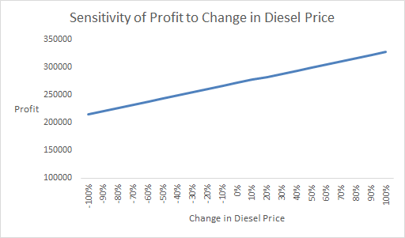
Linear relationship between diesel prices and profit
Profit is more sensitive to changes in molasses prices than changes in diesel prices: Increased diesel prices increase cost, but the additional revenue generated from an equal increase in molasses prices causes overall higher profits
Input Variable | Diesel Price Change (Percentage)
Range | -100% to 100%
Increment | 10%
When the ratio between diesel and molasses prices is fixed at one, the magnitude of change for diesel and molasses prices are the same (10% increase in diesel incurs 10% increase in molasses). Thus, profit is not as sensitive to changes in diesel price as it is to molasses price because revenue increases at a higher rate than cost.

Slide 15
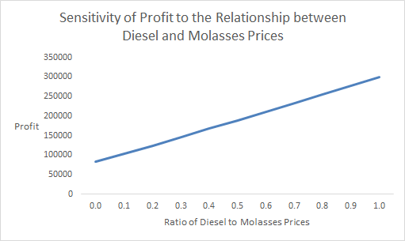
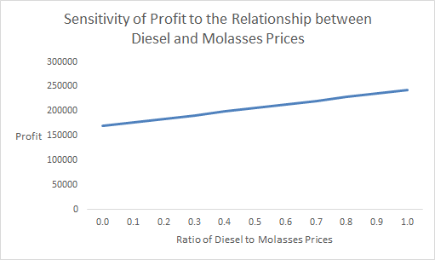
Profit is more sensitive to the relationship between diesel and molasses prices when the change in price is higher.
50% increase in prices
50% decrease in prices

Slide 16
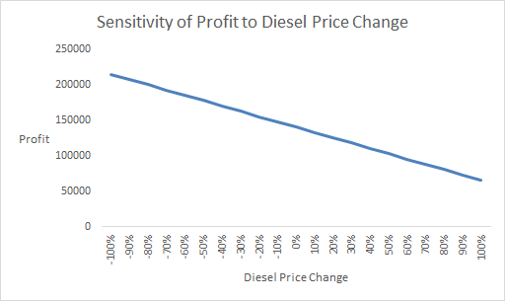
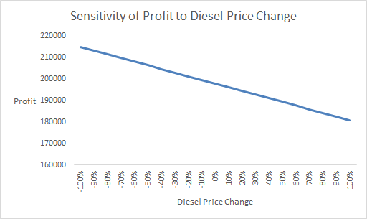
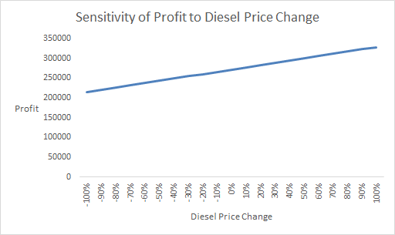
How does the relationship between diesel and molasses prices affect the sensitivity of profit towards price changes?
Ratio = 0.1
Ratio = 0.5
Ratio = 1
Input Variables | Diesel Price Change (Percentage) | Ratio
Range | -100% to 100% | 0 to 1
Increment | 10% | 0.1
The lower the ratio (approaching 0), the more sensitive the profit will be as diesel price fluctuates, since the higher diesel price would incur a relatively lower molasses price increase ($10 increase in diesel can only incur $1 increase in molasses), thus making less revenue to cover the increased diesel cost.
Notes:
The lower the ratio, the more sensitive profit is to price changes. At a higher ratio, profit is less sensitive because the increase in molasses prices can outweigh the increase in diesel prices, generating enough revenue to cover the additional cost. But, as the ratio between diesel and molasses prices becomes smaller, the cost of diesel begins to outweigh the additional revenue from increased molasses prices.

