Slide 1
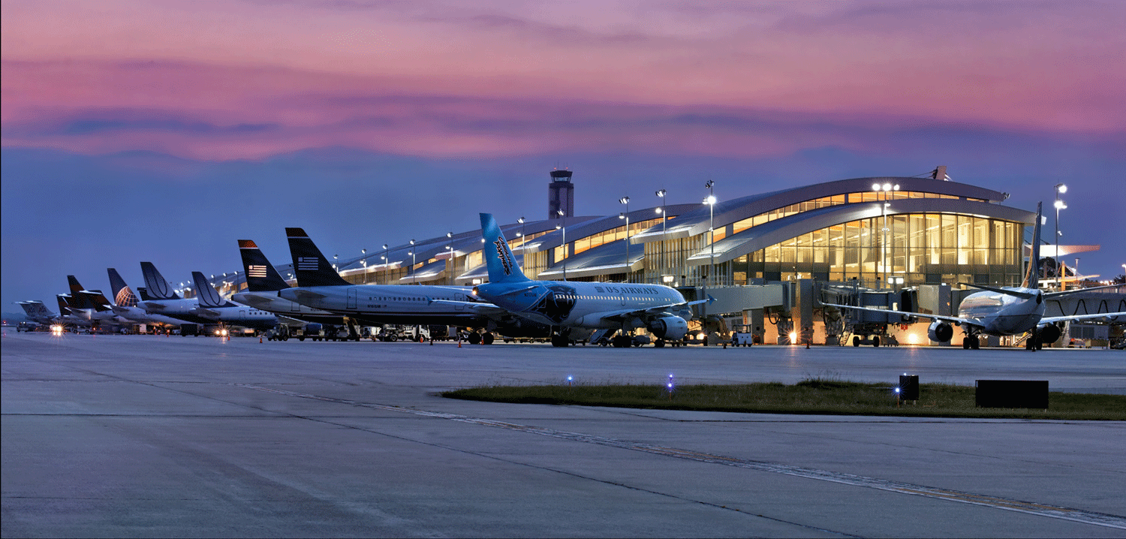
How can the RDU airport manager reduce departure delays?
Team 29
Chelsea Alford, Danielle Shediac, Isaac Parker, Lin Lin, Junhong Wengtan

Slide 2

Notes:
Why delays are bad: cause customers anger/ stress, missed connections and distrust in airlines. This is a key responsibility for the airport manager as he/she is responsible for understanding flight schedules and activity of airlines and maintaining high airport efficiency. A main issue

Slide 3
11.3 mins
average departure delay per flight at RDU compared to 9.2 mins at other US airports
Notes:
This is average dep delay - includes negative delays (early departures)

Slide 4
90%
of flights that depart at least 10 minutes late from RDU have late arrivals

Slide 5

Implement 3-sigma control limits to more closely monitor weekly delays
RECOMMENDATION
Notes:
Implement a 3-sigma control limits system to monitor weekly delays at RDU and penalize carriers that have a weekly carrier delay greater than the upper control limit.

Slide 6
17% decrease
RECOMMENDATION
in average departure delays caused by carriers at RDU, from 73.4 minutes to 61.1 minutes per flight

Slide 7

What is the main cause of departure delays at RDU?

Slide 8
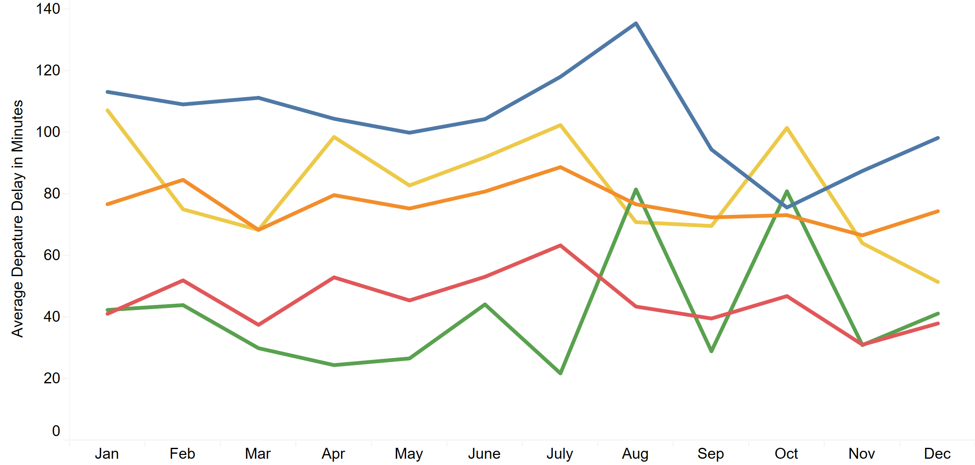
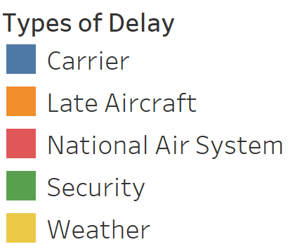
Throughout the year, carrier delays have the highest average departure delays out of all types of delays at RDU

Slide 9
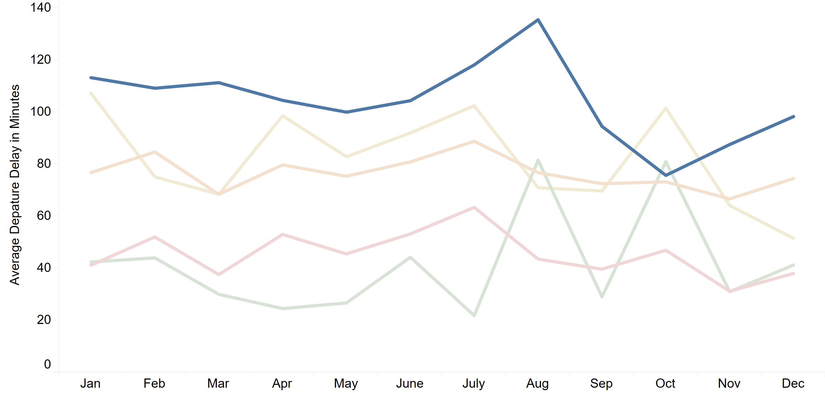
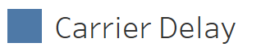
Throughout the year, carrier delays have the highest average departure delays out of all types of delays at RDU

Slide 10
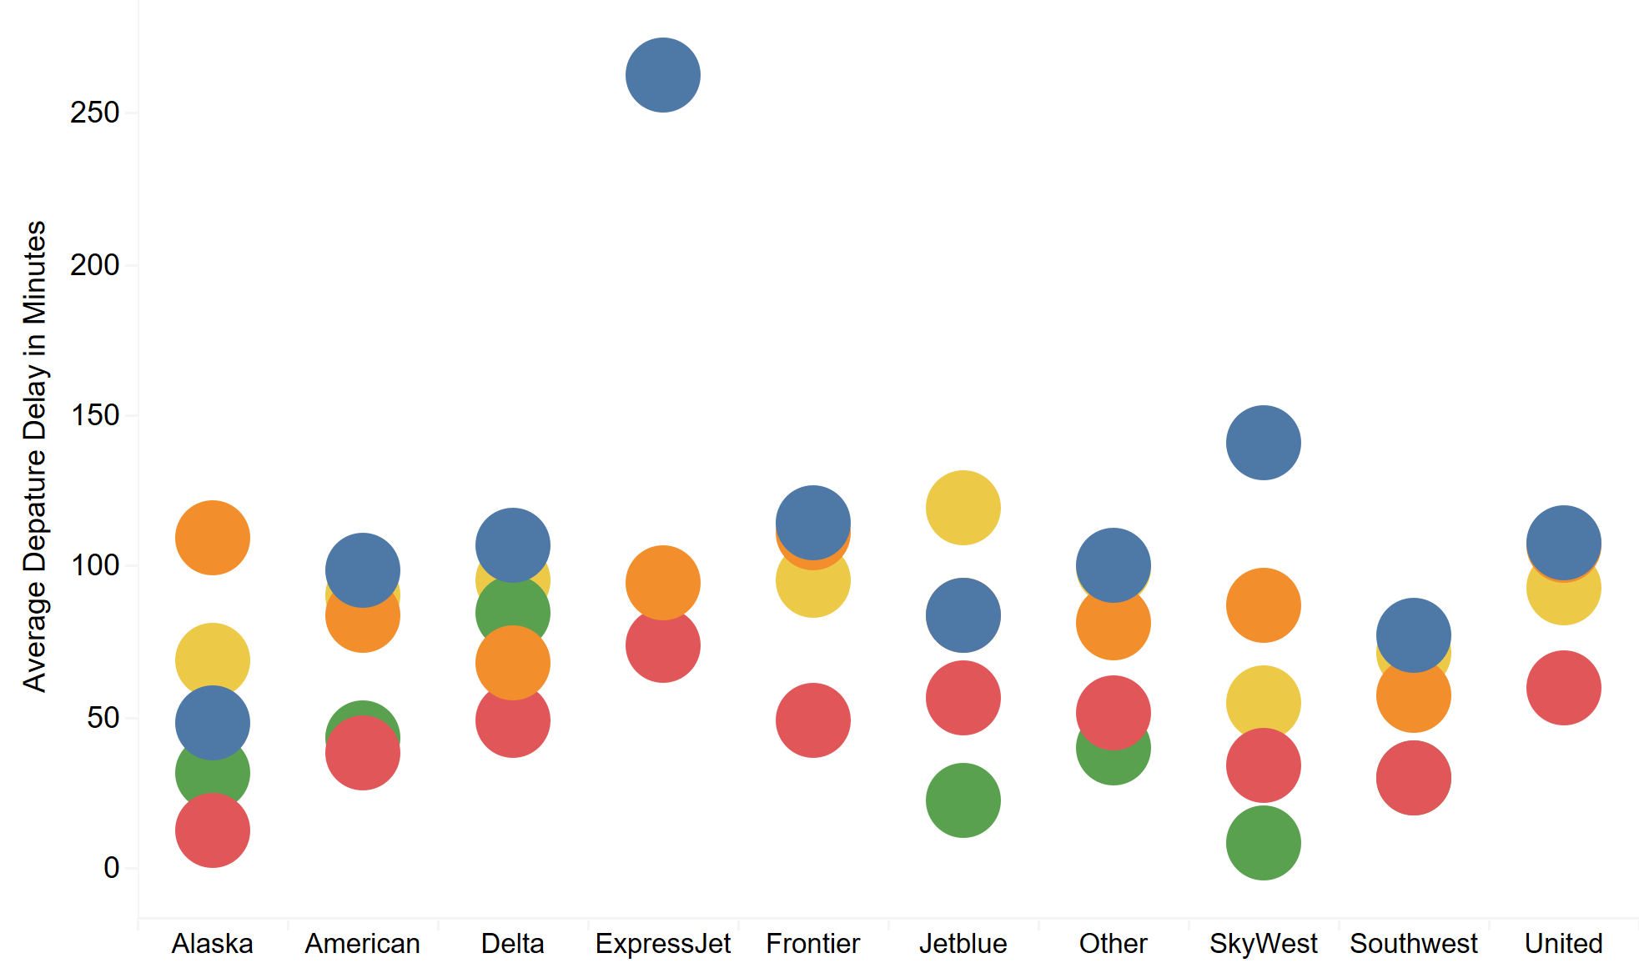
Across carriers that fly from RDU, carrier delays have the highest average departure delays
Notes:
acknowledge here that Alaska Airlines does not follow the same pattern because they have a very low number of flights (9)

Slide 11
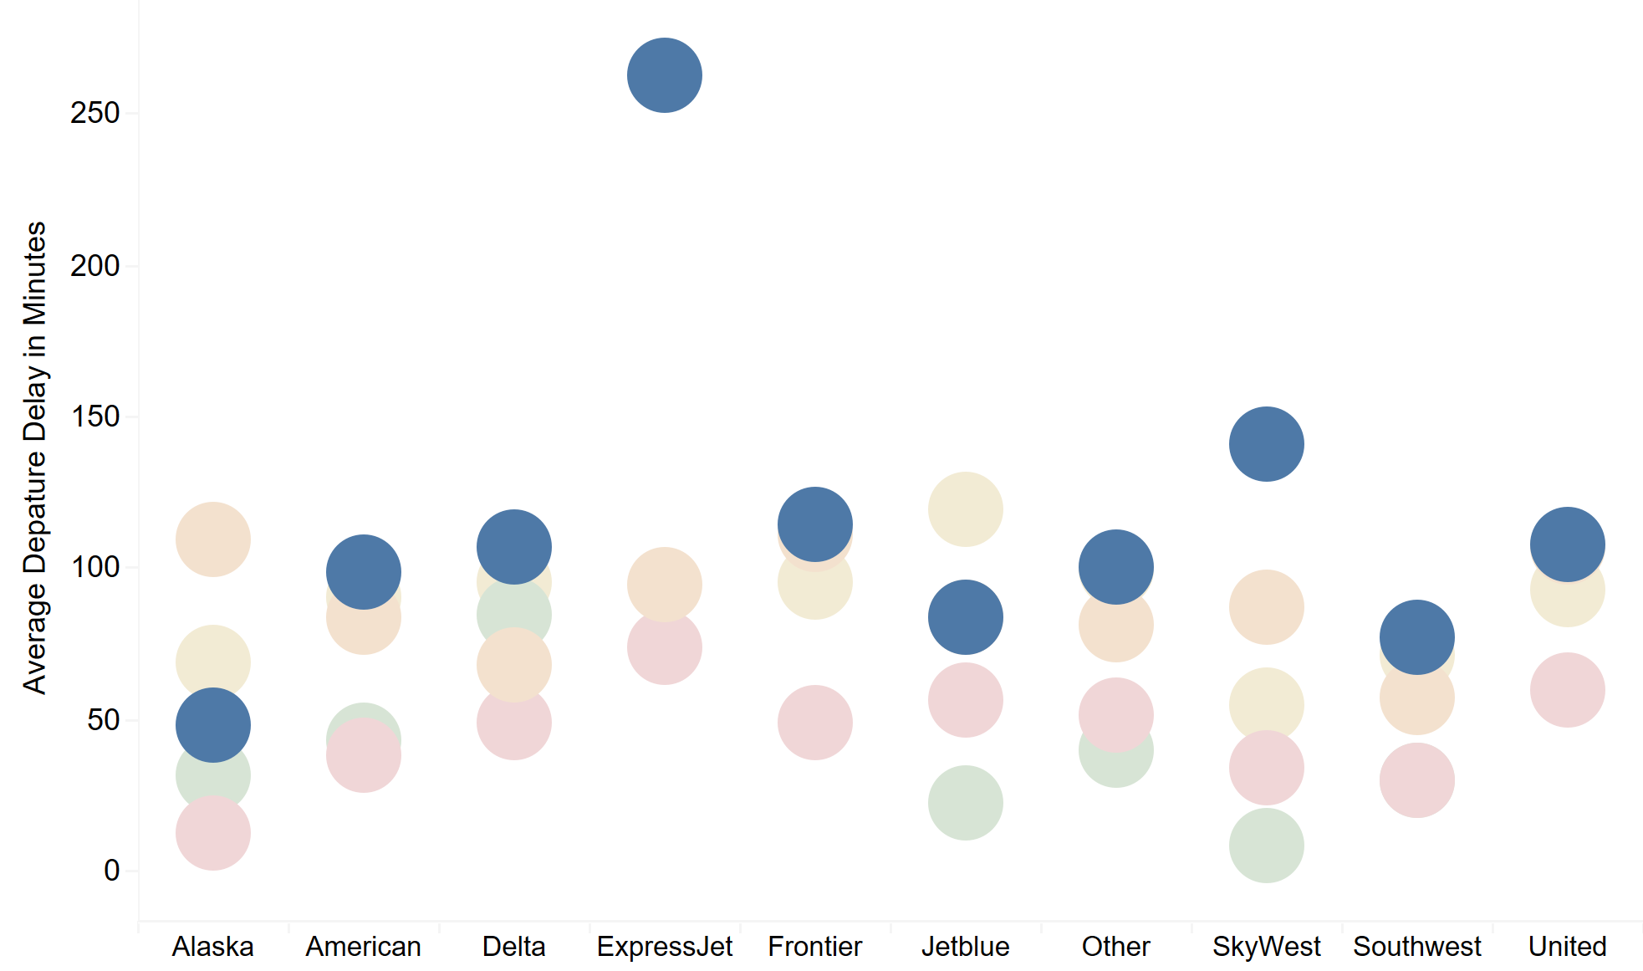
Across carriers that fly from RDU, carrier delays have the highest average departure delays
Notes:
acknowledge here that Alaska Airlines does not follow the same pattern because they have a very low number of flights (9)

Slide 12
What are carrier delays?

Slide 13
Examples of carrier delays
Aircraft Cleaning
Aircraft Damage
Waiting for arrival
of connecting
passengers / crew
Oversales
Engineering
Inspections
Baggage / Cargo Loading
Notes:
The cause of the cancellation or delay was due to circumstances within the airline's control

Slide 14
How is this RDU’s problem?

Slide 15
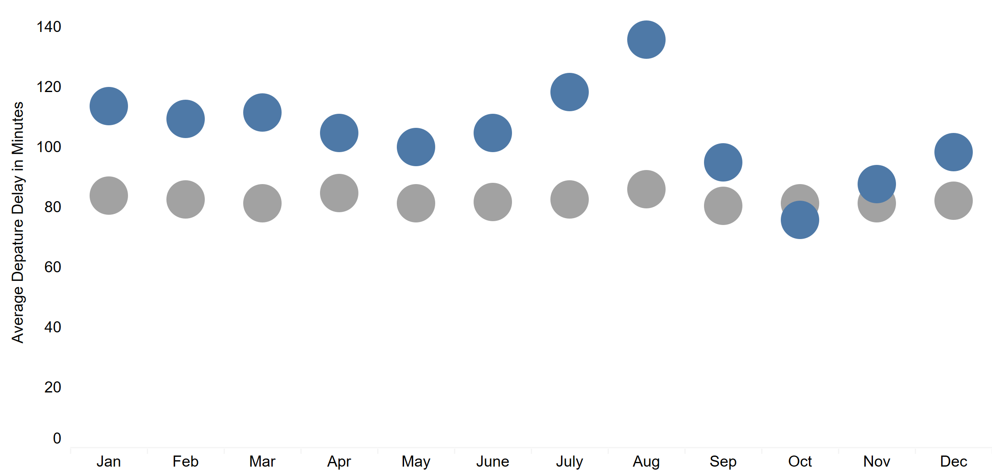

On average, the carrier delays at RDU are worse than those at other airports throughout the year

Slide 16
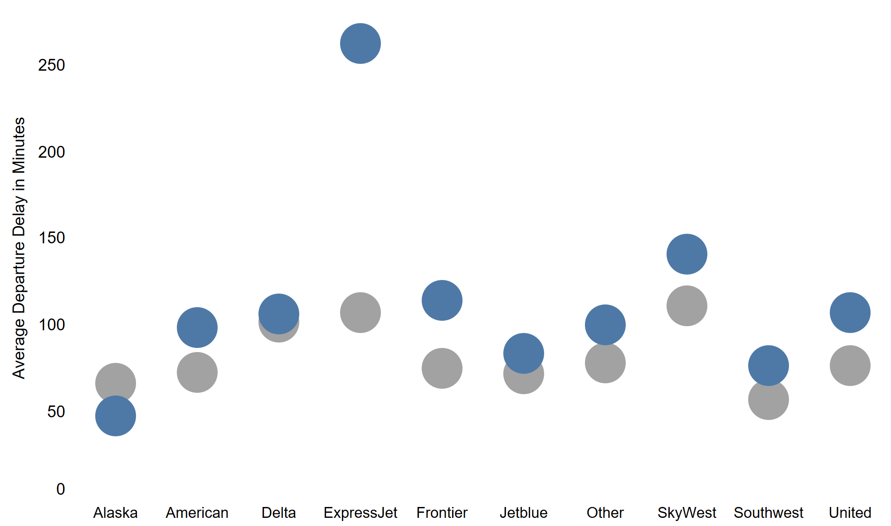
Across carriers, the average carrier delays at RDU are worse than those of the same carriers at other airports

Slide 17
$11.3 million
cost to airlines per year due to carrier delays
Notes:
Cost of carrier delay is $74.24/minute.
Total minutes for carrier delay in RDU: 393,153.
Average carrier delay per months (total carrier delay in mins / 31 months in the dataset) = 12,682 minutes.
Total carrier delay cost, on average, each month is 12,682 * 74.24 = 941,538
https://www.airlines.org/dataset/per-minute-cost-of-delays-to-u-s-airlines/#
This article mentions why we should care about delay. Maybe we can mention the cost of delay
https://www.allthingsontimeperformance.com/flight-delays-in-numbers-not-only-painful-for-passengers/

Slide 18
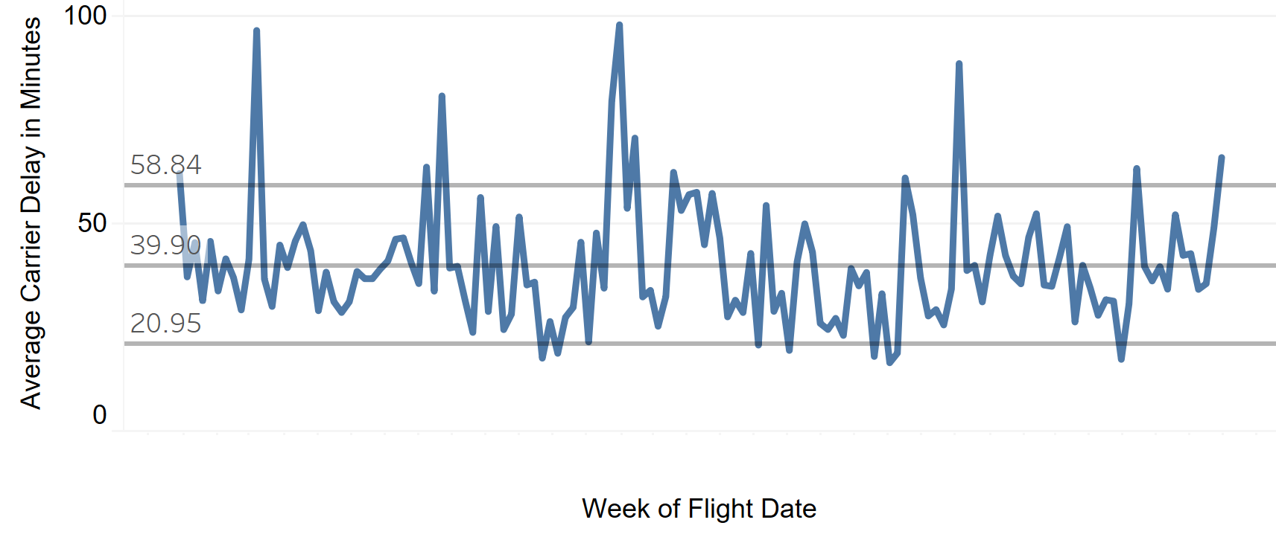
Use 3-sigma control limits to monitor carrier delays more closely
Notes:
Reminder that reducing carrier delays within 3 sigma control limits would reduce departure delays by 17%
Reducing departure delays should in turn reduce arrival delays, having a positive domino effect on flight delays overall
Reduction in arrival delays, causing a positive domino effect on flight delays overall
Improved airport reputation
Job security for RDU airport manager
Satisfied travellers

Slide 19

Notes:
Move back to bigger picture (why do we care/ so what):
A local airport manager should care about the experience of the travelers: minimizing delays and on-time flights are important contributors to a pleasant trip

Slide 20
Thank you!

