Slide 1
Regression Analysis on Infant Mortality Rate in India
Team 29: Chelsea Alford, Lin Lin, Danielle Shediac, Junhong Wengtan, Isaac Parker

Slide 2
Introduction
Case Context
Motivation
Data Understanding

Slide 3
Case Context
We looked into the health survey data in India. This data includes variables, listed below, reflecting various aspects of the health of Indians within the nine Empowered Action Group (EAG) states. These states, while they account for 50% of the population in India, represent a disproportionate amount of infant, child, and maternal deaths. An empirical study with this data may provide insight as to why the EAG states struggle with such high mortality rates.
Variables: state name, district name, literacy rates, infant mortality rate, birthweight, child population, immunization rates, health literacy
Notes:
Data source: https://www.kaggle.com/rajanand/key-indicators-of-annual-health-survey?select=Key_indicator_districtwise.csv

Slide 4
Motivation
We were interested to discover how children vaccinations affect infant mortality rates in India.
Setting up an initial model, we quickly realized an omitted variable bias. While we are sure that the quality of healthcare in any particular region would have a significant impact on mortality rates in that region, we have no data reflecting this. Therefore, we plan to use literacy as an instrument for the omitted variable of healthcare quality / accessibility. Controlling for both the state and birthweight, we hope to elicit a causal effect which shows the impact of vaccinations on mortality.

Slide 5
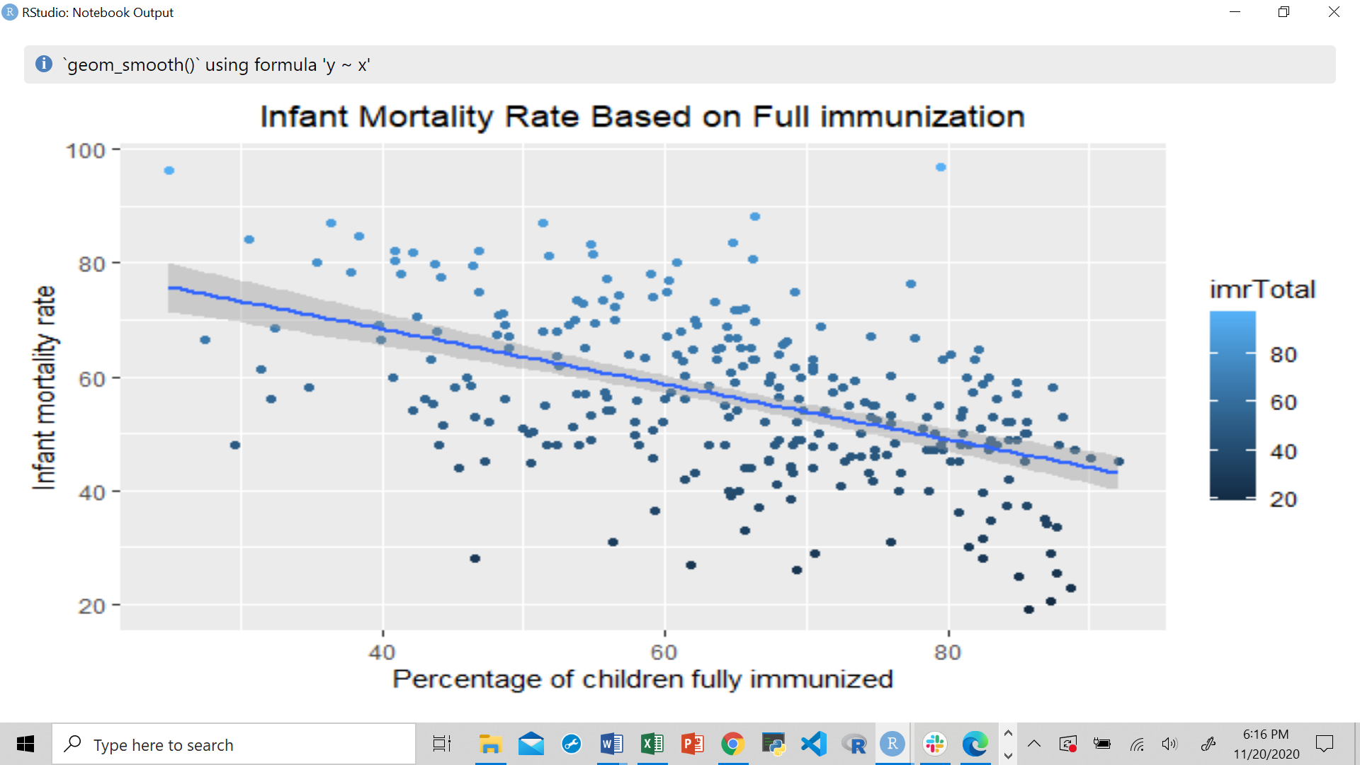
Data Understanding
By plotting the independent variable (infant mortality rate) against the main variable of interest (children fully immunized), it seems like a relationship exists. From the graph, it looks like the higher the percentage of fully immunized children, the lower the infant mortality rate. We would expect this to be the case because as more children are fully vaccinated in a district, the less likely they are to catch deadly diseases.
This does not imply causality, however it is a first step in evaluating the relationship between the two.
Correlation: -0.50

Slide 6
Explanation of Variables
imrTotal: infant mortality rate (%) - dependent target variable
immunizedTotal: children aged 12-23 months fully immunized (%) - independent variable used to elicit causality
bWeightTotal: children with birth weights less than 2.5 kg (%)
State_Name: nine states in India
litRateTotal: effective literacy rate (%)
awarnessTotal: women who are aware of HIV / AIDS (%)
below15Total: population below 15 years old (%)

Slide 7
Literature Review

Slide 8
Literature Review
There are several studies in the literature that have been conducted to search for similar relationships. We focused on those which studied India, as we did, to “control” for other factors in different countries which may skew the findings. Below we summarize some of the most interesting findings.
Parashar: Parashar discovered a positive and significant relationship between the proportion of literate females in a district and a child’s complete immunization status within that district. This correlation maintained significance when controlling for the child’s own mother’s education, and district-level socioeconomic development and healthcare amenities.
Borooah: Borooah’s findings detail a gender bias in child vaccinations, in which the likelihood of girls being fully vaccinated was five percentage points lower than that for boys.
Notes:
Sources:
https://scholarspace.manoa.hawaii.edu/handle/10125/3477
https://jech.bmj.com/content/69/9/849.short
https://www.sciencedirect.com/science/article/abs/pii/S0277953605000225?casa_token=N0bNDBxPK9UAAAAA:MtUuHapyRUsA19vqMG4tCjWbwX8F2os5UNsmmX1Q17yyFCruXl2idiwE4oUkFFfDfEV1rZpS
https://www.sciencedirect.com/science/article/abs/pii/S0277953603003423?casa_token=mk8CL3p6MK0AAAAA:wUKCtJpeIx-SLUdhRwczpu8MVDSA01RNYcVorb8ODvIvcm945R8sR67Nm5kR86griT5qs7_B
https://www.jstor.org/stable/23498935?casa_token=8EM_6shXRZcAAAAA%3AD1qocgA2BOKYTERVKdlQ2OOAB1IRxVI1IvSA3OkM-aorw62jIY4qjl-sQ0wF2BAHe_38vf0ZPb3v2-oNmCGjSpUCLqGe6p71T04O_JwDIY_1Biv3-TM&seq=1#metadata_info_tab_contents

Slide 9
Literature Review
Pandey: Infant and child mortality was found to be affected by the gender of the child, mother’s literacy, access to a toilet, caste, household income, birth order, mother’s age, length of previous and subsequent birth intervals, mortality of an older sibling, and mother’s tetanus immunization.
Johri, et al.: Johri and coauthors found a positive association between maternal health literacy and child’s vaccinations, while controlling for mother’s age, parental education, gender of child, birth order, household religion and wealth.
Gokhale, Rao, Garole: In this study, these authors discovered a high and significant correlation between illiteracy of females and all variables relating to maternal care, as well as infant mortality rate. Interestingly, these negative effects of female illiteracy were compounded in rural areas, as compared to urban areas.
Notes:
Sources:
https://scholarspace.manoa.hawaii.edu/handle/10125/3477
https://jech.bmj.com/content/69/9/849.short
https://www.sciencedirect.com/science/article/abs/pii/S0277953605000225?casa_token=N0bNDBxPK9UAAAAA:MtUuHapyRUsA19vqMG4tCjWbwX8F2os5UNsmmX1Q17yyFCruXl2idiwE4oUkFFfDfEV1rZpS
https://www.sciencedirect.com/science/article/abs/pii/S0277953603003423?casa_token=mk8CL3p6MK0AAAAA:wUKCtJpeIx-SLUdhRwczpu8MVDSA01RNYcVorb8ODvIvcm945R8sR67Nm5kR86griT5qs7_B
https://www.jstor.org/stable/23498935?casa_token=8EM_6shXRZcAAAAA%3AD1qocgA2BOKYTERVKdlQ2OOAB1IRxVI1IvSA3OkM-aorw62jIY4qjl-sQ0wF2BAHe_38vf0ZPb3v2-oNmCGjSpUCLqGe6p71T04O_JwDIY_1Biv3-TM&seq=1#metadata_info_tab_contents

Slide 10
Literature Review
These findings hold various implications for our study.
Firstly, the study done by Parashar found a correlation between literacy and immunizations, which reassures us in the assumption that our instrument is relevant. On the other hand, some of these studies found a correlation between literacy and mortality, suggesting that our assumption of instrument exogeneity may be violated. We will test the validity of our instrument later in out study, with these findings in mind.
Additionally, many of these studies introduced controls that we do not account for, as well as other regressors that showed correlation with both vaccinations and mortality. For example, Borooah found that gender significantly impacted a child’s vaccination status, yet gender is neither a control nor a regressor that we consider in our model. This may highlight that while we are trying to combat omitted variable bias in our model, we will still encounter OVB after we implement IV. This illustrates the practical difficulties in solving omitted variable bias using instrumental variables.

Slide 11
Methodology
Linear Regression
OVB and Instrumental Variables
Simultaneous Equations

Slide 12
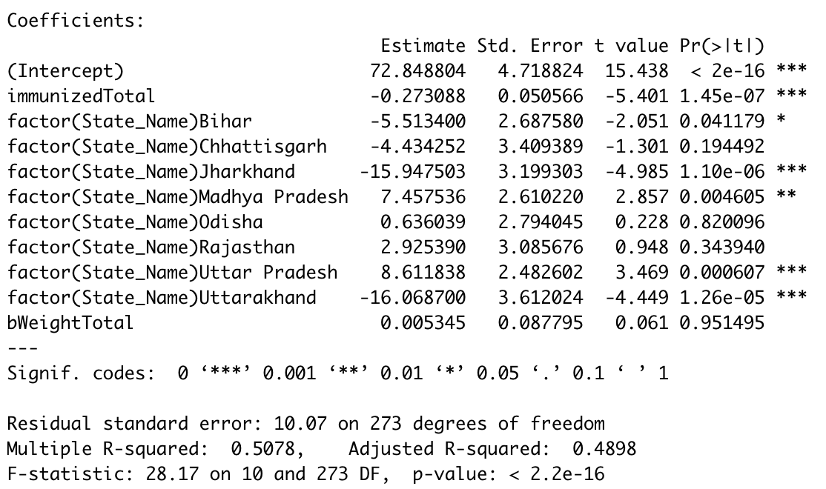
Linear Regression
Results
First, we looked at a multivariate linear regression, while controlling for birth weight (percentage of birth weights less than 2.5 kg) and state differences. The causal effect of interest is the immunization rate on mortality. The regression results are below:
Notes:
Control variables were employed to control for differences between the states of India and the percentage of children with birth weights less than 2.5 kg.
The control variables for states are binary: equal to one if the district was in a particular state and zero if it was not.
Although many of the coefficients on the control variables are statistically insignificant, we felt it was important to control for these aspects in order to get a more realistic picture of how immunization affects mortality rates. The coefficient on the immunization rate was -.27, and because our data is not in decimal form, this implies that for each additional percentage point in immunization, we expect the mortality rate to fall by .27%, all else equal.

Slide 13

OVB and Instrumental Variable
We assume that there is some omitted variable bias in the model, as we do not control for the quality of healthcare.
To solve this bias, we decided to use literacy rate as an instrument for children immunizations.
In the first stage regression, we determined the instrument was relevant at the 99% confidence level.
We cannot test for exogeneity of literacy rate, however we believe that it is exogenous as we doubt that it directly impacts the quality of healthcare and infant mortality rate.
Infant Mortality Rate
Children Immunizations
Quality of Healthcare
Literacy Rate
Notes:
We are interested in the causal effect of the percentage of children (12-23 months) fully immunized on infant mortality rate. This relationship is however plagued by the omitted variable bias. In this case, we believe quality of healthcare is an omitted variable that has a direct impact on infant mortality rate and has an effect on the percentage of children fully immunized.
To solve for this bias, we decided to use literacy rate as an instrument variable. Though we would think this variable would be exogenous, as it does not seem to directly affect the quality of healthcare or the infant mortality rates (once we control for healthcare quality and children immunizations), our findings in the literature review suggest that this instrument may violate exogeneity. Since we cannot determine this directly, we continued with our instrument, but we maintain reservations about its exogeneity. In terms of relevance, we ran the first stage regression of children immunization based upon literacy rate and it seemed like there was a significant positive relationship between the two. As shown in the next slide, we also performed a Weak Instrument test, which confirmed that literacy rate is a relevant instrument.

Slide 14
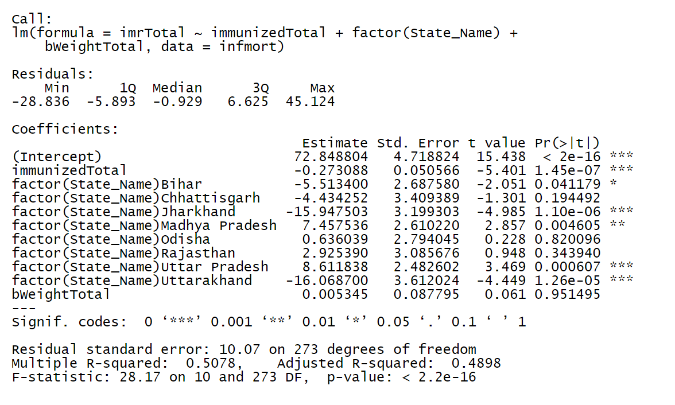
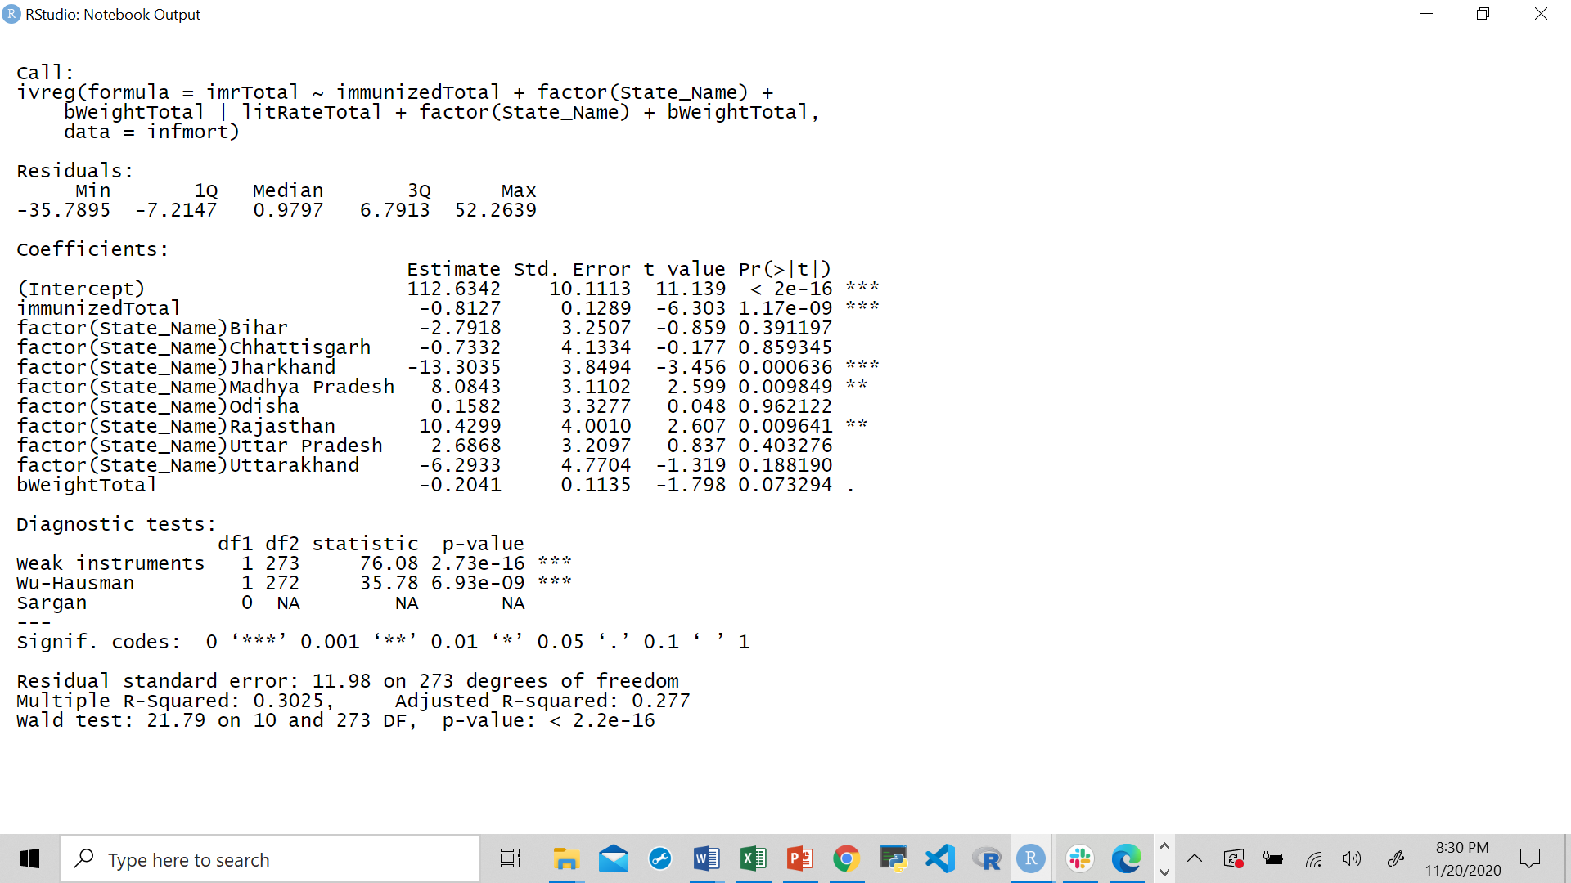
OLS vs. IV Regression Results & Interpretation
We first ran a linear model using dummy variables for state names and % of birthweight less than 2.5 kg as controls:
We then ran an IV regression using literacy rate as the instrument variable for immunizations:
Notes:
The coefficient of immunization on infant mortality rate in the OLS regression is -0.27 while that for the IV regression is -0.81. This shows that the coefficient in the OLS regression was affected by the omitted variable bias. The bias was in fact positive, meaning that it underestimated the negative effect of immunizations on infant mortality rate. We see that by using literacy rate, the impact of immunization on infant mortality rates is stronger.
We then tested for relevance of the instrument variable, literacy rate, using the Weak Instrument Test. The null hypothesis states that literacy rate is a weak instrument. However, we get a very low p-value, indicating we need to reject the null hypothesis. In conclusion, literacy rate is a relevant instrument variable.
We also tested for the endogeneity of the independent variable, immunization. The Wu-Hausman Test’s null hypothesis states that immunizations is exogenous. However, given a low p-value, we must reject the null hypothesis and conclude that immunization is endogenous. This reinforces the omitted variable bias and the fact that we need an instrument variable to solve for this endogeneity.

Slide 15
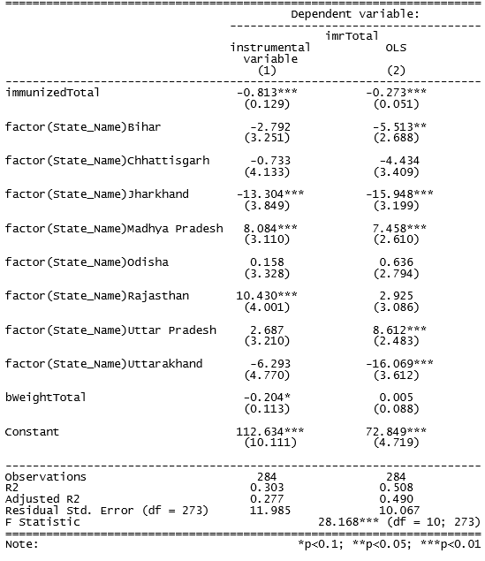
OLS vs. IV Regression Results & Interpretation
Notes:
The coefficient of immunization on infant mortality rate in the OLS regression is -0.27 while that for the IV regression is -0.81. This shows that the coefficient in the OLS regression was affected by the omitted variable bias. The bias was in fact positive, meaning that it underestimated the negative effect of immunizations on infant mortality rate. We see that by using literacy rate, the impact of immunization on infant mortality rates is stronger.
We then tested for relevance of the instrument variable, literacy rate, using the Weak Instrument Test. The null hypothesis states that literacy rate is a weak instrument. However, we get a very low p-value, indicating we need to reject the null hypothesis. In conclusion, literacy rate is a relevant instrument variable.
We also tested for the endogeneity of the independent variable, immunization. The Wu-Hausman Test’s null hypothesis states that immunizations is exogenous. However, given a low p-value, we must reject the null hypothesis and conclude that immunization is endogenous. This reinforces the omitted variable bias and the fact that we need an instrument variable to solve for this endogeneity.

Slide 16
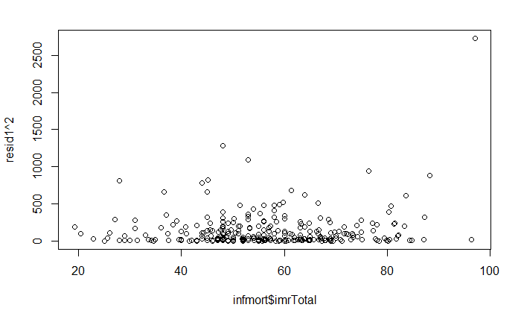
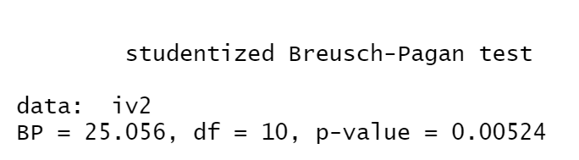
Test For Heteroscedasticity
Squared Residual Plot
Notes:
To understand our model better, we tested heteroscedasticity. We used bptest() to detect heteroscedasticity. The p-value is 0.00524, so we reject the null hypothesis that we have homoscedasticity. Therefore, we do have a heteroscedasticity issue in our model.
We also see this issue by plotting squared residuals against infant mortality rate. Here, the appearance of heteroscedasticity is more intuitive.
Under heteroscedasticity, the estimate coefficient is unbiased and consistent, however, the estimator still will be biased for standard error. This increases the probability of suffering Type 2 error, and we may drop variables actually important to the model.

Slide 17
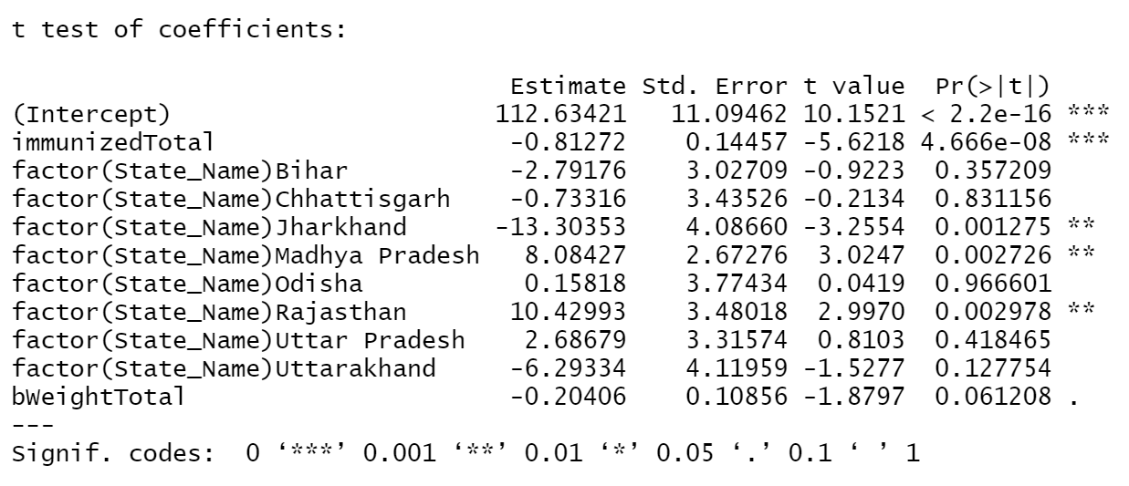
Solution For Heteroscedasticity
Adjust for Robust Standard Errors.
Notes:
In addition to using robust standard errors to solve for heteroscedasticity, we have other methods as well. For example, we can use transformation, as we may have non-linear effects of variables. Also, we may use GLS, FLGS, Clustered Standard Errors, or Weighted Least Squares to help us.
The result of robust.se(iv2). Some standard errors increased, such as the standard error of immunizedTotal. Yet some standard errors decreased, such as factor(State_Name)Chhattisgarh. Some standard errors changed only a little, such as bWeightTotal.

Slide 18
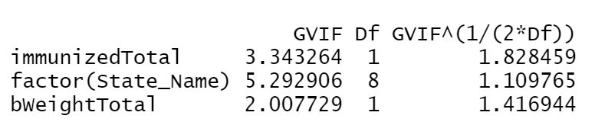
Test For Multicollinearity
Notes:
Code: vif(iv2). VIF results are all far less than 10, thus we don’t have a multicollinearity issue.

Slide 19
Simultaneous Equations - Demonstration
Infant Mortality Rate
Factors impacting infant mortality rate:
Children immunization
State name
Percentage of children with birth weight less than 2.5 kg
Jointly Determined
Children Fully Immunized
Factors impacting children immunization:
Infant mortality rate
Percentage of population younger than 15 years old
Women awareness on HIV / AIDS
Simultaneity Bias
Notes:
Infant mortality and percentage of fully immunized children are jointly determined. In fact, we could expect the percentage of fully immunized children to increase as the infant mortality rate increases. Parents could be more inclined to immunize their children as the infant mortality rate increases.This causes simultaneity bias, meaning we cannot rely on the OLS regression coefficient for immunization on infant mortality rate.

Slide 20
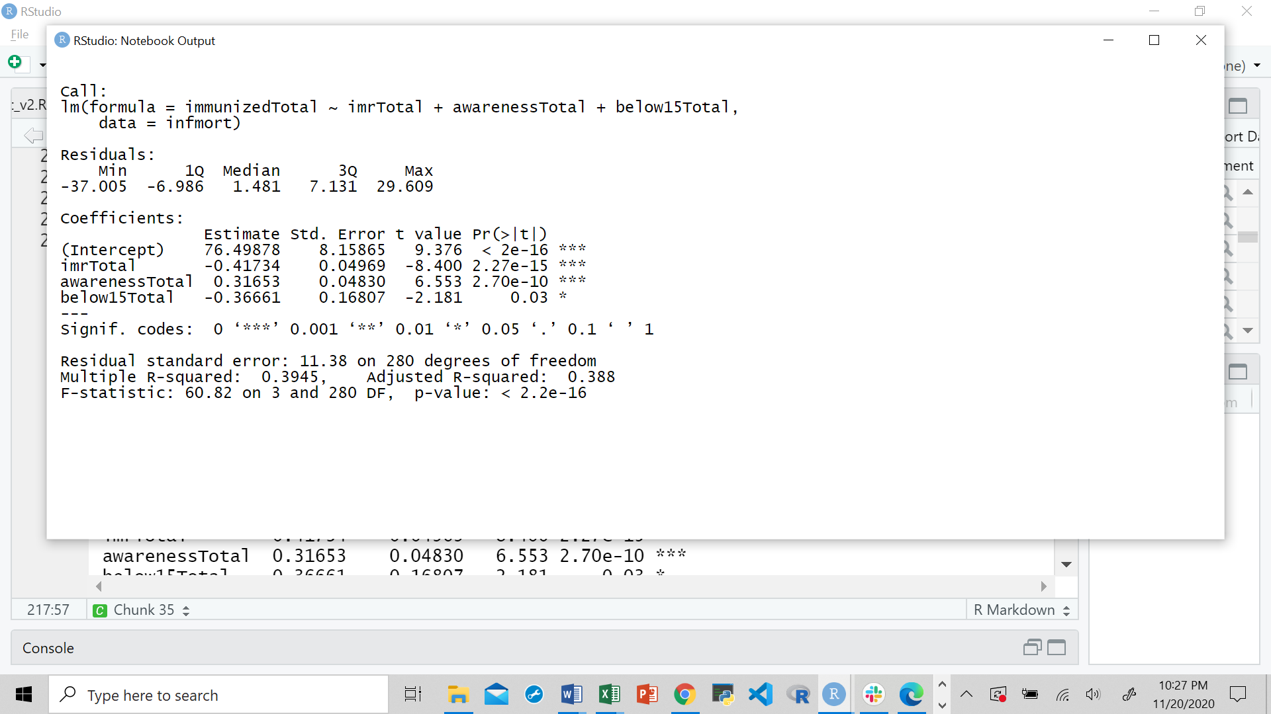
Simultaneous Equations - Linear Regressions
Infant Mortality Rate Regression:
Immunization Regression:
Notes:
The infant mortality rate OLS regression is repeated on the left. On the right, we ran the OLS regression of immunization on infant mortality rate, awareness of HIV / AIDS and percentage of population below 15 years old. We can see that for infant mortality, immunization is significant and that for immunization, infant mortality is significant. This illustrates the simultaneity bias. We therefore cannot rely on the coefficient for immunization in the infant mortality equation (-0.27) because it is biased.

Slide 21
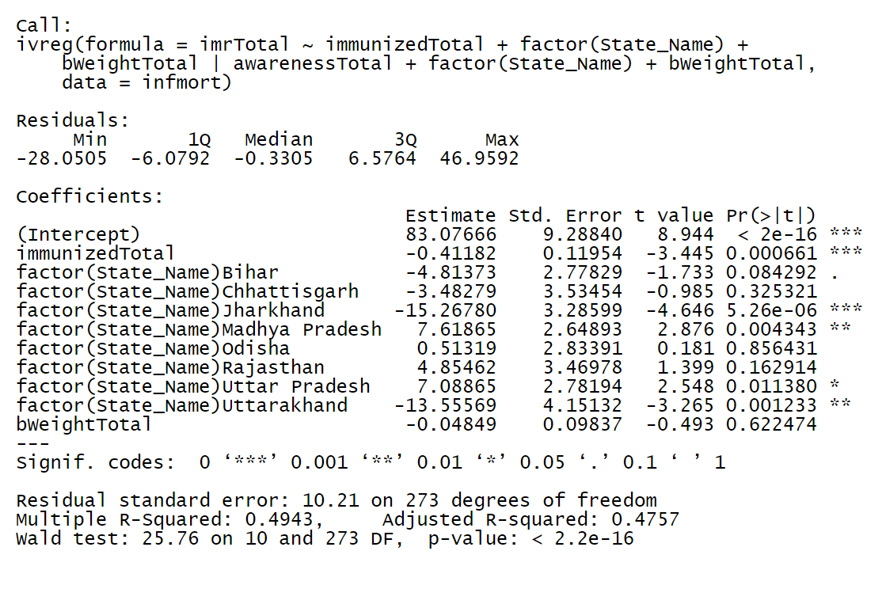
Simultaneous Equations - Instrument Variable
IV Regression for infant mortality using awareness on AIDS / HIV as IV:
Awarness about AIDS / HIV Used as IV for Infant Mortality Equation (Identified Equation)
Exogenous:
Order Condition
Relevant:
Rank Condition
Notes:
A solution to mitigate the simultaneity bias is to identify the infant mortality equation using an instrument variable from the immunization equation. This variable must satisfy the order and rank conditions. Awareness of HIV / AIDS is an exogenous variable present in the immunization equation but not present in the infant mortality equation. This satisfies the order condition. Awareness is relevant to immunization as it has a non-zero population coefficient in the immunization equation(0.32). We could therefore use it as an instrument variable for the infant mortality equation.
Once we do so, the coefficient for immunization changes from -0.27 to -0.41. This means that the coefficient in the OLS regression was affected by the simultaneity bias. The bias was in fact positive, meaning that it underestimated the negative effect of immunizations on infant mortality rate. We see that by using awareness, the impact of immunization on infant mortality rates is stronger.

Slide 22
Conclusion

Slide 23
Findings
In our project, we studied the causal impact of immunization on infant mortality rate. Using linear regression, we found that immunization has a negative effect on infant mortality, as one would expect. However, there were two main problems with using linear regression: omitted variable bias and simultaneity bias.
To solve for the omitted variable bias, we found literacy rate to be an exogenous and relevant instrument variable. After performing an IV regression, the marginal impact of immunization on infant mortality rate was stronger than that of OLS. This confirmed that a bias existed and that it was a positive one that underestimated the impact of immunization on IMR.
To solve the simultaneity bias, we took awareness on HIV / AIDS as an instrument for the IMR equation from the immunization equation. This variable satisfies the order and the rank conditions. In this case, the marginal impact of immunization on IMR is also stronger than that of the OLS regression, but weaker than when we use literacy rate as the instrument variable.
Instrumental variables, while hard to find in practice, can solve for serious biases that show up when using linear regressions.
In our case, the bias was positive and using instrument variables allowed us to make a stronger case for causality of children immunization on infant mortality rates.

