Slide 1
Capstone Project

Slide 2
Introduction
The location of the restaurant not only affects the market development capacity of the catering company, but also the size of its attractiveness to consumers, but more importantly, it has a strategic impact on the long-term benefits.
Here we are mainly trying to investigate where would be a good choice for opening a new Chinese restaurant in Toronto from the perspective of location selection.
Background
Canada has an open immigration policy and a diverse and inclusive culture. Its diverse dining culture makes many restaurants with different styles or exotic flavors emerge in Canada. Toronto, the capital of Ontario, is the largest city in Canada and also one of the most diverse.

Slide 3

Target audience:
Who would be interested in this project?
business person that are considering opening a restaurant and they wonder how to choose the best location for their business;
anyone looking for a nice place to get a meal in Toronto;
Data scientists that are interested in the same topic of using location data to explore a geographical location.

Slide 4
Data
Data that will be used to solve the problem:
Toronto neighborhood data scraped from a Wikipedia page: https://en.wikipedia.org/wiki/List_of_postal_codes_of_Canada:_M
a csv file that has the geographical coordinates of each postal code: https://cocl.us/Geospatial_data
Foursquare location data, with latitude and longitude coordinates of each neighborhood.
Foursquare API to explore neighborhoods in Toronto.

Slide 5
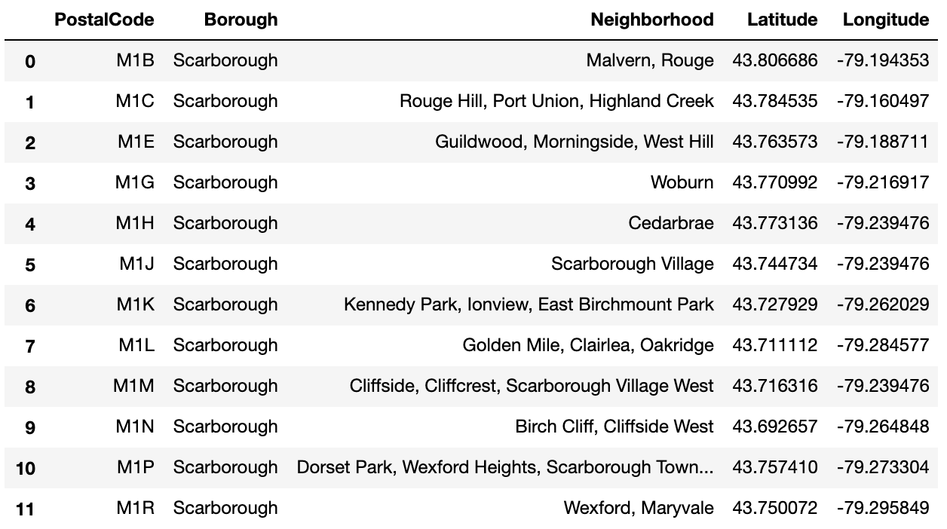
Toronto neighborhood data

Slide 6
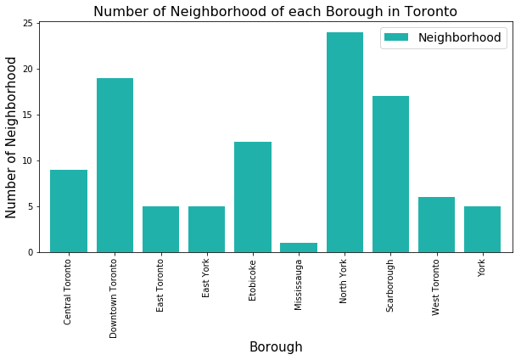
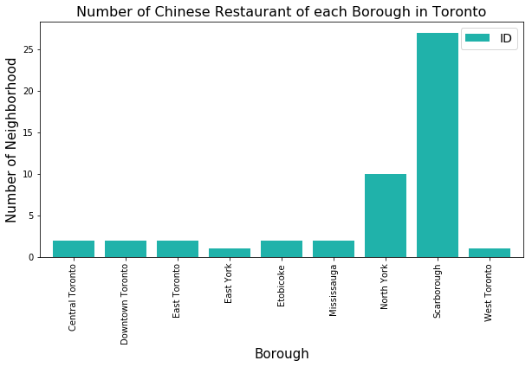
Exploratory Data Analysis

Slide 7
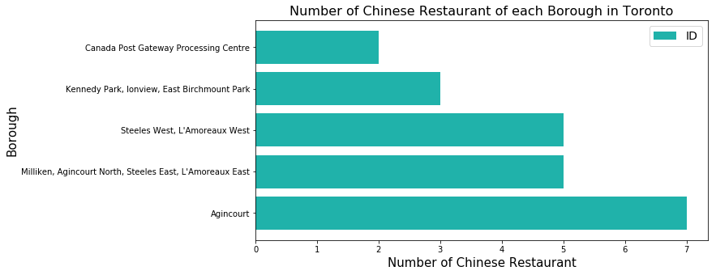

Slide 8
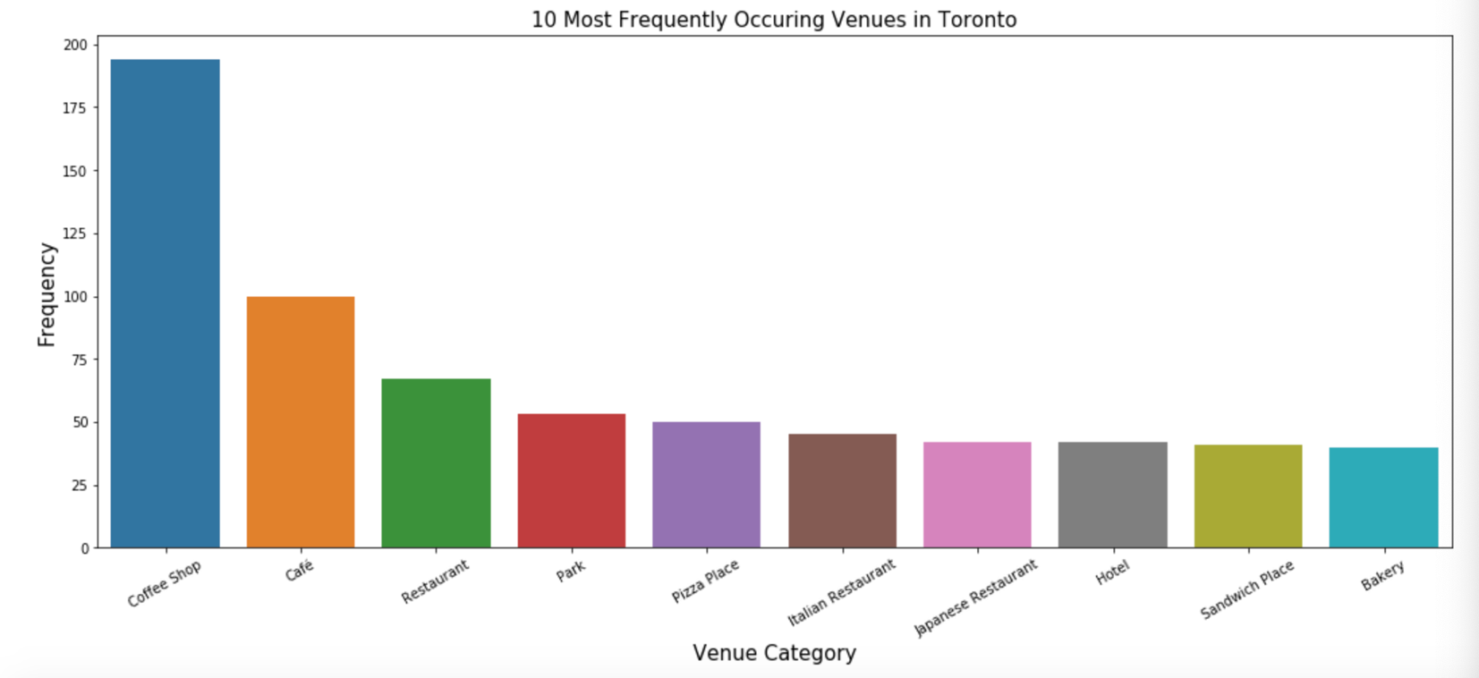

Slide 9
Results & Discussion
Coffee shops, café, Restaurants, park, pizza place are the most common venues in Toronto.
Coffee shops is the most frequent venue among all categories in Toronto according to Foursquare API. For Chinese restaurants specifically, the frequency is quite low, maybe some of them have not been verified and added to Foursquare API database yet. But it can be said that there is still a lot of room for expansion in the market for Chinese restaurant.
Clustering neighborhoods based on their most popular venues grouped.
Scarborough has the largest number of Chinese restaurants. And North York ranks the second place. And Agincourt has the largest number of Chinese restaurants, which is a neighborhood located in Scarborough.
East York and West Toronto only have one Chinese restaurant in the database. Almost all Chinese restaurants are located in Scarborough. North York, East Toronto, Central Toronto, Downtown Toronto, Mississauga, Etobicoke have about the same number.

Slide 10
Conclusion
Depend on the results of our analysis, we conclude that final decision on optimal restaurant location will be made by stakeholders based on specific characteristics of neighborhoods and locations in every recommended zone, taking into consideration additional factors like rent, passenger flow, traffic, etc.

Slide 11
Thanks!

