Slide 1
Pool it Together
Team 1
Chelsea - Sly - CuiCui - Free

Slide 2
Our Mission
Swimming Pool Retail and Service Planning App
Season businesses have unique challenges
Using contractors to complete service work
We want to be competitive with larger businesses

Slide 3
Business Rules
If a customer purchases over $500.00 they get a 10% discount
Customers with pool fully measured receive free water testing
Products aim to be sold for 110% of suppliers price
Top performing Employee receives bonus equal to 10% of their sales

Slide 4
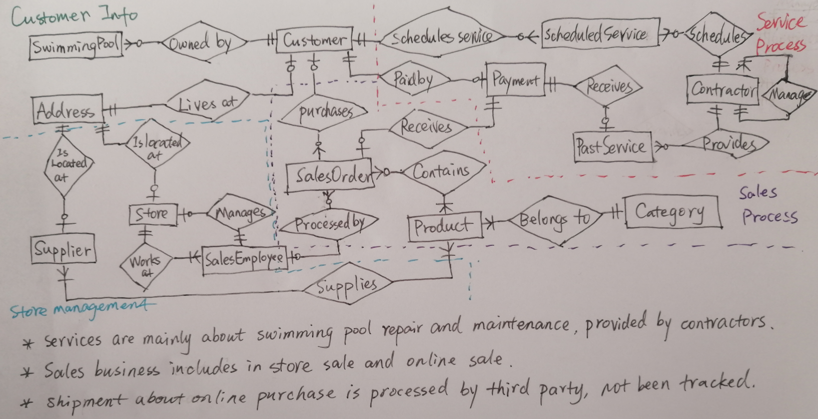
ER Diagram Conceptual Model

Slide 5
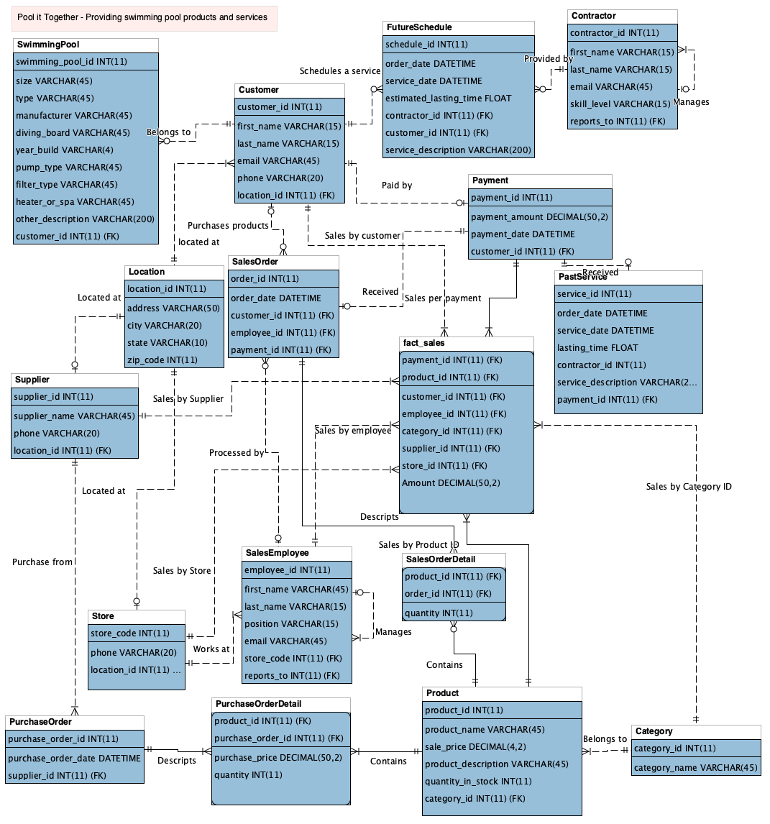
ER Diagram
Physical Model
-The company has several branches, providing swimming pool repair and maintenance services and selling related products.
-The fact table allows users to analyze the revenue by product, product category, customer, employee, store, supplier, etc.

Slide 6
Queries and Stored Procedures
Creating Stored Procedure to find contractor schedule
Creating Stored Procedure to find PO (purchase order) details
Creating Stored Procedure to find TOP customers by sales

Slide 7
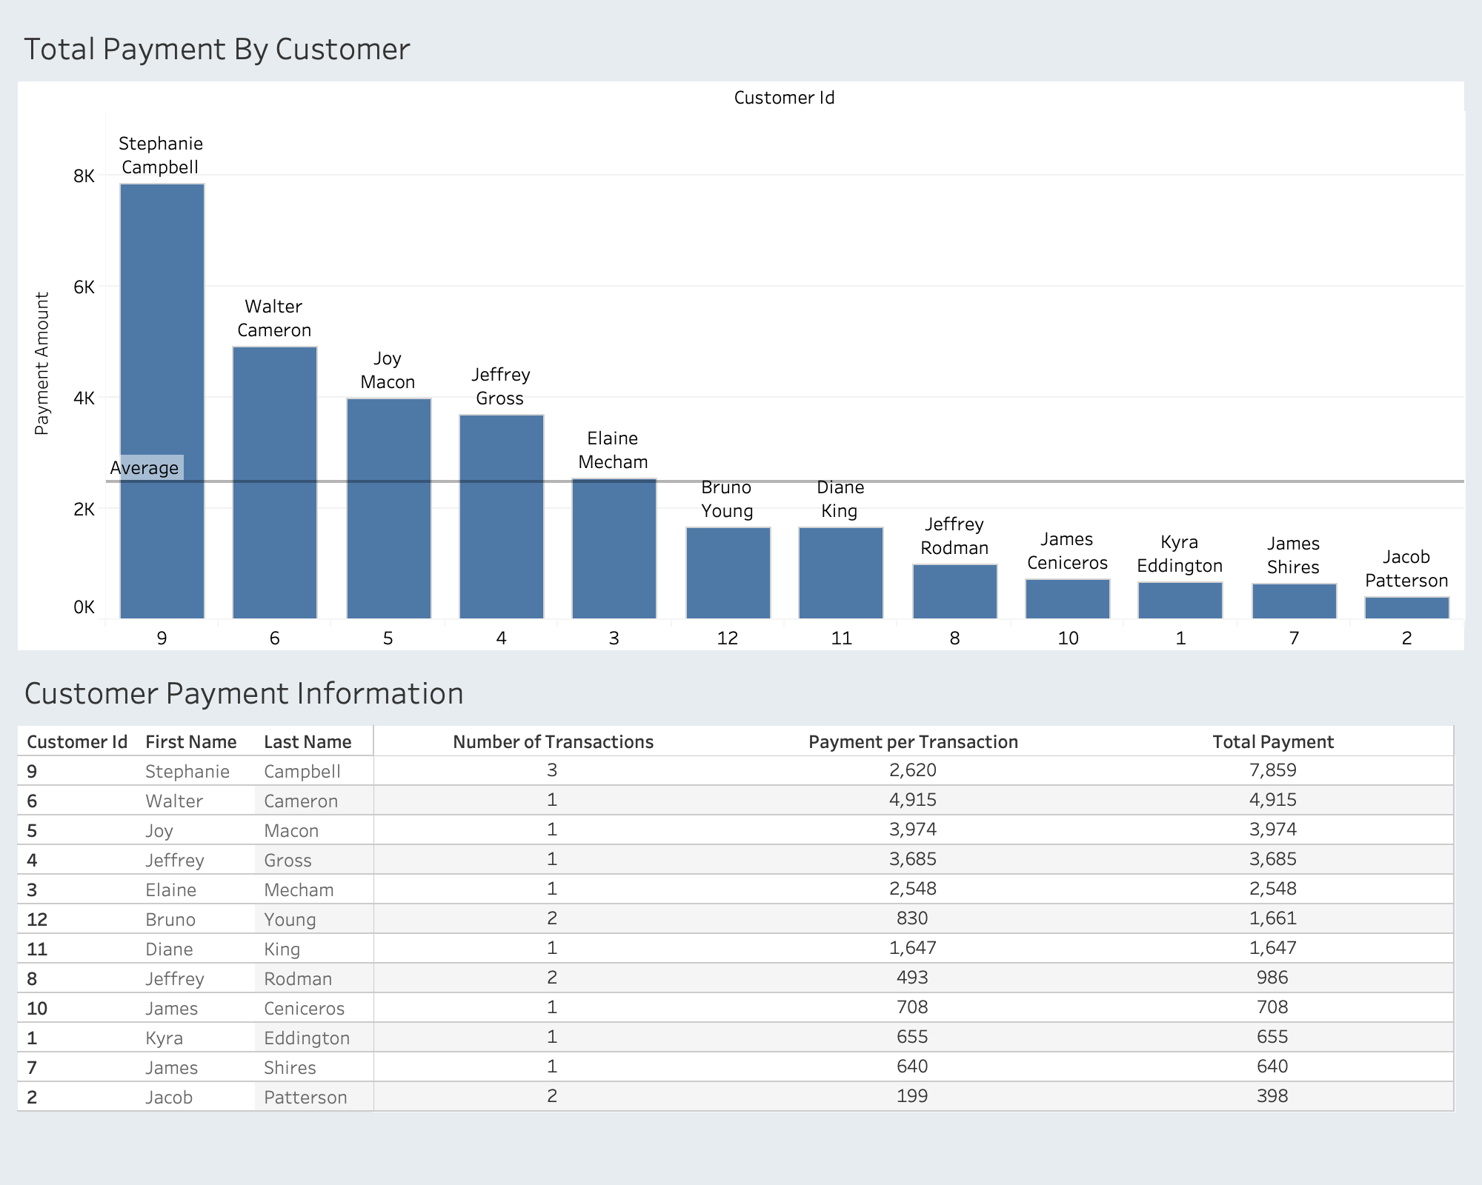
Analytical Output of Tableau - 1
- Who are our loyal customers?
- Tables used: Customer, Payment
- Discount/reward to loyal customers
- Help target specific customers

Slide 8
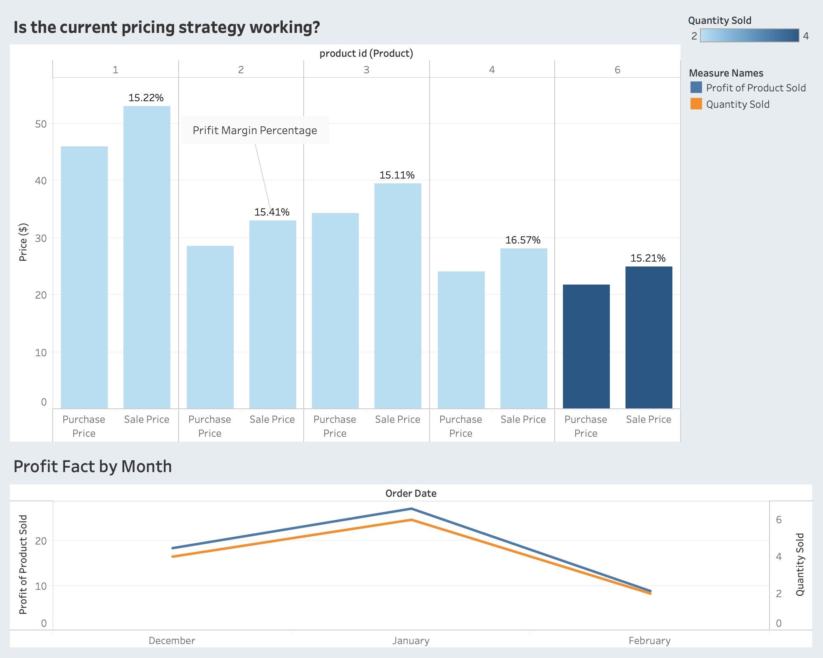
Analytical Output of Tableau - 2
- Do we need to adjust our pricing strategy?
- How’s the business doing in each month?
- Tables used:Product, PurchaseOrderDetail, SalesOrder, SalesOrderDetail

Slide 9
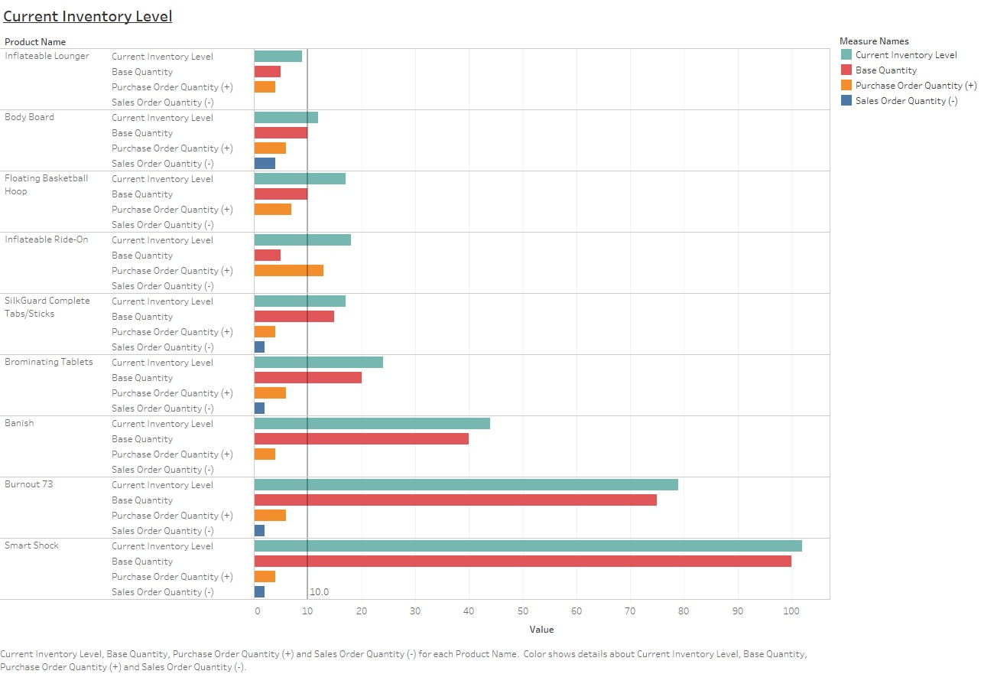
Analytical Output of Tableau - 3
The analytical output to the graph on the right shows how much of the inventory we have been buying and how much we have been selling.
We can use this to look at how each inventory has been performing. If it hasn’t been selling well, it maybe is the time to cut it off.
Table used: Purchase Order Detail, Sales Order Detail, Product

Slide 10
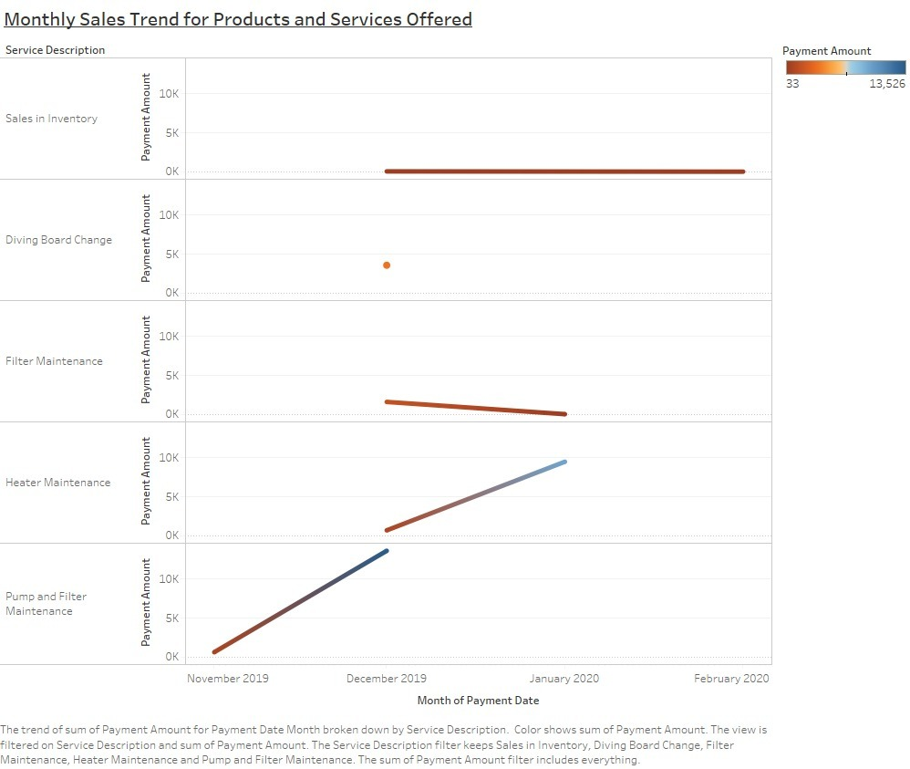
Analytical Output of Tableau - 4
The analytical query and visualization shown in the graph on the right reflect the monthly sales trend for products and services offered.
The graph shows what kinds of service we have conducted and how much sales we have coming into the business.
The null values with no service ID in the original queries reflect the sales in inventory
Table used: Payment and Past Services

Slide 11
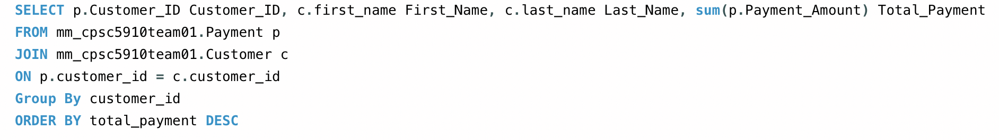
Appendix - Tableau graphs come from...
Important Notes: Further development have also been conducted via Tableau Desktop, including operations such as joining, group by, order by, etc.

Slide 12
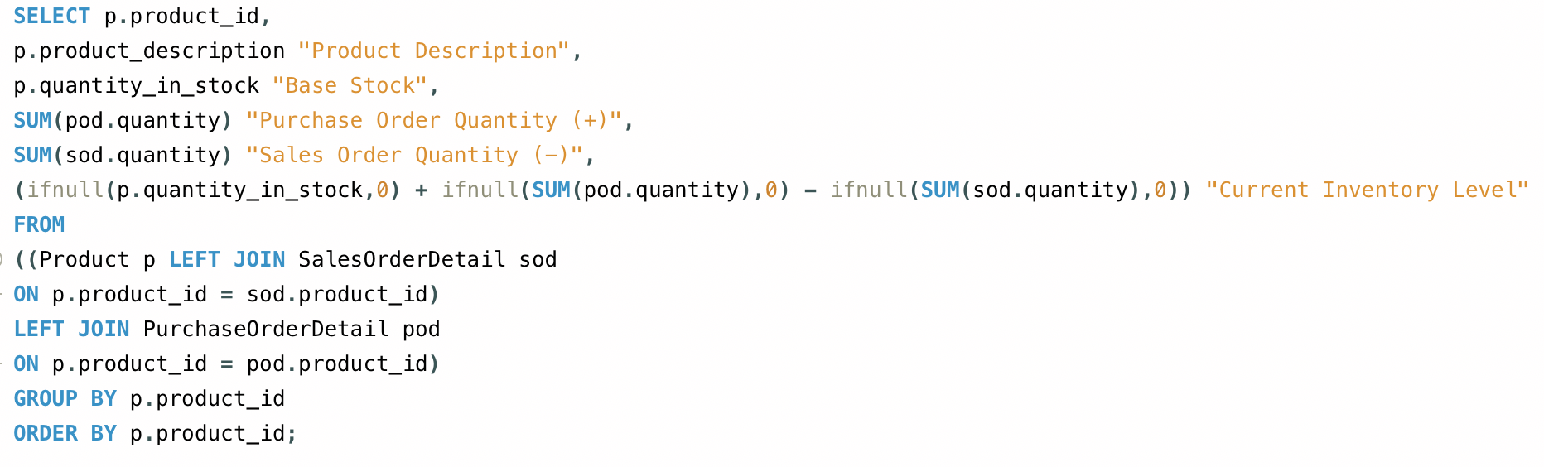
Appendix - Tableau graphs come from...
Important Notes: Further development have also been conducted via Tableau Desktop, including operations such as joining, group by, order by, etc.

Slide 13
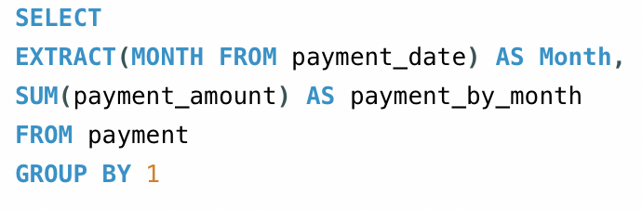
Appendix - Tableau graphs come from...
Important Notes: Further development have also been conducted via Tableau Desktop, including operations such as joining, group by, order by, etc.

