Slide 1
Progress Update: Pseudogene Mapping
Chelsea Ju
2013.08.23

Slide 2
Data Preparation
Take only the top 500 pairs of pseudogene-parent from pseudogene.org (version 72).
The data contains 385 unique parents.
Paired-end reads are generated from dwigsim, without sequencing errors.
Map the reads to reference genome using Tophat2.
Number of Gene | 92 |  | 358
Total Gene Length (base) | 175872 |  | 736926
Coverage and Read Length | Reads (#) | Mapped Reads(%) | Reads (#) | Mapped Reads(%)
10X 75L | 23450 | 96.40% | 98260 | 96.35%
10X 100L | 17950 | 94.37% | 73702 | 94.66%
100X 75L | 234494 | 96.62% | 982562 | 96.45%
100X 100L | 175910 | 94.13% | 737096 | 94.45%

Slide 3
Data Analysis: Approach 2
Build Expression Distribution Matrices for Fragment and FPKM
 | Expected | P1 | P2 | P3 | P4 | P5 | S1 | S2 | S3 | S4 | S5 | Others
P1 | 1291 | 1291 | 0 | 0 | 0 | 4 | 0 | 0 | 0 | 0 | 0 | 0
P2 | 627 | 0 | 504 | 0 | 0 | 0 | 0 | 0 | 0 | 0 | 0 | 314
P3 | 869 | 0 | 0 | 864 | 0 | 0 | 0 | 29 | 0 | 0 | 0 | 0
P4 | 238 | 0 | 0 | 0 | 49 | 9 | 0 | 0 | 13 | 0 | 0 | 0
P5 | 709 | 0 | 0 | 0 | 0 | 709 | 0 | 0 | 0 | 0 | 0 | 0
S1 | 0 | 0 | 0 | 0 | 0 | 0 | 0 | 0 | 0 | 0 | 0 | 0
S2 | 0 | 0 | 0 | 0 | 0 | 0 | 0 | 0 | 0 | 0 | 0 | 0
S3 | 0 | 0 | 0 | 0 | 0 | 0 | 0 | 0 | 0 | 0 | 0 | 0
S4 | 0 | 0 | 0 | 0 | 0 | 0 | 0 | 0 | 0 | 0 | 0 | 0
S5 | 0 | 0 | 0 | 0 | 0 | 0 | 0 | 0 | 0 | 0 | 0 | 0

Slide 4
Data Analysis: Approach 2
Counting Fragments Mapped to Multiple Genes
Over-count: increase fragment count for all the mapped genes
Under-count: ignore all the fragments with multiple mapping
Unique-count: randomly select one gene for that fragment
Extract Matrix Information
Extract the rows that contain at least one mapped fragment from the matrix (ie, sum of FPKM or fragment count > 0)

Slide 5
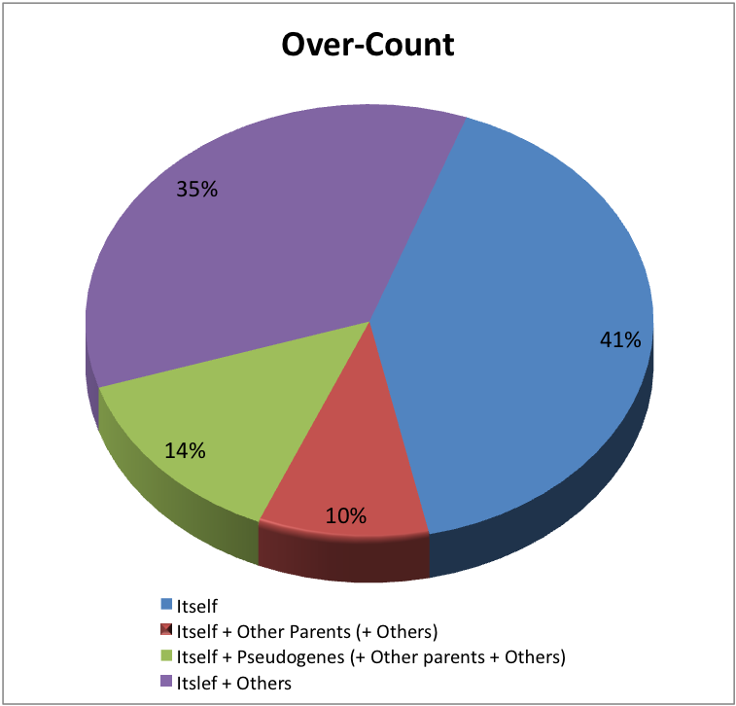
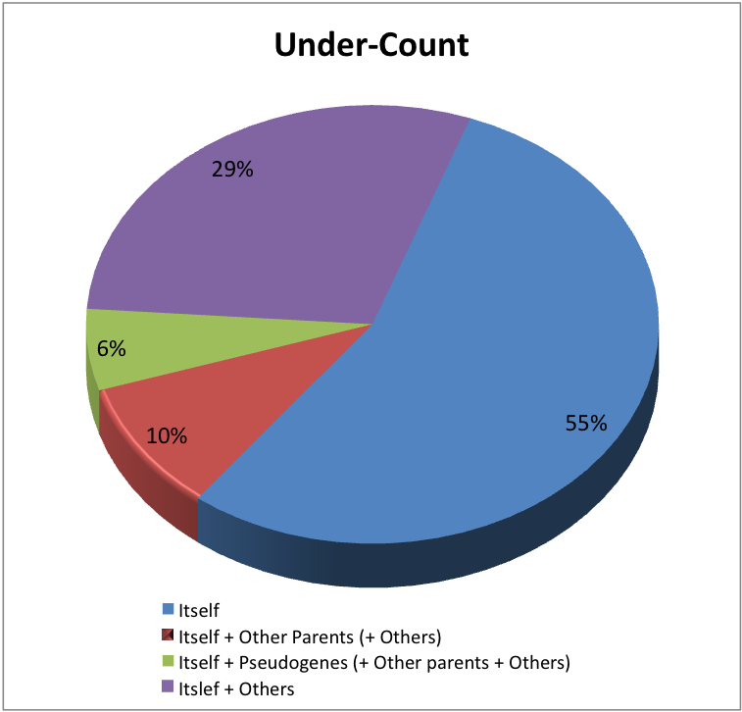
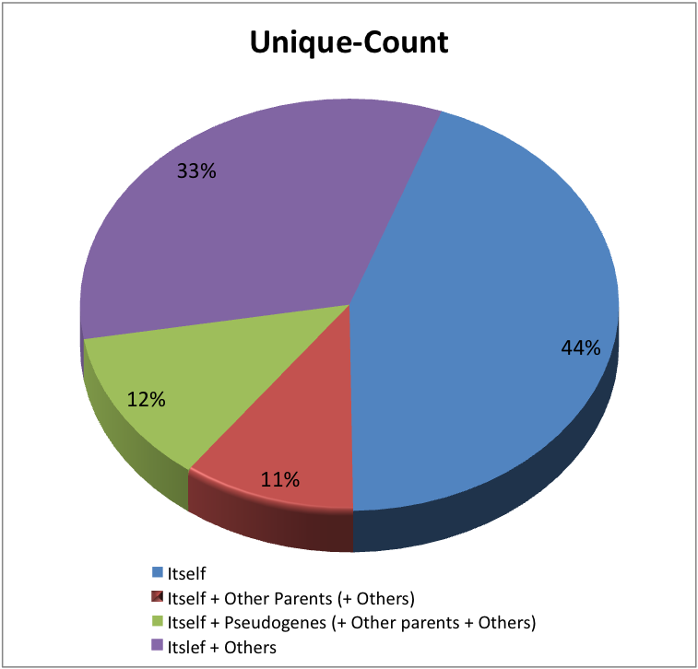
Results: Expression Distribution
Total = 358 parents
Coverage 10X, Read length 100L
~ 12% of the parent genes contain fragments mapped to the pseudogenes

Slide 6
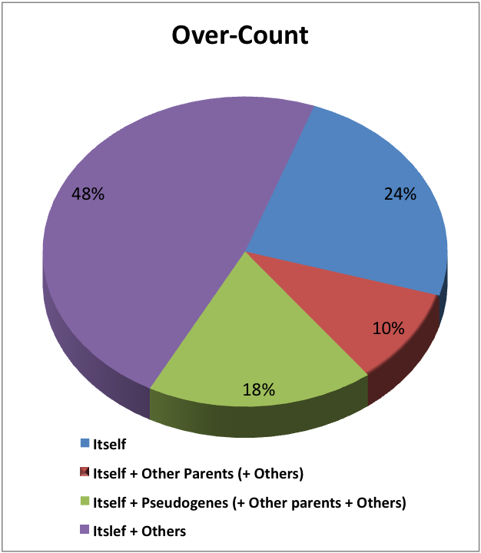
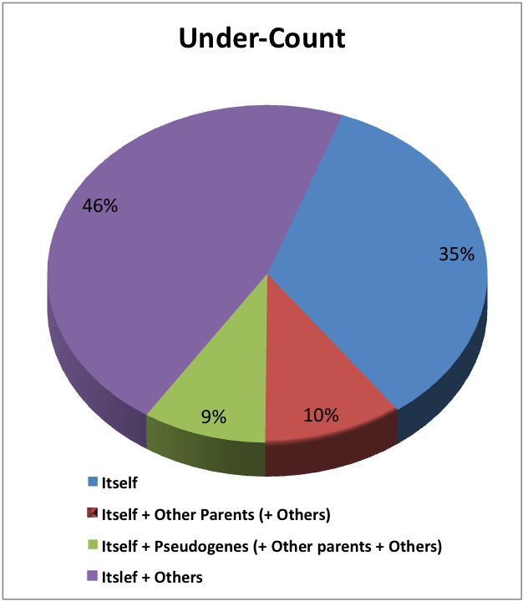
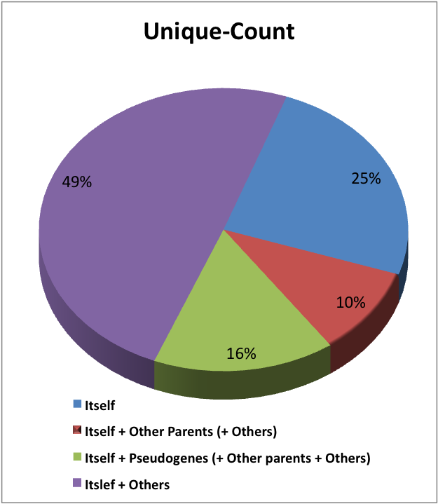
Results: Expression Distribution
Total = 358 parents
Coverage 100X, Read length 100L
~ 14% of the parent genes contain fragments mapped to the pseudogenes

Slide 7
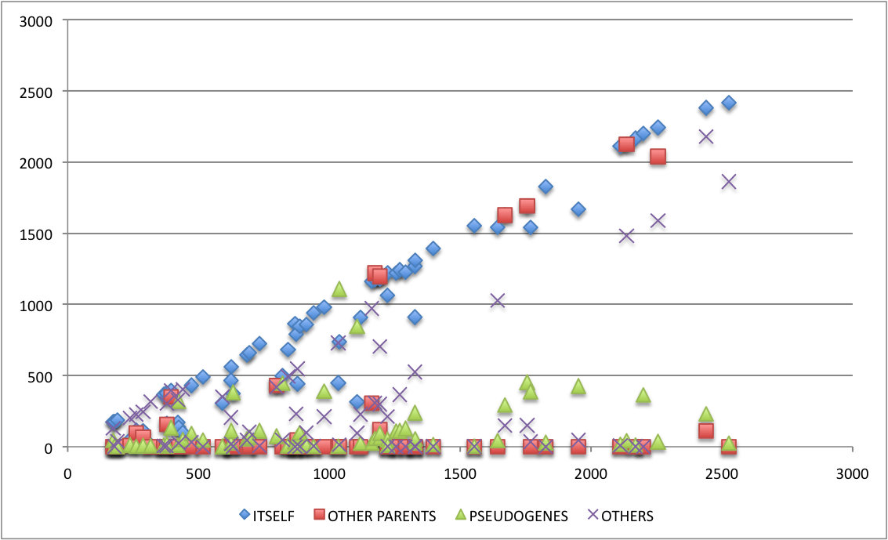
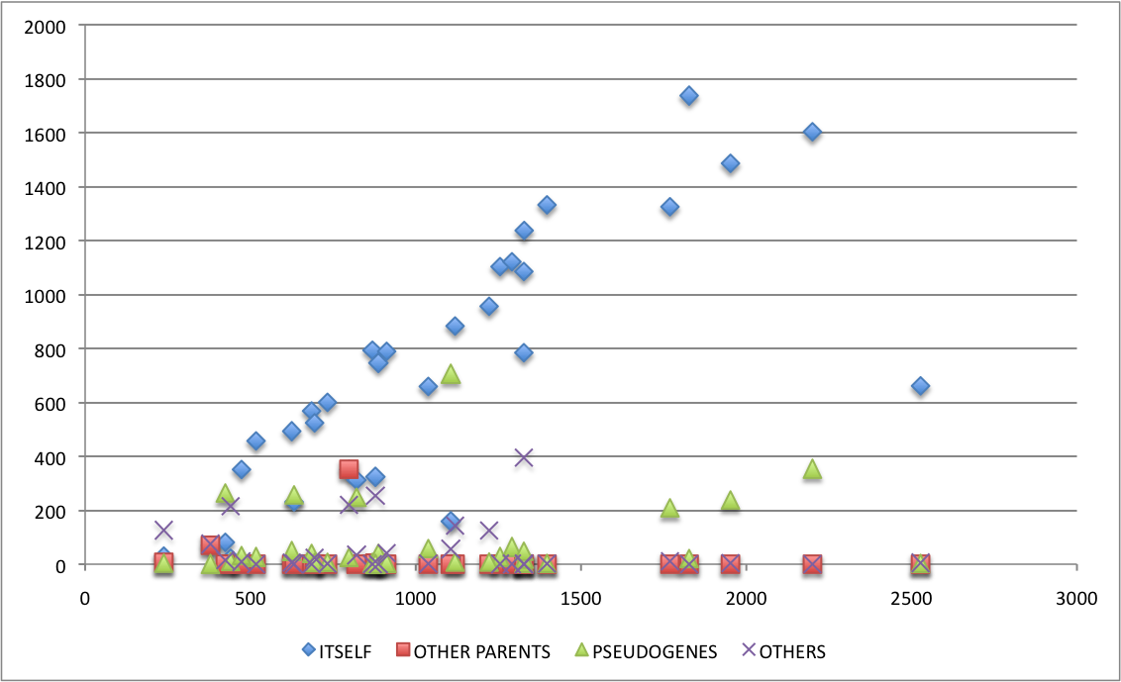
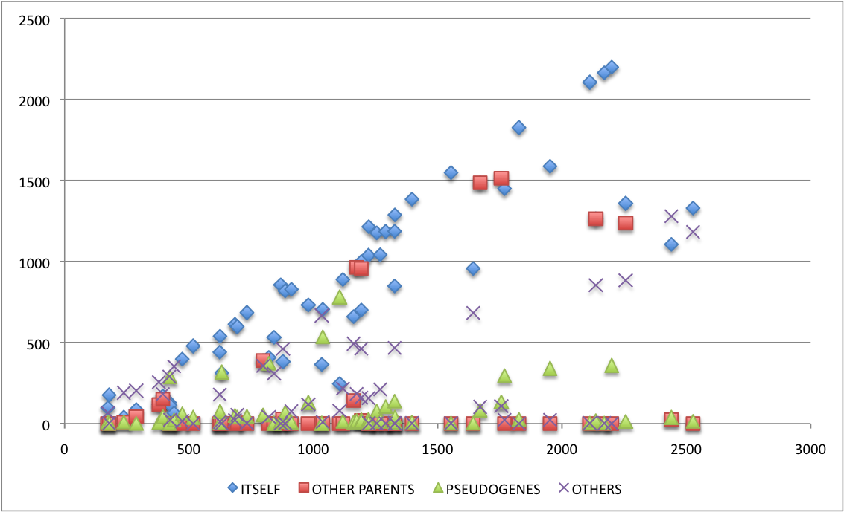
Results: Fragment Distribution of Parents
Over-Count
Under-Count
Expected Fragment
Expected Fragment
Unique-Count
Expected Fragment
Coverage 100X, Read length 100

Slide 8
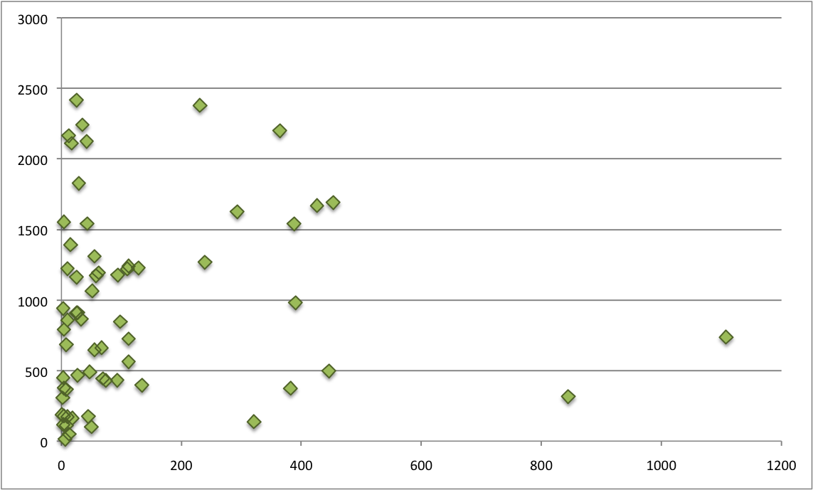
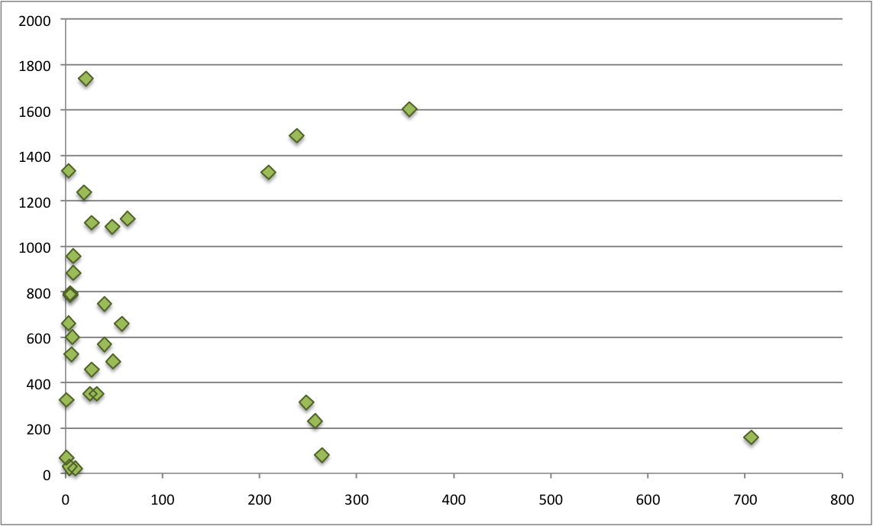
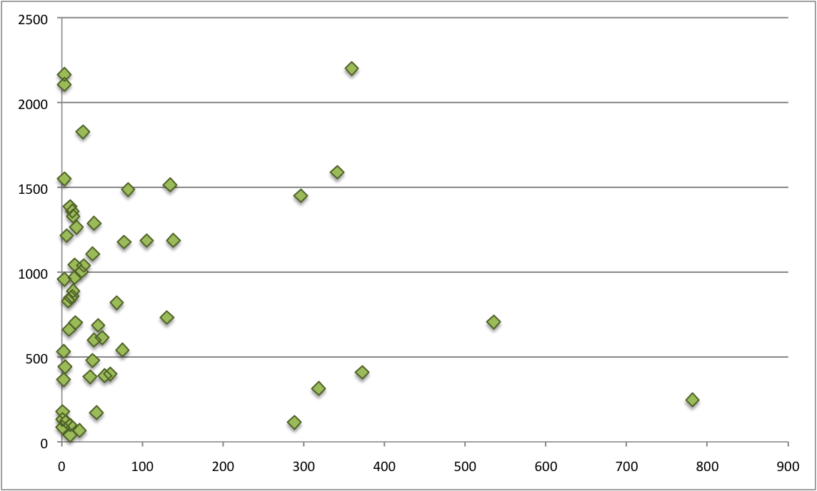
Results: Fragment Count of Parents vs Pseudogene
Over-Count
Under-Count
Parents
Parents
Pseudogene
Unique-Count
Pseudogene
Parents
Coverage 100X, Read length 100
Pseudogene

Slide 9
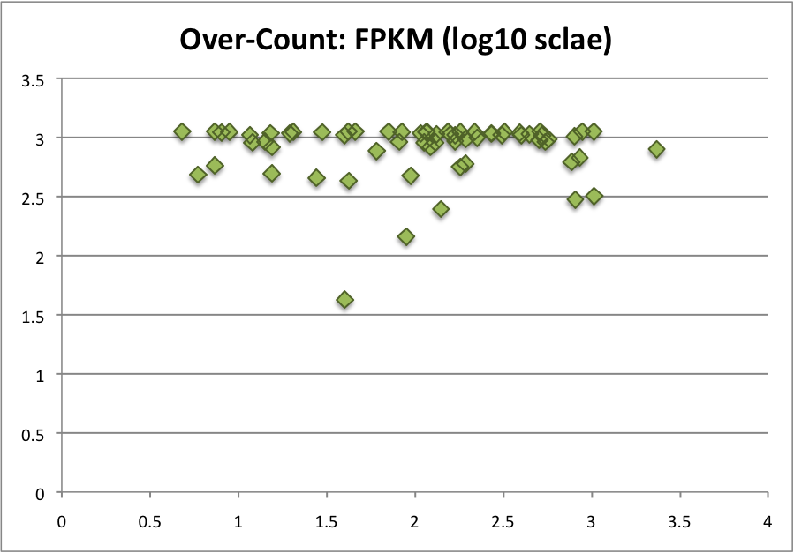
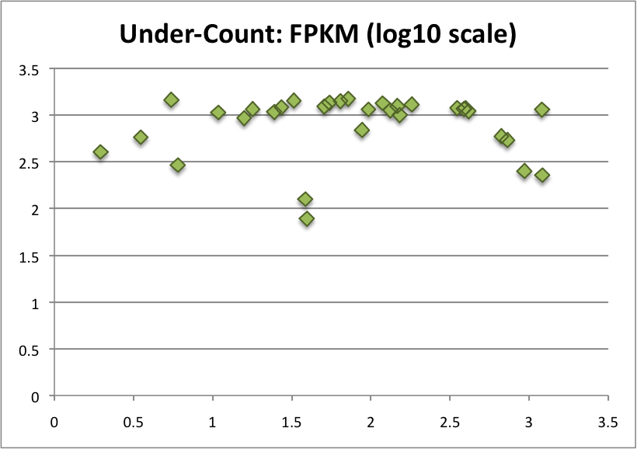
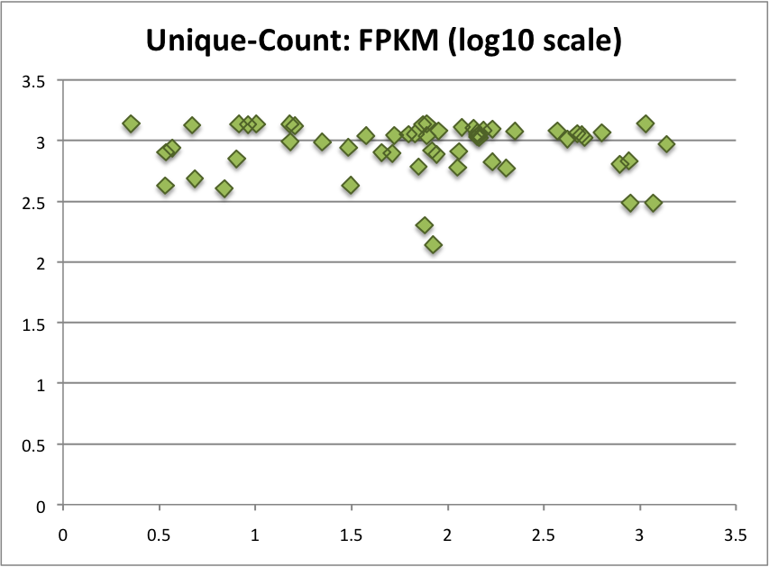
Results: FPKM of Parents vs Pseudogene
Parents
Parents
Pseudogene
Pseudogene
Parents
Coverage 100X, Read length 100
Pseudogene

Slide 10
Using FPKM
Expected Parent FPKM ?~? Parent FPKM + Pseudogene FPKM

