Slide 1
Progress Update: Pseudogene Mapping
Chelsea Ju
2013.10.28

Slide 2
Data Preparation
Carefully select 9 parent genes
3 from each pseudogene category (processed, duplicated, ambiguous)
No overlap position among these parents and the corresponding pseudogenes.
No splice variants among these parents
Each parent has only one pseudogene
Parents |  | Pseudogenes |  | Category
ENSP00000452007 | Chr14 | PGOHUM00000246300 | Chr22 | Processed
ENSP00000347924 | Chr10 | PGOHUM00000240367 | Chr2 | Processed
ENSP00000347920 | Chr9 | PGOHUM00000240625 | Chr2 | Processed
ENSP00000248980 | Chr22 | PGOHUM00000239919 | Chr12 | Duplicated
ENSP00000436283 | Chr11 | PGOHUM00000264368 | Chr7 | Duplicated
ENSP00000404448 | Chr20 | PGOHUM00000239905 | Chr12 | Duplicated
ENSP00000349685 | Chr8 | PGOHUM00000237210 | Chr17 | Ambiguous
ENSP00000315295 | Chr11 | PGOHUM00000244707 | Chr1 | Ambiguous
ENSP00000367868 | Chr10 | PGOHUM00000241919 | ChrX | Ambiguous

Slide 3
Data Preparation
Paired-end reads are generated from RANseqSim, without sequencing errors.
Map the reads to reference genome using Tophat2.
18 set of experiments were run with different coverage (10X, 20X, 30X), read length (75L, 100L), and abundance (10A, 30A, 50A)
10X75L10A | 10X75L30A | 10X75L50A
20X75L10A | 20X75L30A | 20X75L50A
30X75L10A | 30X75L30A | 30X75L50A
10X100L10A | 10X100L30A | 10X100L50A
20X100L10A | 20X100L30A | 20X100L50A
30X100L10A | 30X100L30A | 30X100L50A

Slide 4
Data Analysis: Approach 2
Build Expression Distribution Matrices for Fragment and FPKM
Counting Fragments Mapped to Multiple Genes
Over-count: increase fragment count for all the mapped genes
Extract Matrix Information
Extract the rows that contain at least one mapped fragment from the matrix (ie, sum of FPKM or fragment count > 0)

Slide 5
Results: Performance
Experiment | # of reads | # of mapped reads | % of mapped reads | Time
10X75L10A | 53454 | 53402 | 99.90% | 8 hrs
10X75L30A | 160380 | 160241 | 99.91% | 8 hrs
10X75L50A | 267294 | 267216 | 99.97% | 9 hrs
20X75L10A | 106914 | 106828 | 99.92% | 8 hrs
20X75L30A | 320760 | 320662 | 99.97% | 5 hrs
20X75L50A | 534594 | 534441 | 99.97% | 12.5 hrs
30X75L10A | 160380 | 160328 | 99.97% | 8 hrs
30X75L30A | 481140 | 480990 | 99.97% | 12 hrs
30X75L50A | 801900 | 801657 | 99.97% | 14.5 hrs
10X100L10A | 40092 | 40075 | 99.96% | 2 hrs
10X100L30A | 120282 | 120225 | 99.95% | 6 hrs
10X100L50A | 200472 | 200392 | 99.96% | ? hrs
20X100L10A | 80190 | 80145 | 99.94% | 7 hrs
20X100L30A | 240570 | 240472 | 99.96% | 9 hrs
20X100L50A | 400950 | 400768 | 99.95% | 5 hrs
30X100L10A | 120282 | 120230 | 99.96% | 4 hrs
30X100L30A | 360852 | 360677 | 99.95% | 5 hrs
30X100L50A | 601422 | 601135 | 99.95% | 10 hrs

Slide 6
Results: Reads Mapped to Pseudogenes
Parents |  | Pseudogenes |  | Category | Reads Mapped to Pseudogenes
Name | Location | Name | Location |  | 75L | 100L
ENSP00000452007 | Chr14 | PGOHUM00000246300 | Chr22 | Processed | Y | N
ENSP00000347924 | Chr10 | PGOHUM00000240367 | Chr2 | Processed | N | N
ENSP00000347920 | Chr9 | PGOHUM00000240625 | Chr2 | Processed | N | N
ENSP00000248980 | Chr22 | PGOHUM00000239919 | Chr12 | Duplicated | N | N
ENSP00000436283 | Chr11 | PGOHUM00000264368 | Chr7 | Duplicated | N | N
ENSP00000404448 | Chr20 | PGOHUM00000239905 | Chr12 | Duplicated | Y | Y
ENSP00000349685 | Chr8 | PGOHUM00000237210 | Chr17 | Ambiguous | N | N
ENSP00000315295 | Chr11 | PGOHUM00000244707 | Chr1 | Ambiguous | N | N
ENSP00000367868 | Chr10 | PGOHUM00000241919 | ChrX | Ambiguous | N | N

Slide 7
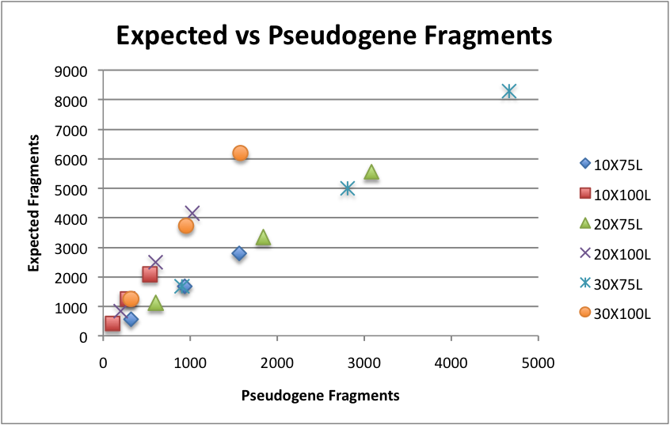
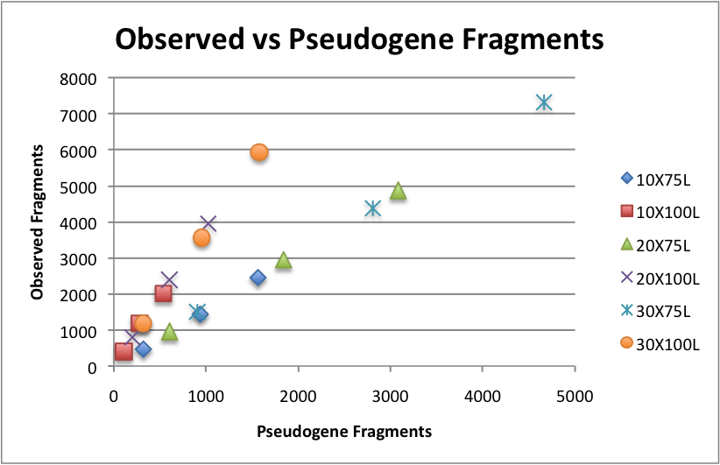
Results:ENSP00000404448

Slide 8
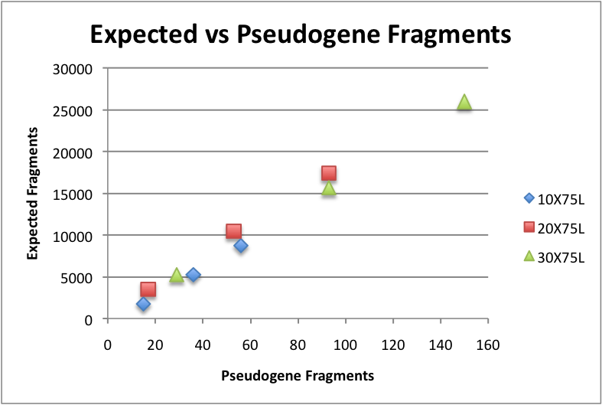
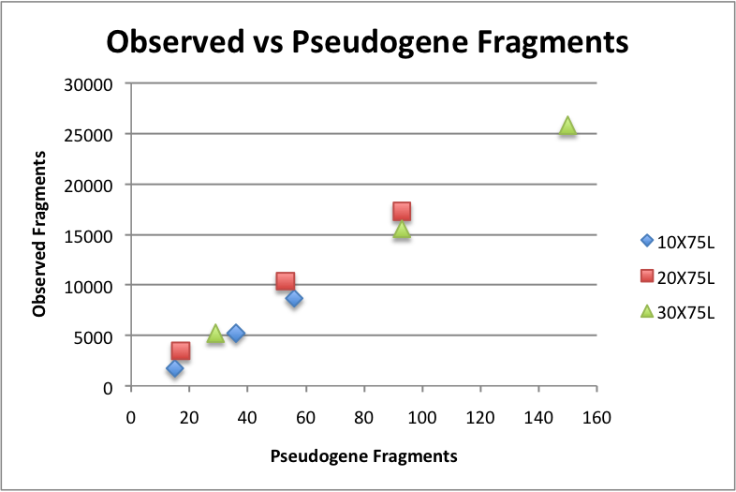
Results:ENSP00000452007

Slide 9
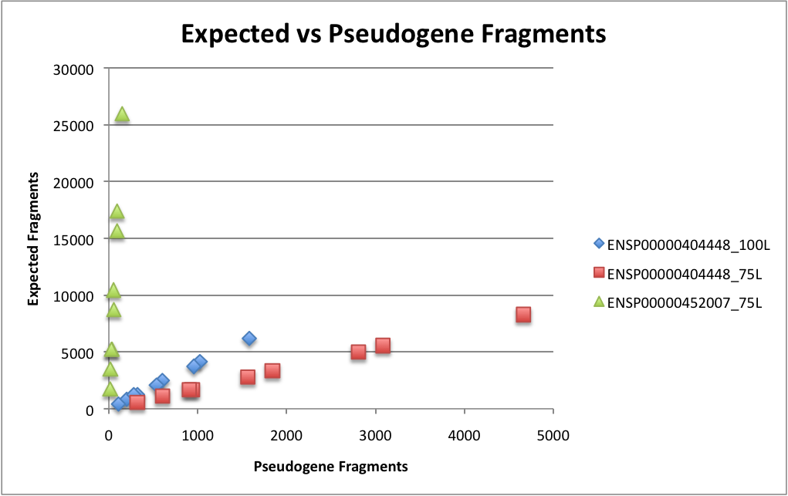
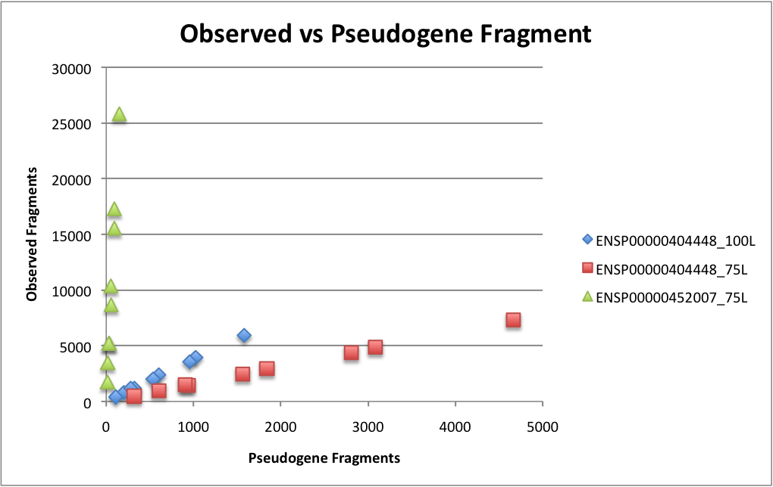
Results: ENSP00000404448 + ENSP00000452007

